Slide 1

ACS
DIVISION OF POLYMER CHEMISTRY
Treasurer Report
POLY Business Meeting August 2022
Presented by Christine Coltrain (Treasurer)
Support from Kathy Mitchem, Lesia Pristas, and Carlee Black
August 2022

Slide 2
Outline
2022 Budget & Actual To-Date Activity
Discussion items
Staff Appreciation
Income and Sponsor Opportunities

Slide 3
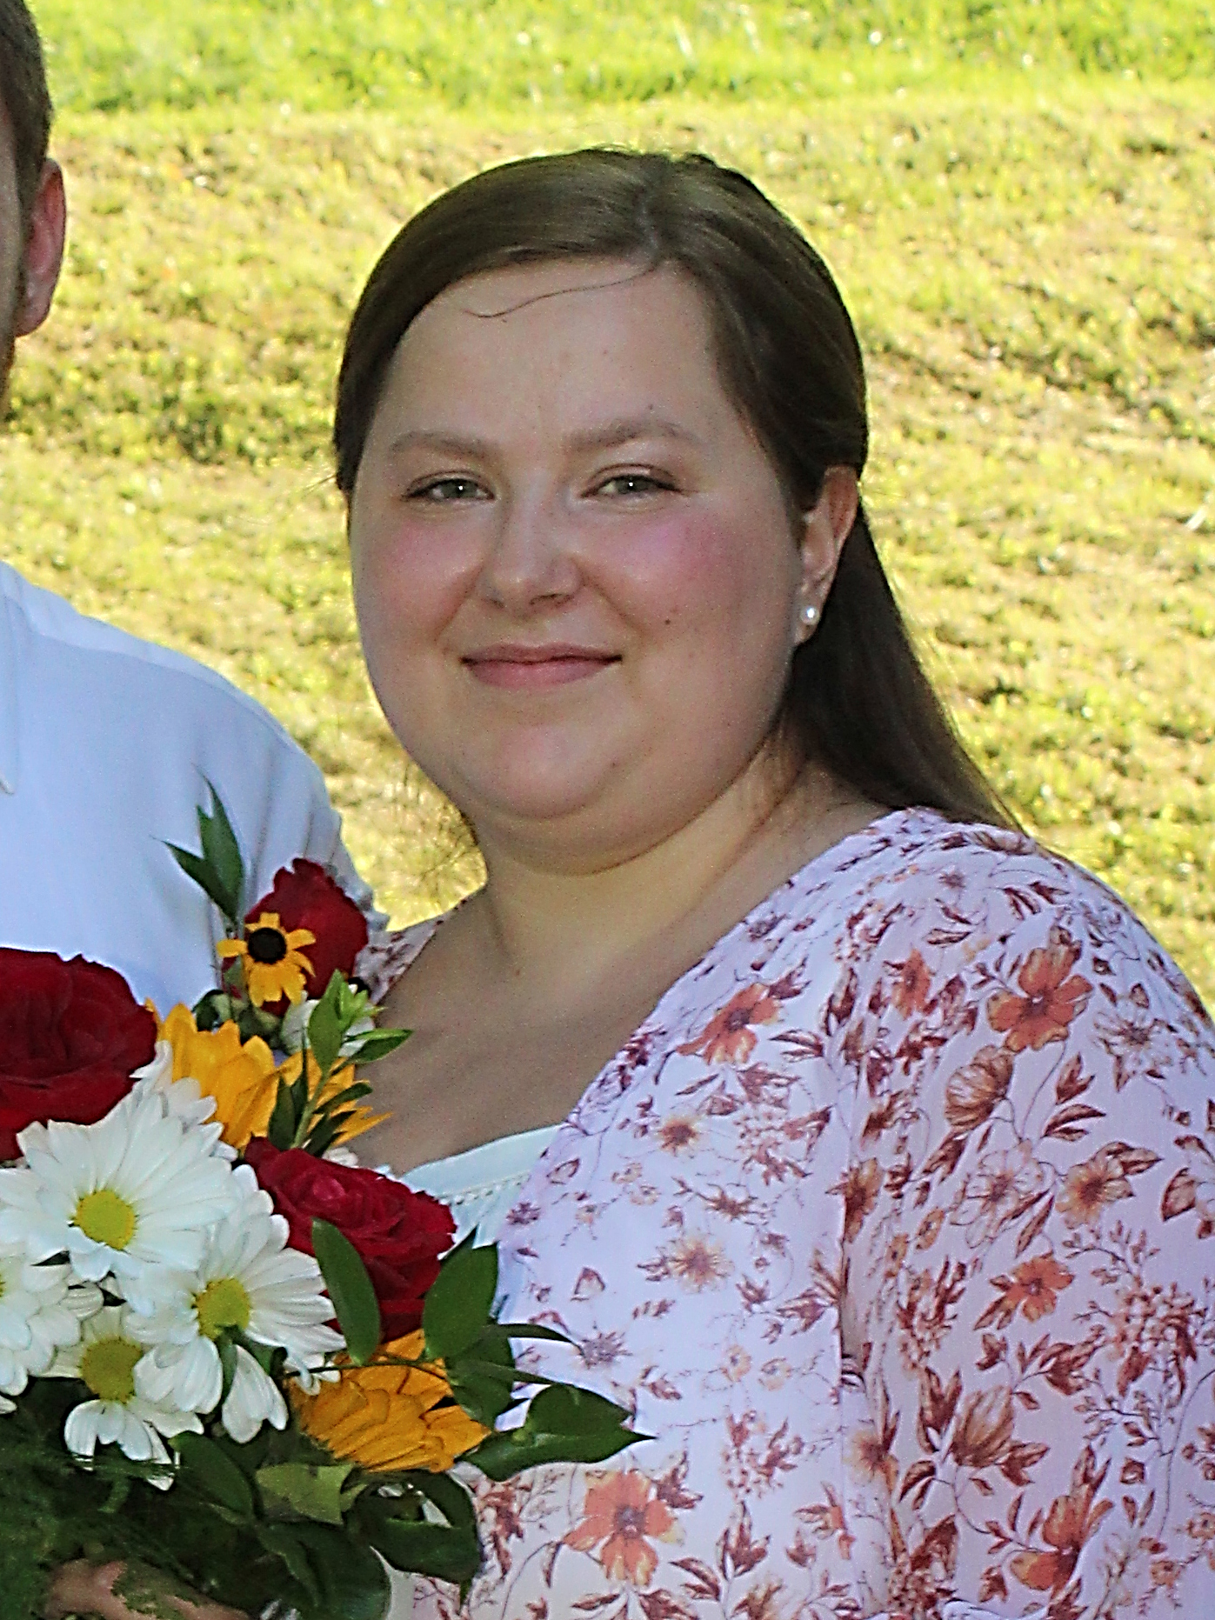
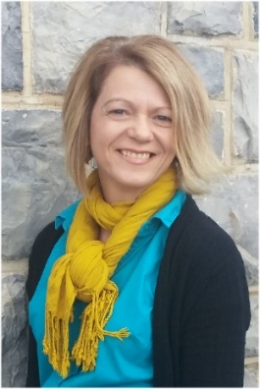
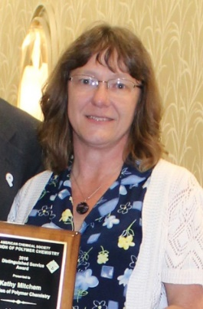
POLY Business Office
THANK YOU!!!
  Oversite: *POLY Supervisor– Christine Coltrain
  *VT Representative-Bob Moore
  Location: ICTAS II, 1075 Life Science Circle, Virginia Tech, Blacksburg, VA
  Carlee Black
  Awards
  Memberships
  Publicity
  Workshop Assistant
  Graphical Abs./Preprint
  Facebook/Enews/Listserve Posts
  Websites Updates
  Supplies/Orders
Lesia Pristas
  Workshops
  Event Planning
  Industrial Advisory Board
  Office Web Site
  Bookkeeping Audit
  Virtual Meeting Management
Kathy Mitchem
  Budgeting/Bookkeeping
  ExComm Officer Support
  ACS Meetings Support
  Publications/Circulation
  VT/Staff Oversite

Slide 4

2022 Budget / Actuals

Slide 5
2022 Budget (reality check)
by Treasurer, Christine Coltrain, 8/2022
Proposed 2022 budget is within historical range; expenses slightly higher
*Values do not include transfers

Slide 6
by Treasurer, Christine Coltrain, 8/2022
2021 POLY APPROVED BUDGET AND ACTIVITY TO DATE (Overview)
To balance the 2022 Budget we allowed for $213k in cash-in from checking account surplus or investment account to balance the budget – checking is healthy so we will use this first.
  Includes Investment cash-in for POLY sponsored awards ($10k/year)
No cash-ins from investment accounts have been executed YTD, but some will be needed before YE to cover Fall expenses.
2022 June Checking Balance: $119k (YE2021 was $231k)
2022 July Investment Balance: $1,195k

Slide 7
Trends / Major Sources of Income
by Treasurer, Christine Coltrain, 8/2022
Membership Dues
ACS Division Allocation
Workshops
Sponsors
IPG grants
2022SP $32,710
- this was for July-December 2021
- will receive payment in September for Jan-June 2022 membership.
2022 – $56,654
Essentially the same as last year’s value

Slide 8
Major Sources of Income for POLY
by Treasurer, Christine Coltrain, 8/2022
Membership Dues: Received $33k Spring 2022; Fall payment will arrive in September (downward trend)
ACS Division Allocation - $56k (received in 2022); similar to that received in 2021 (1 payment)
Workshops Delta
Historically Raised $45k to $60k per year
2020/2021: Significantly reduced due to Covid-19
2022: Meeting attendance s increasing. 34k anticipated delta (battling inflation expenses)
Sponsors 2022 & 23: 20-25k expected
    5-10k ACS National Meeting (ACS Pubs, TOSOH, Waters]
    4-5k Newsletter Advertisers (TOSOH, American Standards, Polyhedron)
    7-10k Awards (Henkel, Springer, BioMacro., IAB)
    Other Opportunities – Seeking sponsors for Awards, Newsletter, and MORE! NEEDED for growth!!
IPG (Innovative Project Grants / ACS):
The maximum funding per project is $7,500; the maximum funding per calendar year is $12,500.
NEW: Convergent Research Community Innovative Project Grant (IPG) grants from ACS.
  POLY received a $30k Convergent Research Community IPG grant in 2021 (for 2022,23) for the proposed “Sustainable Polymers: A Multidisciplinary Challenge”…. And these do not limit the $12,500/year maximum.

Slide 9

by Treasurer, Christine Coltrain, 8/2022
Sponsorship Opportunities
Open Sponsor Opportunities
Newsletter Advertising | $500-$5,000 | Annually
E-news with Web Link | $500 | Annually
Webinars | $1,000-$2,500 | Each
Mark Scholar Awards | $4,500 | Bi-Annually
Plenary Speaker | $1,500 | Bi-Annually
Poster Session | $2,500 | Per Mtg
Major Awards Mavel/Flory/Mark/IPS | $5,000 each | Bi-Annually
Tentative Sponsor In Place
Student Social | $1,000-$2,000 | Annually
Coffee Break Sponsor | $600-$3,000 | Pre Mtg
Poster Awards | $2,000 | Annually
POLY/PMSE Award Reception | $5,000 | Per Mtg
Previous Sponsors - THANKS
    ACS National Meeting (ACS Pubs/TOSOH/Waters)
    Award Support (Henkel, ACS Pubs, Springer Nature)
    IAB Sponsored Awards
    Newsletter Advertisers (Tosoh, American Standards, Polyhedron)
New sponsors could potentially generate $20,000+
Workshop sponsor funds go back into the workshop but don’t always contribute to POLY bottom line

Slide 10
Income/Expenses
Details
In 2022 POLY is striving to return to historically normal income/expense amounts.
Attendance at meetings and workshops in increasing but inflation is resulting in some increased expenses

Slide 11
2022 Budget and Activity (details, continued)
by Treasurer, Christine Coltrain, 8/2022
POLY symposia support
    Spring committed $7800
    Fall committed $7800
  H.N. Cheng generously provided ACS presidential funds to cover several Fall symposia focused on Sustainability
  Convergent IPG will also be used to sponsor several symposia focused on Sustainability
ACS Mtg includes coffee, Plenary, poster events, Membership booth, board and other meetings
Some leftover expenses from 2021.
Expensing of Convergent IPG Grant (received $30k in 2021) in 2022-2023.
Thanks H.N.

Slide 12
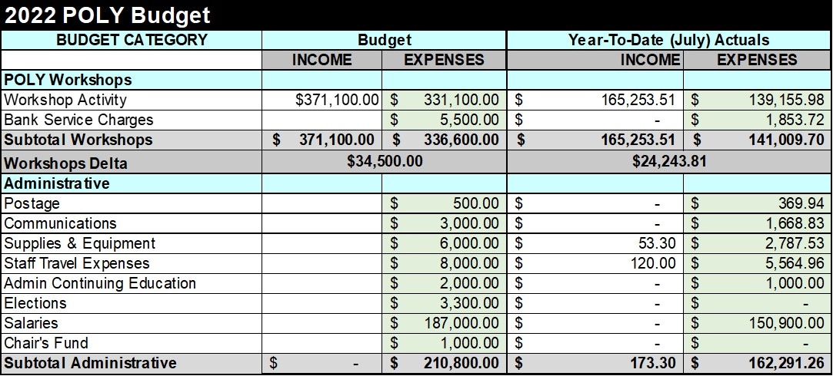
2022 Budget and Activity (details, continued)
by Treasurer, Christine Coltrain, 8/2022
Salaries increase reflects VT (State) cost of living increase (5%), beginning August 2022.
2022 Workshops: Planned 6; 3 held (delta ~ $15k); and 3 to be held this Fall
Organizers worked very hard to bring in Sponsorships and attendance to Workshops
Lesia and team have also worked very hard to organize 6 workshops in 2022 - Thanks
  Expenses higher due to inflation
  Also planning virtual rebroadcasts from workshops

Slide 13
2022 Budget and Activity (details, continued)
by Treasurer, Christine Coltrain, 8/2022
“IPG Membership” expense reflects IPG grant received ($7k) in 2020 – proposed “Video Peer Competition” – not fully used ytd
Most award activity will be in the fall

Slide 14
by Treasurer, Christine Coltrain, 8/2022
2022 Overview – Recap
2022 Budget YTD
  Continued decline in revenues from ACS dues.
  ACS Allocation on budget.
  Workshops are on the rebound.
  Some income received in 2020 from sponsors is being expensed in 2022/23.
  Both the checking and investment accounts remain healthy.
The ACS Report for 2022 has been filed
The 2022 Tax forms 990 have been filed with the IRS
POLY finances remain compliant as non-profit status: 10-year sum of budget delta combined with investments cashed
  The significant dedication of Kathy, Lesia, Carlee was invaluable in POLY’s success during this year of constant changes

Slide 15
2022 POLY Improvement Initiatives
  Significant efforts in Student-oriented activities and active Membership Committee
    Membership Committee is zoom-meeting regularly to seek new ways to engage members
    POLY Programming provides organizer recognitions and lapel pins to increase appreciation
    Reduced Student Membership Fee
    Educational incentives - MACRO website
    Student Chapters
    Awards for young professionals (YIPS, Travel, POSTER awards)
    Current Chair is striving to improve POLY Publicity (Web/Twitter/Other Posts) to promote member info.
    ACS/POLY Strategic Planning is scheduled for January 2023 to develop future goals
  Return to in-person ACS National Meetings and Committee Meetings provides better networking and an increase in membership and awareness which will in turn increase ACS Allocations

Slide 16
2022 POLY Improvement Initiatives
  Industrial members representation through IAB, symposia, networking, and Awards (IPS, YIPS)
    IAB has been supportive of webshops, webinars, student symposia, awards – Thank you!!
  POLY Awards continue to be sponsored and highlighted
  6 Workshops scheduled in 2022 in an attempt to catch up on 2020/21 cancellations
    Workshop Committee is striving to reach out to new organizers & topics to engage new demographic to increase participation, attendance, membership
Great Team!!
Always looking for members to become involved

Slide 17
Discussion Items
Other / questions?

