Slide 1

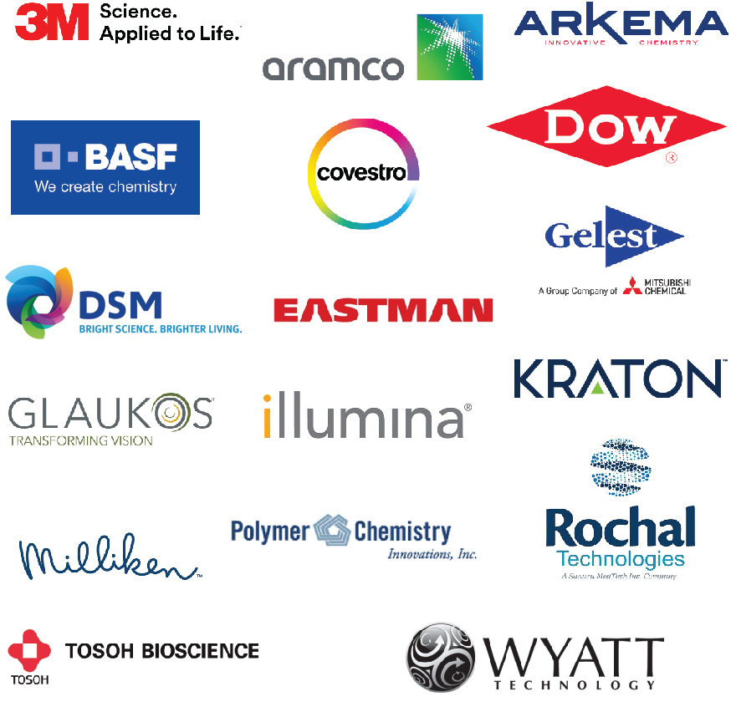
POLY Industrial Advisory Board
Annual dues: $1,500
Chair: Corinne Lipscomb (3M)
Vice Chair: Hayley Brown (Dow)

Slide 2
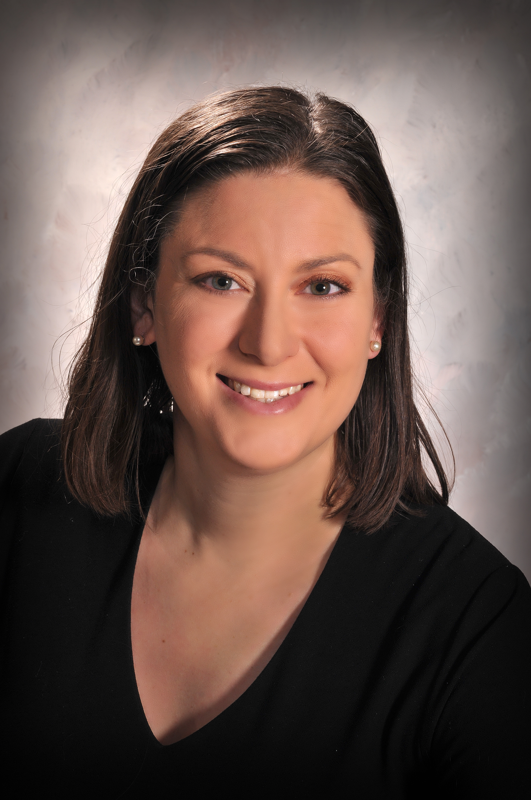
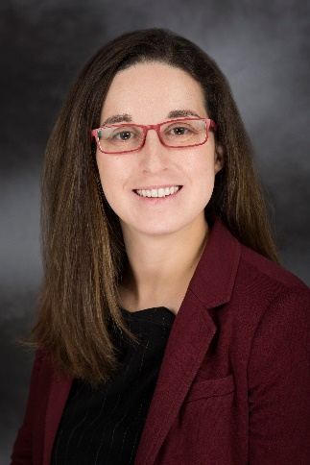
IAB Mission & Officers 2022
Chair: Corinne Lipscomb
(3M Company)
Co-Chair: Hayley Brown
(Dow)
Networking
Finance & Reporting
Bulletin
IPS & YIPS Support
New Initiatives
Succession Planning
Membership
Programming
“Enhance and foster industrial engagement and support to develop programming, education, recognition & awards within the ACS Division of Polymer Chemistry.”

Slide 3
IAB Focuses for 2022
Maintain programming, awards support
Return to in-person meetings
  IAB Networking Sessions
  IAB meeting
Understanding value IAB provides in long-term hybrid environment
Driving new memberships

Slide 4
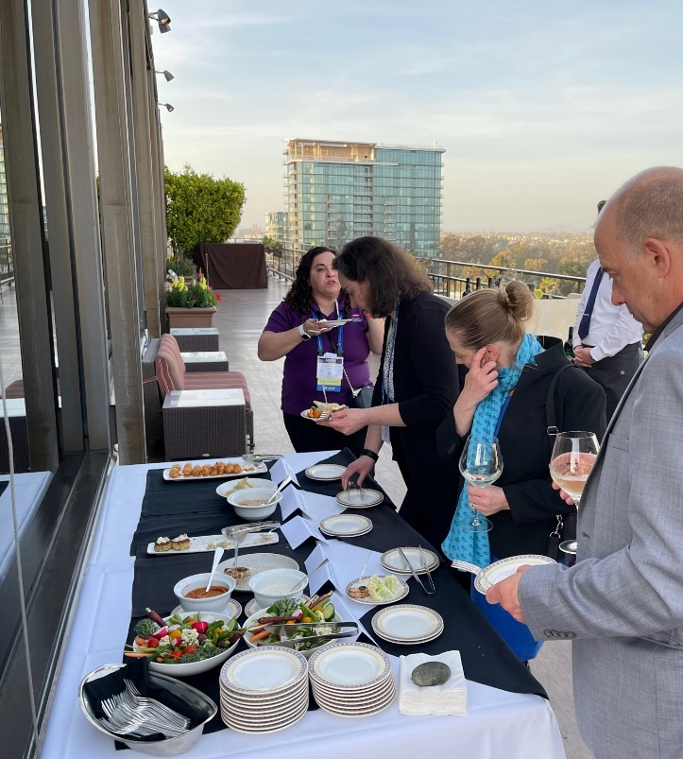
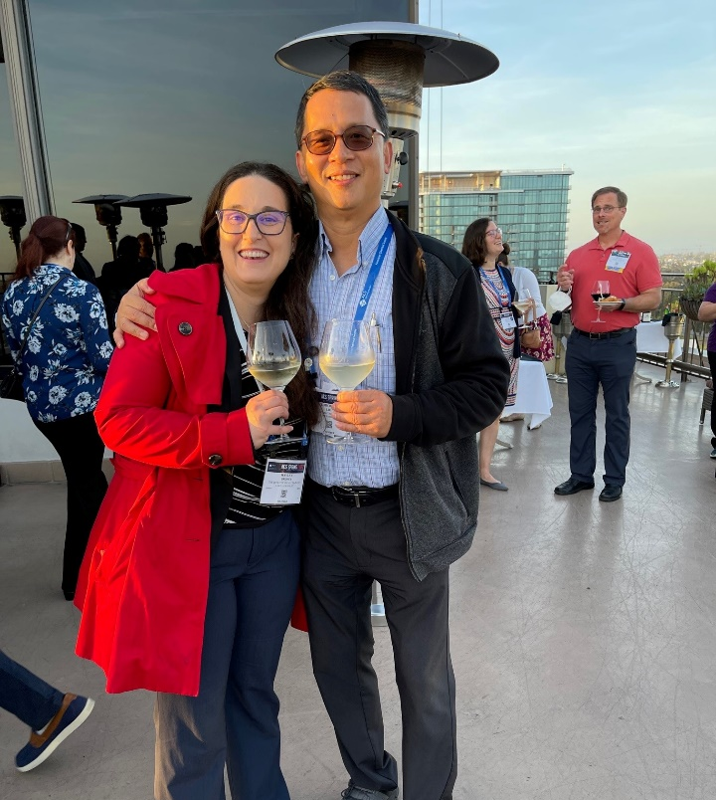
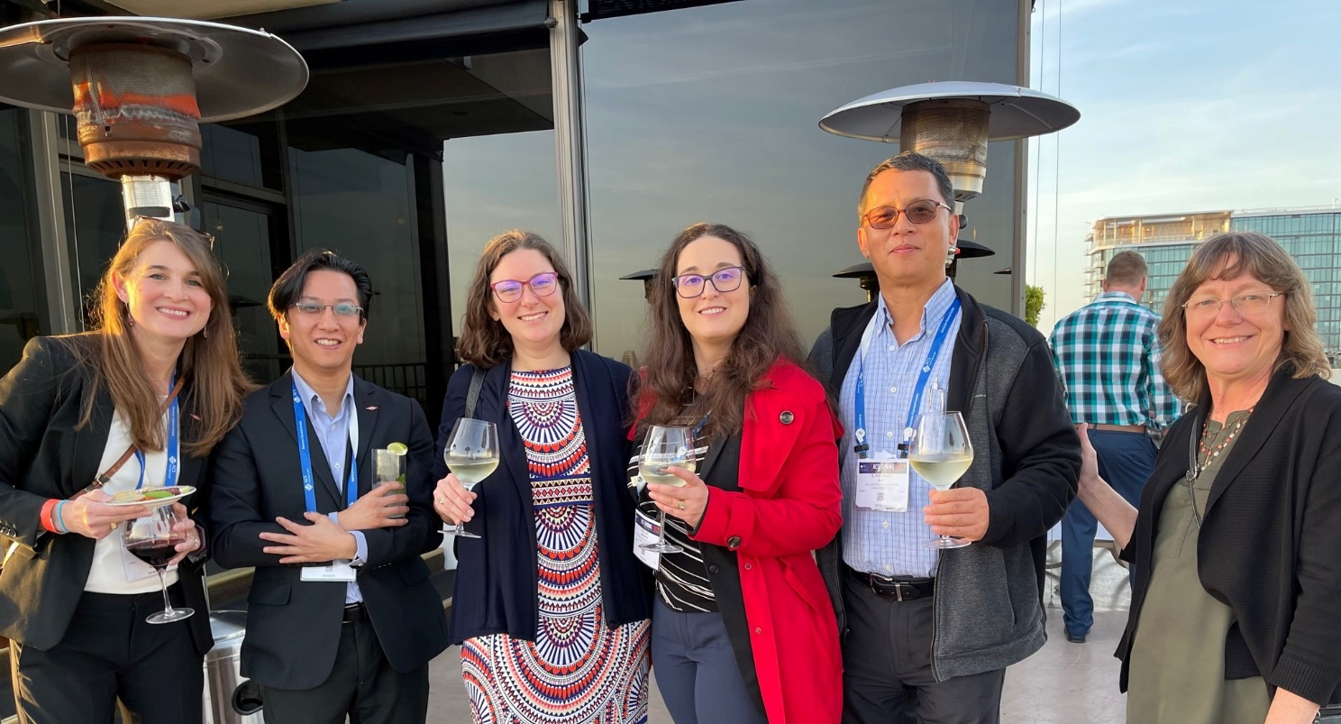
Networking
Spring 2022
  San Diego ACS
  Back to in-person
  Mr. A’s Restaurant
Spring recap
(images by Michael Liu)

Slide 5
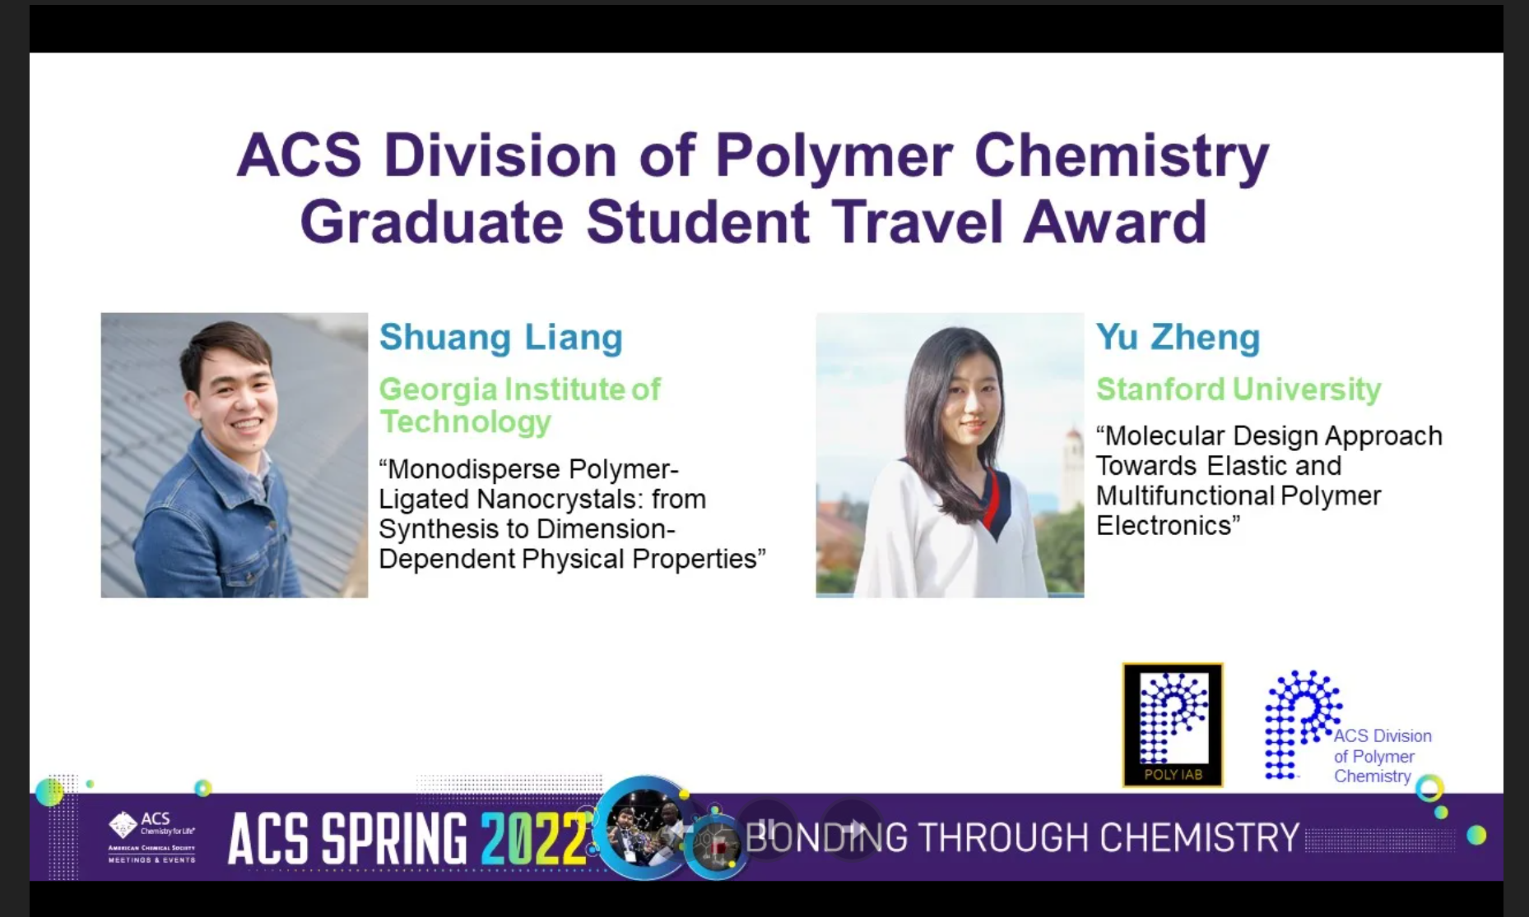
22 Spring Awards
Continue to support 4 POLY Graduate Student Travel Awards ($750 each)
Spring recap

Slide 6
Spring ACS Programming in 2022
  Spring ACS
      IIPS – Spring 2022, Bonding Through Chemistry, March 20 – 24, San Diego, CA. Organizers/chairs: Michael Minkler (Milliken), Michael Liu (Glaukos), Manesh Sekharan (Dow), Hayley Brown (Dow)
      Graduate Research Symposium support, March 20 – 24, San Diego, CA - supported
      Undergraduate Research Symposium support, March 20 – 24, San Diego, CA - supported
Spring recap

Slide 7
Organized at this ACS Meeting – Join us!!!
Fall ACS
IAB Events
IAB Programming
Monday, 22 August
Industrial Innovations in Polymer Science:
08:00am – 4:50pm USA / Canada – Central, Location: S105a (McCormick Place Convention Center)
Daniel Abebe, Organizer, Presider; Hayley Brown, Organizer, Presider; Michael Petr, Organizer, Presider, Session Type: Oral – Hybrid
Tuesday, 23 August
Industrial Polymer Scientist Award in honor of Margaret Sheridan:
08:00am - 12:00pm USA / Canada – Central, Location: S105a (McCormick Place Convention Center)
Brett Krull, Organizer, Presider; Cristina Urdaneta Thomas, Organizer, Session Type: Oral - Hybrid
  Monday 22 August at 6:00 pm
  IAB Networking Reception (all Exec, IAB Companies, and their invitees)
  Location: Fatpour Tap House McCormick,
  https://www.fatpourmccormick.com/
  2206 S. Indiana Ave., Chicago IL 60616
Tuesday 23 August 7:30 am
Industrial Advisory Board (IAB and ExCom Only)
In-person breakfast meeting
McCormick Place Convention Center, Room: McCormick S106b

Slide 8
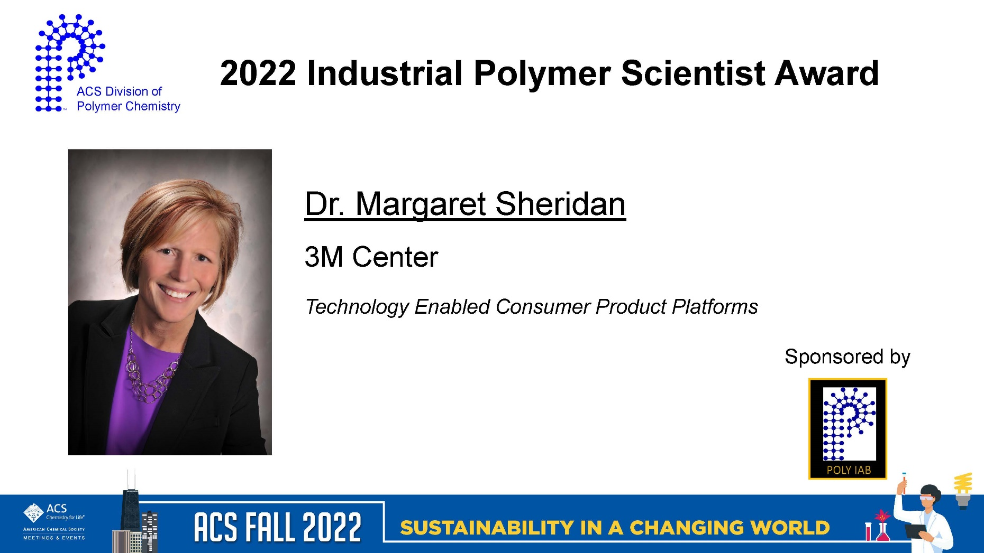
22 Fall Awards
Fall ACS

Slide 9

22 Fall Awards
Fall ACS

Slide 10
CALL FOR AWARD SUBMISSIONS
YIPS AWARD
Young Industrial Polymer Scientist
Award Deadline: 10/31/2022
Purpose: Recognize outstanding industrial innovation and creativity in the application of Polymer Science, conducted by young individual scientists.
https://polyacs.org/awards/

Slide 11

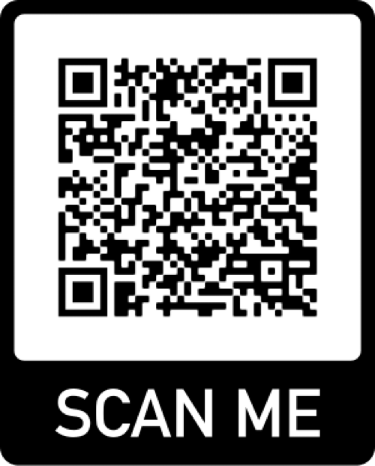
ACS POLY IAB New Industry Networking Group (NING)
Mission Statement
The New Industry Networking Group (NING) is a broad coalition supported by the ACS Division of Polymer Chemistry (POLY) Industrial Advisory Board (IAB) that provides early career polymer science/engineering professionals resources and connections to have meaningful conversations about experiences working in industry and to learn from each other at our initial stage of career and life after graduate school.
Who We Are
We are a self-organizing organization run by diverse, early career industrial professionals, affiliated with the ACS POLY, that seek to strengthen our professional network and build community among members in the IAB companies.
What We Do
Provide an informal gathering place for early career industrial scientists and engineers through Slack to communicate about upcoming conferences, awards, and other opportunities that align with the mission of the ACS POLY IAB.
Host bimonthly virtual seminars featuring accomplished industrial scientists and engineers. Topics include navigating career pathways, network building both inside and outside of your company, and fostering outreach programs to local communities.
Assist with ongoing efforts of the ACS POLY IAB in programming, education, recognition, and awards.
Click here to join

Slide 12
Operations Manual Language on Industrial Sponsors/Industrial Advisory Board
POLY transitioned from “Industrial Sponsors” and “Industrial Sponsors Award” to “Industrial Advisory Board” and “Industrial Polymer Scientist Award” years ago but POLY Operations Manual language not updated
Need to address how industrial awards are handled, per current Operations Manual Language
  Discussion to clarify procedure for the 4 divisional awards vs. all other awards

Slide 13
Operations Manual Language on Industrial Sponsors/Industrial Advisory Board
Proposal to change all instances of “Industrial Sponsors” to “Industrial Advisory Board” in accordance with current divisional practice
Proposal to change “Industrial Sponsors Award” to “Industrial Polymer Scientist Award”
  Note operations manual judging criteria for this award- change would mandate IAB provisioning judges for this award
  Young Industrial Polymer Scientist Award, as an IAB-sponsored award, would be administered by IAB analogous to DSM Student Awards and other non-divisional awards

Slide 14
IAB Membership Updates
POLY IAB should reflect the diversity of companies working in the polymer arena
  Consistent increase in number of start ups in polymer space
  Conversations with small number of start ups indicates they won’t join at current membership fee
Proposal – 1 vote per member company (can be after the fact)
No Change to Large Company (>500 employees) Dues - $1500
New bracket for Small Companies (<500 employees) - $500

Slide 15
Thank you
Industrial Advisory Board

Slide 16
Notes

Slide 17
In 2022-
 | Proposed | To date - Aug
Income | 23,000.00 | 17,500.00
Expenses
Networking | 10,000.00 | 3,340.25
Meetings | 11,000.00 | 1,082.82
Awards | 1,200.00 | 1,500.00
Programming (no virtual) | 2,000.00 | 2,000.00
Other (shirts, pins) | 1,800.00 | 0
subtotal | 26,000.00 | 7,923.07
Bal | -3,000.00 | 9,576.93
Budget

Slide 18
In 2021-
 | Proposed | Actual, year-end
Income | 24,000.00 | 22,825.20
Expenses
Networking | 7,000.00 | 3,463.64
Meetings | 8,000.00 | 254.00
Awards | 6,200.00 | 6.930.00
Programming … virtual, future webshops | 3,200.00 | 8,000.00
Other (shirts, pins) | 1,600.00 | 0
subtotal | 26,000.00 | 18,647.64
Bal | -2,000.00 | +4,277.56
Budget

Slide 19
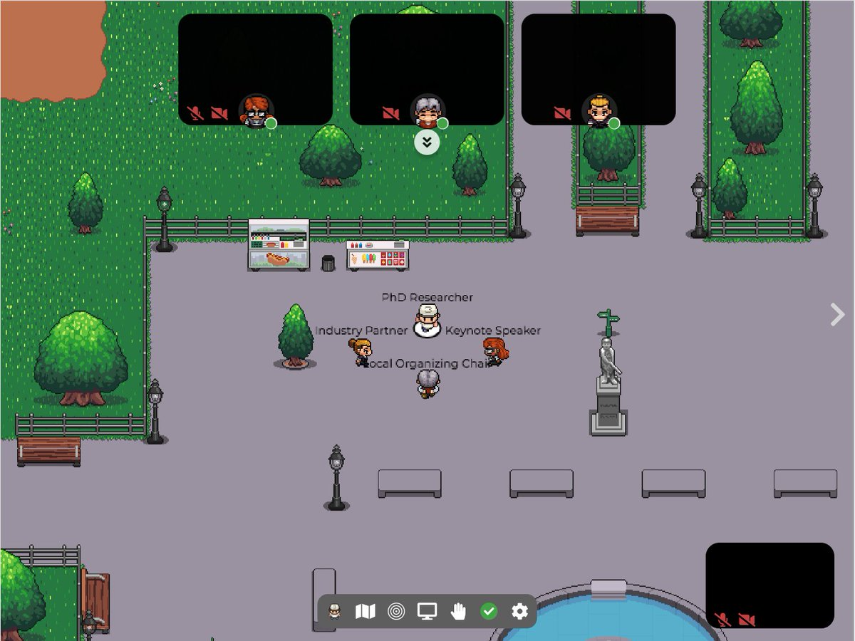
Networking
No networking in the spring
Virtual networking in late fall via gather.town (recommended by IAB members and used by VA Tech for the Graduate Research Polymer Conference)
  Platform free for less than 25 attendees (set up by Hayley Brown)
  Shipped networking items, cost less than 2K
  20 registered to participate
  Significant positive feedback
Plans are for a live event at the Spring ACS Meeting

Slide 20
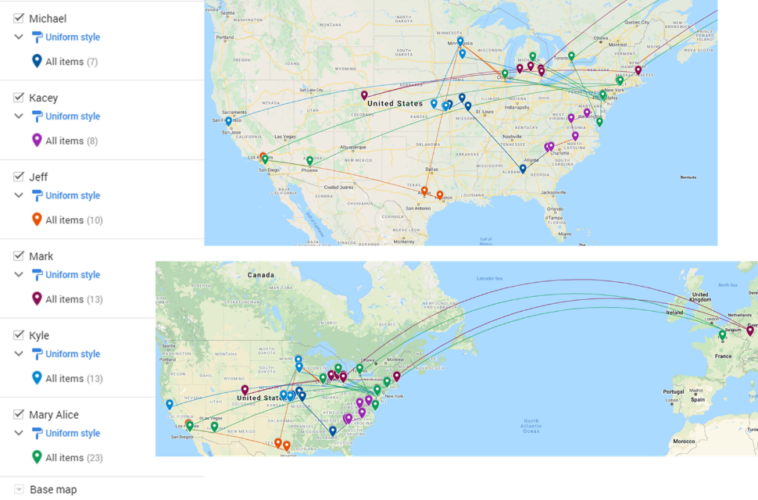
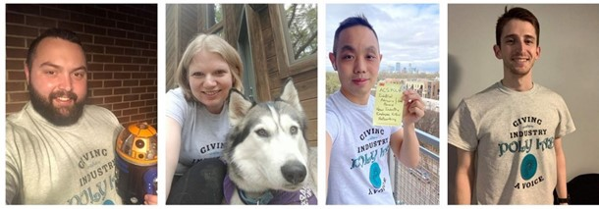
Networking, also in 2021-
New Industry Employee Networking – Pilot 4 Session Framework
Introduction Session & Get to Know You Activity – February
Unwritten Rules to Industry Success Panel Discussion - April
YIPS Winner Discussion with Jason Rolland (YIPS 2019) - August
Mark Schwartzlander, BASF
Kyle Snow, Citrine Informatics
Mary Upshur, Dow Chemical
Kacey Hall, Milliken Chemical
Jeff Ting, 3M Company
Michael Minkler, Milliken Company
“Given the challenges of starting a new career in industry during the pandemic, the New Industry Virtual Networking event was a fantastic way for us to connect and engage with our industrial colleagues in the polymer science and engineering community. Hearing from speakers across different companies in the POLY IAB allowed us to appreciate the diversity of career pathways that a polymer scientist can take.“

Slide 21
Networking, also in 2021-
New Industry Employee Networking – Pilot 4 Session Framework
Introduction Session & Get to Know You Activity – February
Unwritten Rules to Industry Success Panel Discussion - April
YIPS Winner Discussion with Jason Rolland (YIPS 2019) - August
Mark Schwartzlander, BASF
Kyle Snow, Citrine Informatics
Mary Upshur, Dow Chemical
Kacey Hall, Milliken Chemical
Jeff Ting, 3M Company
Michael Minkler, Milliken Company
“Given the challenges of starting a new career in industry during the pandemic, the New Industry Virtual Networking event was a fantastic way for us to connect and engage with our industrial colleagues in the polymer science and engineering community. Hearing from speakers across different companies in the POLY IAB allowed us to appreciate the diversity of career pathways that a polymer scientist can take.“

Slide 22
2021 Programming - other
Webinars
POLY Webshops
Regional Meeting
Spring ACS Webinar: Solving the Plastic Waste Problem
IAB’s Peter Boul moderated this event.
IAB sponsored speaker honoraria
Spring Webshop on Stimulus-Responsive Polymers and Liquid Crystal Elastomers
IAB’s Peter Boul moderated this event.
IAB sponsored speaker honoraria
  2021 Rocky Mountain Regional Meeting.
  October 28 – 30, 2021
  Organized by IAB Member Laura Stratton
  Joint session/webinar
  Fall ACS Webinar: Polymers and Nanomaterials for Low Carbon Energy
  Organized by Peter Boul.
To continue to support of these and other programming opportunities, IAB will identify if initiatives help to achieve supporting the interests of its industrial members.

Slide 23
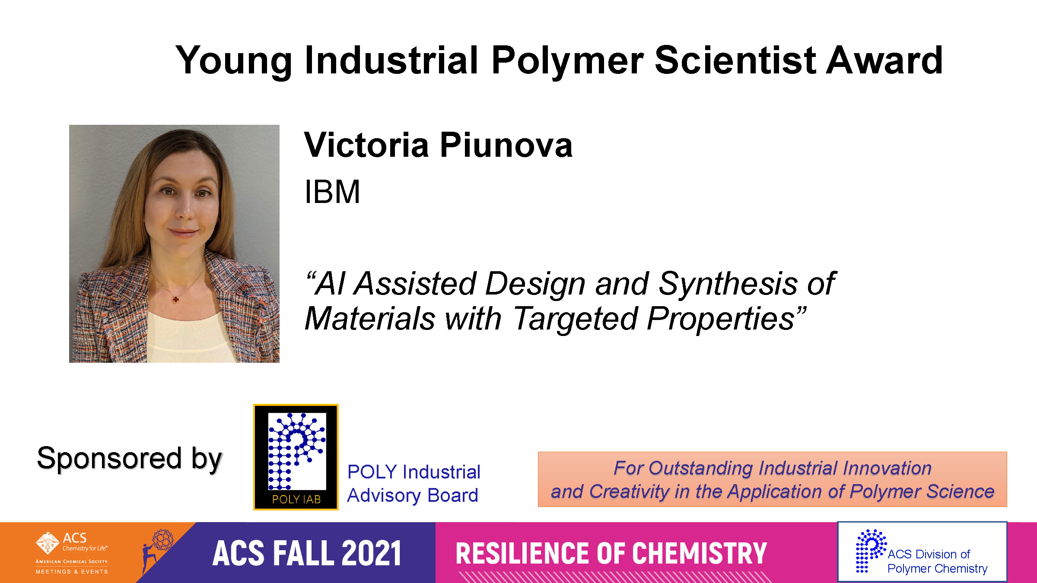
Awards supported in 2021

Slide 24
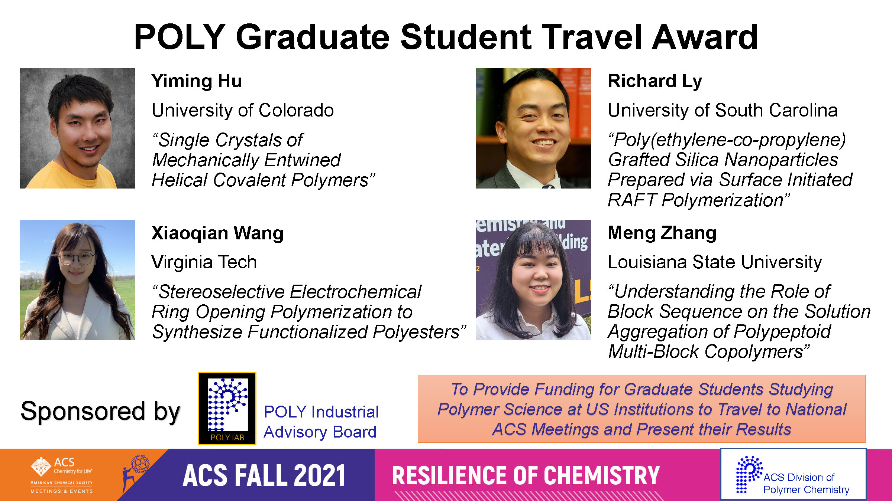
Awards supported in 2021

Slide 25
ACS Programming in 2021
Spring ACS
  IIPS - Industrial Innovations in Polymer Science, Spring virtual ACS Meeting, April 8, 2021. The session was chaired by Michael Abrams (Arkema), Peter Boul (AramcoAmericas), and Bradley Rodier (Rochal).
Fall ACS
  IIPS - Industrial Innovations in Polymer Science: Sustainable Materials, Fall virtual piece of ACS Meeting, August 23, 2021, The session was chaired by James Bohling, Organizer, The Dow Chemical Company; Wei Gao, Organizer, The Dow Chemical Company; Michael Minkler, Organizer, Miliken

