Slide 1
ACS DIVISION OF POLYMER CHEMISTRY
Treasurer Report POLY Excomm Winter Meeting January 2024
Presented by John Matson (Treasurer)
Support from Kathy Mitchem and Carlee Black
Presented by John Matson (Treasurer)
Support from Kathy Mitchem and Carlee Black

Slide 2
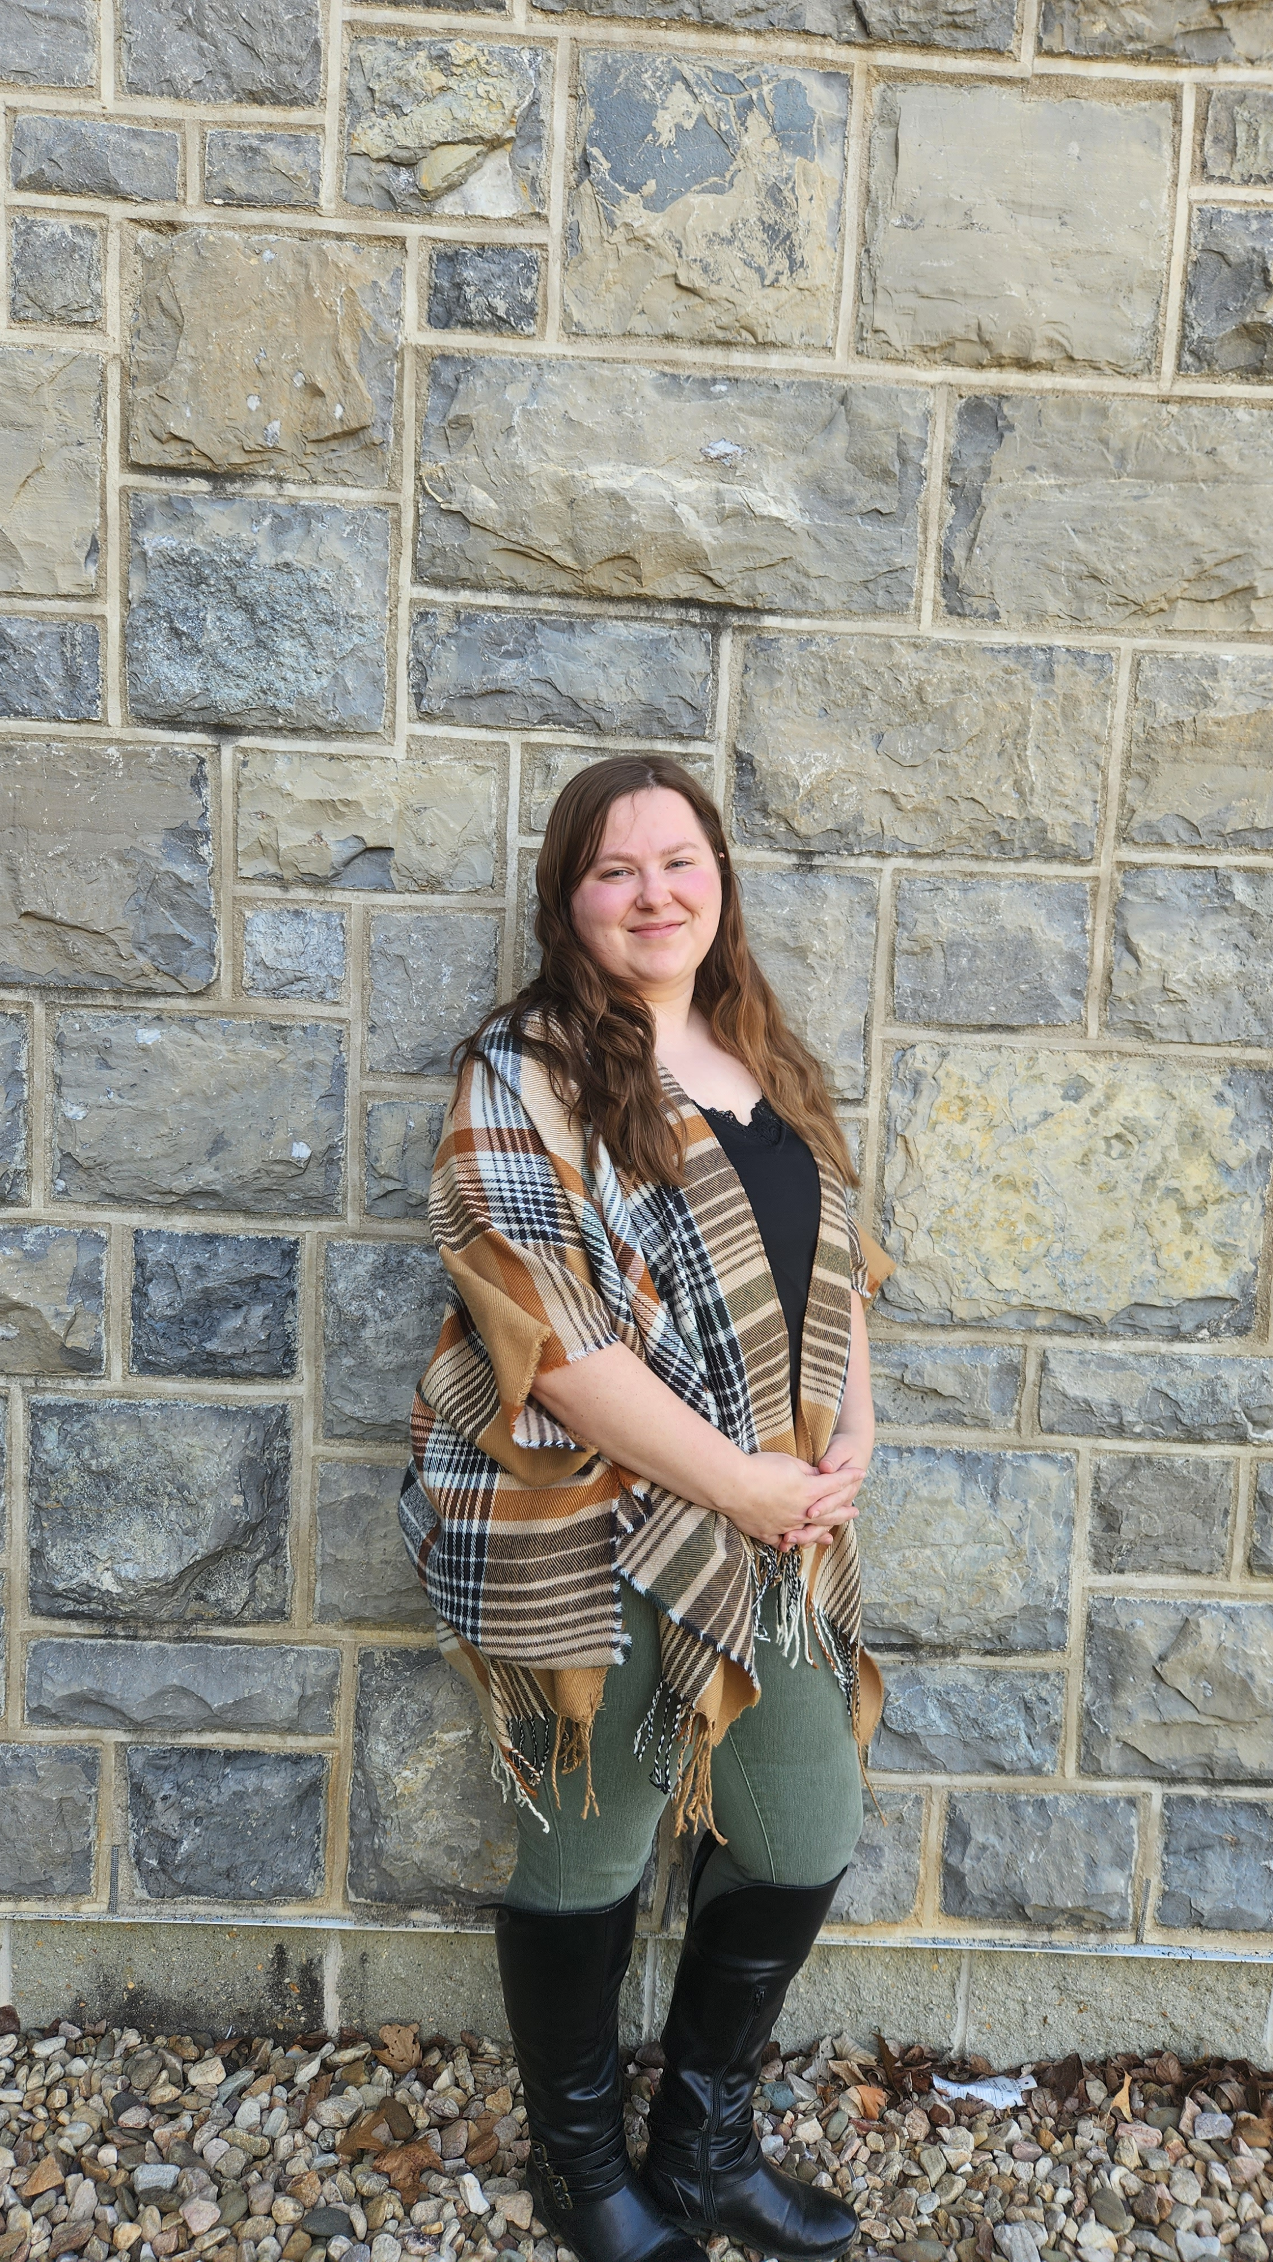
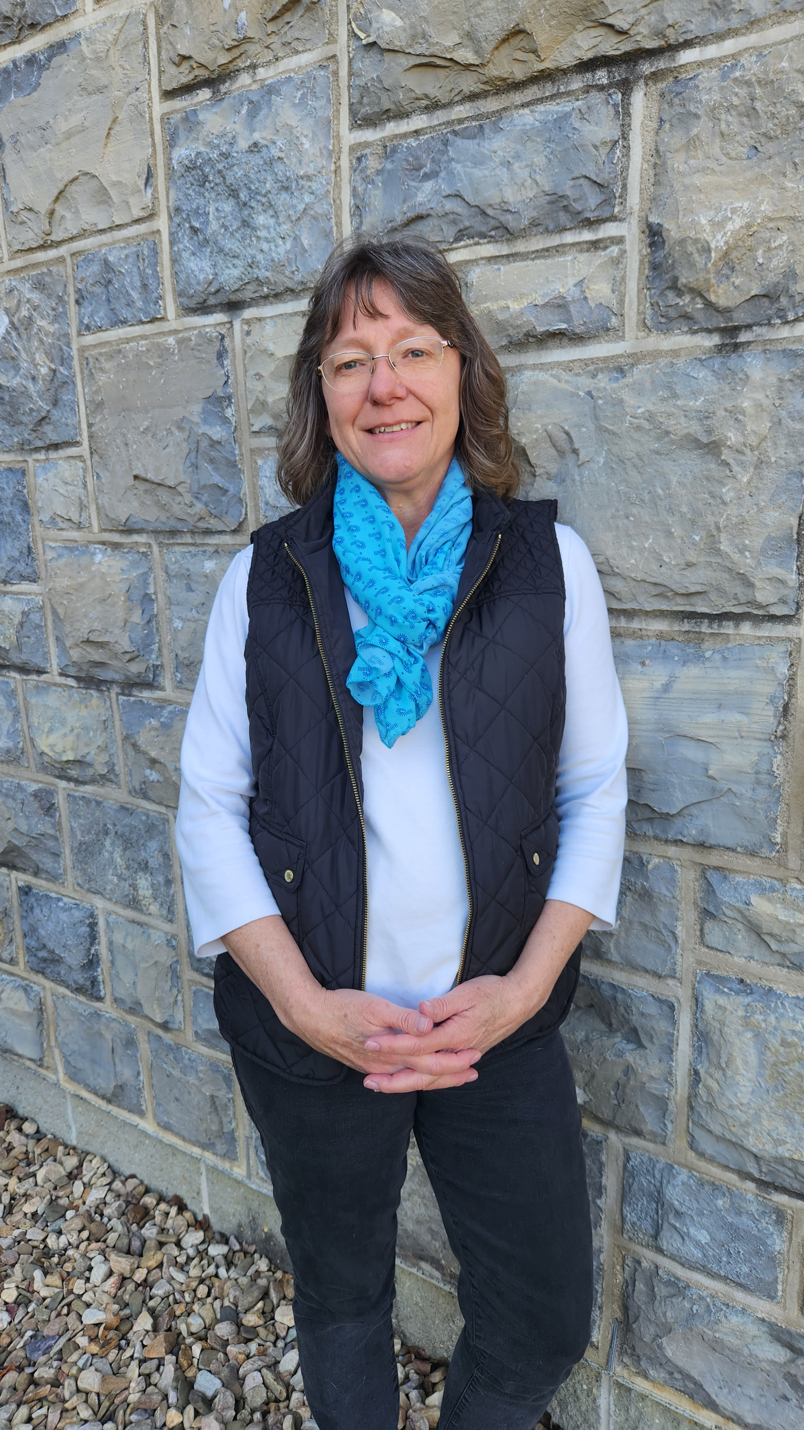
POLY Business Office
Oversite: *POLY Supervisor– John Matson (Treasurer)
*VT Representative - Bob Moore
Kathy Mitchem
Business Manager
Full Time
Budget & Bookkeeping
ExComm Officer Support
Workshops & Event Planning
ACS Meetings
Committee Assistance
Election Oversite
VT-Staff-Office Oversite
Carlee Black
Administrative Assistant Salary 32 h / week
Membership Support
Workshop/Meeting Prep
Awards
Newsletter & Publicity Posts:
Websites Updates
Graphical Abstracts/Preprint
Office Supplies
Thank you
POLY leadership for taking on more tasks
Staff Reduction 2023: From 3 full-time to 1 full-time and one ¾.
Reduced Workshops
Officers/Committees require less assistance

Slide 3
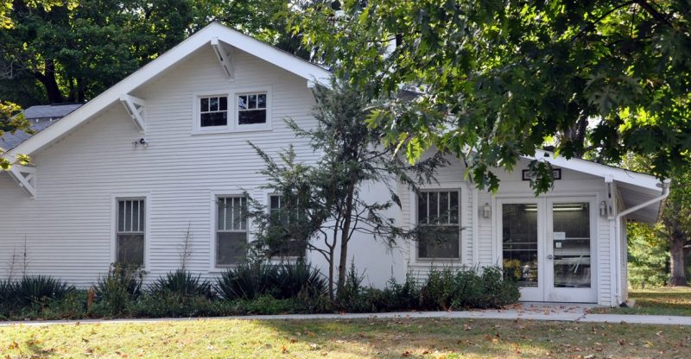
Business Office
Current Location:
ICTAS II, Virginia Tech, Blacksburg, VT
….We are on the move
A new group is taking over POLY’s space in ICTAS II
Bob Moore is striving to find new office space
POLY must be out in February; new space needs 4-6 months
Potential new location Wright House (Not confirmed)
During Interim:
Staff will work from home
2) POLY “STUFF” (files/library/workshop/membership)
- Reduce Material
- Looking into short-term storage (4-6 months)
- Could become long-term storage
NEW BUDGET ITEM:
$3,000 for Storage Unit + New Office Items
(VT should finance move and provide workstations)

Slide 4
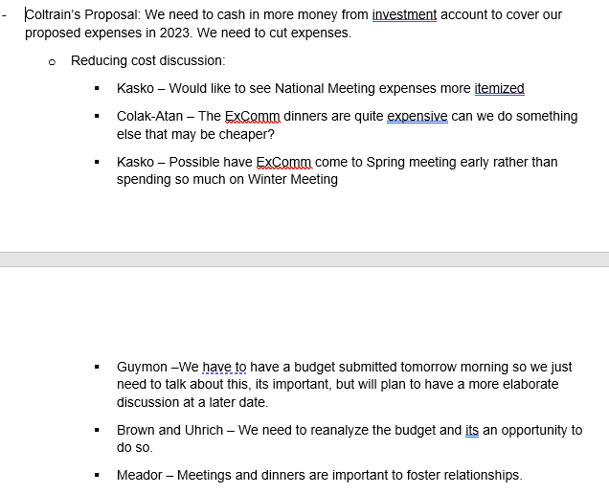
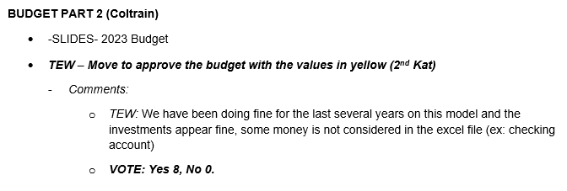
Budget Commentary from 2023 Minutes

Slide 5
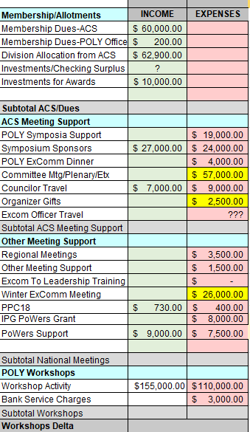
2024 Projected Budget
Highlighted cells indicate areas for potential trimming
Key Adjustments
Membership/Allocation:
Projections similar to last year
Investment/Checking Surplus line added at the end of meeting
ACS Meeting:
POLY Symp. Support and Sponsors similar to past
ExCom Dinner: Historically 8k, 2023 Used 2k, 2024 4k
Committee Meeting: Provided 28.5k per mtg (Justin will review)
NEW: ExComm Officer Travel: Discussed in a moment
Other Meetings:
ACS Leadership training: No one attending (reduced)
Winter ExComm Mtg: Reduced from past (mostly travel & lodging)
NEW: Powers: Received ACS IPG 8k in 2023, out in 2024
NEW: Powers Admin/Financial Support (to be discussed by Derek)
POLY Workshops:
45k Projected Gain
2 workshops

Slide 6
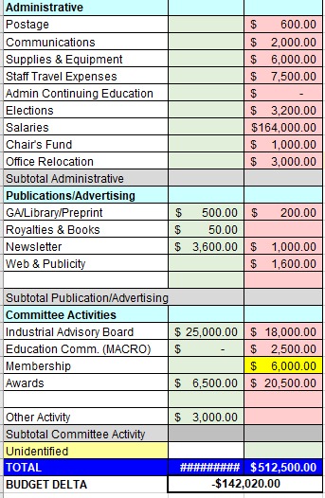
2024 Projected Budget
Key Adjustments
Administrative:
Postage up ($100)
Salary: 2023 VT Cost of living, approved 2024 raise.
(Kathy Full-time, Carlee 32 hrs, + up to 200 wage hrs)
ExCom Dinner: Historically 8k, 2023 2k, 2024 4k
NEW Office Relocation: To be discussed
Publications:
Reduced expenses slightly
Committee Activity:
IAB adjusted slightly (Hayley to report)
MACRO: Zoom discussion –slightly higher
Membership: Question from Matson—is $6000 likely to bring in $6000 worth of new memberships?
Budget Delta:
Must be “0” by the end of this meeting (non-profit)
Covered by Investments/Checking Surplus
2023 Projected investment cash out: -$185,775; Actual -$169,363

Slide 7
NEW Proposal - Officer Travel Support
New Budget Area:
A few ExComm officers request travel support to ACS Meetings Annually
ACS Meeting travel costs typically come from grant budgets for academics; if we are paying for ourselves to come to each and every ACS meeting for 4 nights, then that grant money is not available to our students.
Councilors are already funded by ACS/POLY
Proposal: Up to $500 per person to help defray costs
Question from Kathy: If approved, who will approve support?
How many people would take this support?
DISCUSSION . . . .

