Slide 1
POLY/PMSE Student Chapters and Related – Fall 2024
Missing 50% of the student reports
(Not all reports were received last year either.)
Proposal: We should change how we request reports and clarify that funds for the upcoming year will be withheld until reports are received…beyond simply not including their report in the judging.
Also, we are modifying the report template and will provide better clarification about what is needed on the reports
New chapter member: University of Utah
23-24AY report winners:
1st: U. FL
2nd: U. CO
3rd: CWRU
Goal/ suggestion for enhancing student chapter participation
Work with student chapters to enhance career and personal growth that are available to all graduate/ undergraduate student members (ex., conflict resolution, mental health, personal advocacy, finding your passion, good reading material, and YouTube channels (Like Andy Stapleton’s), etc.). Thoughts?
Notes:
Add Centennial events, and also special issues, editorial, perspective (QR codes or citation info so people can find it?)

Slide 2




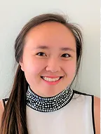

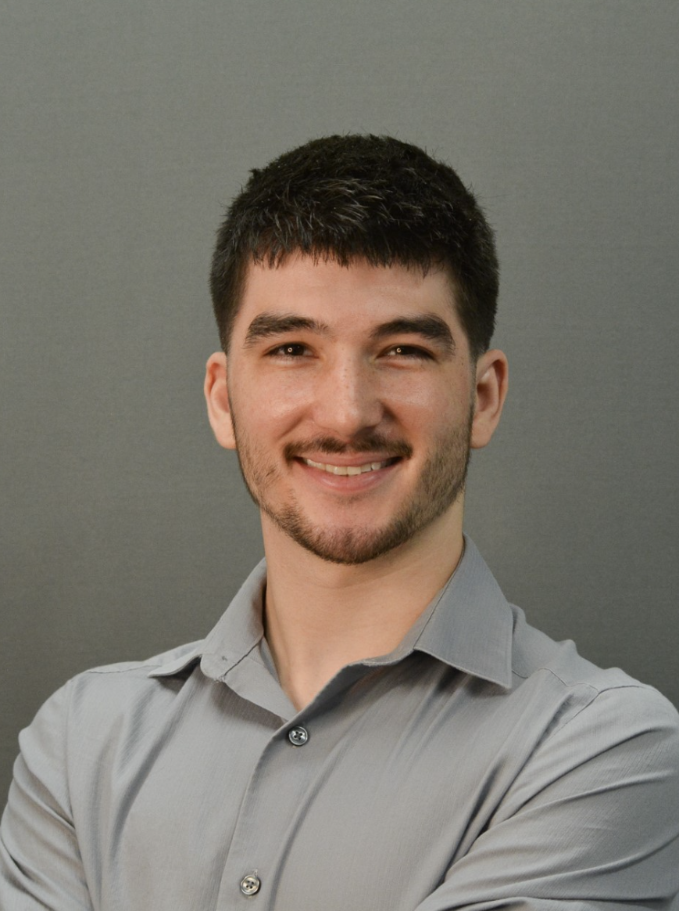
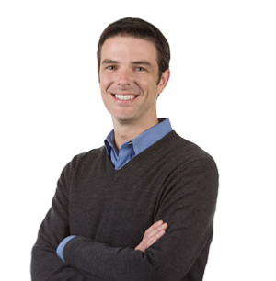
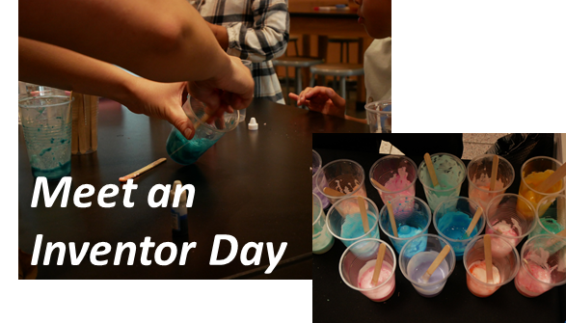
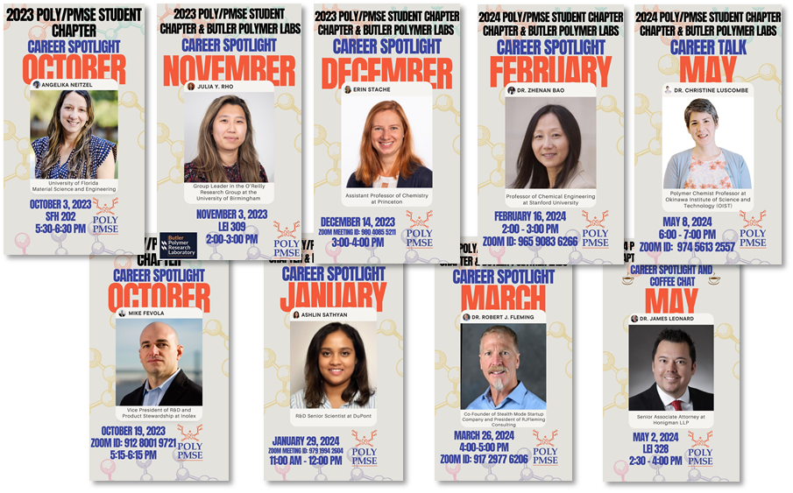
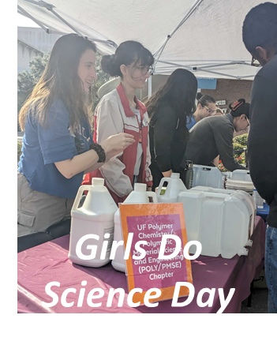
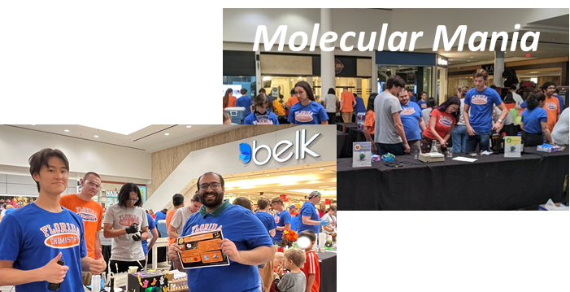
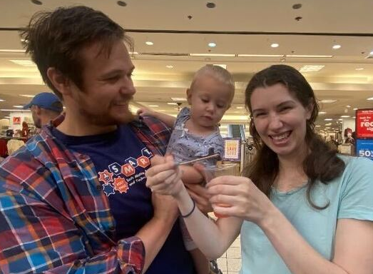
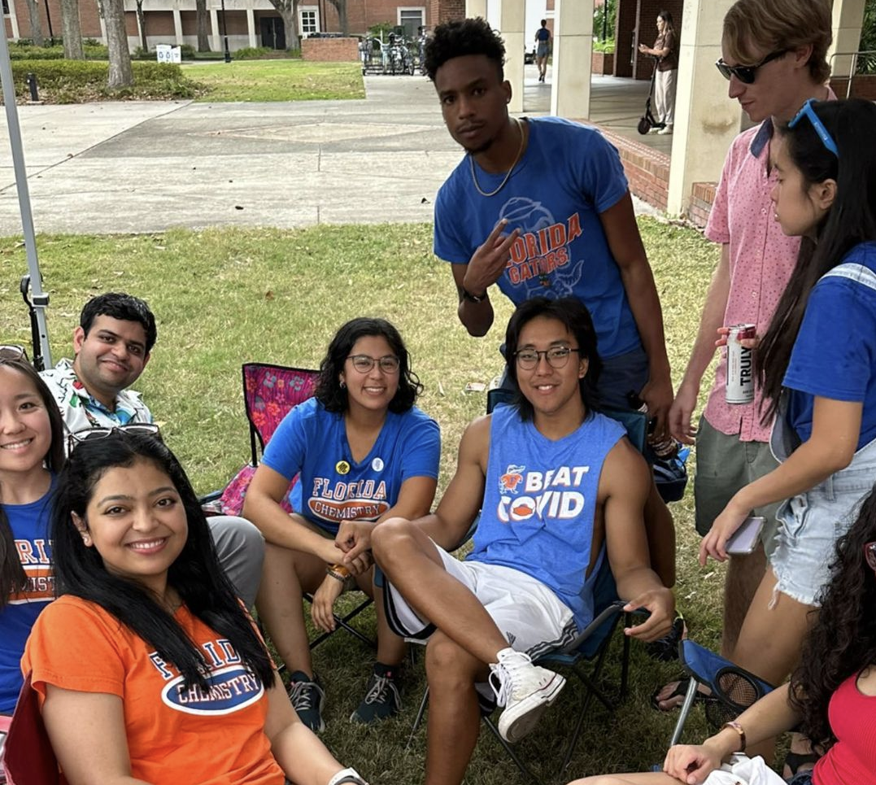
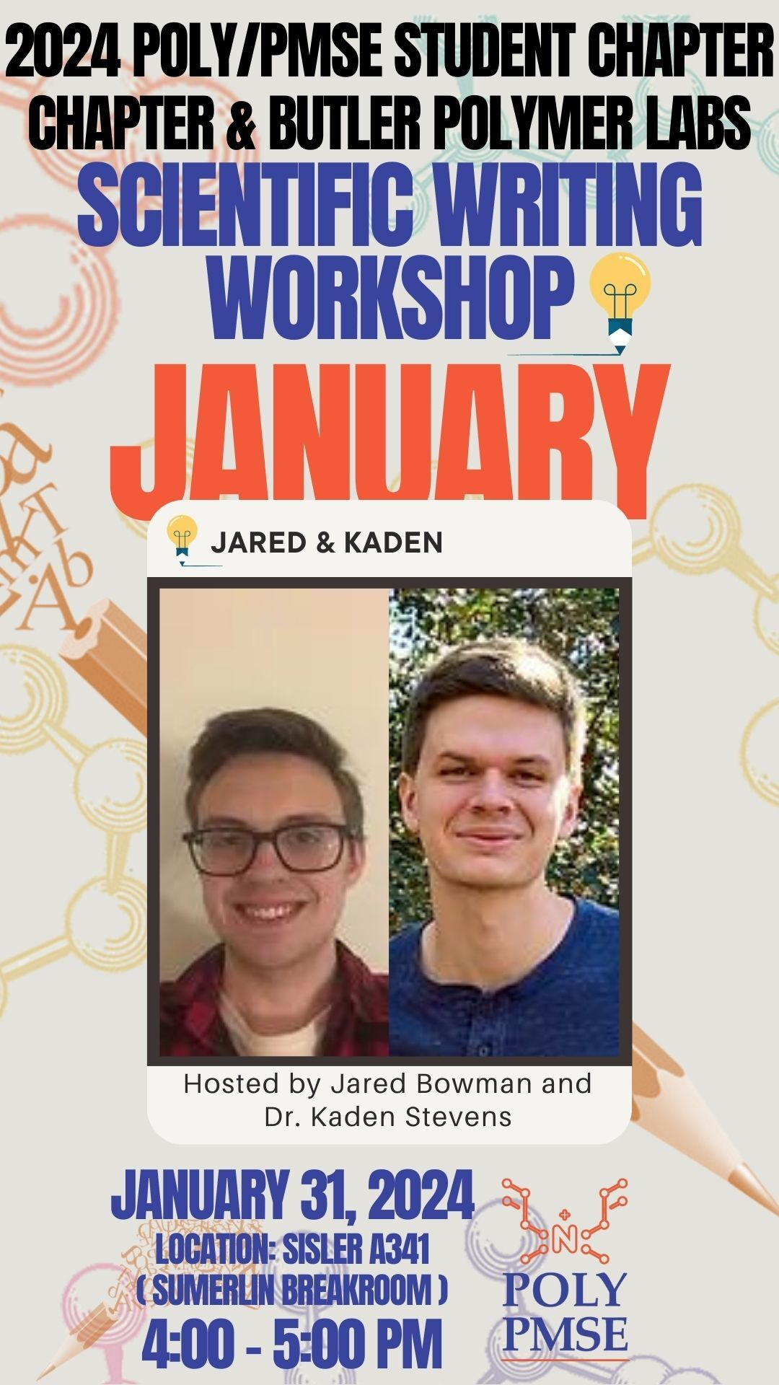
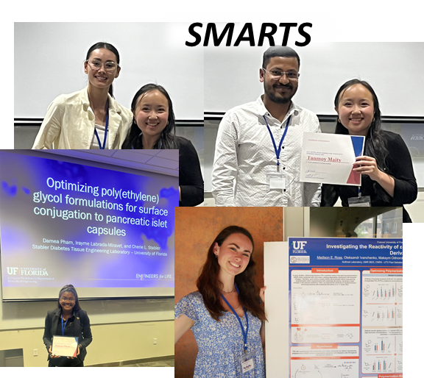
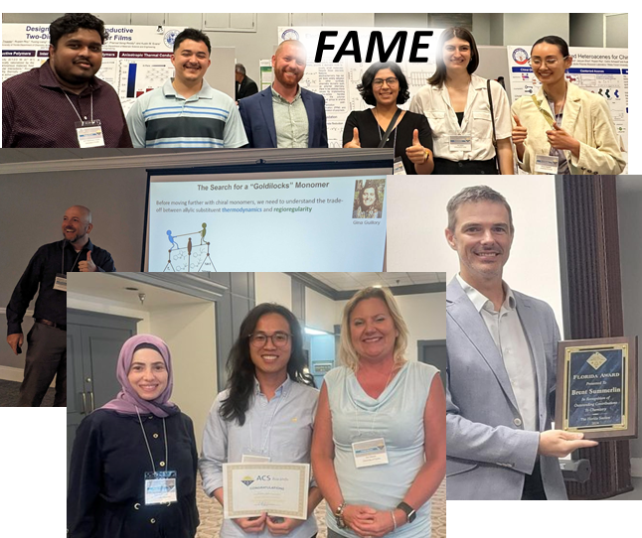

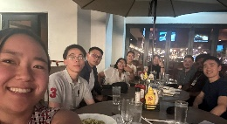
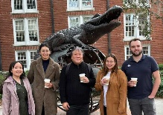



University of Florida (UF) POLY/PMSE Student Chapter
2023-2024
Mission
70 Graduate Student Members
14 Undergraduate Members
The UF Student Chapter of the Polymer and Polymer Materials Science and Engineering Divisions ACS is established to provide students in the chemical sciences:
A social environment to network with other students with related interests
Professional associations that provide intellectual stimulation
Experience in preparing and presenting technical material before chemical audiences
A forum in which members can foster professional pride in the chemical sciences
A venue to spread awareness of the responsibilities and challenges facing the modern professional
A network of peers with a diverse background, allowing for collaborations between members
An opportunity to engage with the greater community around science related content
A supportive environment focused on increasing diversity, equity, and inclusion
Officers
Faculty Advisor
President
Ariana Tamura
Sumerlin Research Group
atamura@chem.ufl.edu
Vice President
Megan Lott
Sumerlin Research Group
m.lott@chem.ufl.edu
President-Elect
Cole Stearns
Castellano Research Group
cole.stearns@chem.ufl.edu
Brent Sumerlin
sumerlin@chem.ufl.edu
Sumerlinlab.com
2023-2024 Events
Outreach
Professional Development
10/28/23 | Molecular Mania 2023 Community event with >300 people where POLY/PMSE members made slime, extracted strawberry DNA, and performed interactive science experiments with kids to teach chemistry concepts.
12/2/23 | Cade Museum: Meet An Inventor Day Ran interactive science booths with Poly-Snow and Slime demos to teach Gainesville children and families about polymer science.
2/11/24 | Girls Do Science Day 2024 Performed children’s science experiments at the Florida Museum of Natural History in honor of International Women’s Day; women graduate/undergraduate students interacted with and encouraged the youth to pursue STEM degrees.
4/18/24 | STEAM Family Science Night 2024 Science experiments and interactive demos performed at Howard Bishop Middle School to engage grade schools.
4/26/24 | Chemathon 2024 Polymer Chemistry Characterization Laboratory Tours Toured high school students through the UF polymer characterization labs and taught
them about various instruments polymer chemists use.
Career Spotlight Series (Pathway to Faculty) | Faculty in various stages of their career discuss their experiences in graduate school and beyond; speakers give insight to pursuing academic positions.
10/3/23 | Prof. Angelika Neitzel (University of Florida)
11/3/23 | Dr. Julia Rho (University of Birmingham)
12/14/23 | Prof. Erin Stache (Princeton University)
2/16/24 | Prof. Zhenan Bao (Stanford University)
5/8/24 | Prof. Christine Luscombe (Okinawa Institute of Science and Technology)
Career Spotlight Series (Industry) | Industrial professionals from public, private, and consulting firms provide
insight into a broad range of career options available after graduating with a doctoral degree in Chemistry.
10/19/23 | Dr. Mike Fevola (Inolex, VP of R&D)
1/29/24 | Dr. Ashlin Sathyan (DuPont, Senior Scientist)
3/26/24 | Dr. Robert Fleming (Stealth Mode Startup, Co-Founder; RJFleming Consulting, President)
5/2/24 | Dr. James Leonard (Honigman LLP, Senior Associate Attorney)
Journal Clubs | Biweekly literature presentations held for students to practice presenting in low-stress environments; focused on recent chemistry/materials publications. 13x meetings held: 9/12/23, 9/26/23, 10/10/23, 10/24/23, 11/7/23, 11/21/23, 1/23/24, 2/6/24, 2/20/24, 3/5/24, 3/19/24, 4/2/24, 4/16/24, 4/30/24
Social Events
Education
9/8/23 | POLY/PMSE Welcome Event Yearly kickoff meeting where new students can meet current POLY/PMSE members and learn more about ways to engage the organization.
5/31/24 | FAME PMSE Happy Hour Hors d’oeuvres and cocktails served in a relaxed social environment; held in honor of FL-ACS Award Winner and POLY/PMSE Faculty Advisor Prof. Brent Sumerlin.
COFFEE CHATS WITH ACADEMIC & INDUSTRIAL PROFESSIONALS | Social meetings with invited faculty/polymer chemists, where students can network with professionals in a relaxed environment over coffee/refreshments.
9/5/23 | Prof. Kaitlyn Crawford (University of Central Florida)
10/10/23 | Prof. Jonathan Malen (Carnegie Mellon University)
11/30/23 | Prof. Takuzo Aida (University of Tokyo)
2/8/24 | Prof. Frank Leibfarth (University of North Carolina at Chapel Hill)
2/13/24 | Prof. Timothy Lodge (University of Minnesota)
5/2/24 | Dr. James Leonard (Honigman LLP)
Writing Workshops | Monthly workshops held to improve scientific communication, discuss
effective writing, and peer review student-submitted documents.
1/31/24 | Introduction to Scientific Writing (Hosts: Dr. Kaden Stevens & Jared Bowman)
2/29/24 | Writing for Oral Examinations (Host: Lauren Bishop)
4/20/24 | How to Write Letters of Recommendation (Host: Prof. Austin Evans)
Scientific Development | Workshops targeting soft skills and useful information for research.
10/11/23 | How to Build Your Resume (Hosts: Dr. Madelyn Evans & Prof. Austin Evans)
11/8/23 | AI in Research (Host: Dr. Lily Diodati)
3/21/24 | How to Negotiate Salaries (Hosts: Dr. Madelyn Evans & Prof. Austin Evans)
Symposia
4/19/24 | Soft Matter Applied Research & Technology (SMARTS) Interdepartmental symposium for graduate and undergraduate speakers to present their research. Organized 12 oral presenters, 18 poster presenters, and four keynote speakers (Prof. Joshua Moon, CHE; Prof. Jennifer Andrew, BME; Prof. Adam Veige, CHM; and Prof. Kenneth Wagener, CHM/Emeritus), along with coffee and lunch breaks.
5/30 – 6/1/24 | ACS Florida Annual Meeting & Exposition (FAME) Organized three oral, FL-ACS Award, and two POLY/PMSE poster sessions for student and faculty presenters. Awarded two Best PMSE Poster awards and reimbursed students for travel. Faculty (oral) speakers included Profs. Brent Sumerlin (UF; 2024 FL-ACS Winner), Adam Veige (UF), Daniel Savin (UF), Nathan Gianneschi (Northwestern University), Adrian Figg (Virginia Tech), Hao Sun (New Haven), Austin Evans (UF), Kaitlyn Crawford (University of Central Florida), Justin Kennemur (Florida State University), and Rituparna Samanta (University of South Florida). Student presenters came from universities across the state of Florida.
2024-2025 Plans
Outreach: Participate in Molecular Mania 2024, future Meet an Inventor Days, and Girls Do Science 2025.
Professional: Career Spotlight Series continuation; broaden to include speakers from government and niche chemistry career sectors.
Social: Continued coffee chats, start monthly mindfulness activities.
Educational: Broaden writing workshops to focus on specific aspects of research/scientific writing; continued journal clubs.
Other: Collaborate with UF Chem Club and Alpha Chi Sigma to increase undergraduate participation in all events.
Get involved!
@ufpolypmse
https://www.butlerpolymerlab.com/poly-pmse

