Slide 1

ACS DIVISION OF POLYMER CHEMISTRY Treasurer Report POLY Business Meeting March 2024
Presented by John Matson (Treasurer) with help from Christine Coltraine (past Treasurer)
Support from Kathy Mitchem and Carlee Black

Slide 2
Outline
2023 Budget / YE actuals
Discussion items
Staff Review
Major Income Trends
2024 Approved Budget

Slide 3
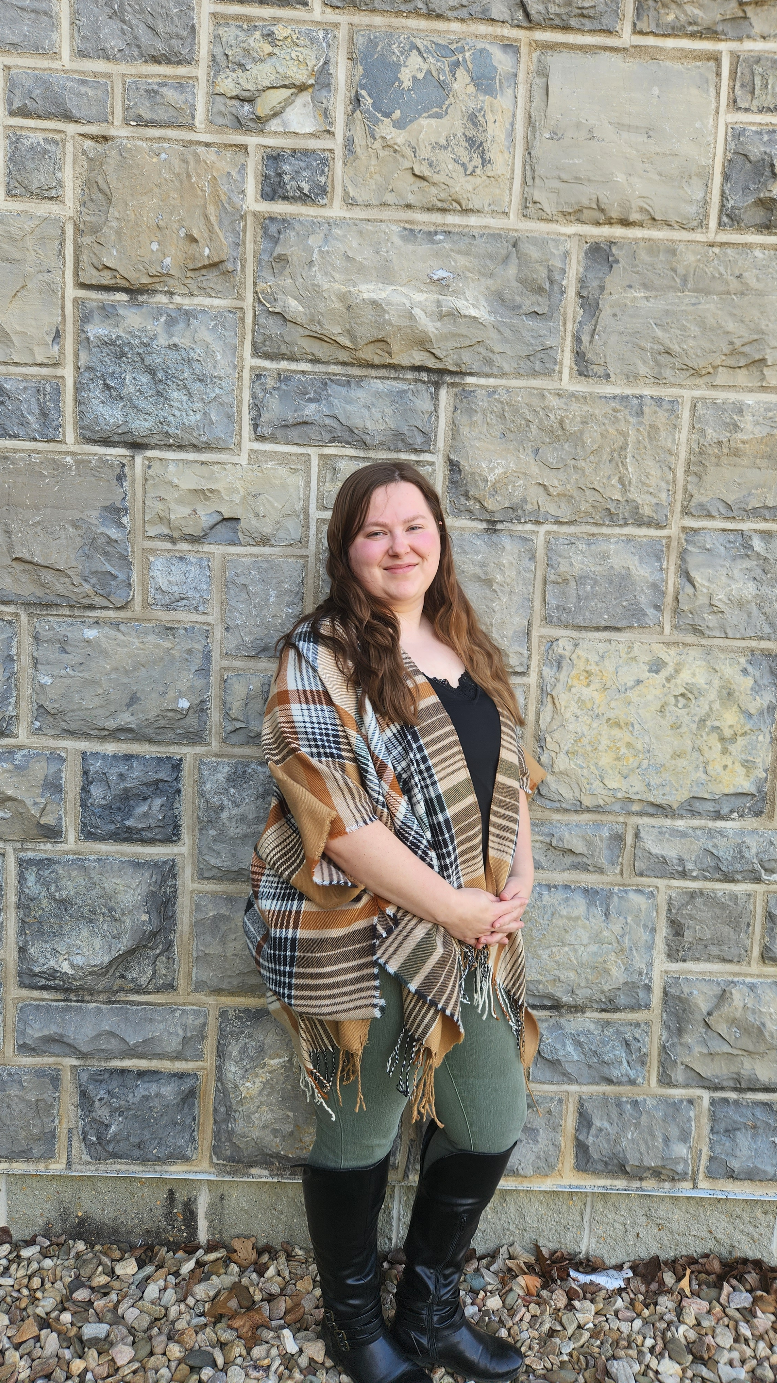
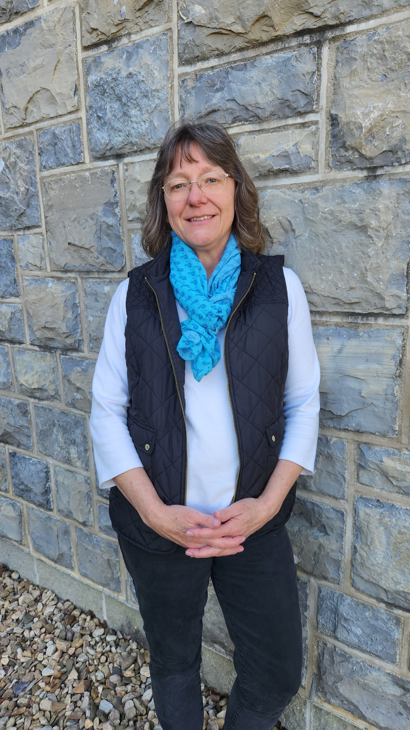
POLY Business Office
The
POLY leadership is committed to taking on more tasks in 2024 to help Kathy and Carlee
Oversite: *POLY Supervisor: John Matson (Treasurer)
*VT Representative: Bob Moore
Location: Virginia Tech, Blacksburg, VA (office move underway)
Carlee Black
Administrative Assistant Salary 32hrs Week
Membership Support
Workshop/Meeting Prep, Website, etc.
Awards Oversite
POLY Newsletter & Publicity Posts:
Facebook, E-news, ListServe
General Websites Updates
Graphical Abstracts/Preprint
Office Supplies/Orders
Kathy Mitchem
Business Manager
Full Time
Budget Support-Bookkeeping
ExComm Officer Support
Workshops & Event Planning
ACS Meetings Support
Industrial Advisory Board
- & Other Committee Assistance
Election Oversite
VT/Staff/Office Oversite

Slide 4
2023 Budget / YE Actuals

Slide 5
Important points
ACS POLY Membership and allocation: Membership dues continue to drop; we received only $59k in 2023. This is a concerning trend.
Workshops: Workshops were a strong point in 2023, making us $67k over 3 workshops.
Investment: We cashed-out $155k from investments in 2023. Because the market did well in 2023, our balance was still above YE2022, but this is not sustainable.
ExComm: We decreased ExComm dinner expenses ($6k down to $2k)
ACS expenses: Expenses for the ACS Fall meeting were very high and POLY incurred extra charges
2023 Budget Report

Slide 6
Major Income Sources
Membership Dues: $67-68k average (decreasing)
ACS Division Allocation: ~$50-60k average (sometimes ACS provided bonus which is very much appreciated and needed – Councilors please relate this to ACS)
Workshops Delta Budget: The amount per workshop varies widely; some bring in a lot, while others cost POLY money.
We began asking in 2023 for a minor administration fee for handling of symposia sponsors for ACS symposia
Sponsors (we anticipate $20-30k each year)
$2-3k ACS National Meeting – decreasing
$4k Newsletter Advertisers – decreasing
$6-10k Awards (6k comes through POLY)
$10k IAB Reception/Awards/Symposia (IAB)
Other opportunities – Sponsors for various awards would help our bottom line

Slide 7
Major Income Trends 1
2023 – $56,477 + “Extra Allocation” of $5,900 received in 2024
2023SP $35,095 (for July-Dec 2022 membership)
2023 FL $24,000 (for Jan-June 2023 membership) – VERY LOW

Slide 8
Major Income Trends 2
4 Workshops + 1 Virtual were held in 2021
6 workshops were held in 2022
3 workshops were held in 2023 [Fluoropolymer 2023 (June); Sustainable Polymers (October); Controlled Radical Polymerization (November) and PPC 2023 (December)]

Slide 9
Approved 2024 Budget

Slide 10
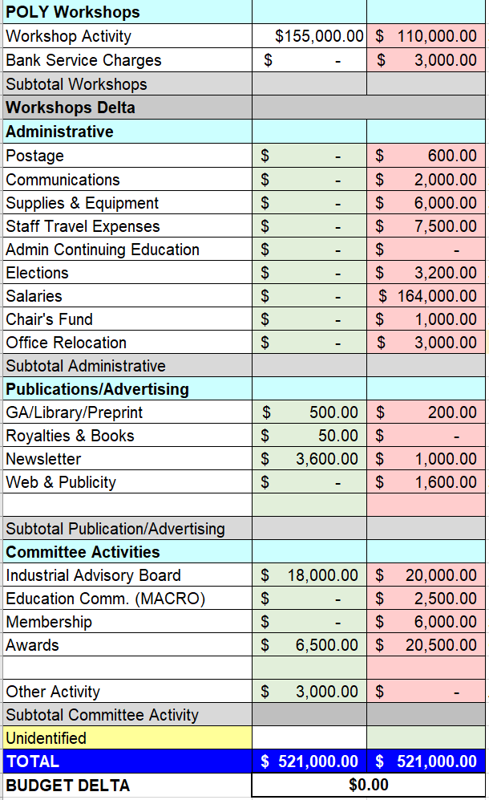
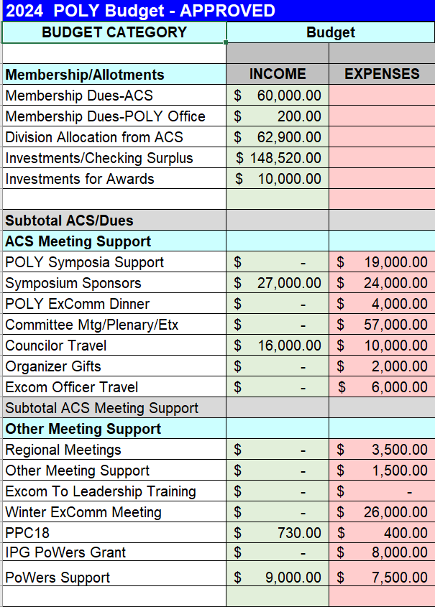
2024 Final Approved Budget
Important points
Investment: We anticipate cashing out $148,520 from investments in 2024. Again, this is not sustainable.
New councilor travel program: We envision making $6,000 in 2024 due to adjustments from ACS in councilor travel reimbursement.
ExComm officer travel: We approved up to $500 per ExComm officer per meeting to help defray travel costs to ACS meetings. Limit $6,000 total.
Workshops: We estimate $45,000 in workshop profits in 2024.

Slide 11
Discussion Items
Reducing spending will not alleviate our budget problems. We are stretched very thin as it is.
How can we bring in more money?
Award sponsors
Increase membership
Consider workshops carefully and insist on cheaper cities for smaller workshops
Other ideas?

