Slide 1

ACS DIVISION OF POLYMER CHEMISTRY Treasurer Report Zoom Ahead of POLY Winter ExComm Meeting 2025
Presented by John Matson (Treasurer)
Support from Kathy Mitchem and Carlee Black
Notes:
I have a 20-minute slot for this.

Slide 2
2024 Year-End Positives and Negatives
Positives
Income
Workshops did very well, with a delta of $80K (this includes $40K in admin fees), $38K above budget. Fantastic!
Investments had a good year (up 14%, $144K).
We withdrew only $68K from investments in 2024 ($148K was projected), a difference of +$80K.
Expenses
We saved money in a few areas, notably:
Winter ExComm $4K
ExComm officer travel $5K
Admin expenses $10K (Thanks, K & C!)
Red Herrings (things that are misleading)
We received three ACS grants for $42K in 2024, most of which will go out in 2025, making 2024 look artificially better and 2025 artificially worse.
Negatives
Income
POLY membership dues generated $49K ($59K in 2023), $11K below budget.
ACS allocation was $58K ($56K in 2023), $5K less than budgeted.
Expenses
Symposium support costs were $5K more than budgeted, likely due to better advertising that it is available.
We were $7K over budget for ACS national meeting expenses.
Summary
Workshops kept us in good shape, thanks to organizers who donated to POLY rather than spending their surpluses.
Smaller positives and negatives offset.
Overall, income is declining and expenses are increasing.

Slide 3
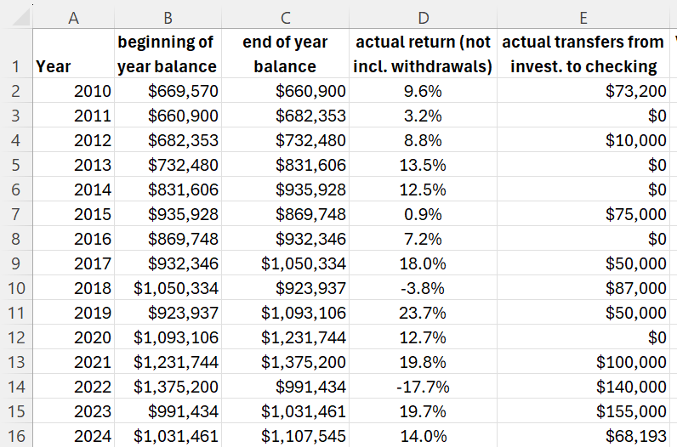
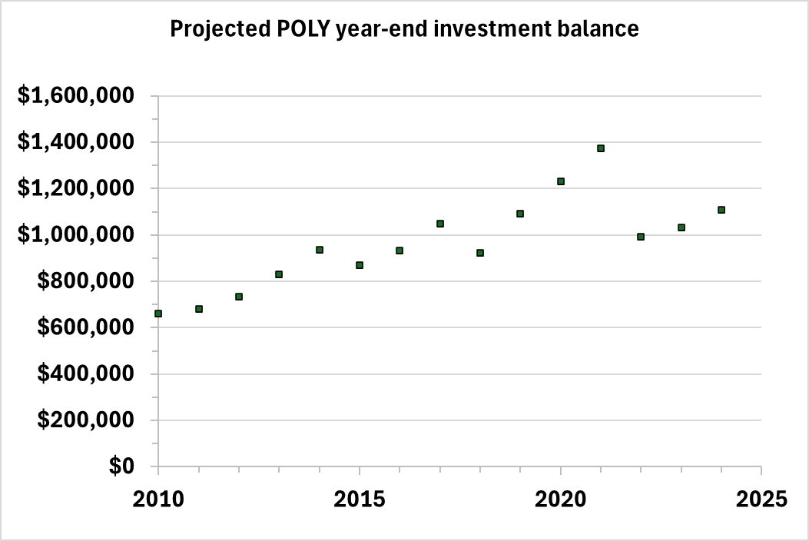
Investments 1: Historical data basis for model
Historical data
Average return since 2010: 9.5% (high = 24%, low = –18%)
Average withdrawal since 2010: $54K (high = $155K, low = $0K [5 times])
Projection Simulation Model and Methodology
Based on these historical data, I set up a randomizer to project future returns, ranging from –10% to +30%, with an average of 10% (slightly rosier than historical data).
I then produced an Excel macro to run 1,000 simulations each at various annual withdrawal amounts (e.g., $100K/year up to $180K/year).

Slide 4
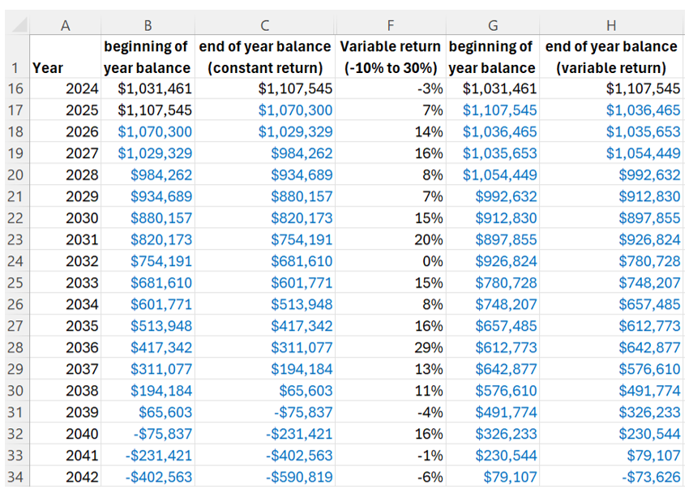
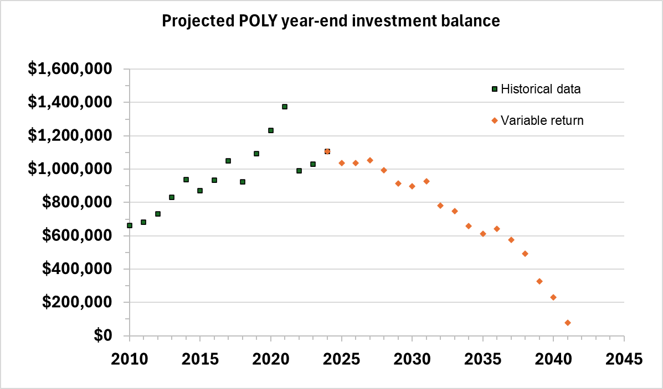
Investments 2: Example Projection Simulation
Example Projection: Annual withdrawal of $148K (our budgeted 2024 withdrawal)
The macro ran 1,000 simulations for this scenario, randomizing return rate each time.
POLY investment balance was >$0 past 2050 in just 5.3% of simulations.
The average year for investment balance dropping below $0 was 2036.
For this particular projection:
POLY investments dropped below $0 in 2042.
Average return through 2042 was a reasonable 9.0%.

Slide 5
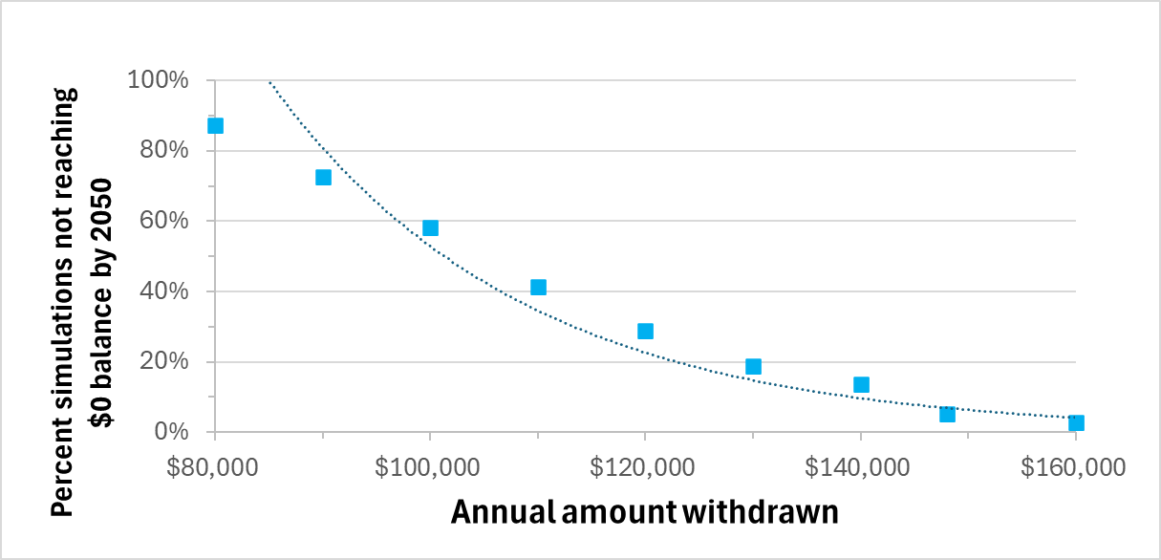
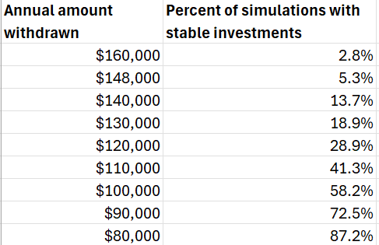
Investment 3: Projection Simulations Summary
Projection Simulation Summary: Chances of stability versus annual withdrawal amount
I ran 1,000 simulations each for a range of scenarios from $80K–160K annual withdrawal.
Based on these 10,000 simulations, I graphed “stability chance” vs. annual withdrawal amount
A target annual withdrawal amount of $105K/year gives POLY a 50% chance of retaining an investment balance past 2050.
I recommend that we withdraw no more than ~$110K/year from investments, adjusting for year-end affects as needed. I plan to revisit this value annually.

Slide 6
Discussion Points
Investments
2024 looks good on paper (made $144K, spent $68K), but with adjustments for ACS grants (+$42K), we derive a more realistic $110K reliance on investments.
$110K/year is below “sustainable” (41% likelihood of POLY still having an investment fund in 2025).
Our current 2025 budget projects a withdrawal of $179K in 2025.
Averaging $179K (2025) and $68K (2024) shows a $124K/year reliance on investments, a bit too high.
Potential ways to improve our bottom line
ACS meeting expenses, particularly A/V and F&B, are a potential place to continue trimming.
Justin has generated more sponsorship funds for coffee from Tosoh. Thanks, Justin!
Each board meeting lunch costs POLY $7K (F&B costs $90–110/person). We discussed dropping to one in-person board meeting per year. The other could be on zoom
Each programming lunch costs ~$6K. We discussed switching to snacks or coffee.
Each plenary costs ~$9K. We have not yet discussed trimming this event.
Pending sponsorships
We had a deal with ACS pubs in 2023-24. We need a point person to renegotiate for 2025-26.
New sponsorships
To be discussed by Laura in more detail in Phoenix
Symposium support
Organizers are more aware of our support. Fewer symposia in future meetings will help, but should we trim to $400/session (up to $1200 total)? Some other adjustment?

Slide 7
ACS DIVISION OF POLYMER CHEMISTRY Treasurer Report POLY Winter ExComm Meeting 2025
Presented by John Matson (Treasurer)
Support from Kathy Mitchem and Carlee Black
Notes:
I have a 20-minute slot for this.

Slide 8
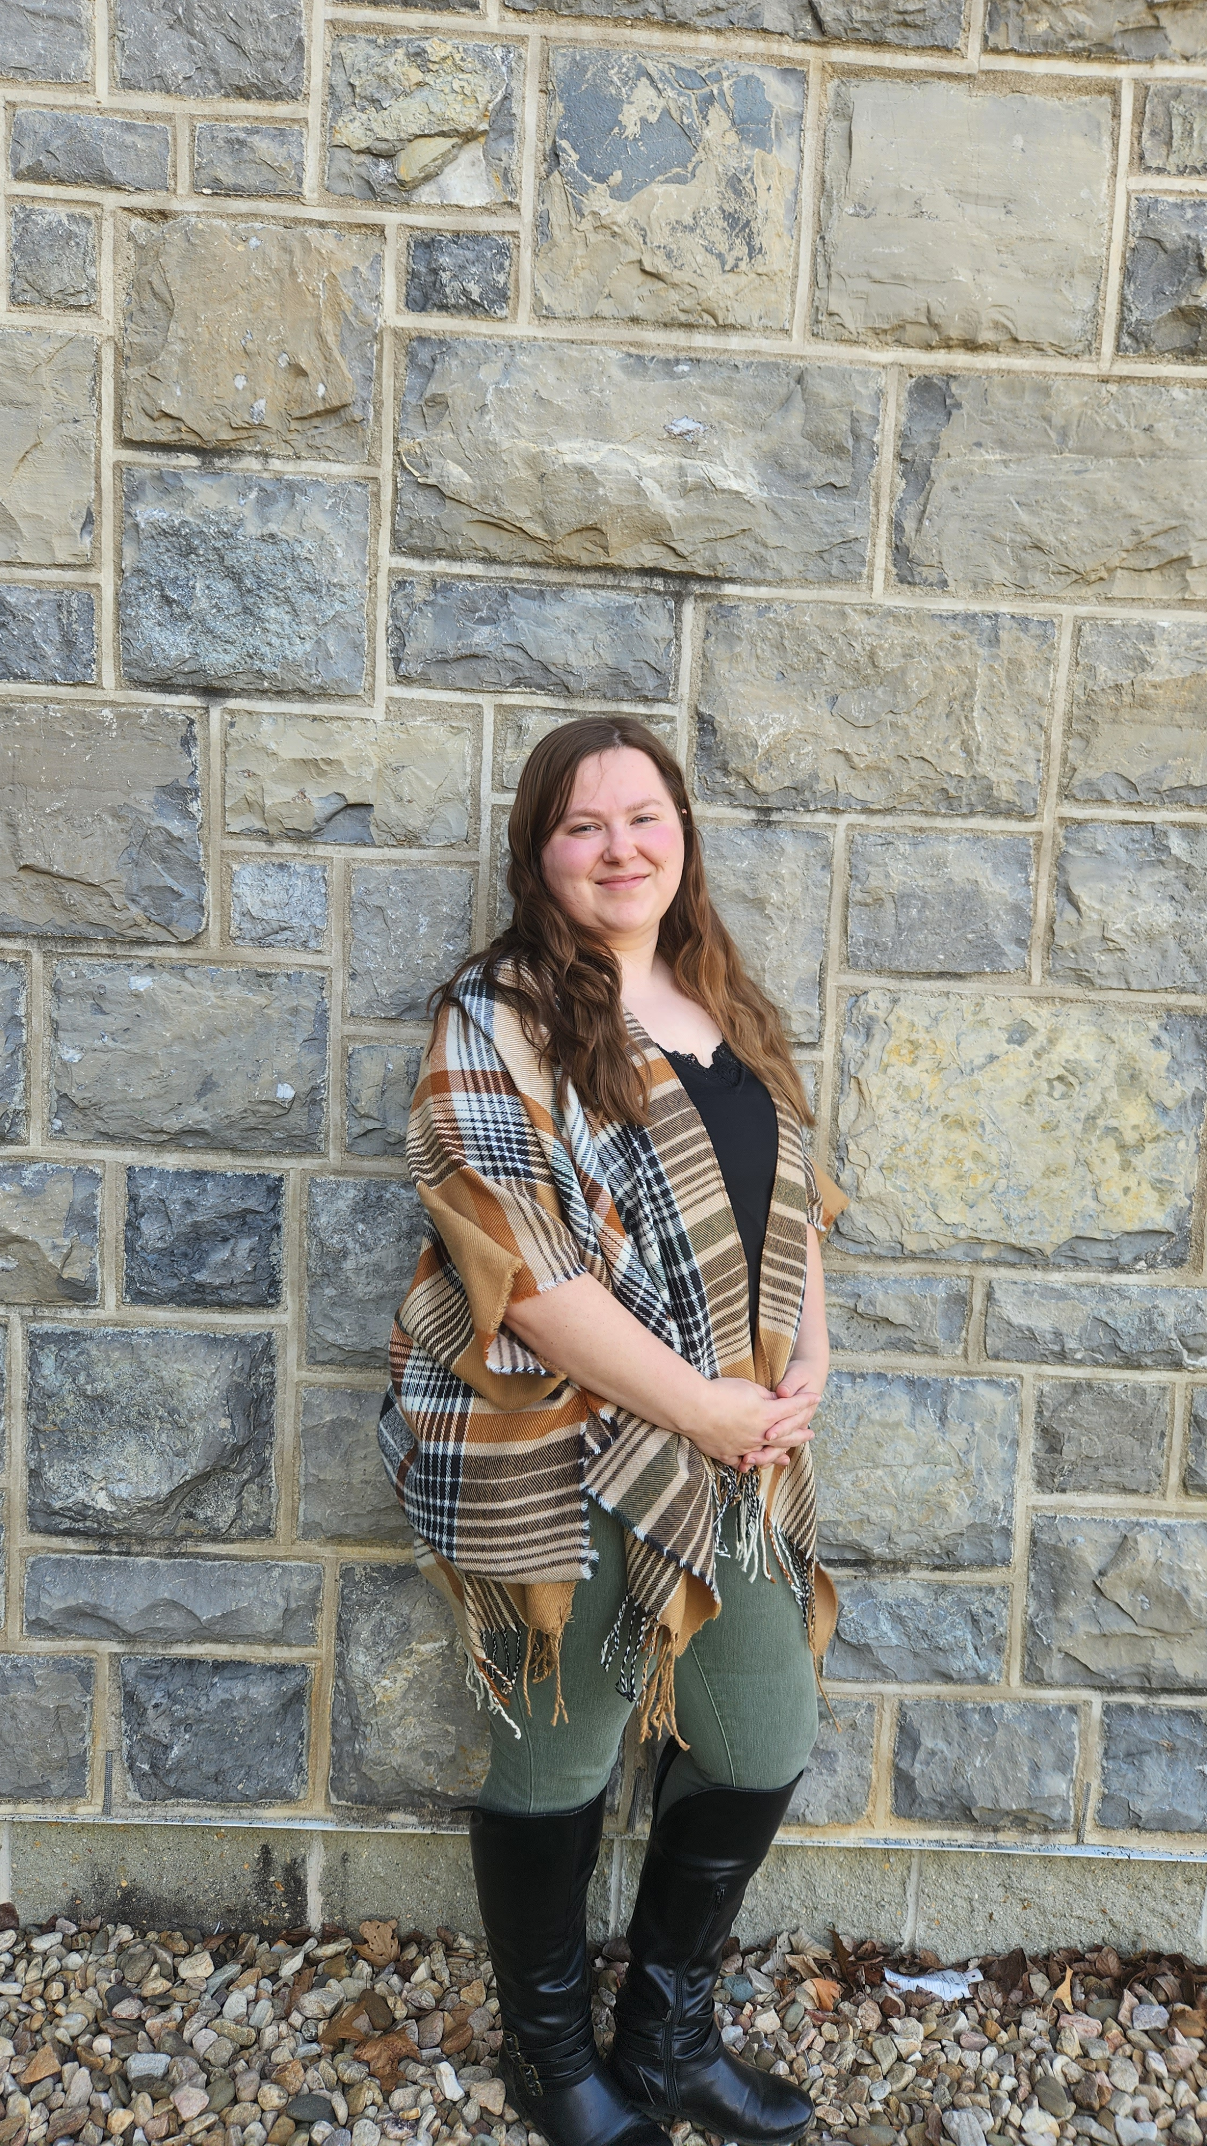
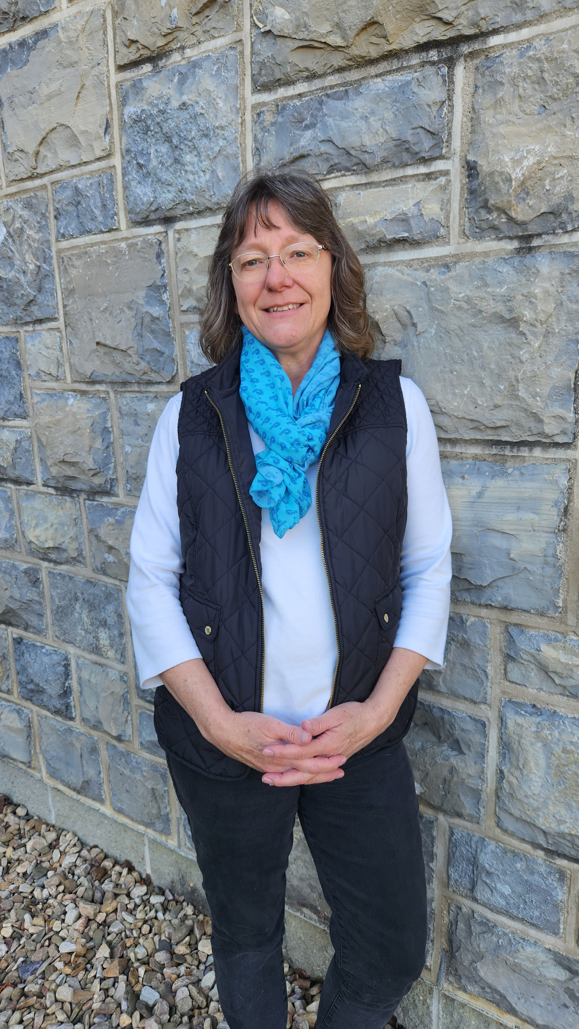
POLY Business Office
Oversite:
*POLY Supervisor– John Matson (Treasurer)
*VT Representative-Bob Moore
Location: Both are currently working from home in Blacksburg, VA
Carlee Black
Administrative Assistant Salary 32hrs Week
Membership Support
Workshop/Meeting Prep, Website, etc.
Awards Oversite
POLY Newsletter & Publicity Posts:
Facebook, E-news, ListServe
General Websites Updates
Graphical Abstracts/Preprint
Office Supplies/Orders
Kathy Mitchem
Business Manager
Full Time
Budget Support-Bookkeeping
ExComm Officer Support
Workshops & Event Planning
ACS Meetings Support
Industrial Advisory Board
- & Other Committee Assistance
Election Oversite
VT/Staff/Office Oversite

Slide 9
2024 Budget / YE Actuals

Slide 10
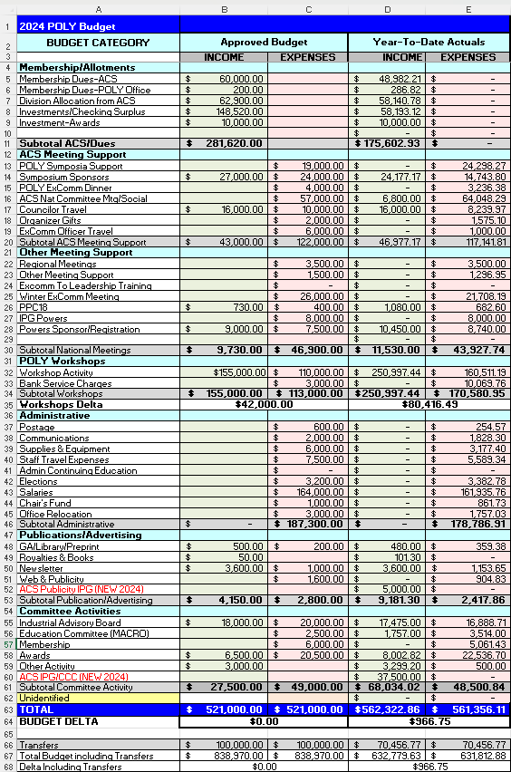
2024 Budget Report: Complete Budget
Important points
This is the complete 2023 budget and year-end actuals.
The next slides contain breakdowns.

Slide 11
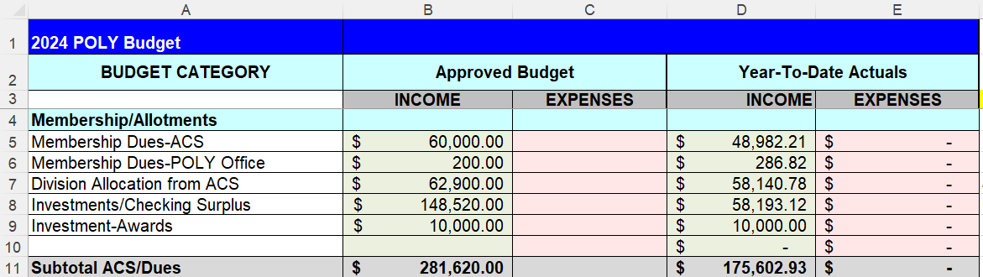
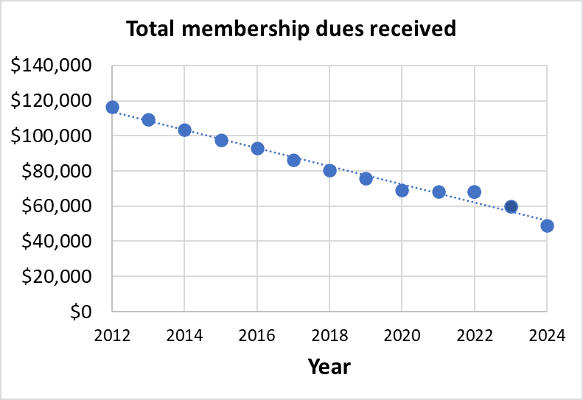
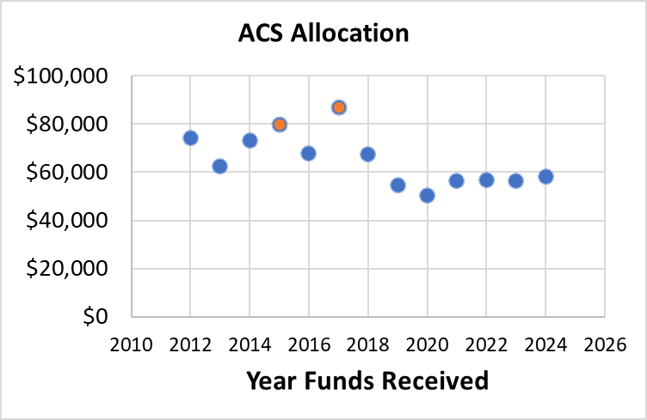
2024 Budget Report 1: Income from dues & ACS
Important points
Membership dues (5): Over 12 years, we are dropping ~$5K/year; $10K last year. This trend is concerning
ACS allocation (7): ACS allocation is $4.7K less than expected. This trend is flat.
Summary
Our budget projections were relatively conservative, and even less income has come in from these sources.
We project $50K (dues) and $59K (ACS) for 2025.

Slide 12
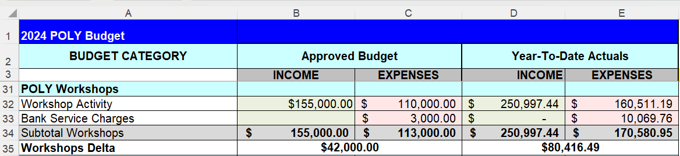
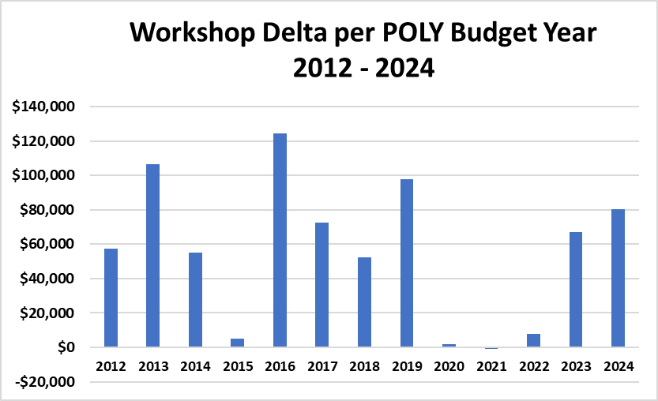
2024 Budget Report 2: Income from workshops
Important points
Fire and Polymers (May 2024) was a scientific and financial success. $22.6K donated to POLY above $20K admin fee.
Advances in Polyolefins (Sep 2024) was also quite successful $3.3K donated to POLY above $20K admin fee.
Summary
The $20K/workshop admin fee ($40K total) covers business office time and other expenses
POLY made $38K more than projected.
Workshop profits are not guaranteed, and workshops can lose money.

Slide 13
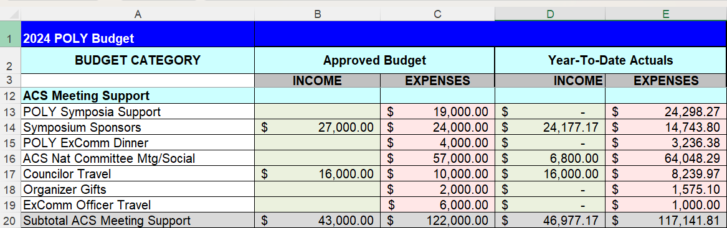
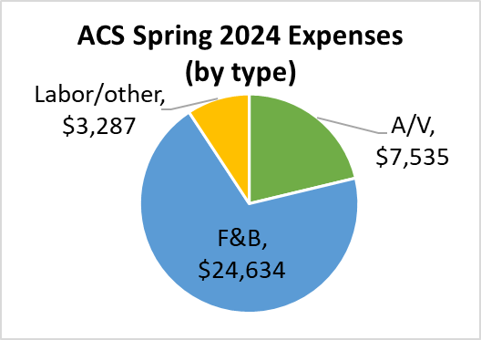
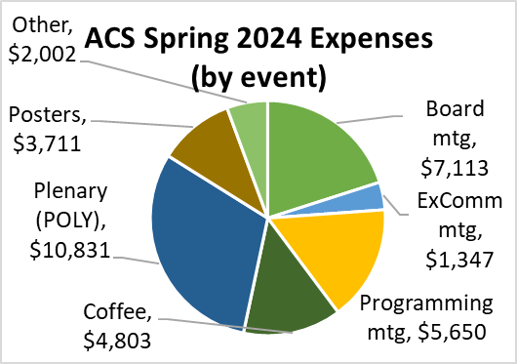
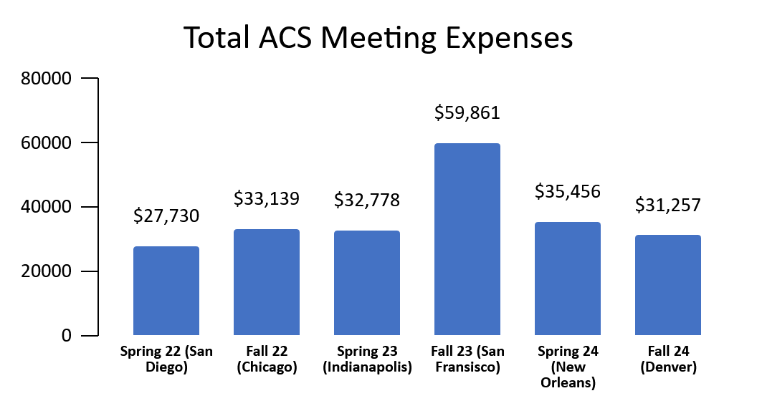
Important points
Symposia support (13): We were $5K over budget. More are using it.
ExComm dinner (15): We were ~$1K under budget.
ACS meeting (16): We overspent by $7K despite trimming coffee service for Denver.
ExComm officer travel (19): Only one person took advantage (Matson).
Summary
F&B costs remain high.
Cuts here would help.
2024 Budget Report 3:
ACS meeting-related expenses

Slide 14
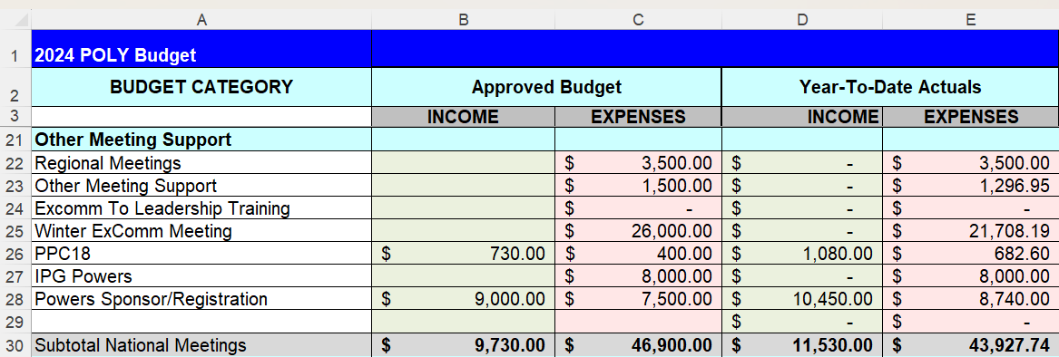
2024 Budget Report 4: Other Meetings
Important points
Winter ExComm meeting (25): We came in $4.3K under budget for 2024.
Summary
No major unexpected outcomes so far here.
Nice job, everyone, in keeping Winter ExComm expenses under budget.

Slide 15
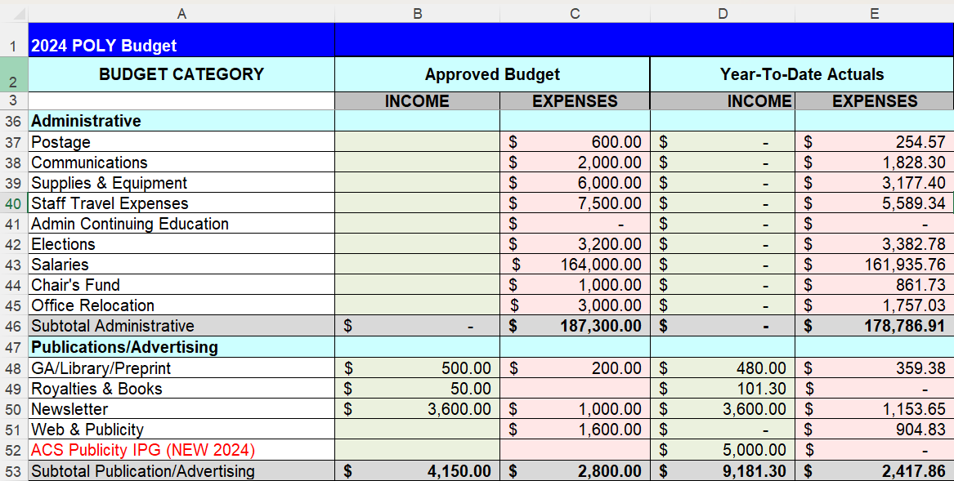
2024 Budget Report 5: Administrative
Important points
Supplies (39): Kathy and Carlee reduced expenses on supplies (e.g., computer).
Staff travel (40): Kathy removed 1 day of travel per meeting.
Office relocation (45): Kathy and Carlee are working from home. Monthly storage fees are included on this line.
Publicity IPG (52): Congratulations to Corale and Taylor for winning an ACS grant to enhance POLY’s web and outreach
Summary
No major unexpected outcomes here.

Slide 16
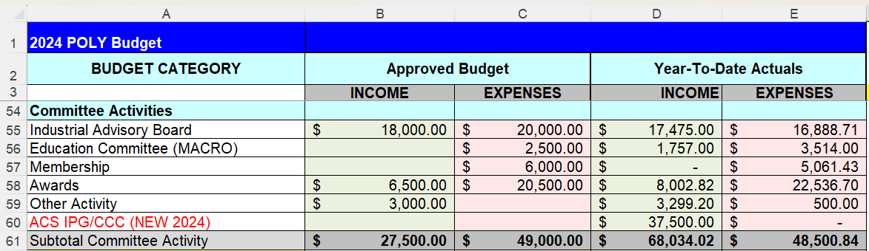
2024 Budget Report 6: Committee Activities
Important points
MACRO (56): Overall spent $1K less than expected.
Awards (58): There is $14K in potential award sponsorships.
IPG/CCC grant (60): The big new grant to Wei Gao and company. A good chunk will go out in 2025.
Summary
More award sponsors would help our bottom line

Slide 17
Sponsorship Support
Newsletter Advertising | 1/8 pg $20 up to Full pg $2,000 | Semi-Annually
E-news with Web Link | $500 | Annually
Mark Scholar Awards (3 awards) | $4,500 | Bi-Annually
Plenary Speaker | $1,500 | Annually ($600x2 annually)
Major Awards: Each: Marvel, Flory, Mark, IPS | $3,500 each (prize & travel) | Bi-Annually
Student Social | $1,000-$3,000 | Semi-Annually
Cookie/Snack Break Sponsor | $1,500 per ACS Mtg | Semi-Annually
Tentative Sponsor In Place for 2025
Coffee Break Sponsor | $3,250 per ACS meeting (?) | TOSOH
Poster Awards | $750 per ACS meeting | Springer
General Division Sponsorship | $1,250 per ACS meeting | ACS Publications?
General Papers | $600 per ACS meeting | Polymer Chemistry
Poster Session Food and Beverage | $3,000 per ACS meeting | JAI

Slide 18
2024 Investments Activity

Slide 19
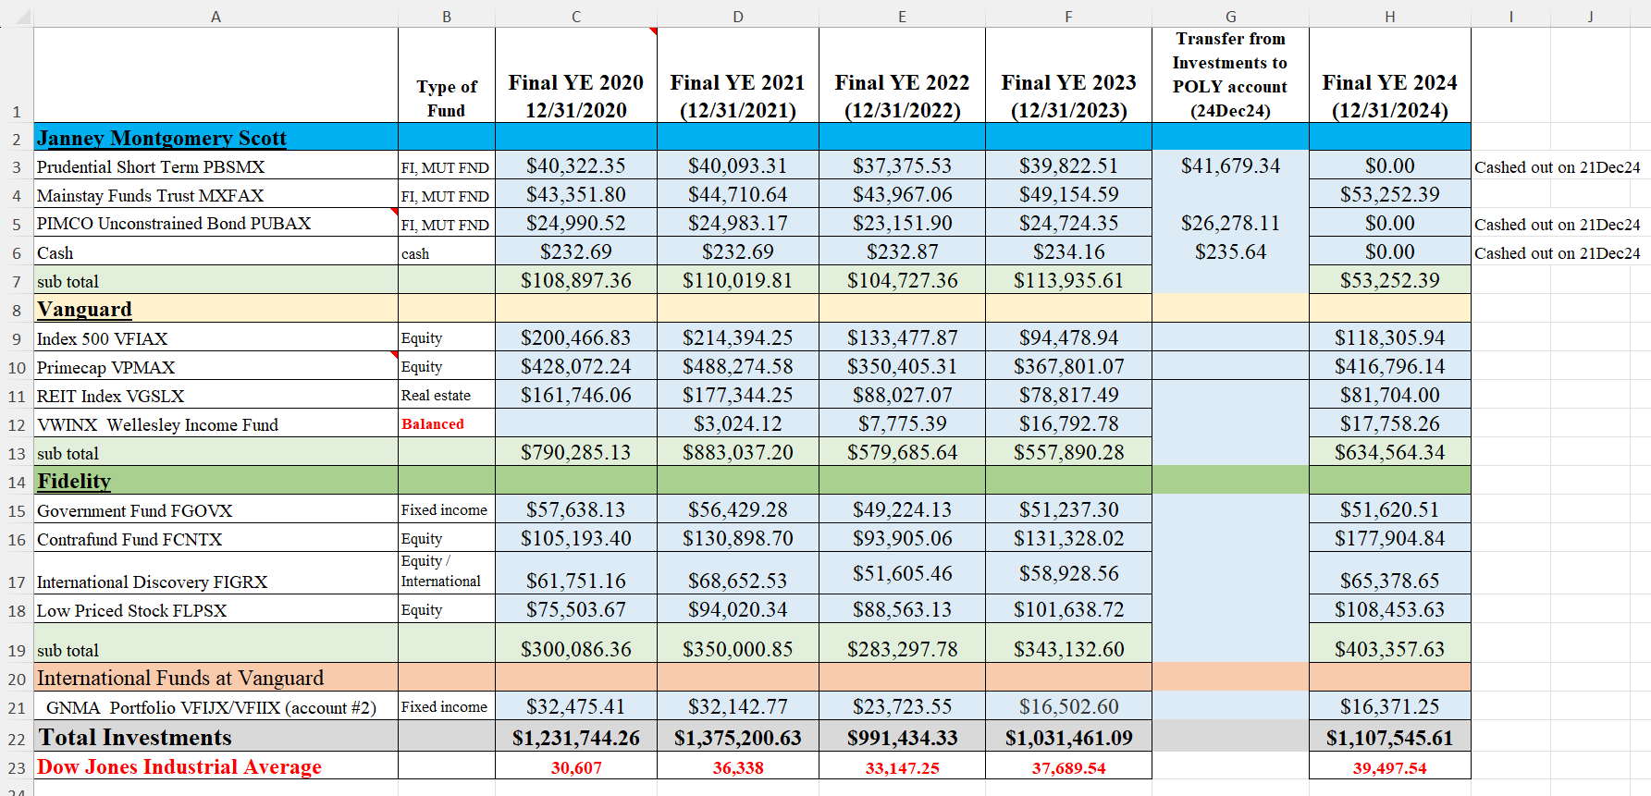
POLY Investment Fund Details
Actions taken in 2024
Moved $500 from Account-2 (international) to Account-1 (POLY) for international committee.
Moved $68,193.12 from Janney (PBSMX, PUBAX, cash) to checking account.

Slide 20
Discussion

Slide 21
Discussion Points
Potential ways to improve our bottom line
ACS meeting expenses, particularly A/V and F&B, are a potential place to continue trimming.
Justin has generated more sponsorship funds for coffee from Tosoh. Thanks, Justin!
Each board meeting lunch costs POLY $7K (F&B costs $90–110/person). We discussed dropping to one in-person board meeting per year. The other could be on zoom
Each programming lunch costs ~$6K. We discussed switching to snacks or coffee.
Each plenary costs ~$9K. Any changes here?
Poster session F&B and set-up/break-down costs are new. Can we reduce them?
New sponsorships
To be discussed by Laura in more detail.
Symposium support
Organizers are more aware of our support and asking for it. Fewer symposia in future meetings will help. Should we trim to $400/session (up to $1200 total)? Some other adjustment?
Other
Pacifichem
In the past, POLY has chosen some symposia to support ($1000/symposium). Do we want to incur this expense again?
International committee
Could this committee prepare an annual budget as most others do?
Anything else?

Slide 22
2025 Budget (see Excel file)

