Slide 1

ACS
DIVISION OF POLYMER CHEMISTRY
Treasurer Report
POLY ExComm Meeting March 2025
Presented by John Matson (Treasurer)
Support from Kathy Mitchem and Carlee Black

Slide 2
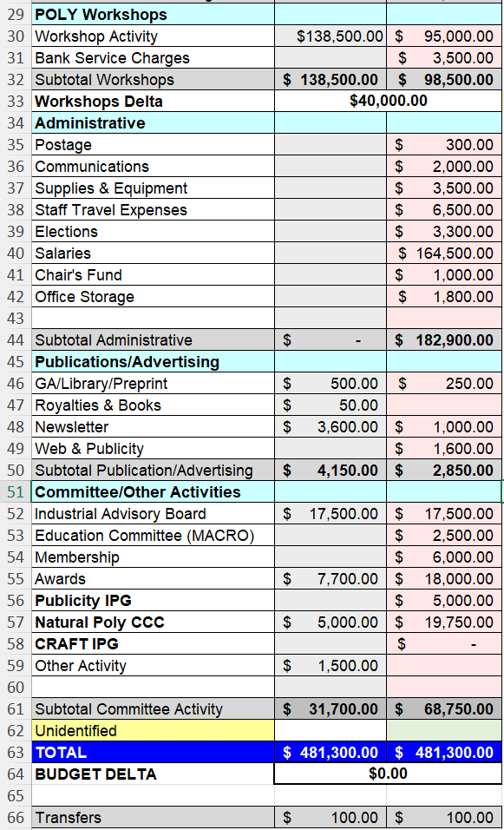
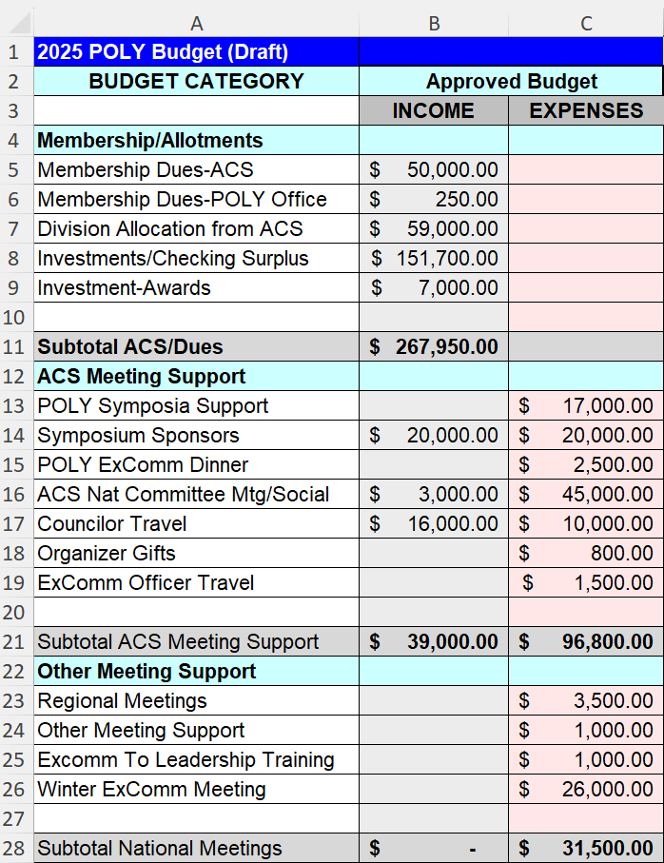
2025 Final Approved Budget
Important points
Investment: We anticipate cashing out $151,700 from investments in 2025. Significant cuts to ACS meeting expenses at Winter ExComm (Jan 2025) reduced this from the original projection of $179,000.
Membership dues: The Feb dues payment was up slightly from 2024 ($27.6K versus $27.2K), an encouraging sign that the decades-long drop may be stabilizing.
ACS Expenses: We reduced F&B spending at both fall and spring ACS business and programming meetings.
Sponsorships committee: An effort to increase sponsorships is underway.

Slide 3
Early Positives and Negatives
Positives
Winter Excomm: The winter ExComm meeting is on budget.
POLY dues: Feb dues payment was up slightly from last year, plus we received a bonus from 2023, bringing us to $28.0K ($27.2k in Feb 2024).
Balances: Our checking account balance is in good shape for now, so we should not have to withdraw money from investments until later this year.
Negatives
Symposium spending: We budgeted $17K for symposium support. We have already committed to $9700 for spring 2025 meeting and $2500 for fall 2025 meeting. We may go a bit over budget here.

Slide 4
Investments status
We will not need to withdraw money from investments until much later this year, so current investment values are not relevant.

