Slide 1

ACS DIVISION OF POLYMER CHEMISTRY Treasurer Report POLY Business Meeting August 2025
Presented by John Matson (Treasurer)
Support from Kathy Mitchem and Carlee Black

Slide 2
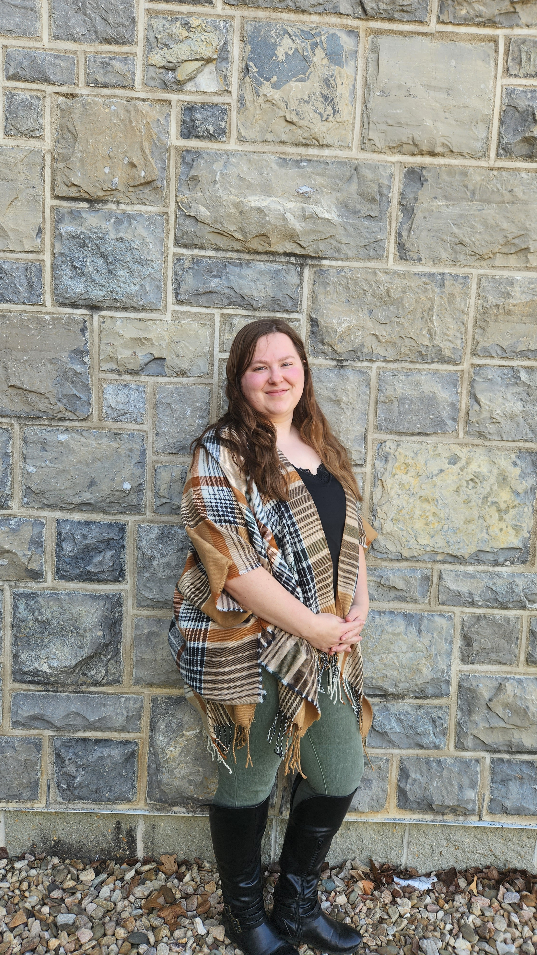
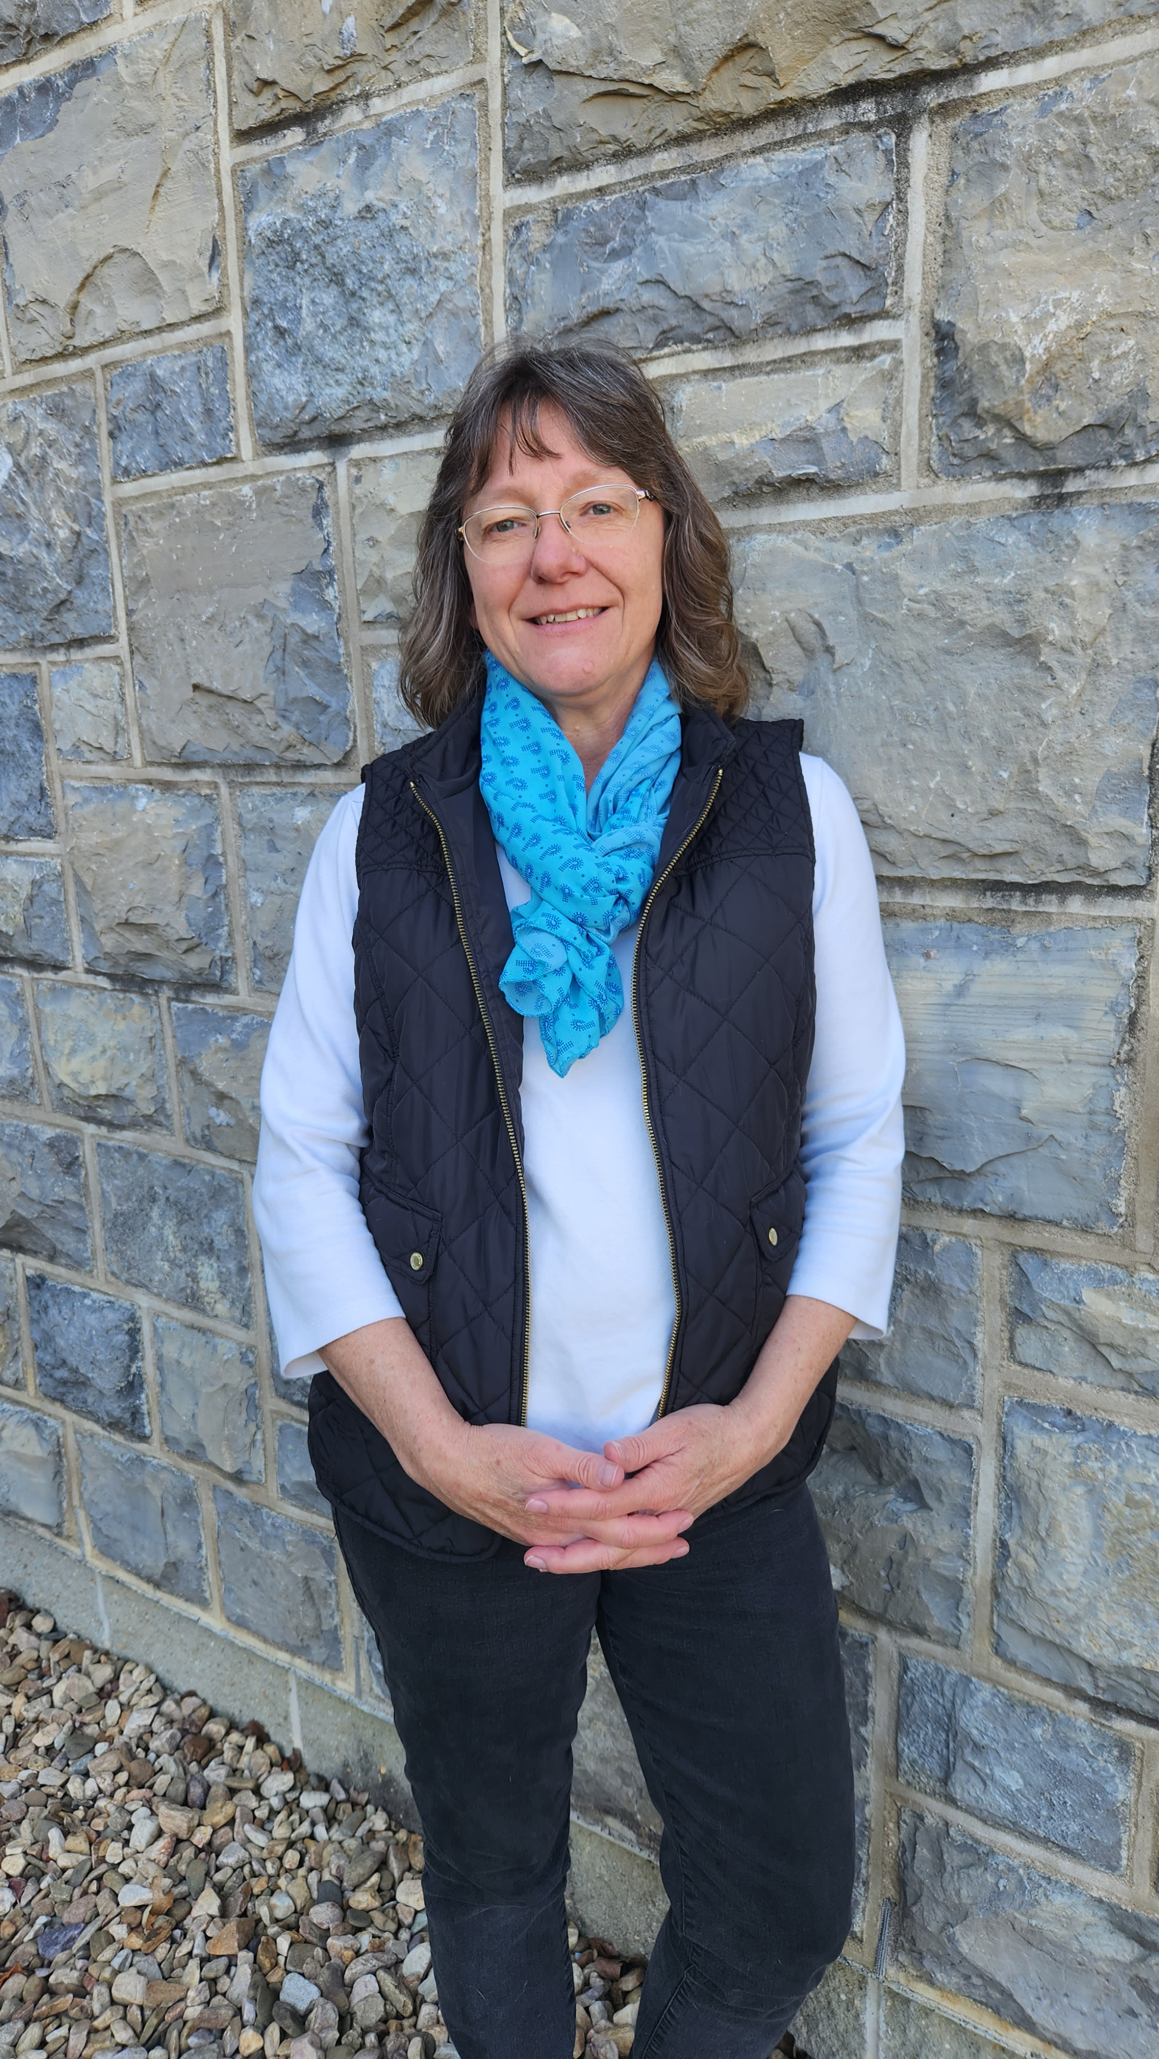
POLY Business Office
Oversite:
*POLY Supervisor– John Matson (Treasurer)
*VT Representative – Bob Moore
Location: Both are currently working from home in Blacksburg, VA, but new offices are coming soon.
Carlee Black
Administrative Assistant Salary 32hrs Week
Membership Support
Workshop/Meeting Prep, Website, etc.
Awards Oversite
POLY Newsletter & Publicity Posts:
Facebook, E-news, ListServe
General Websites Updates
Graphical Abstracts/Preprint
Office Supplies/Orders
Kathy Mitchem
Business Manager
Full Time
Budget Support-Bookkeeping
ExComm Officer Support
Workshops & Event Planning
ACS Meetings Support
Industrial Advisory Board
- & Other Committee Assistance
Election Oversite
VT/Staff/Office Oversite

Slide 3
2025 Approved Budget

Slide 4
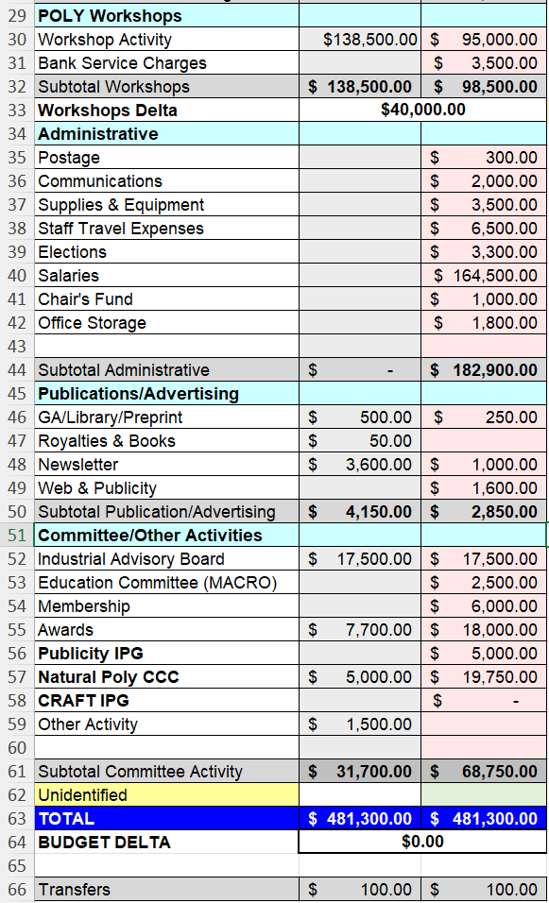
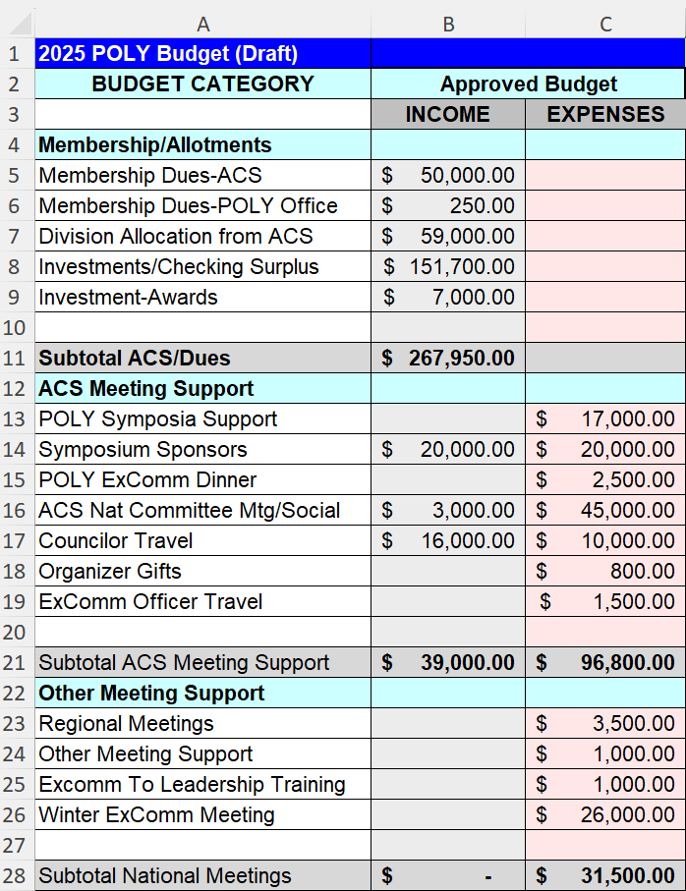
2025 Final Approved Budget
Important points
Investment: We anticipate cashing out $151,700 from investments in 2025. Significant cuts to ACS meeting expenses at Winter ExComm (Jan 2025) reduced this from the original projection of $179,000.
ACS Expenses: We reduced F&B spending at both fall and spring ACS business and programming meetings.
Symposium support: We decided to limited symposium support to $17K.
ExComm dinner: We decided that POLY would pay for the spring ExComm dinner only.

Slide 5
2025 Budget / Actuals (as of July 30, 2025)

Slide 6
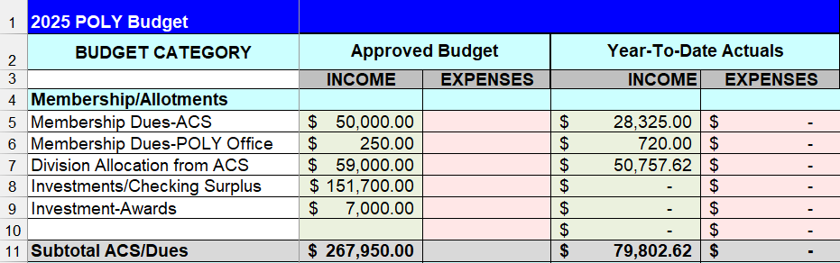
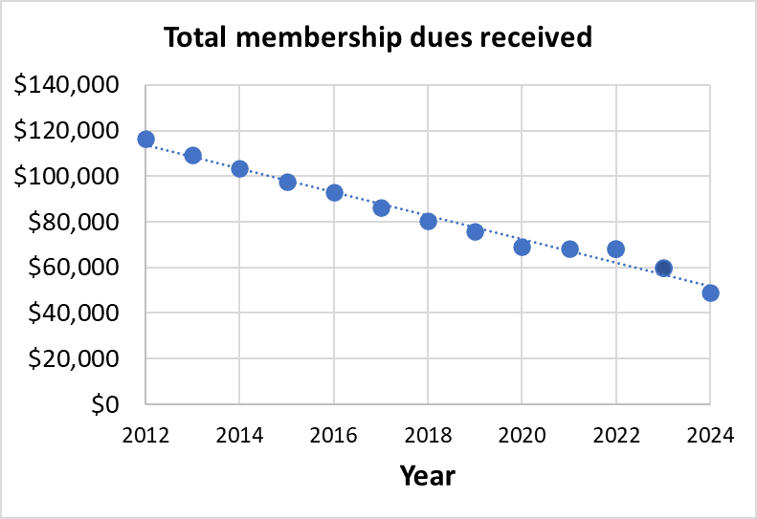
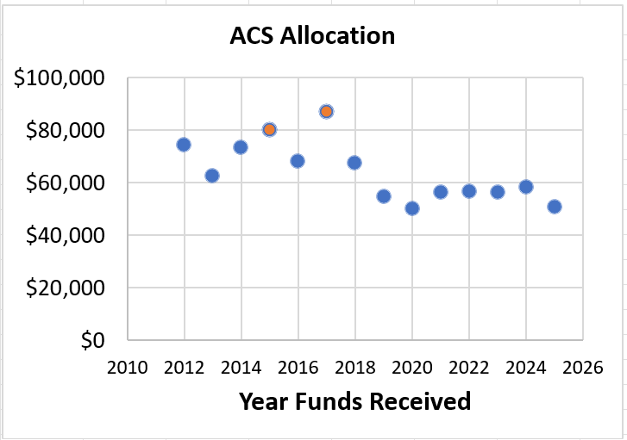
2025 Approved Budget & Activity 1:
Income from dues & ACS
Important points
Membership dues (5): Both dues payments have now come in. The 1st ($28,325) was encouraging. The 2nd ($16,520) was not. We will finish the year at $45K.
Dues to POLY office (6): Carlee added a JOIN button on the workshop registration page.
ACS allocation (7): ACS allocation is $8K less than budgeted.
Summary
ACS dues will be down $5K, and our budgeted division allocation is down $8K from our budget.

Slide 7
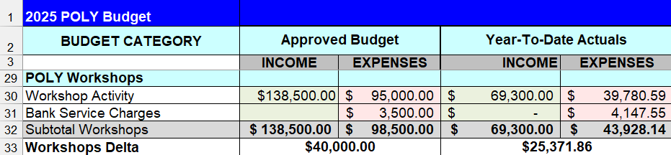

2025 Approved Budget & Activity 2:
Income from workshops
Important points
Fluoropolymers workshop (Jun 2025, Savannah, GA) was a scientific success and financially viable. It had 67 total attendees and netted $4K to POLY. Excellent fundraising made up for a lower than projected number of attendees. Incredible work at a very difficult time!
Fuel Cells workshop is coming up (Nov 2025, Safety Harbor, FL) is up next. Registration deadline is mid-Sep.
Summary
The workshop delta stands at $25K now; we hope to hit our budget projection of $40K.

Slide 8
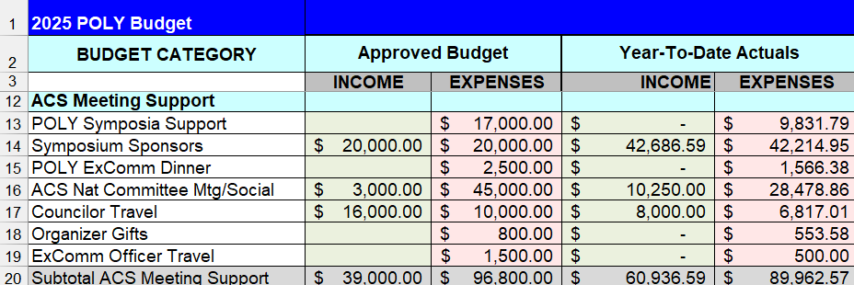
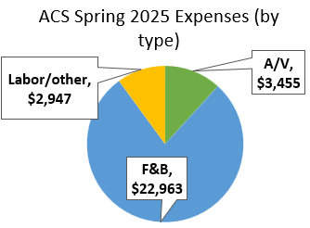
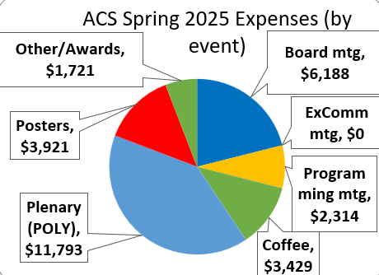
Important points
Symposia support (13): We are on track to be close to our $17K budget.
ACS meeting (16): JAI increased sponsor income (thanks, Justin!). We are on track to be on budget.
ACS meeting (16): POLY/ PMSE were charged $3K for 6 posters at the plenary. Changes coming.
Summary
We are keeping ACS costs down through several recent changes.
2025 Approved Budget & Activity 3:
ACS meeting-related expenses
Notes:
Note that I realized just before presenting that the ACS expenses at each recent was outdated. I need to update that excel file and put it back on this slide for the Jan retreat.

Slide 9
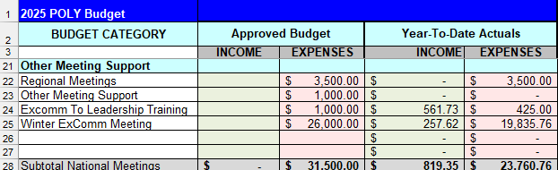
2025 Approved Budget & Activity 4:
Other meetings
Important points
Winter ExComm meeting (25): We are right on budget after factoring in the upcoming deposit for next Winter ExComm ($6K).
Summary
No major unexpected outcomes so far here.
Nice job, everyone, in keeping Winter ExComm expenses on budget.

Slide 10
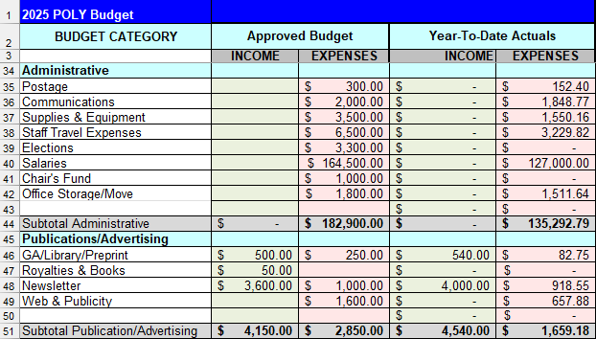
2025 Approved Budget & Activity 5:
Administrative
Important points
Nothing critical
Summary
No major unexpected outcomes so far here.

Slide 11
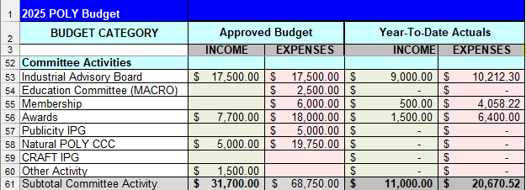
2025 Approved Budget & Activity 6:
Committee Activities
Important points
Awards (58): The majority of awards activity occurs in the fall.
Summary
It would help to have more award sponsors, as always.

Slide 12
2025 Investments Activity

Slide 13
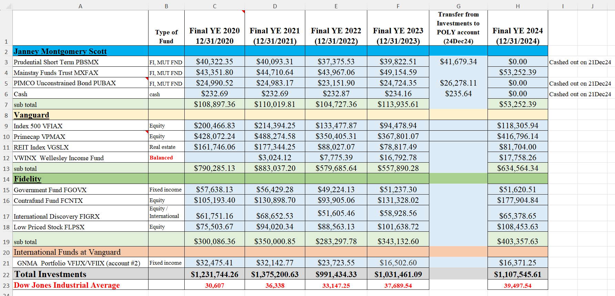
POLY Investment Fund Details
Summary of investments balance through Aug 8, 2025
As of Aug 8, investments were up $99,237 (9.0%) since Jan. 1, 2025. The market has been very good for POLY so far.
We withdrew $30K on Aug 11, 2025.
Budget deviations may even out near year’s end, so I anticipate withdrawing close to the projected $152K total (~$120K remaining) later this year.

Slide 14
2025 Sponsorship Support

Slide 15
Sponsorship Support
Newsletter Advertising | 1/8 pg $20 up to Full pg $2,000 | Semi-Annually
E-news with Web Link | $500 | Annually
Mark Scholar Awards (3 awards) | $4,500 | Bi-Annually
Plenary Speaker | $1,500 | Annually ($600x2 annually)
Major Awards: Each: Marvel, Flory, Mark, IPS | $3,500 each (prize & travel) | Bi-Annually
Student Social | $1,000-$3,000 | Semi-Annually
Cookie/Snack Break Sponsor | $1,500 per ACS Mtg | Semi-Annually
General Division Sponsorship
Sponsors In Place for 2025
Coffee Break Sponsor | $3,250 total for the year | TOSOH
Poster Awards | $750 per ACS meeting | Springer
General Papers | $600 per ACS meeting | Polymer Chemistry
Poster Session Food and Beverage | $3,000 per ACS meeting | JAI

