Slide 1
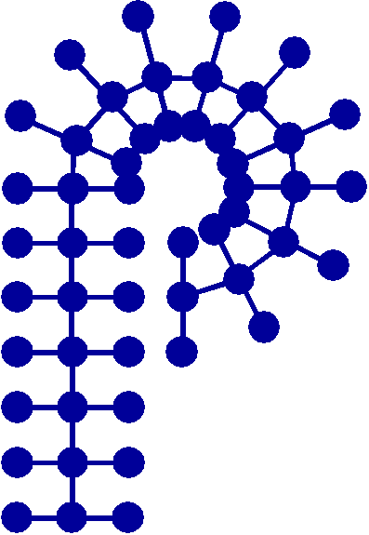
Publicity/Communications Team
Current Chair: Tayler Hebner (Purdue University)
Members:
Coralie Backlund (Novo Nordisk Foundation)
Kaden Stevens (University of Florida)
Jeff Ting (Nanite)
We are actively looking for new members of our team – please reach out if you have anyone in mind that may be interested in getting more involved in POLY!
American Chemical Society Division of Polymer Chemistry

Slide 2

Social Media Growth 2020-2024
Date | Twitter | Facebook | LinkedIn
Dec. 2020 | 3,527 | 2,532 | 1,106
Dec. 2021 | 4,091 | 2,535 | 1,107
Dec. 2022 | 4,550 | 2,584 | 1,155
Dec. 2023 | 4,979 | 2,642 | 1,219
Dec. 2024 | 5,228 | 2,647 | 1,458
Administered mainly by Business Office/Jeff
Facebook has leveled off
Twitter continues to grow
LinkedIn is growing, now the group is open
New addition: POLY BlueSky account
American Chemical Society Division of Polymer Chemistry

Slide 3
Newsletter/E-News Advertisers
General Info.
Drafting process begins a week post ACS mtgs.
Posted before July & November 1 per POLY bylaws
Posted online (interactive newsletter) at https://www.polyacs.net/newsletter
Article suggestions/improvements?
Estimated 2025 Expense
Expense: $1,000
​Estimated 2025 Advertising
Tosoh Bioscience $3,000
Cancelled Advertisers
American Polymer Stand. Corp. $480
Polyhedron Laboratories, Inc. $480
HMJ $1,000
Specific Polymers $800
Malvern Instruments $4,200
Polymaterials $480
Scientific Polymer Prod., Inc $480
Polymer Char $1,920
Wyatt Technology Corp. $3,600
DTCS $1,600
Sigma-Aldrich $3,700
Taylor & Francis $960
Article Deadlines are Important
American Chemical Society Division of Polymer Chemistry

Slide 4
Website/Communications Strategy Update
2024 goal achieved – all content migrated to polyacs.org (no more .net site)
Current project: communications strategy analysis/revamp
  TPG grant used to hire web design/communications specialist (Joann Young)
Goals:
Create a communications strategy that will allow for effective communication of POLY’s
value proposition on the website, Facebook, LinkedIn, X/Twitter, and YouTube pages
Develop more active interactions between POLY members on social media platforms
Create an online community of engaged members, nationally and internationally
Develop a template strategy for when and what to post on which platform to spur the
highest level of interactions between members
Demonstrate the value of ACS and POLY membership
Provide updated curated POLY content for the best user experience
Retain and increase membership
American Chemical Society Division of Polymer Chemistry

Slide 5
Website/Communications Strategy Update
  Timeline (goal of completion within ~ 12 months):
  Phase I: Research & Discovery (includes surveying current membership, and data gathering and analysis)
  Phase II: Creating a Communications Strategy Based on Data (includes report and
  presentation)
  Phase III: Implementation
  Phase IV: Final Assessment and Adjustment
  Current task: survey current membership
  We will be sending out a survey to active members
    Any suggestions for particular groups to be included?
    Want to capture broad range of grad students, postdocs, faculty, industry, government, etc
    Request: when we send you the survey, please fill it out yourself and send it to your research group + 5 other personal contacts asking them to complete it
American Chemical Society Division of Polymer Chemistry

