Slide 1
2025 Winter ExComm Meeting
WELCOME
Presentations and Meeting Information:
https://www.polyacs.net/polywinterexec
Please send your ppts to …
Carlee Black: CARLEEL@VT.EDU
Voting Members = Elected Officers
Chair, Vice-Chair, Chair-Elect, Past Chair,
Treasurer, Secretary, Membership-At-Large,
and 4 Councilors
(not Alternate Councilors or Committee Officers or Special Guests)

Slide 2
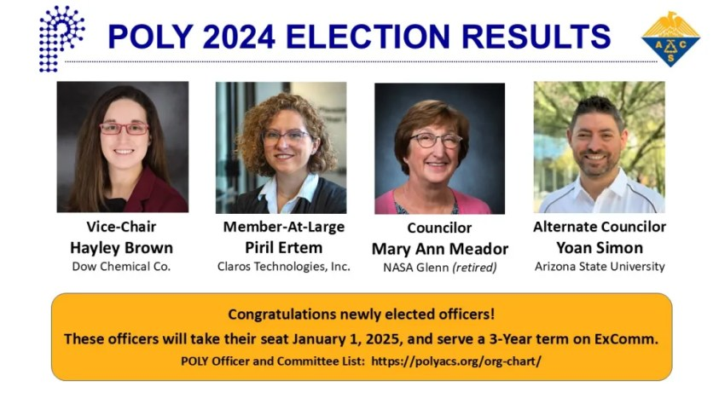

Slide 3
POLY Organizational Chart
IAB
Workshops
Awards
International
ACS Programming
Regional Mtg
CHAIR-ELECT
VICE-CHAIR
Membership Publicity
Web/News/Media
Business Office
SECRETARY
TREASURER
CHAIR
Investment
MEMBER-AT-LARGE
PAST-PAST-CHAIR
Student Chapters
Fellows/Awards Promotion
Membership Comm
Councilors
PAST-CHAIR
Nomenclature
Alternate Councilors
Bylaws & Operations
Education
CHAIR: The duties of the Chair are to preside at meetings of the Executive Committee and at business meetings of the Division; to carry out the policies of the membership and of the Executive Committee; and to appoint committees of the Division
All positions with red boxes are Voting ExComm Officers. Elected officers serve 3 years and can run 2 terms (if re-elected)

Slide 4
Agenda – Friday Evening
5:30 PM | Complimentary Happy Hour in Hotel Lobby
5:30 | Mingle and catch up with everyone in Hotel Lobby while you enjoy your complimentary happy hour
6:00 p.m. | Welcome Highlight any changes to the agenda Any additional updates or updates | Laura Stratton
6:15 | Mental Health in the Sciences (draft title) with Erin Kent, LSSW | Erin Kent
 | Open conversation will follow
 | Dinner on your own

Slide 5
Agenda – Saturday Morning
7:00 am | Free made-to-order breakfast provided by the hotel in foyer
8:00 | Welcome -Around the Room Intro -Voting Body -Minutes Review(Justin Kennemur) | Laura Stratton
8:15 | Councilor’s Reports | Brian Long Mary Ann Meador Greg Tew Kathryn Uhrich
8:30 | Secretary’s report (Justin Kennemur) -Publicity / Website / Strat Update -ACS/POLY Non-Technical Meetings – Other: What’s required, what we’re doing, what will change | Tayler Hebner Justin Kennemur
9:30 | Chair Elect (Derek Patton) -IAB (10 minutes) -Awards & New Rubrics (10 minutes) -ACS Programming (20 minutes) | Jeff Ting Toby Nelson Danniebelle Haas
10:10 | Break

Slide 6
Agenda – Saturday Afternoon
10:25 | Treasurer’s Report and Budget Outlook | John Matson
11:25 | Sponsorship and Support Committee | Justin Kennemur/ Laura Stratton
12:00 | Break / Working Lunch (Order from menu and delivered to room)
12:10 | Nominations: -POLY Fellows -ACS Fellows Nominations/Nominator -Distinguished Service Awards | Laura Stratton
12:50 | Election Slate Matrix | Allan Guymon/ Dawanne Poree
1:00 - | Break (if needed)
6:15 p.m. | Meet to share rides to dinner … - 7:00 p.m. Dinner at Blanco Borgata

Slide 7
Agenda – Sunday Afternoon
7:00 am | Free made-to-order breakfast provided by the hotel in foyer
8:00 am | Welcome and Updates
8:15 | Vice Chair (Hayley Brown) -Workshop Recap & Vote on APO Proposal -International Committee -Regional Meetings | Hayley Brown
8:45 | Other topics requiring discussion prior to budget
9:15 | Final Budget Approval | John Matson
9:45 | Break
10:00 | Strategic Plan Reports | Allan Guymon And others

Slide 8
REMINDER: Distinguished & Special Service Awards
Distinguished Service
NOMINATION PROCEDURE
ABOVE AND BEYOND SERVICE
Submit recommendation letter to: POLY Chair
Deadline: 1/31/25
Nominations from: POLY Executive Committee Only
Selected by: Chair
No limit per year, but not always given.
P. Arjunan
F. E. Bailey
W. J. Bailey
T. Baughman
K. Beers
F. Blum
W. Brittain
H. Brown
N. L. Byerly
C. Carraher
K. Carter
K. Cavicchi
H. N. Cheng
B. Culbertson
F. Dammont
W. H. Daly
J. Droske
E. M. Fettes
W. Ford
D. Garcia
W. E. Gibbs
J. Hampton
P. M. Hergenrother
Marc Hillmyer
J.C. H. Hwa
S. Iacono
R. M. Ikeda
S. C. Israel
K. Kiick
J. Lal
C. Coltrain
J. Linhardt
L. Linkous-Pristas
C. S. Marvel
K. Matyjaszewski
F. R. Mayo
J. Mays
M. Meador
W. V. Metanomski
J. E. McGrath
K. Mitchem
R. B. Moore
R. S. Moore
S. Morgan
S. Orski
C. G. Overberger
T. J. Pacansky
E. M. Pearce
J. Pochan
J. Riffle
B. Rattner
A. B. Salamone
J. C. Salamone
U. Schubert
W. Stockmayer
R. F. Storey
G. Tew
B. H. Ullyot
E. J. Vandenberg
S. R. Venumbaka
J. Vogl
O. Vogl
F. H. Winslow
Special Service
F. Blum
N. Byerly
H.N. Cheng (x2)
C. Coltrain
B.M. Culbertson
W.H. Daly
F.R. Dammont
S. Iacono
J.E. McGrath
K. Mitchem
E.M. Pearce
J. Pochan
A. Salamone
E.J. Vandenberg

Slide 9

ACS Fellows Award
WHO?
Name, Nominator
Name, Nominator
Name, Nominator
Name, Nominator
Name, Nominator
Name, Nominator
Name, Nominator
Name, Nominator
ACS Fellows Website: https://www.acs.org/funding/awards/acs-fellows.html
The number of nominations submitted by each Division may not exceed twice the number of Councilors from the Division. (8)
Documented excellence and leadership that has an impact in the science, the profession, education, and/or management.
(2) Documented excellence and leadership in volunteer service, based on specific results achieved, in service to the ACS and its membership and community.
Nominations for the 2024 Class of Fellows will be open from February 1 to April 1, 2024.

Slide 10


POLY Fellows Award
Review Committee
Past Chairs: Allan, Semra, Andrea
Eligibility: A nominee must be a member of the POLY division of ACS. Consideration will be given for contributions of scientific accomplishments or service to the profession, or both. The number of new POLY Fellows selected each year will equal 0.1% of the current POLY membership or be no less than 4. Selection will be based on
Achievements: typically demonstrated by the impact of successful accomplishments
Contributions: typically demonstrated by enabling or causing a successful accomplishment
Polymer science: impact on basic and applied research, technology development, and engineering
Profession: impact on education, public policy, technical management, and leadership in professional organizations
Substantial service to POLY may also be used for the selection of worthy candidates.
Of note, all recipients of the Herman F. Mark Award, Paul J. Flory Award, Carl S. Marvel Award, Industrial Polymer Science Award, and Distinguished Service Award will be inducted as fellows.
Selected:
Timothy White, University of Colorado
Andrea Kasko, UCLA
Brent Sumerlin, University of Florida
Jeffrey Youngblood, Purdue University
Inducted:
(2024 Awardees)
Carl L. Willis (IPS) and the Sara Orski (DA)
To Be Presented - Spring ACS
Next Award Deadline - November 30, 2025
American Chemical Society Division of Polymer Chemistry

