Slide 1

Secretary Report – Justin Kennemur
LAST
APPROVAL OF MINUTES
SPRING 2025 BOARD MEETING
(circulated to polyorgchart email on August 8th)
American Chemical Society Division of Polymer Chemistry

Slide 2
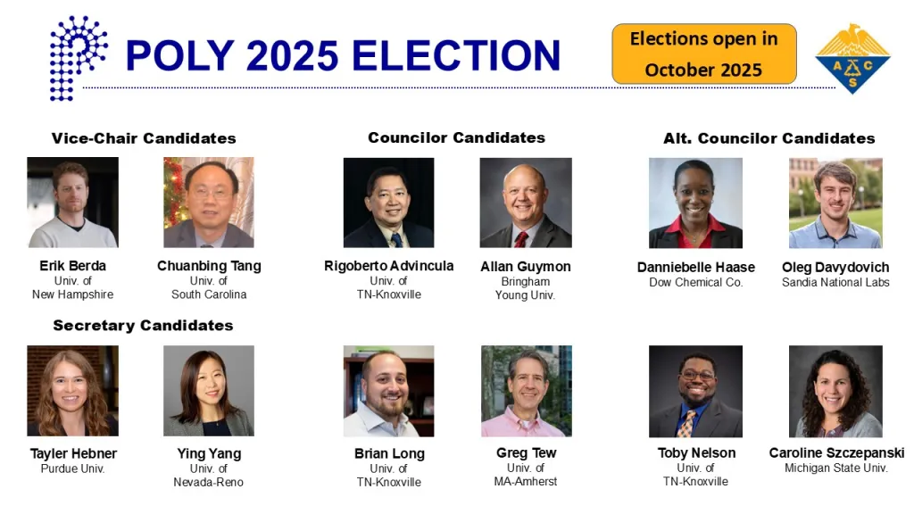
Call for additional nominations?
POLY Bylaws Sec. 2.
At any time before the adjournment of the annual business meeting, additional candidates may be nominated by written petition, each signed by at least ten Division members and transmitted to the Secretary of the Division. Each petition must be accompanied by a written statement by each nominee agreeing to serve if elected, by a brief biography of each nominee, and if supplied, a statement from the nominee to accompany the election ballot. The Secretary shall determine the eligibility of said petition candidates.
American Chemical Society Division of Polymer Chemistry

Slide 3
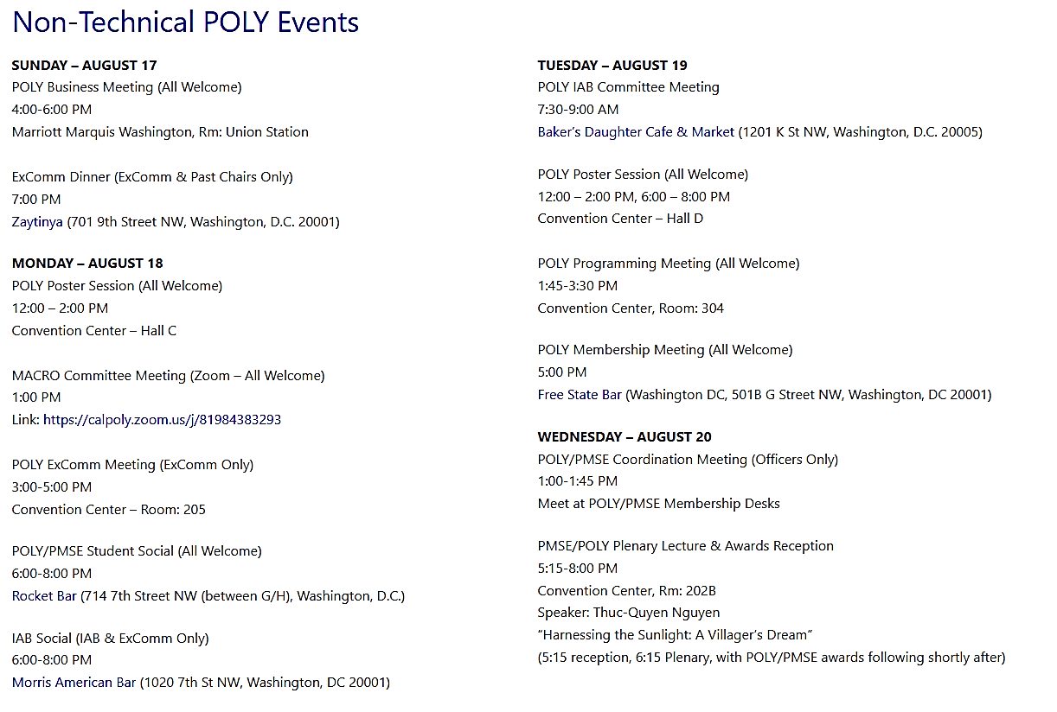
All of this is found on the POLY Website under National Meetings polyacs.org
MEETING AT A GLANCE: POLY Non Technical Events
Also COFFEE: served M, Tu, W at 9:30 at membership desk
American Chemical Society Division of Polymer Chemistry

Slide 4
Volunteers Needed
I have to leave Tuesday PM
Looking for volunteers to hand out drink tickets at the Plenary.
American Chemical Society Division of Polymer Chemistry

Slide 5
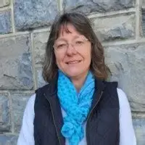
THANK YOU!!!
COMING SOON: POLY Secretary SOP
It’s been a pleasure serving as Secretary with you all.
Not goodbye…..See you later.
Can’t thank you enough Kathy for all the help!!!
American Chemical Society Division of Polymer Chemistry

