Slide 1

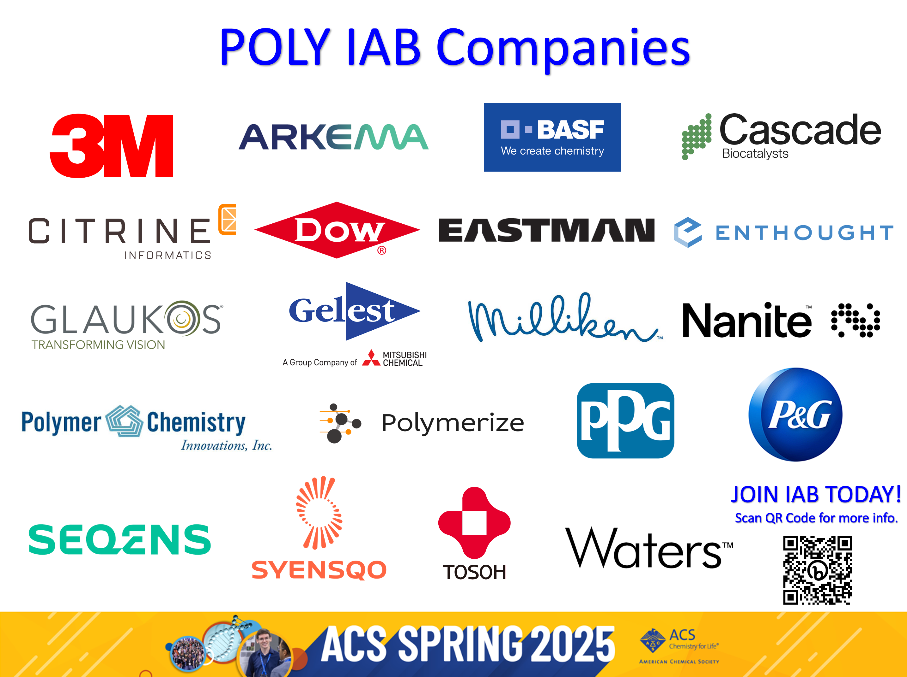
POLY Industrial Advisory Board
Annual dues: $1,500
Small company dues: $500
Chair: Jeff Ting (Nanite)
Co-Chair: Mike Sims (Syensqo)

Slide 2

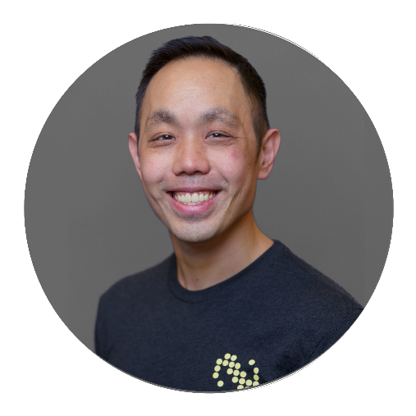
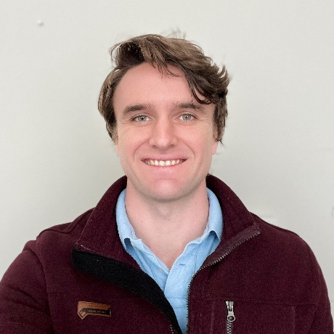
IAB Mission & Officers 2025
Chair: Jeff Ting (Nanite)
Co-Chair: Mike Sims (Syensqo)
Networking
  Monday networking hour
  Tuesday morning breakfast
Finance & Reporting
  IAB business meetings
Bulletin
Succession Planning
Industrial Awards (IPS & YIPS) Support
  POLY Awards Subcommittee Member
New Initiatives
Membership & Retainment
Programming
  Industrial Innovation in Polymer Science (IIPS)
  Other industrial programming
“Enhance and foster industrial engagement and support to develop programming, education, recognition & awards within the ACS Division of Polymer Chemistry.”

Slide 3
IAB Focuses for 2025
Maintain programming & awards support
Deliver on member company initiatives
  IAB Networking Sessions
  IAB Meetings
Integrate smaller company members
Understanding value POLY and IAB provide in long-term hybrid environment
Balance with business office changes

Slide 4
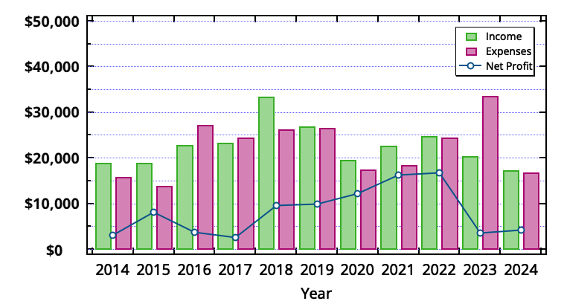
IAB Budget Overview

Slide 5
2024 IAB Budget Summary
 | Final 2024 | Proposed 2025
Income | $17,475 | $20,500
Expenses
Networking | $7522.04 | $7000.00
Meetings | $3116.67 | $5100.00
Awards | $3000.00 | $5500.00
Programming (no virtual) | $3250.00 | $1000.00
Other (shirts, pins) | $0 | $0
subtotal | $16,888.71 | $18,600.00
Bal | $586.29 | $1900.00

Slide 6


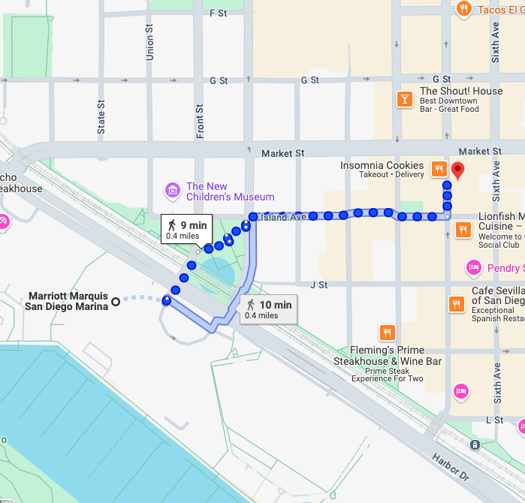
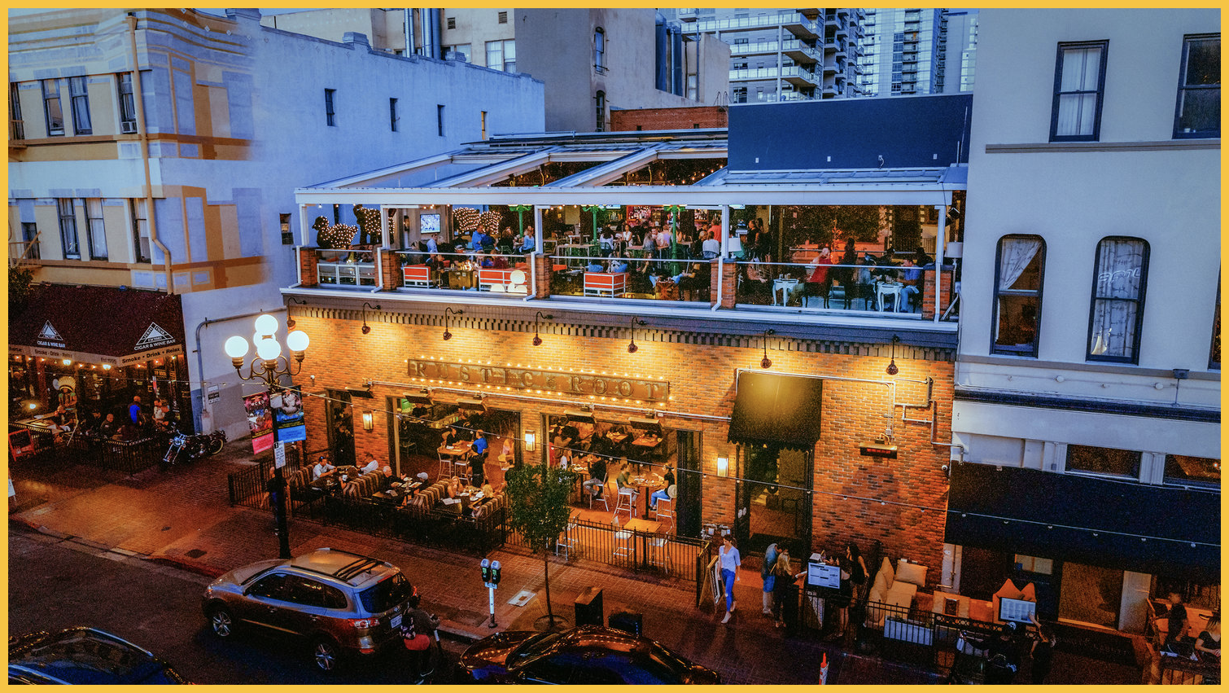

Spring 2025 Programming and Networking
Industrial Innovations in Polymer Science (IIPS) Symposium
Organizers: Michael Liu, Laura Macdougall, Jie Wu
Monday, March 24th - AM & PM Sessions
Pacific Ballroom, Section 18
IAB Networking Reception
Monday, March 24th, 6:00-9:00 pm
Rustic Root Rooftop
535 Fifth Ave, San Diego, CA 92101
IAB Members, POLY ExCom Officers, and potential Industrial representatives welcome
Industrial Advisory Board Meeting
Tuesday, March 25th (continental breakfast), 7:30 am
Rancho Santa Fe 1-2, San Diego, CA
IAB Member Company Representatives, POLY ExCom Officers Only

Slide 7

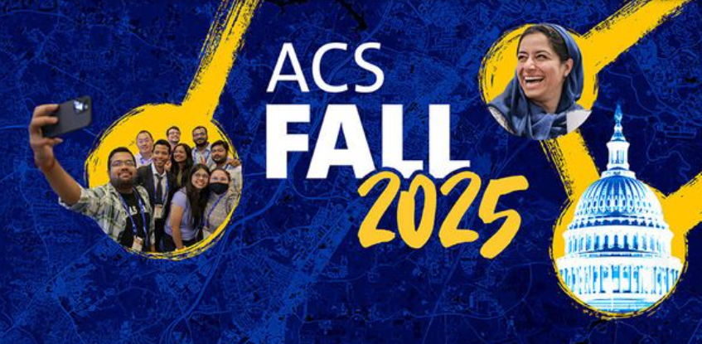


Fall 2025 Programming and Networking
Industrial Innovations in Polymer Science symposium
Organizers: Michael Petr, Rohini Gupta, Manesh Sekharan
Washington, DC
Young Industrial Polymer Scientist Award
Organizer: Shashi K. Murthy
Washington, DC
Next Generation Materials Discovery and Production
Organizer: Mike Sims
IAB Networking Reception
TBD
IAB Members, POLY ExCom Officers, and potential Industrial representatives welcome
Industrial Advisory Board Meeting
TBD
IAB Member Company Representatives, POLY ExCom Officers Only

Slide 8

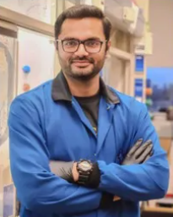
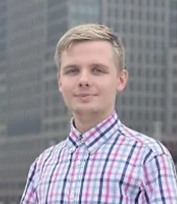
2025 POLY
Graduate Student Travel Award
Muhammad Arslan
University of Houston
Bohdan Domnich
North Dakota State University
To provide funding for graduate students studying polymer science at
US institutions to travel to national ACS meetings and present their results

Slide 9

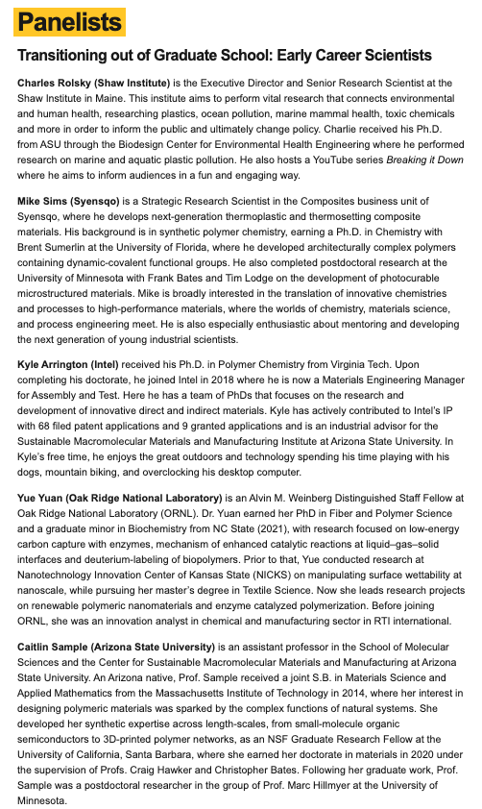

IAB Sponsored Meeting
POLY Biannual - NGRPC
National Graduate Research Polymer Conference

Slide 10
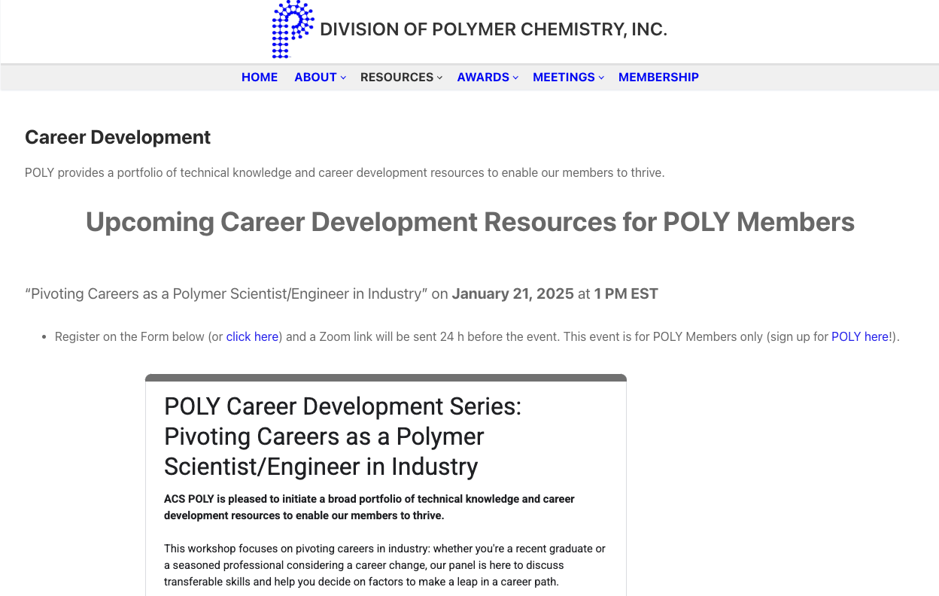
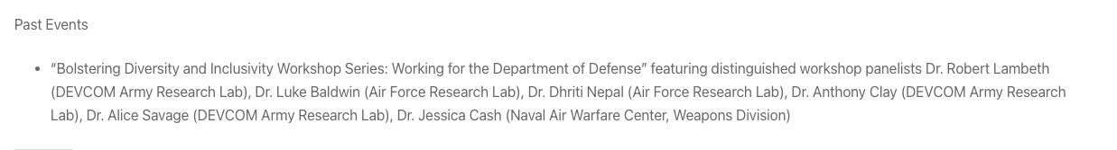
New Initiatives in 2025

Slide 11
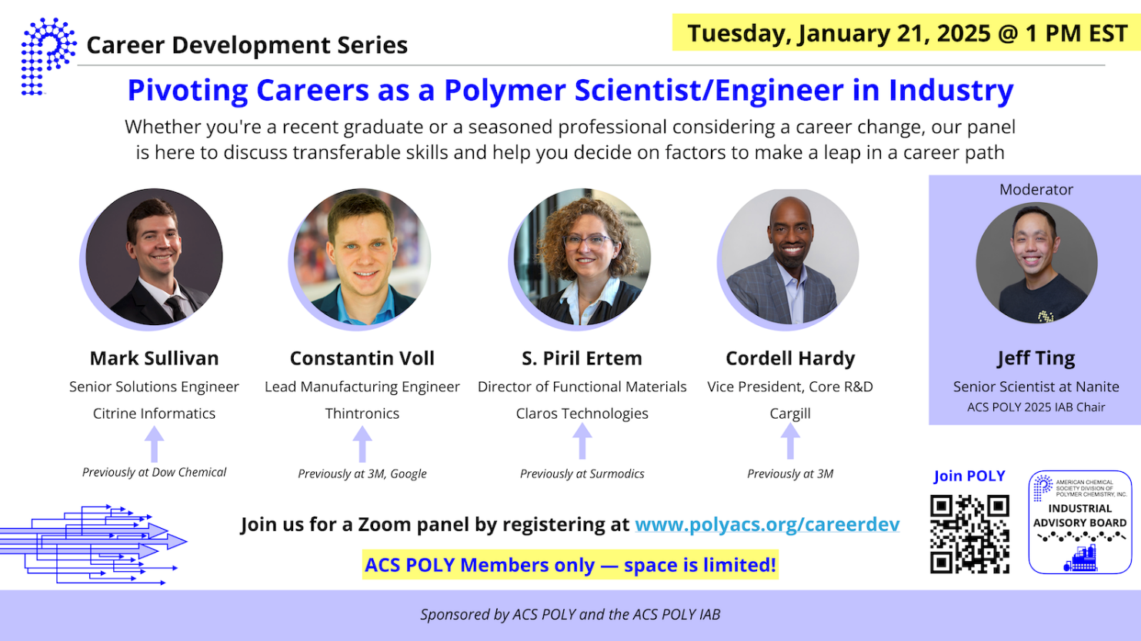
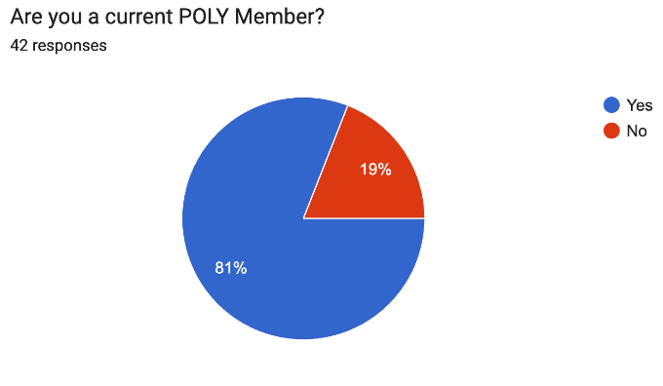
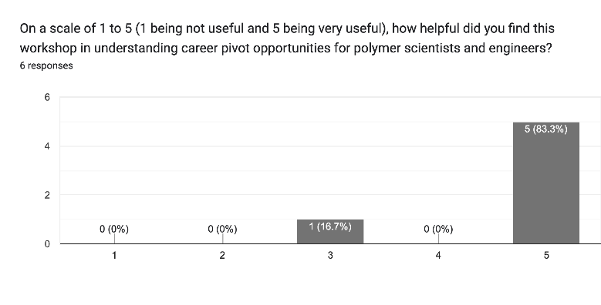
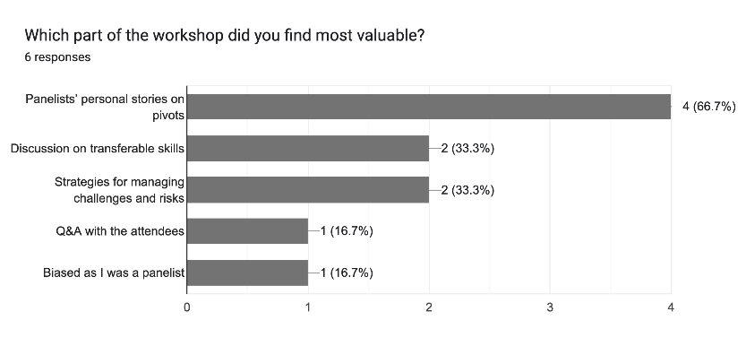
New Initiatives in 2025
40 Sign-Up Responses
20 Attendees on Zoom
Topics Covered
Exploring Career Options and Understanding the Pivot
Identifying Transferable Skills
Managing Challenges and Risks

Slide 12
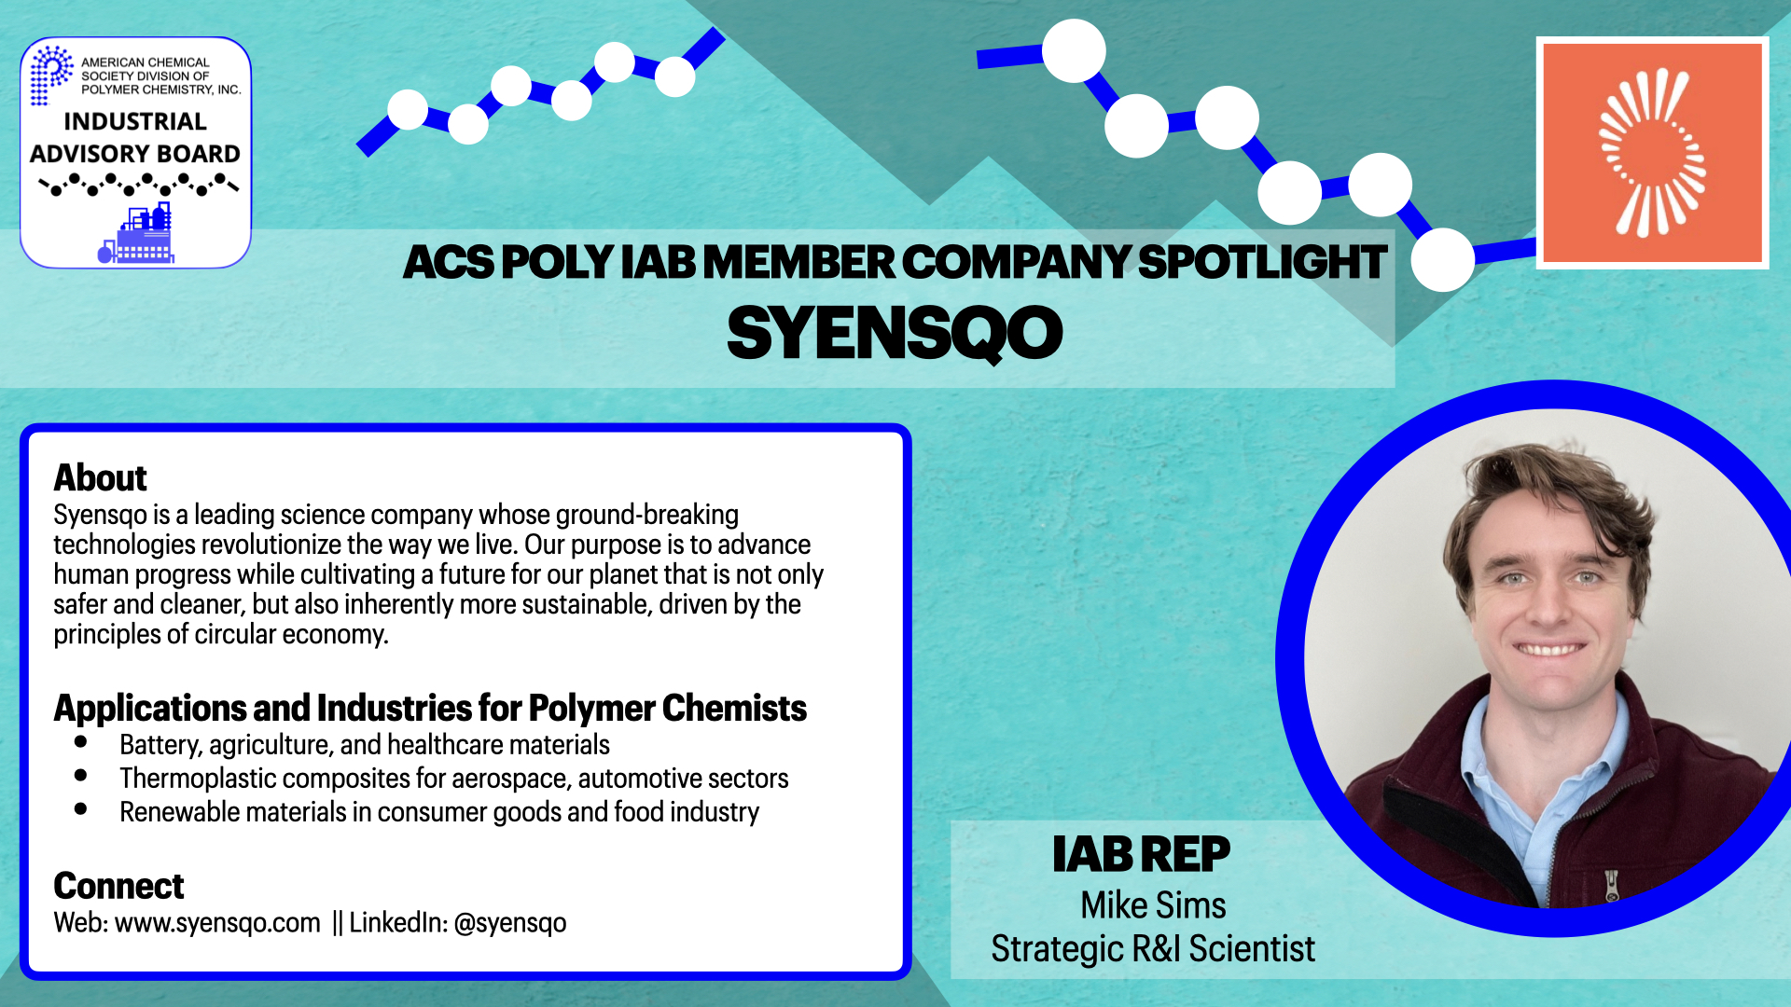
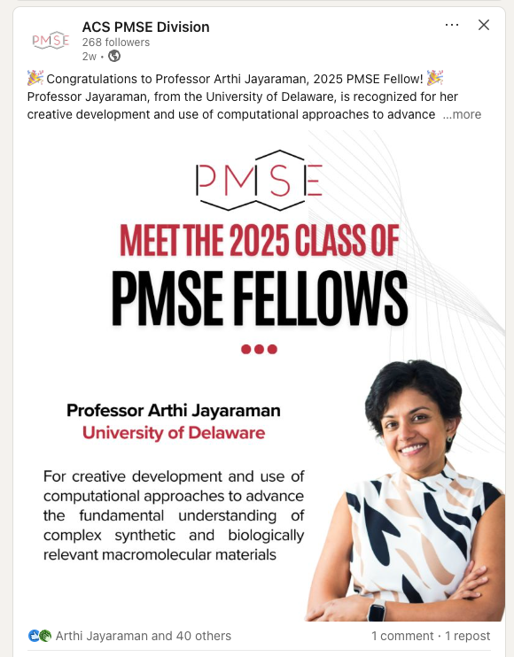
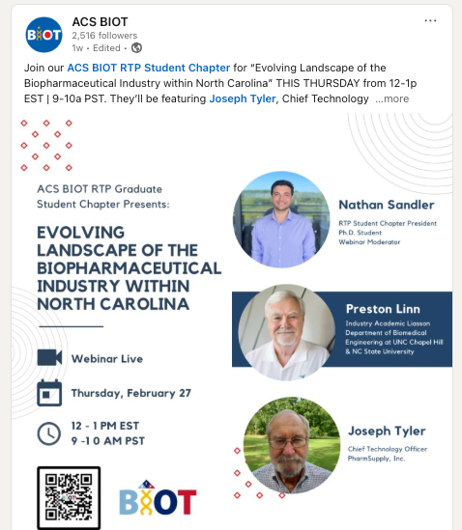
Publicity Initiative: IAB Members Spotlight
Example: Highlights company, applications/industries, and IAB representative for sharing with Network
Inspiration

Slide 13
Future ideas
Expand virtual panel topics
  How to get your first industry job
  Career progression in industry
  Basics of IP/patents
Workshops at ACS meetings
  Resume building
  Interviewing/soft skills
IAB Company Posters
  Showcase at ACS POLY sessions?

Slide 14
Thank you
Industrial Advisory Board

