Slide 1

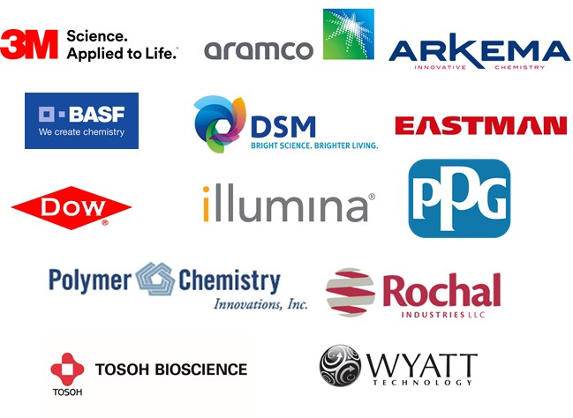
POLY Industrial Advisory Board
Annual dues: $1,500
Chair: Corinne Lipscomb (3M)
Vice Chair: Peter Boul (Aramco)

Slide 2
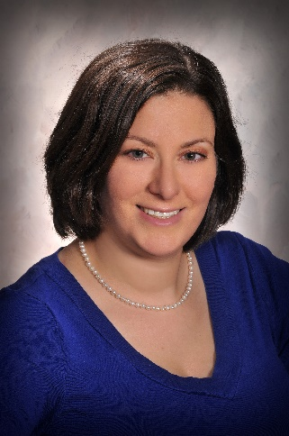
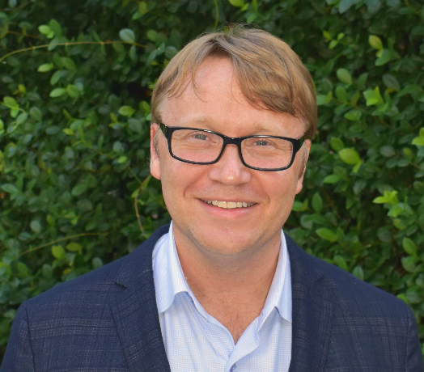
IAB Mission & Officers 2019
“Enhance and foster industrial engagement and support to develop programming, education, recognition & awards within the ACS Division of Polymer Chemistry.”
Chair: Corinne Lipscomb
(3M Company)
Vice: Peter Boul
(Aramco)
IPS & YIPS Support
Networking
Finance & Reporting
Bulletin
New Initiatives
Programming
Succession Planning
Membership
Grants & External Funding

Slide 3
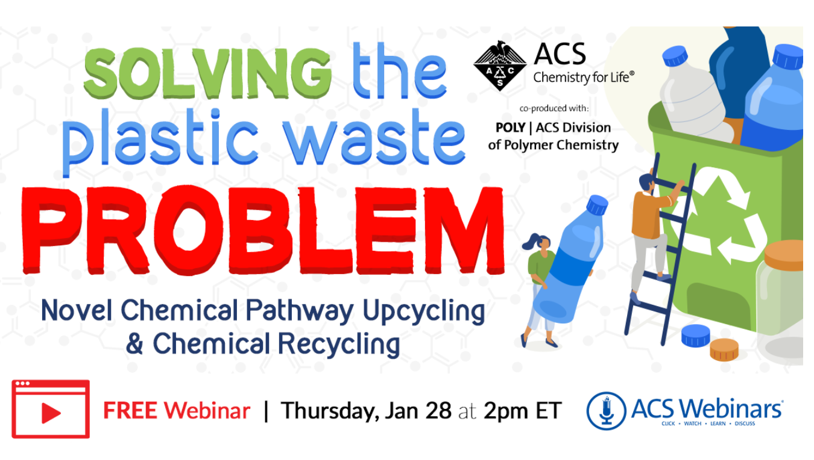
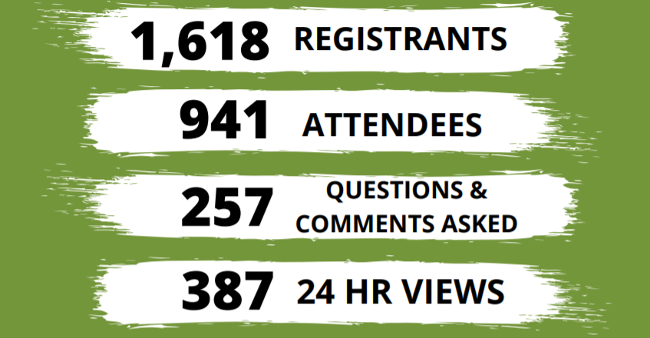
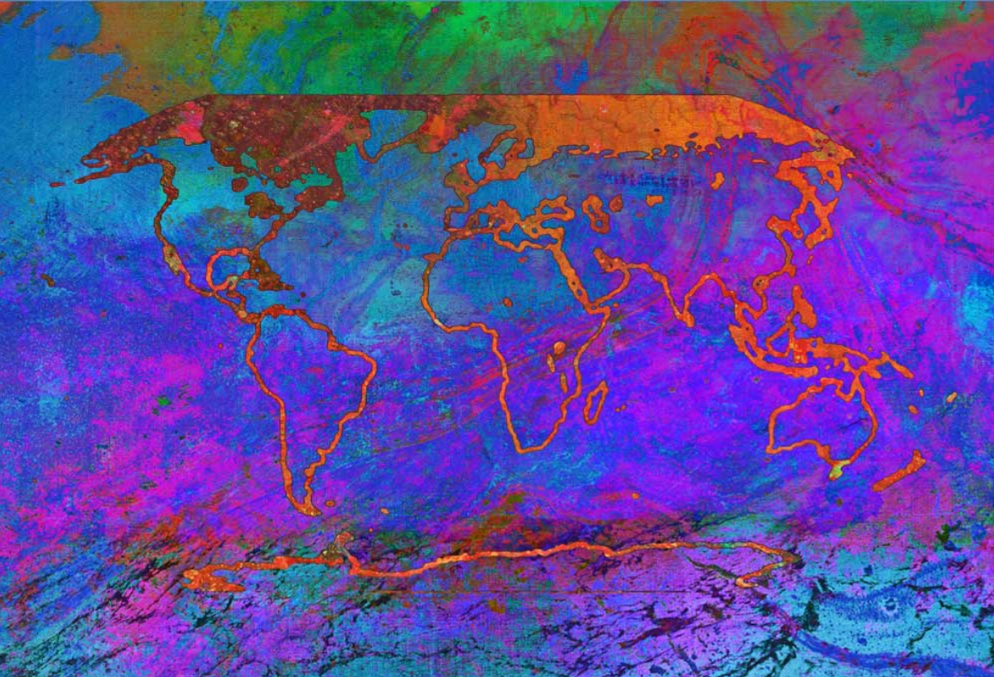
2021 – IAB Virtual Events, ACS Webinars
Speakers
Philippe Reutenauer (LEA NATURE)
Katrina Knauer (Biocellection)
Moderator
Peter Boul (Aramco)
At least 100 industrial attendees
Fall Webinar – Polymers and Nanomaterials for Reduced Emissions
October 21, 2021
Speakers
Emily Pentzer, Texas A&M University
Ajayan Vinu, University of Newcastle
Moderators
Laura Stratton, Polymer Chemistry Innovations, Inc.
Peter Boul, Aramco

Slide 4
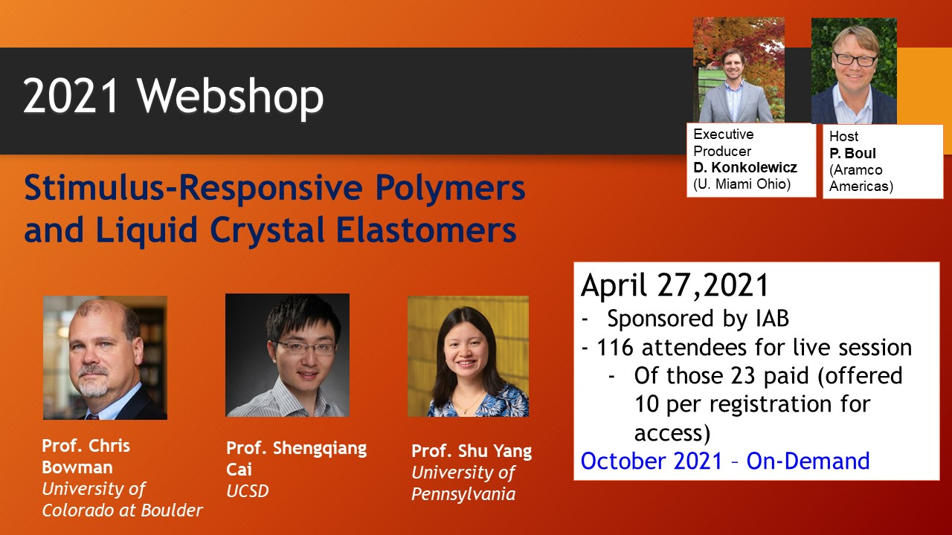
2021 – IAB Virtual Events, POLY Webshops
At least 37 industrial attendees

Slide 5
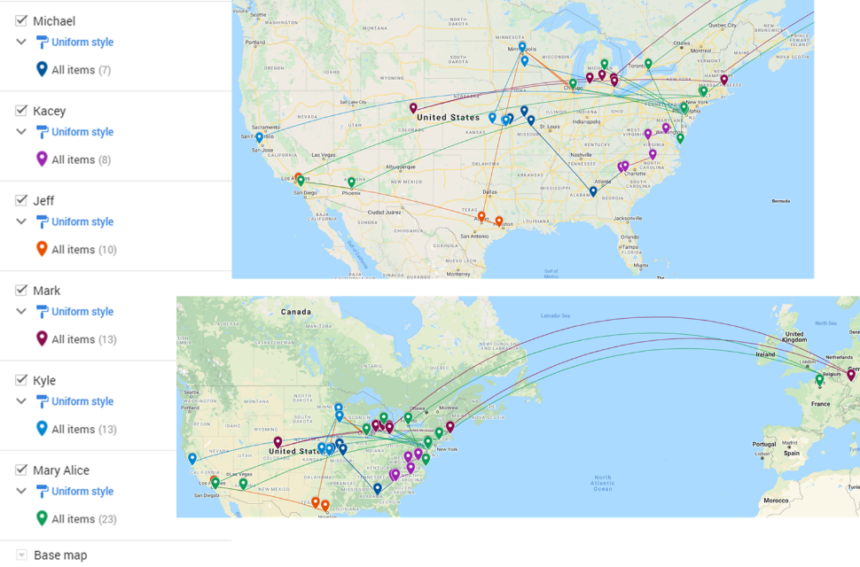



In 2021-
New Industry Employee Networking – Pilot 6 Session Framework
Introduction Session & Get to Know You Activity – February
Organized by Michael Minkler, Milliken Chemical
Unwritten Rules to Industry Success Panel Discussion - April
Organized by Jeff Ting, 3M Company
Learning from YIPS Winners – October
Organized by Mary Upshur, Dow Chemical
Other sessions TBD, which organization by:
Mark Schwartzlander, BASF
Kyle Snow, Citrine Informatics
Kacey Hall, Milliken Chemical

Slide 6
Fall 2021-
Fall ACS
  IIPS - Industrial Innovations in Polymer Science: Sustainable Materials, 10:30am - 12:30pm USA / Canada - Eastern , August 23, 2021, Room: Zoom Room 25, James Bohling, Organizer, The Dow Chemical Company; Wei Gao, Organizer, The Dow Chemical Company; Michael Minkler, Organizer, Miliken
  Young Industrial Polymer Scientist Award in honor of Victoria Piunova, 10:30am - 12:15pm USA / Canada – Eastern, August 23, 2021 , Room: A311-A312, J Hedrick, Organizer, Presider, IBM Research
  Student Travel Awards (4 x $750), Awards recognized at the Wednesday Plenary Session
Other events
  2021 Rocky Mountain Regional Meeting. October 28 – 30, 2021- including IAB networking event
Future-
  IIPS – Spring 2022, Bonding Through Chemistry, March 20 – 24, San Diego, CA, Call for abstracts (open now) and closes on Monday, October 11
  IIPS – Fall 2022, Sustainability in a Changing World, August 21 – 25, Chicago, IL
  IPS Award – Fall 2022, 3 applications received on 7/31/21. POLY Awards Committee is currently reviewing
  Student Travel Awards (4 x $750)

Slide 7
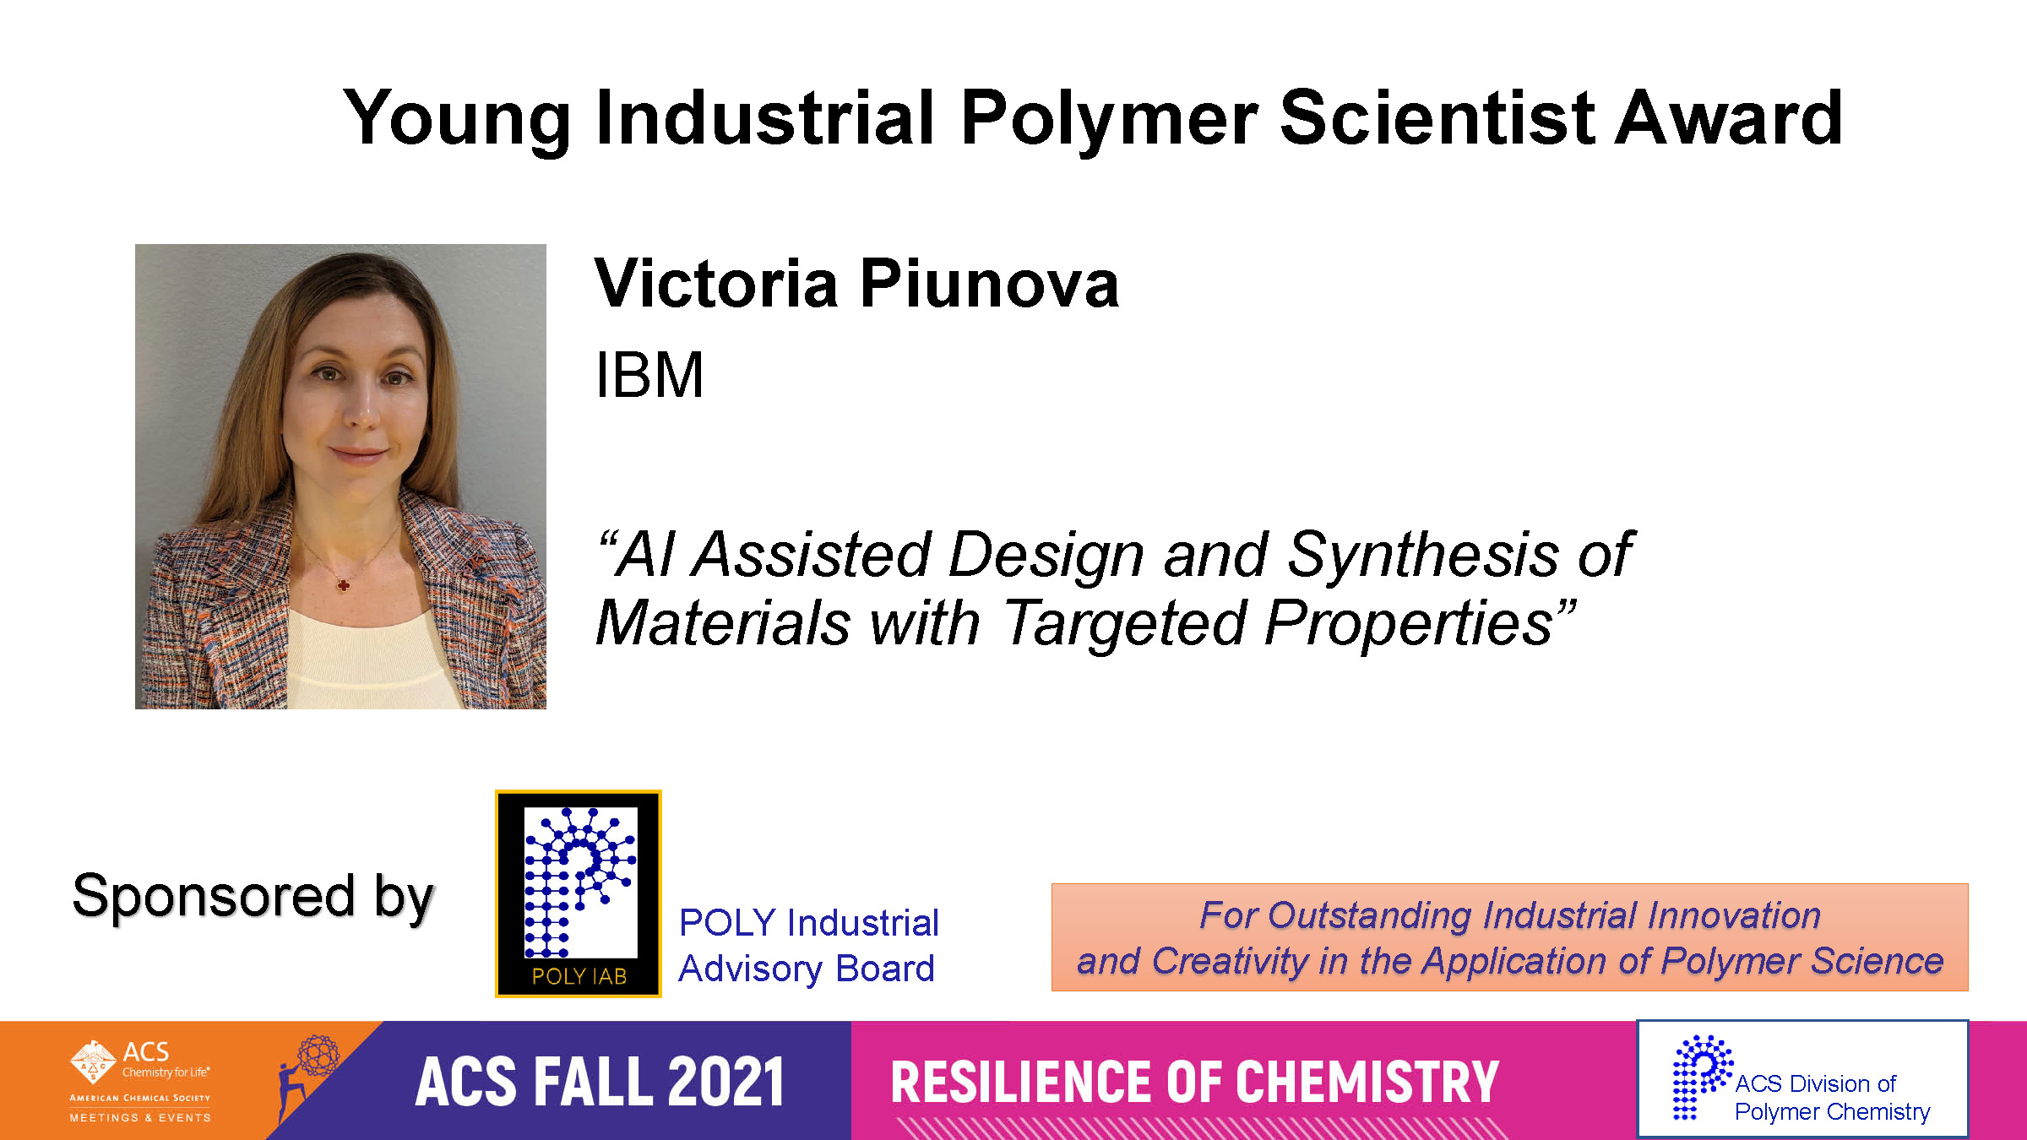

Slide 8


Slide 9
In 2021-
 | Proposed | Mid-year
Income | 24,000.00 | 11,325.00
Expenses
Networking | 7,000.00
Meetings | 8,000.00 | 254.00
Awards | 6,200.00
Programming … virtual, future webshops | 3,200.00 | 2,000.00
Other (shirts, pins) | 1,600.00
subtotal | 26,000.00 | 2,254.00
Bal | -2,000.00 | 9,071.00
Budget, approved
Anticipated this Fall.
750x 4 Travel Awards
Support for YIPS

Slide 10
Thank you
Industrial Advisory Board
IAB Fall Meeting
Monday August 30, 2021 * 2:00 pm – 3:00 pm EDT (1PM CST)
VIA ZOOM

Slide 11
Notes:

Slide 12



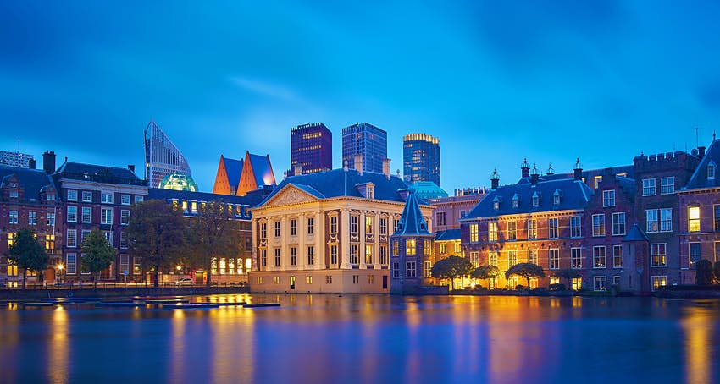

2022 – Energy Industry Event
Polymer Chemists Welcome!
Energy Materials Workshop
Topics Covered
Smart Materials
Applied Polymer Science
Batteries
Hydrogen storage materials
Carbon conversion technologies
Geothermal Technologies
Advanced Well Technologies
Leonardo Royal Hotel
The Hague, Netherlands
March 15-16 2022
Organizers
Peter Boul, Aramco
Gaurav Agrawal, Newpark
For more information contact:
peter.boul@aramcoamericas.com

Slide 13
In 2020-
Programming
Meetings
Networking
Virtual
  - IIPS13 San Francisco (Fall 2020): P. Boul, K. Knauer, D. Germack
  Monday, Aug 17 10:00 AM
  “Chemistry from Bench to Market”
  - Q&A through POLY
  - IAB Meeting in both the Spring and Fall
  Fall IAB Networking Reception (3 opportunities offered)
  December Young Industrial Employee virtual networking sessions (2 opportunities offered)

Slide 14
In 2020-
 | Proposed |  | Actual
Income | 40,500.00 |  | 19,681.65
Expenses
Networking | 10,000.00 |  | 680.32
Meetings | 10,800.00 |  | 400.00
Awards | 5,200.00 |  | 5,099.00
Programming … virtual, future webshops | 2000.00 |  | 10,695.00
Other (shirts, pins) | 1,600.00 |  | 648.82
subtotal | 30,100.00 |  | 17,523.14
Bal |  |  | 2158.51
Budget
  Some 2021 items were pre-paid during 2020
  38% drop-off in funds collection in 2020

