Slide 1
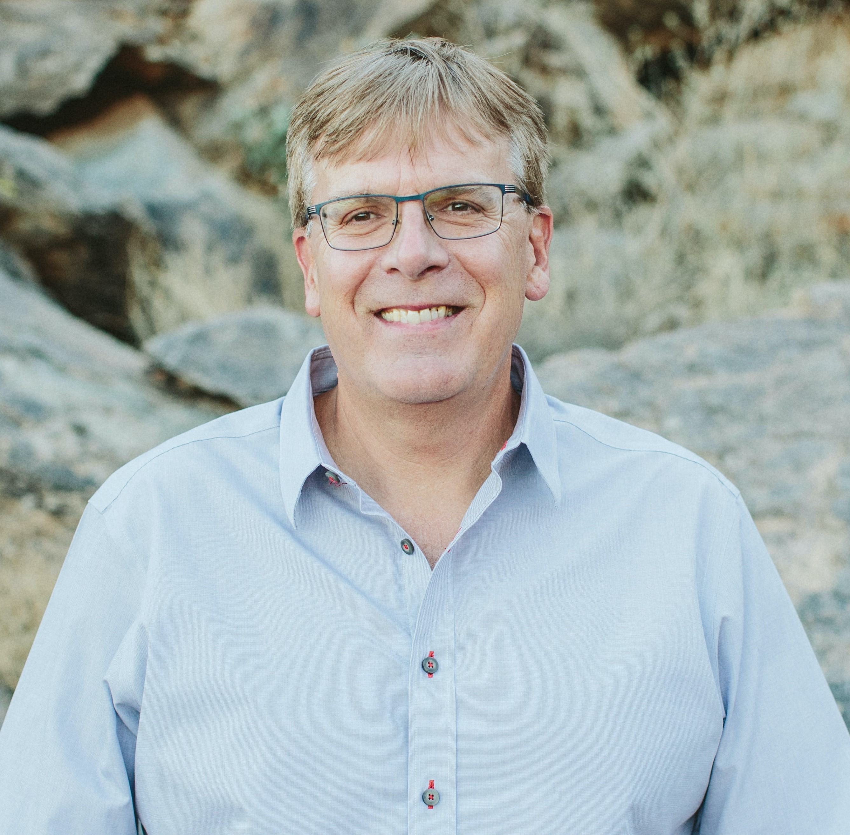


Congratulations Paul J. Flory Polymer Education Award
Tim received his Ph.D. in Chemistry from Virginia Tech under the direction of Prof. James McGrath, and he subsequently joined both Eastman Kodak and Eastman Chemical companies for eight years upon graduation. He joined the faculty in the Department of Chemistry at Virginia Tech, where he also served as the Director of the Macromolecules Innovation Institute until 2019. In 2020, Prof. Long accepted an interdisciplinary faculty position across the School of Molecular Sciences (SMS) and the School for Engineering Matter, Transport, and Energy (SEMTE) at Arizona State University (ASU) where he will launch and lead the Biodesign Center for Sustainable Macromolecular Materials and Manufacturing (BCSM3). In addition to over 400 peer-reviewed publications, his research awards include the 2020 Virginia Outstanding Faculty Award, 2015 Virginia Scientist of the Year, 2010 Virginia Tech Alumni Research Award, ACS PMSE Collaborative Research Award, PSTC Carl Dahlquist Award, 2019 ACS Rubber Division Thermoplastic Elastomer Award, and the ACS POLY Mark Scholar Award. He has served as the Chair of the ACS Division of Polymer Chemistry, Chair of the Gordon Research Conference in Polymers, 2012 Chair of the IUPAC World Polymer Congress, and he currently serves as the Past-President of the Adhesion Society. He is a member of advisory boards for leading journals, and he was recently appointed as Editor-in-Chief of Wiley Polymer International. His most recent research efforts address the need for tailored advanced macromolecules for advanced manufacturing (3D printing), including vat photopolymerization, direct ink write, binder jetting, powder bed fusion, and melt extrusion.
Timothy Long
Arizona State University
In recognition of promoting undergraduate
and/or graduate polymer education.
½ day symposia and award presentation to be held at the Spring 2022 ACS National Meeting in San Diego, CA.
ACS Division of Polymer Chemistry

Slide 2

Upcoming Awards Deadlines
Industrial Polymer Scientist Award
Under Review
Sponsor: POLY IAB
Graduate Student Travel Award
Application Due: 9/11/2021 @ 5 PM PST
Sponsor: POLY Industrial Advisory Board
Mark Young, Scholar, and Senior Awards
Application Due: 11/1/2021
Sponsor: POLY
POLY Fellows
Application Due: 11/30/2021
Sponsor: POLY
ACS Macro Letters/Biomacromolecules/ Macromolecules Young Investigator Award
Application Due: 1/2022
Sponsor: ACS MacroLetters/POLY/ Biomacromolecules/Macromolecules
Henkel Award for Outstanding Graduate Research in Polymer Science & Engineering
Application Due: 1/25/2022
Sponsor: Henkel
DSM Bright Science Award for Ph.D. Students
Application Due: 2/2022
Sponsor: Royal DSM
Carl S. Marvel Award for Creative Polymer Chemistry
Application Due: 7/1/2022
Sponsor: POLY

Slide 3
General Award Announcements
Starting January 2022, Semra will step down from the awards committee to fill her new position as POLY chair. The awards committee will need a replacement soon. If anyone has an idea of who to suggest as a replacement or if you would like to volunteer, please let Alan Hopkins (alan.r.hopkins@aero.org) know.
The Graduate Student Travel Award submission deadline is September 11, 2021, by 5 PM PST. POLY has supported graduate travel since 2009. Over 50 graduate students were awarded funding to help cover travel cost in order to attend ACS National Meetings. This award is one the few successful ACS programs that help and promote graduate students which may lead to potential future POLY members!

