Slide 1
POLY Webinar Update
Tomonori Saito, Brent Sumerlin, Rebecca Olson Short, Bob Lambeth

Slide 2

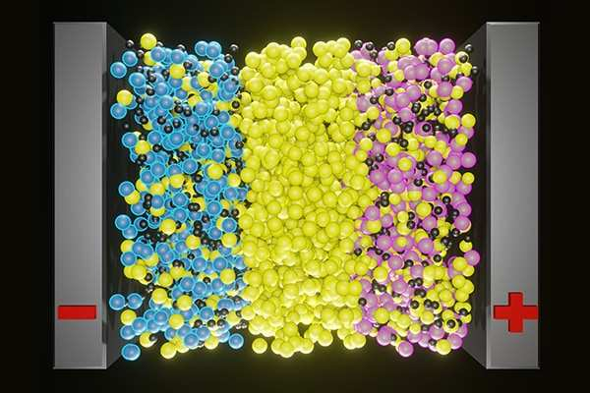
POLY Webinars: 2024
Better Ion Transport Through Polymer Chemistry 2/8/2024
Better Biodegradable Vinyl Polymer Materials by Improving Radical Ring-Opening Polymerization (rROP)
5/2/2024
Polymer Brushes
9/19/2024
Alexei Sokolov
ORNL/UT Governor's Chair, Professor
Chemical Sciences Division
Oak Ridge National Laboratory
Department of Chemistry
University of Tennessee, Knoxville
Michael Hickner
Craig A. Rogerson Endowed Professor
Department of Chemical Engineering and Materials Science
Michigan State University
X. Chelsea Chen (moderator)
R&D Staff - Polymer Scientist
Chemical Sciences Division
Oak Ridge National Laboratory
Jia Niu
Associate Professor of Chemistry
Department of Chemistry
Boston College
Julien Nicolas
CNRS Research Director
Institut Galien Paris-Saclay, CNRS UMR 8612
Faculté de Pharmacie, Université Paris-Saclay
Josh Worch (moderator)
Assistant Professor of Chemistry
Department of Chemistry
Virginia Tech
Harm-Anton Klok
Ecole Polytechnique Fédérale de Lausanne (EPFL)
Institut des Matériaux, Laboratoire des Polymères
Christopher Bates
Associate Professor
University of California, Santa Barbara
Materials
Christian Pester (moderator)
Associate Professor
University of Delaware
Department of Materials Science and Engineering

Slide 3
First POLY/ACS Webinar in 2024
Speakers
Alexei Sokolov
ORNL/UT Governor's Chair, Professor
Chemical Sciences Division
Oak Ridge National Laboratory
Department of Chemistry
University of Tennessee, Knoxville
Michael Hickner
Craig A. Rogerson Endowed Professor
Department of Chemical Engineering and Materials Science
Michigan State University
Moderator
X. Chelsea Chen
R&D Staff - Polymer Scientist
Chemical Sciences Division
Oak Ridge National Laboratory
POLY Leads
335

Slide 4
Second POLY/ACS Webinar in 2024
Speakers
Julien Nicolas
Director of Research at CNRS, Institut Galien Paris-Saclay, University Paris-Saclay/CNRS & Associate Editor, Chemistry of Materials
Jia Niu
Associate Professor of Chemistry,
Boston College
Moderator
Josh Worch
Assistant Professor of Chemistry,
Virginia Tech
POLY Leads
105

Slide 5
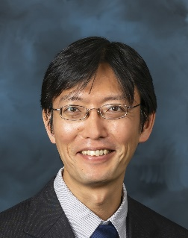
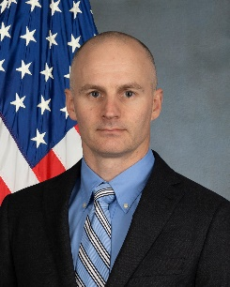
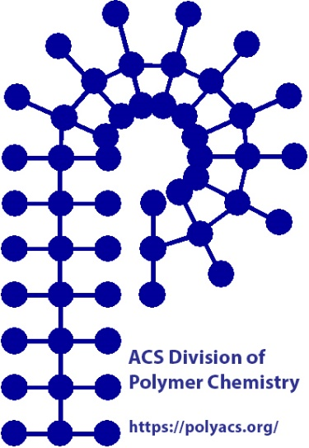
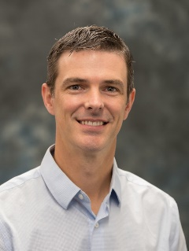
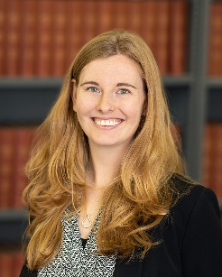
POLY Webinar Committee
Future Webinar
Please send your ideas and feedback to any of us.
Tomonori Saito (chair), Oak Ridge National Laboratory saitot@ornl.gov
Bob Lambeth (vice-chair), Amy Research Laboratory robert.h.lambeth2.civ@army.mil
Brent Sumerlin, University of Florida sumerlin@chem.ufl.edu
Rebecca Olson Short, PPG RAShort@PPG.com

