Slide 1


Committee Appointments
Membership Committee
International Committee
Regional Meetings Committee
American Chemical Society Division of Polymer Chemistry

Slide 2
Membership, Publicity, and Communications
What can we do to address the issue? Ideas, suggestions?
Membership Committee:
Kat Knauer – Member-at-Large
* Chair: Colleen Scott (Miss State Univ.)
Will Gutekunst (Georgia Tech)
Brian Long (UT Knoxville)
* Co-Chair: Mark Grinstaff (BU) or Melanie Chiu (Stony Brook U)
* Co-Chair: Erin B. Murphy (Industry)
Liz Bright (3M) – POLY/PMSE Student Chapters
      POLY Student Advisory Board
Proposed Actions:
Committee will work together on developing strategy to retain members
Can we have a 2nd Member-at-Large?
Revamp Membership site:
  Move membership on the main tab
  Highlight top 5 benefits
  Should we have a members only access?
      Job postings Discussion blogs
      Recorded symposia links
      Graphical abstracts, Other Ideas??
Publicity:
Chair: Emily Pentzer (TAMU)
POLY Website: Justin Kennemur (Florida State Univ.)
Prath Kharkar (Acelity)
Spencer Brucks (MIT)
Jeff Ting (Univ. of Chicago)
Proposed Actions:
Consistency in presentation format/template
Awards
Symposia
Member Recognition, etc..
Work closely with Communications
Publicize membership benefits
General
POLY affiliate only option
MACRO
Membership Drive
Communications:
*Chair: Helen Tran (Univ of Toronto
Other suggestions?
Proposed Actions:
Drive social media presence
  POLY highlights
  ACS content
  Membership benefits
  Volunteer opportunities
  Volunteer sign-up sheet
American Chemical Society Division of Polymer Chemistry

Slide 3
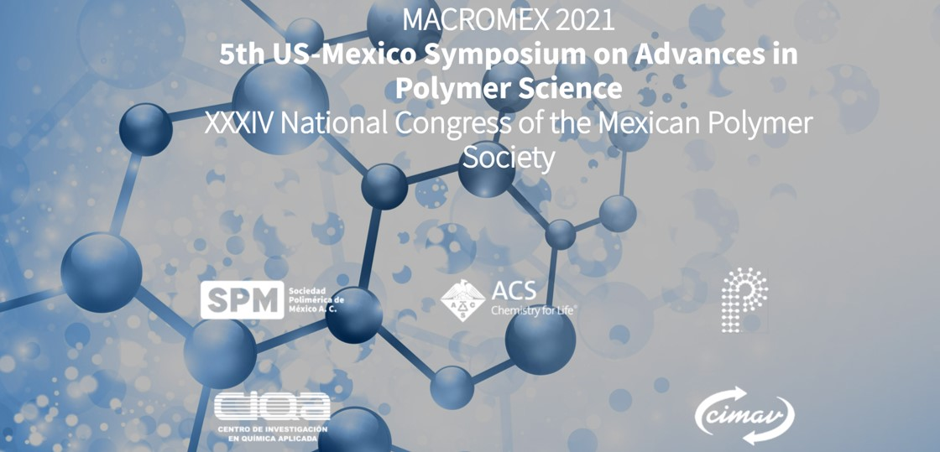
International Committee 2021
November 1 - 4, 2021
Riveria Maya, Mexico
American Chemical Society Division of Polymer Chemistry

Slide 4
International Committee Appointments
International Committees main function is to encourage and facilitate the interaction of foreign
organizations and individuals interested in polymer science and technology with the activities of
the ACS Division of Polymer Chemistry.
Current Committee:
Chair: Rogiberto Advincula (UT-ORNL)
Mike Meador (NASA Glenn – retired)
Thomas W. Smith (RIT)
Peter Zarras (ORNL)
Kevin Cavicchi (Univ. of Akron)
Recommendation:
Increase international activity in truly global level
Appoint co-chairs with defined focus on a global region
Proposed Committee for 2022:
Co-Chair: Rogiberto Advincula (UT-ORNL) / Americas
*Co-Chair: Wei Gao (Dow) - Asia
*Co-Chair: EU ??? – Potentially Yoan Simon (Univ. of S. Miss, Richard Hoogenboom (Ghent Univ.)
Mike Meador (NASA Glenn – retired)
Others?
American Chemical Society Division of Polymer Chemistry

Slide 5
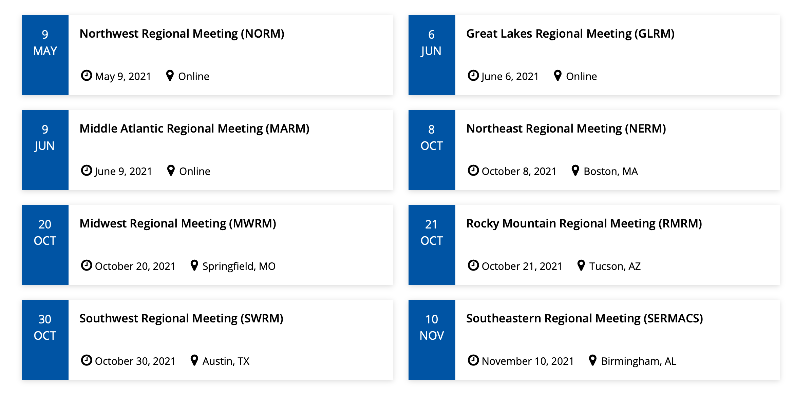
Regional Meetings 2021
Regional Meeting – Mark Dadmun
Other Meeting Support – Current Chair
2021
Regional Meetings
$500 Rocky Mountain Regional meeting
$1,000 POLY Graduate Meeting - VT (Virtual)
Annual Budget
Regional = $2,000 Other - $1,500
American Chemical Society Division of Polymer Chemistry

Slide 6
Regional Meetings Committee
In 2021, Regional Meetings Committee:
    Chair: Mark Dadmun
    Brittany deRonde (ProAmpac)
    Kenny Mineart (Bucknell)
    Dawanne Poree (ARO)
    Piril Ertem (Surmodics)
  Charge: For POLY to develop a more pro-active approach to interacting with the regional ACS meetings to expand benefits for our members and continue to improve our outreach beyond the national meetings.
American Chemical Society Division of Polymer Chemistry

Slide 7
Regional Meetings Committee
Areas identified for potential opportunity:
  Who attends the Regional Meetings?
    Industrial scientists at small to mid-size companies
    Students and early career scientists
    Faculty at primarily undergraduate institutions
  Can we connect with 2022 Regional Meeting Chairs?
    To alert them to POLY support of Regional meeting symposia with details and limitations
    To request their perspective/input/feedback of how POLY may better serve these communities at Regional meetings
  Can we engage POLY/PMSE Student chapters at Regional meetings?
    Potential activities include lunch and learn, Science Café, or networking activities.
    Other suggestions:
      Utilize POLY IAB to discuss opportunities for industrial members to network with students/post-docs at Regional Meetings
      POLY Meeting Chairs to discuss opportunities to steer proposed symposia to Regional meetings.
American Chemical Society Division of Polymer Chemistry

Slide 8
Regional Meetings 2022
In 2022, Proposal for the Regional Meetings Committee:
Build on the momentum from 2021
Appoint Laura Stratton as the Co-Chair to work with Mark Dadmun and the Committee
  Laura had a great success at Rocky Mountain Regional Meeting in 2021
Proposed Strategy:
Have a representative of POLY at as many regional meetings as possible
Potentially focus on students in the area or pre-scope who is the major audience in those regions and organize target events.
Work on organizing local panel discussion on careers for students, networking hours etc..
Publicize the events on POLY social media channels
American Chemical Society Division of Polymer Chemistry

Slide 9
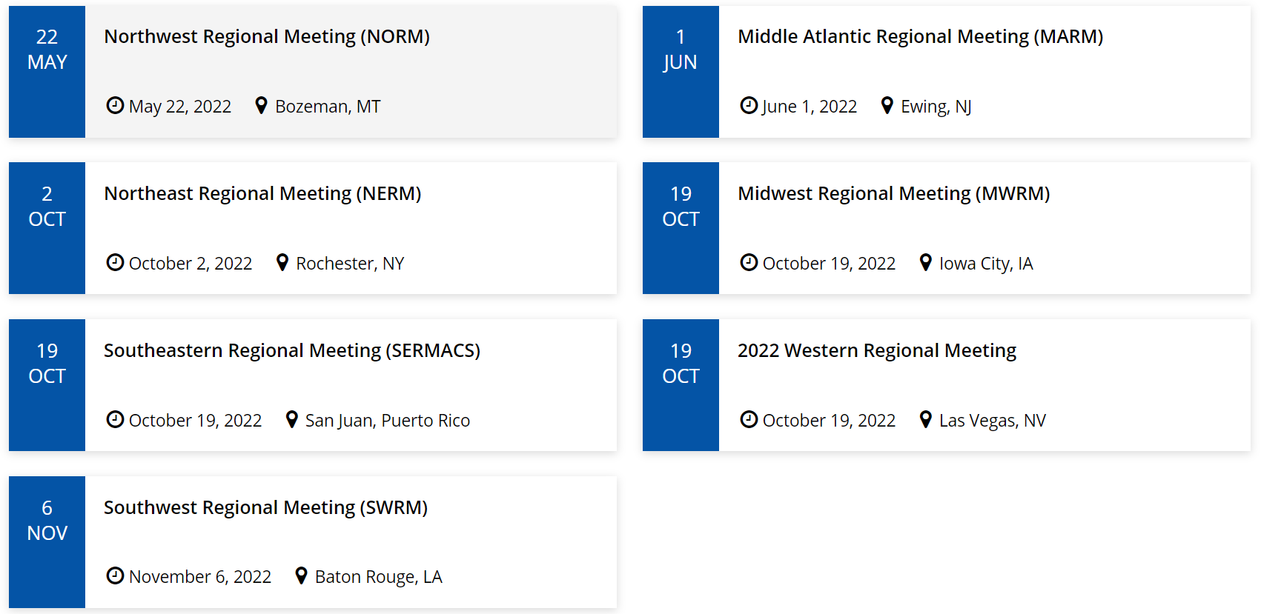
Regional Meetings 2022
American Chemical Society Division of Polymer Chemistry

