Slide 1
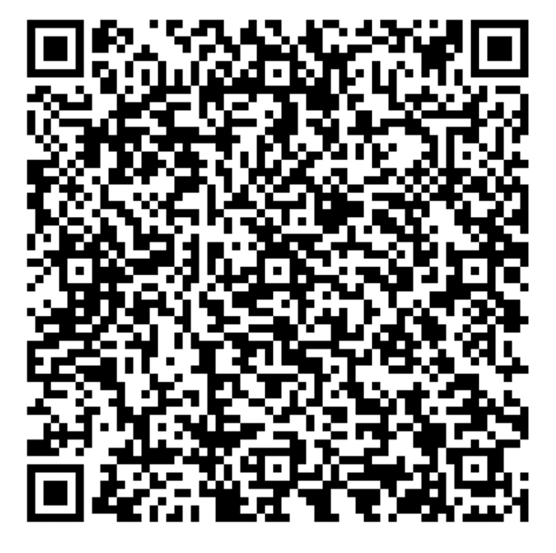
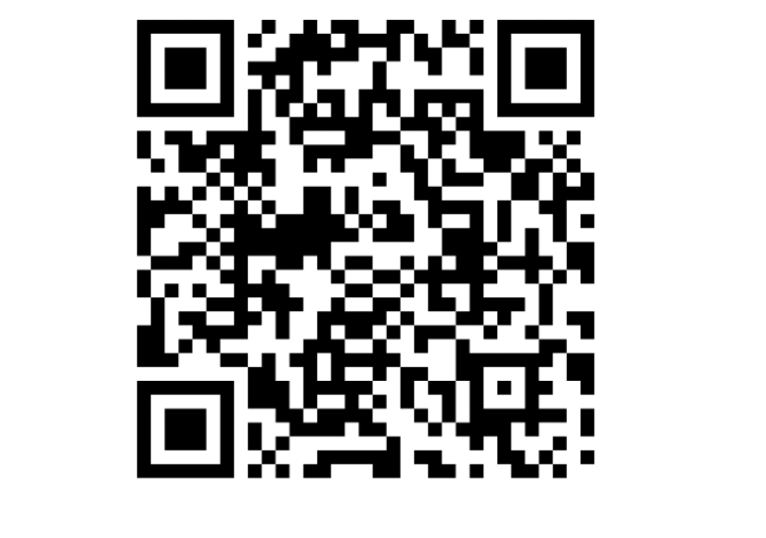
POLY Publicity/Communications Committee
Special Events Calendar:
Volunteering Form:
Current team:
Chair - Tayler Hebner (Purdue University)
Coralie Backlund (Novo Nordisk)
Jeff Ting (Nanite)
Kaden Stevens (University of Florida)
Recent/Ongoing Projects:
National Meeting POLY Special Events Calendar
  Goal – increase visibility and communication of special events at national meetings
  Fall 2024 meeting pilot – google calendar linked on website and distributed/displayed on POLY table as QR code at meeting (enables saving of events to your own google calendar)
  Please (1) help advertise to the general community that this exists and (2) give us feedback so we can further improve at the next meeting!
Migration of all content to polyacs.org (moving away from .net site)
  95% complete with help from Kathy and Carlee
  Let us know if you find anything that still links back to a .net page
Polyacs.org website revamp and revise communications strategy
  In process of hiring external consultant/web designer
Volunteer interest forms now linked on website – please share and encourage others to fill it out!

