Slide 1
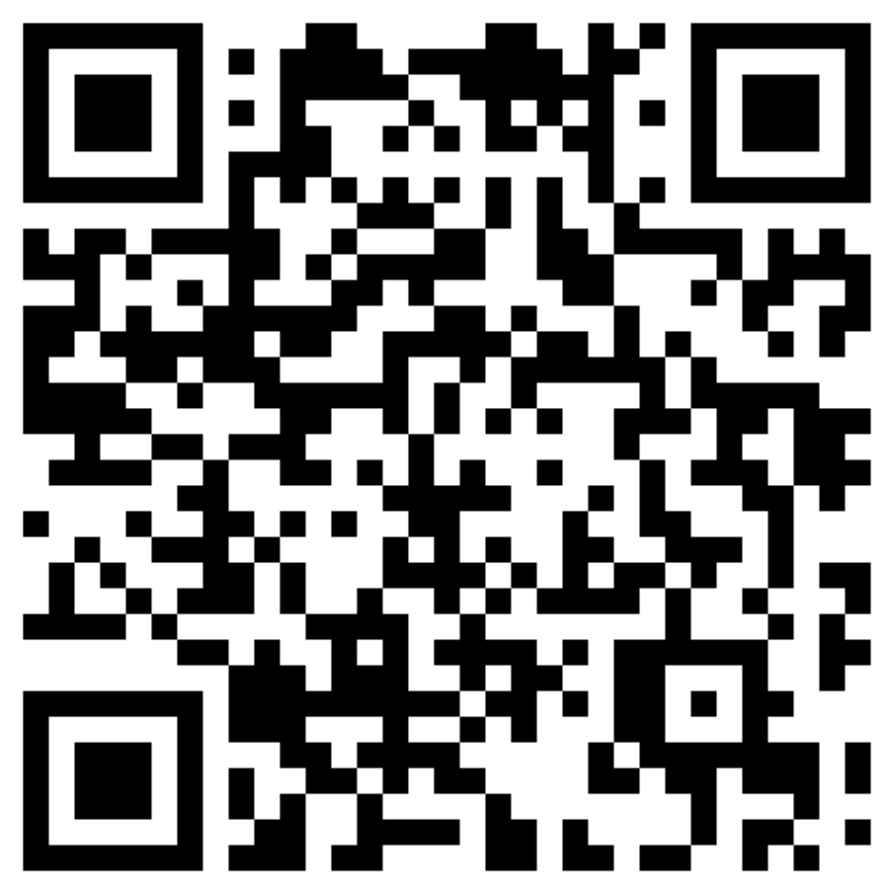
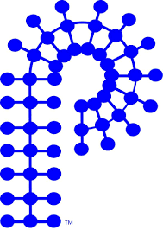




POLY Publicity/Communications Committee
Current team:
Chair - Tayler Hebner (Purdue University)
Coralie Backlund (Lonza)
Jeff Ting (Nanite)
Kaden Stevens (University of Southern Mississippi)
Recent/Ongoing Projects:
Communications strategy & website revamp (see next slide)
New(ish) linkedIn page – please go follow!
  We will continue to post on this page moving forward, not in the old “group”
IAB and academic ”spotlight” features on social media
Reminder: volunteer interest forms now linked on website – please share and encourage others to fill it out!

Slide 2
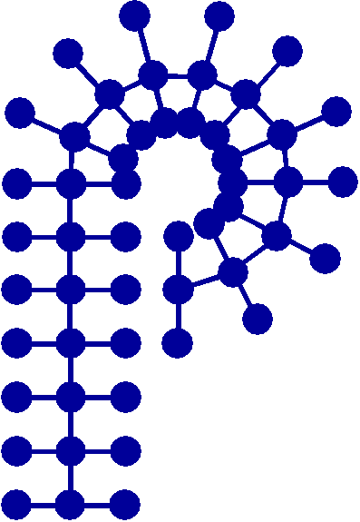
Website/Communications Strategy Update
Current project: communications strategy analysis/revamp
  TPG grant used to hire web design/communications specialist
Create a communications strategy that will allow for effective communication of POLY’s value proposition on the website, Facebook, LinkedIn, X/Twitter, and YouTube pages
Develop more active interactions between POLY members on social media platforms
Create an online community of engaged members, nationally and internationally
Develop a template strategy for when and what to post on which platform to spur the highest level of interactions between members
Demonstrate the value of ACS and POLY membership
Provide updated curated POLY content for the best user experience
Retain and increase membership
Timeline (goal of completion within ~ 12 months):
  Phase I: Research & Discovery (includes surveying current membership, and data gathering and analysis)
  Phase II: Creating a Communications Strategy Based on Data (includes report and presentation)
  Phase III: Implementation
  Phase IV: Final Assessment and Adjustment
American Chemical Society Division of Polymer Chemistry

Slide 3
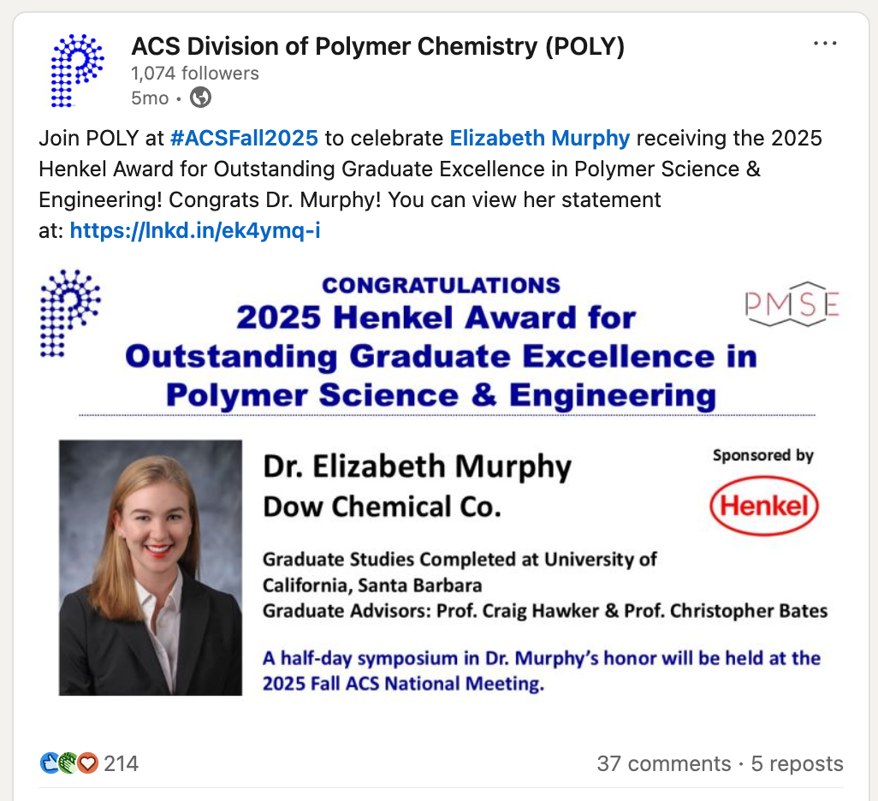
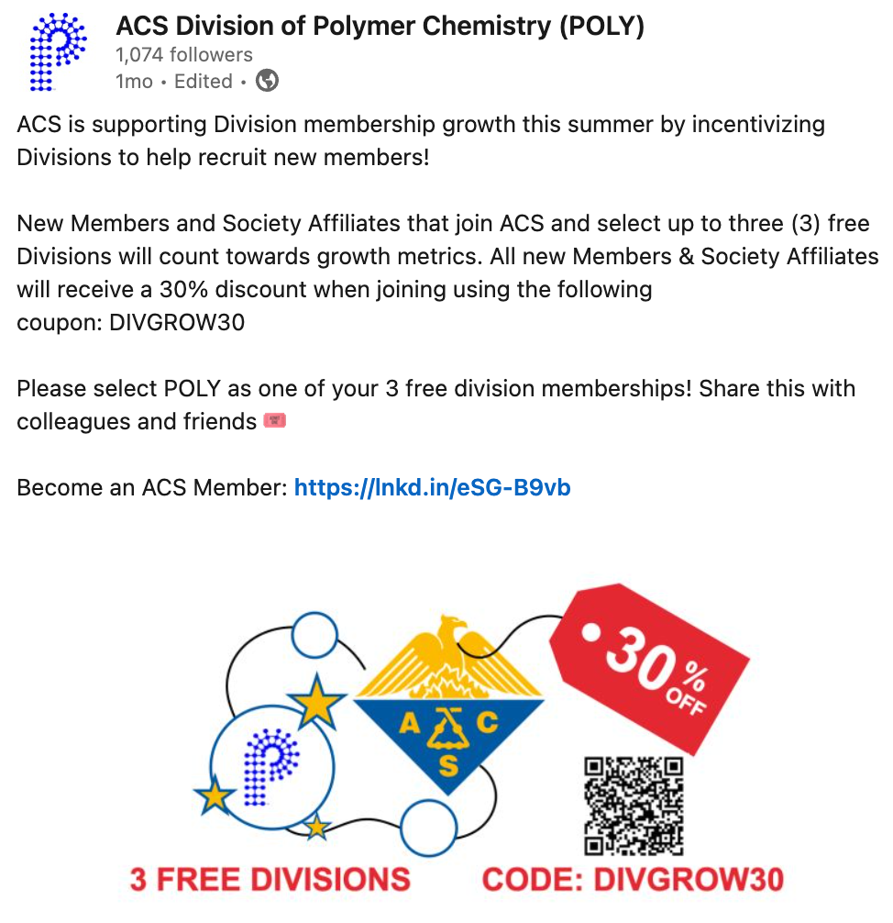
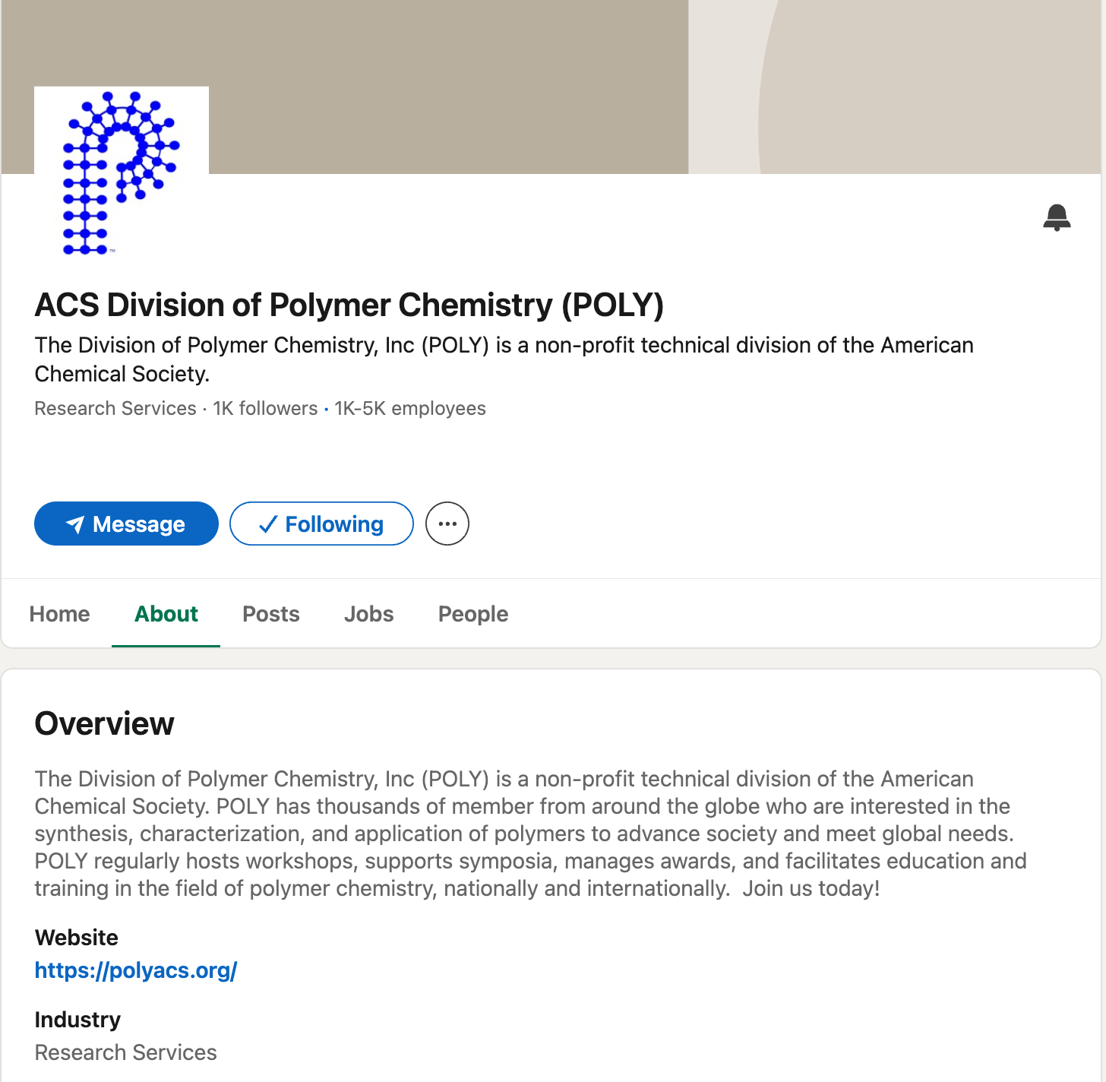
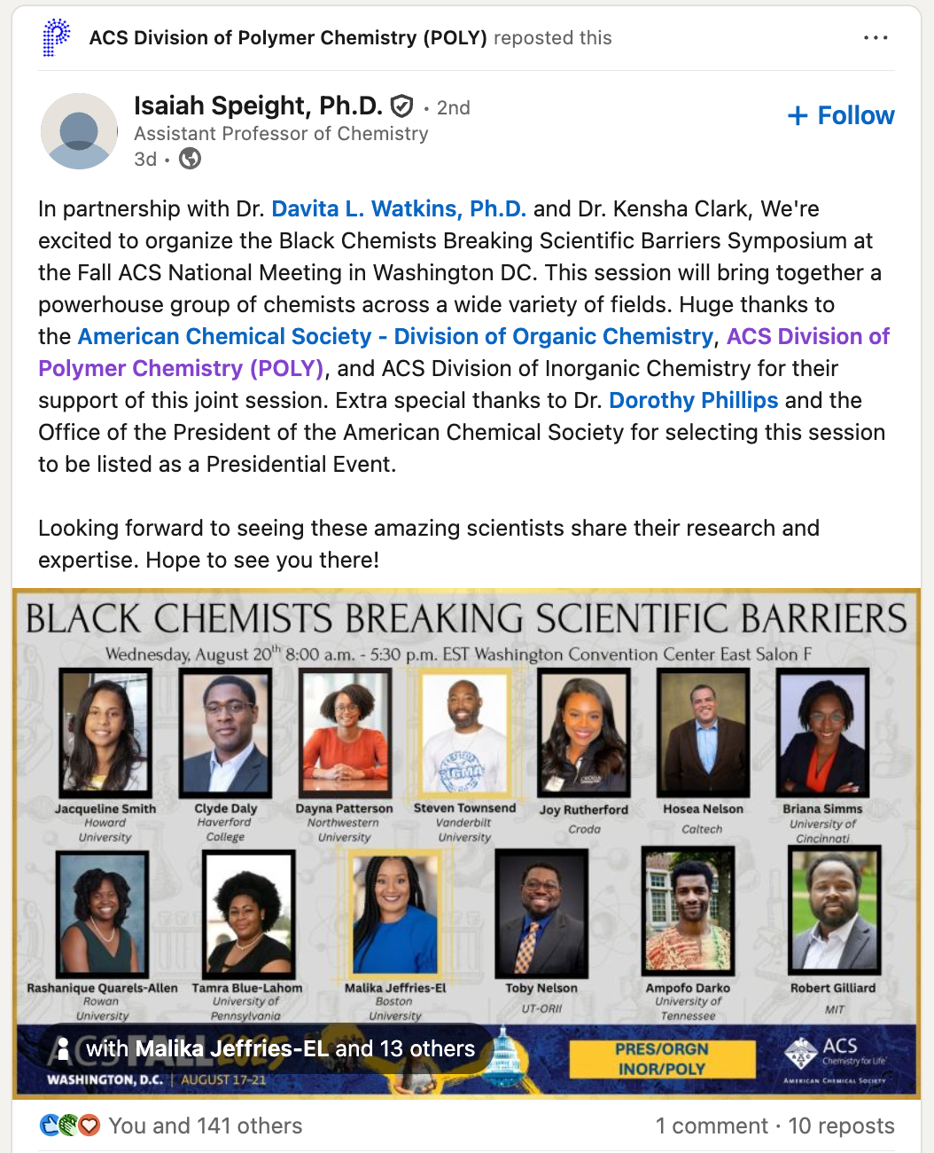
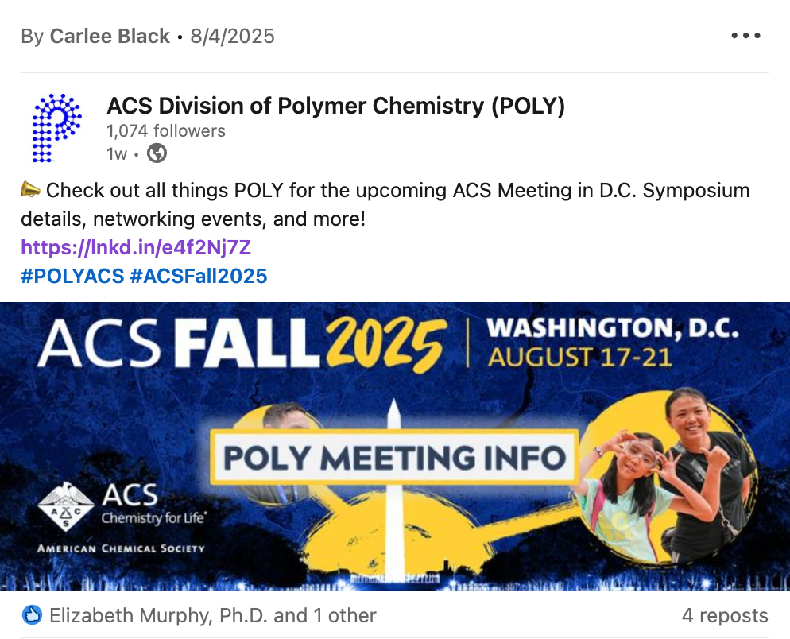
Social Media Initiative: LinkedIn
1000+ Followers!
Post original content
Share POLY content
American Chemical Society Division of Polymer Chemistry

Slide 4
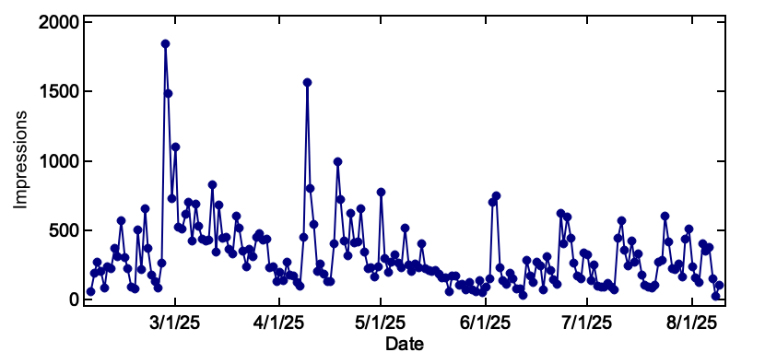
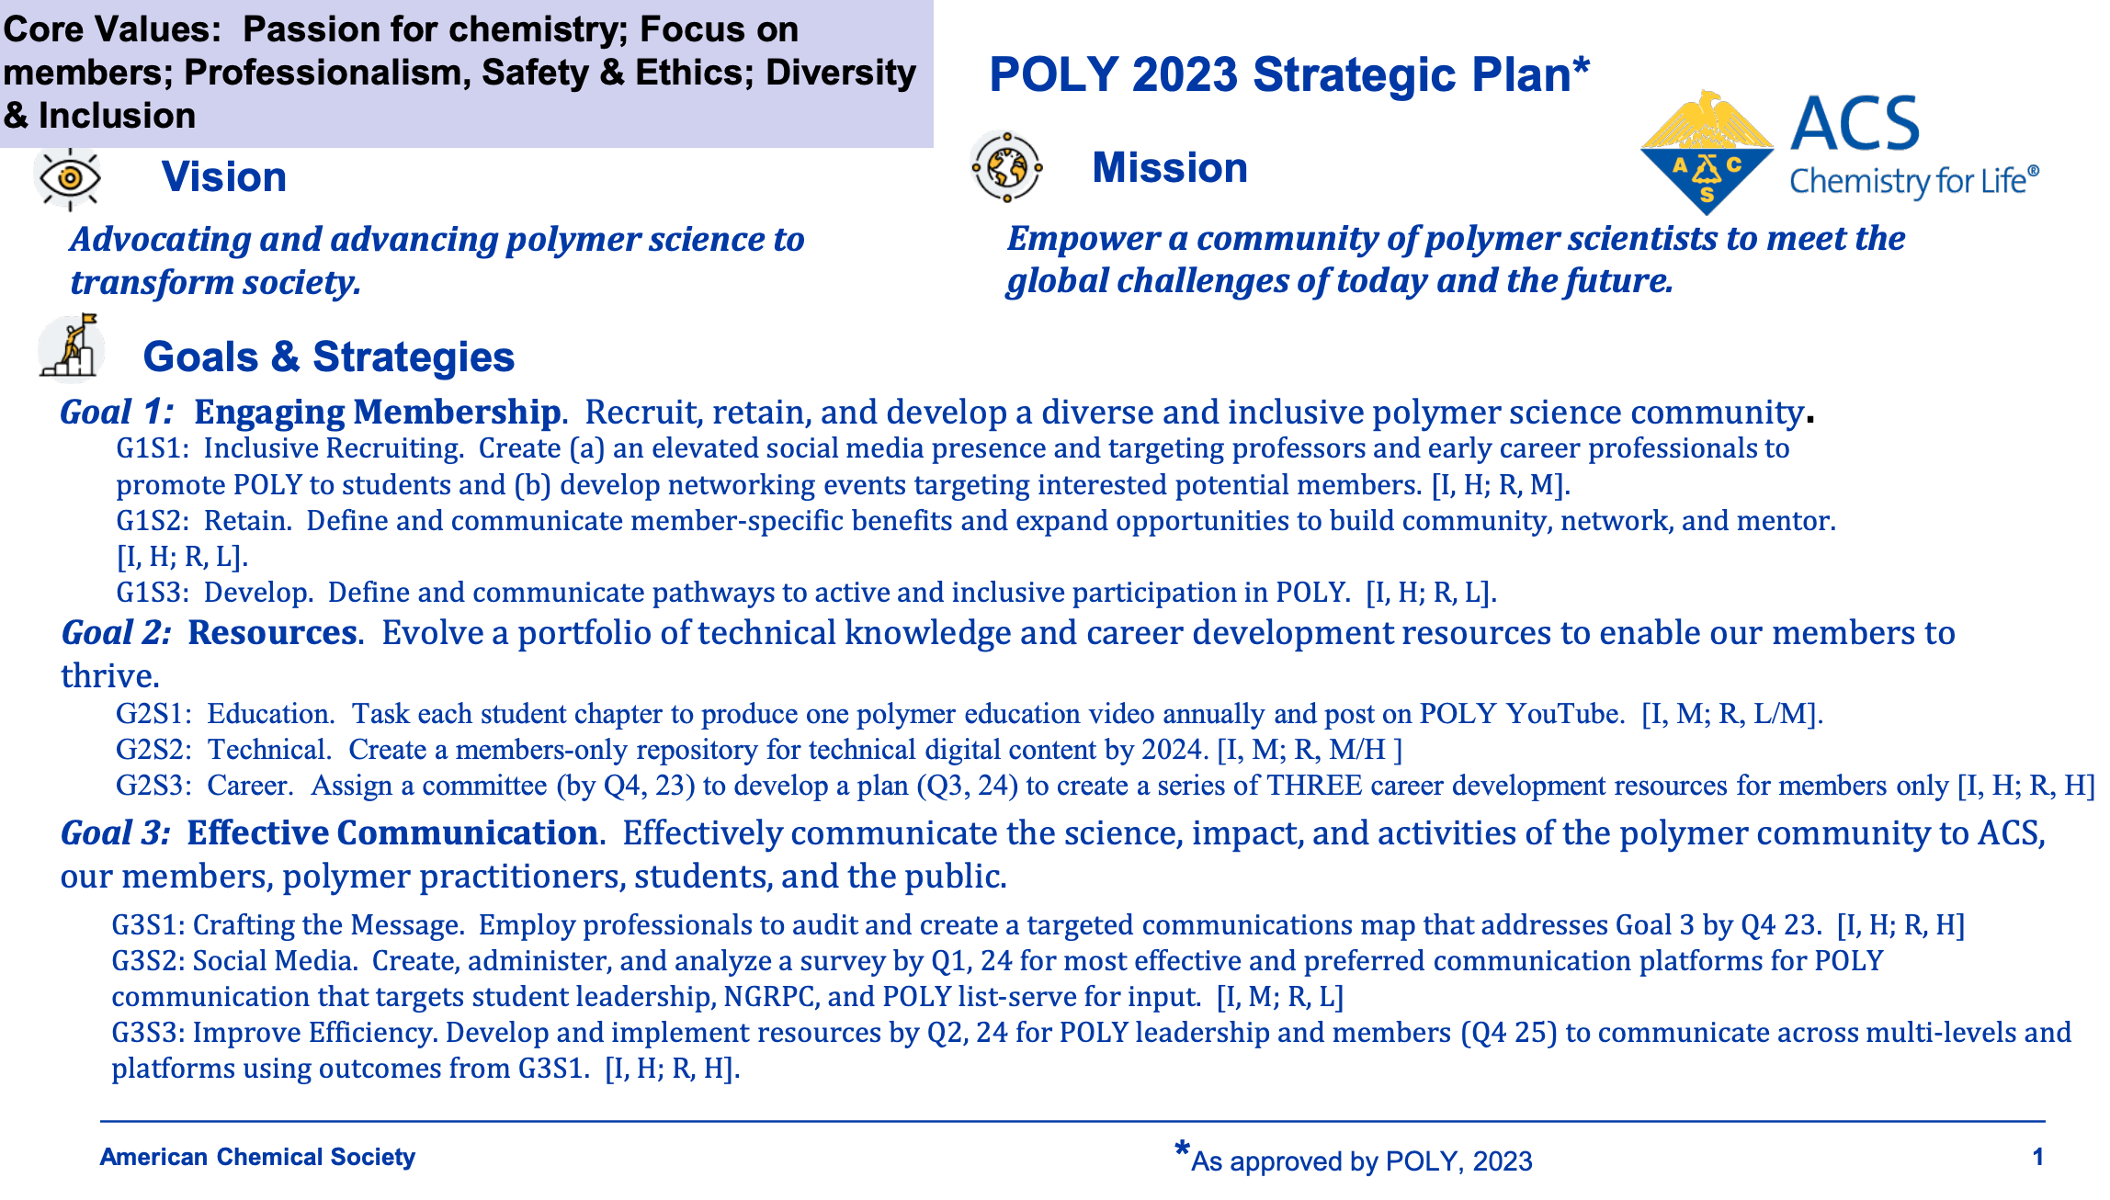
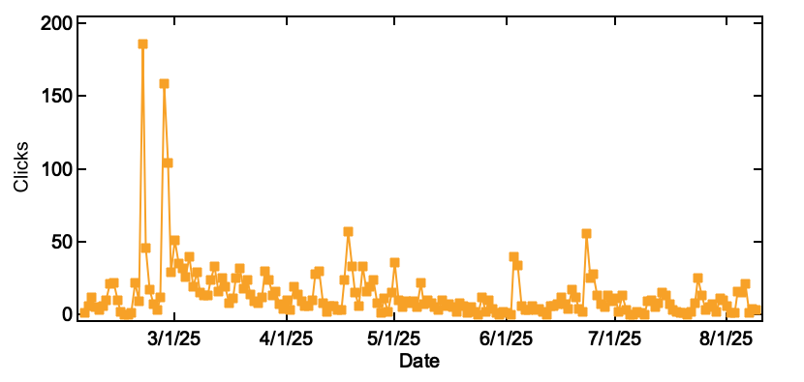
Social Media Initiative: LinkedIn
Engagement: curating content for professors, early professionals, and students/postdocs in the POLY community
Communication: reworking strategic comm plan
Ongoing work: new initiatives like the POLY Spotlight project, POLY IAB Feature, etc.
American Chemical Society Division of Polymer Chemistry

Slide 5
Social Media Initiative: LinkedIn
Engagement: curating content for professors, early professionals, and students/postdocs in the POLY community
Communication: reworking strategic comm plan
Ongoing work: new initiatives like the POLY Spotlight project, POLY IAB Feature, etc.
Highlight research specialties, recent publications/innovations
IAB members
Early/mid-career academic researchers
  Assistant professors w/ 4+ years POLY membership
American Chemical Society Division of Polymer Chemistry

