Slide 1

Strategic Planning Report
G3 – S2 Champions: Justin Kennemur & Dawanne Poree
G3: Effective Communication. Effectively communicate the science, impact, and activities of the polymer community to ACS, our members, polymer practitioners, students, and the public.
S2: Create, administer, and analyze a survey by Q1, 24 for most effective and preferred communication platforms for POLY communication.
American Chemical Society Division of Polymer Chemistry
ExComm Winter Meeting, Orlando, FL 01/27/2024

Slide 2
Strategic Planning Report: G3-S2
Champions: Justin Kennemur & Dawanne Poree
G3: Effective Communication. Effectively communicate the science, impact, and activities of the polymer community to ACS, our members, polymer practitioners, students, and the public.
S2: Create, administer, and analyze a survey by Q1, 24 for most effective and preferred communication platforms for POLY communication.
Targeted Date of Completion: Q1 - 2024
American Chemical Society Division of Polymer Chemistry
ExComm Winter Meeting, Orlando, FL 01/27/2024

Slide 3
Strategic Planning Report: G3-S2
SURVEY TIMELINE - REPONSES
QR Code Survey at San Fran was a bust: 11 total surveys taken
New survey was created with ACS Team: Officially handled through Qualtrics and full data analysis accessible
Nov 27 - Survey went live and POLY-L email sent (93 responses on Nov 29 am)
Nov 29 – Survey link sent out on “X” and LinkedIn (123 responses on Jan 2)
Jan 4 - Final Reminder/announcement to entire POLY list, closed survey EOB on Jan 10.
FINAL RESPONSE COUNT: 142 responses (133 complete, 9 partials)
American Chemical Society Division of Polymer Chemistry
ExComm Winter Meeting, Orlando, FL 01/27/2024

Slide 4
Strategic Planning Report: G3-S2
SURVEY CONTENT:
Q1: POLY Member? Y/N
Q2: Age Group
Q3: Area of Occupation
Q4: Preferred current POLY based communications? (multi-select)
Q5: Social Media User? Y/N
Q6: What Social Media would you like to see POLY Communication? (multi-select)
Q7: Other ways for communication? Y = text box N = I’m happy
American Chemical Society Division of Polymer Chemistry
ExComm Winter Meeting, Orlando, FL 01/27/2024

Slide 5
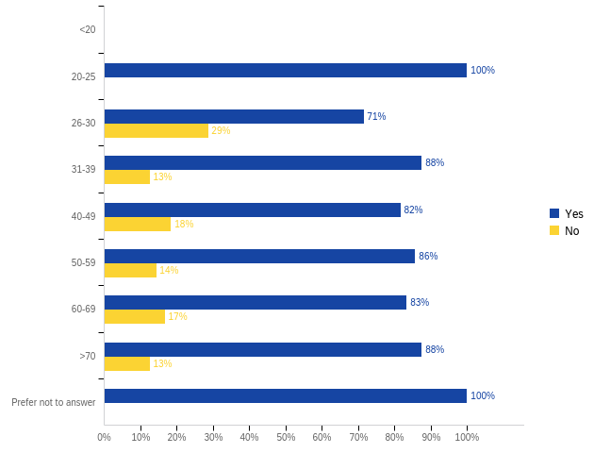
Strategic Planning Report: G3-S2
POLY Member? Y/N
American Chemical Society Division of Polymer Chemistry
ExComm Winter Meeting, Orlando, FL 01/27/2024

Slide 6
Strategic Planning Report: G3-S2
(only 1 survey)
(14 surveys)
(17 surveys)
(32 surveys under 40 yrs age)
American Chemical Society Division of Polymer Chemistry
ExComm Winter Meeting, Orlando, FL 01/27/2024

Slide 7
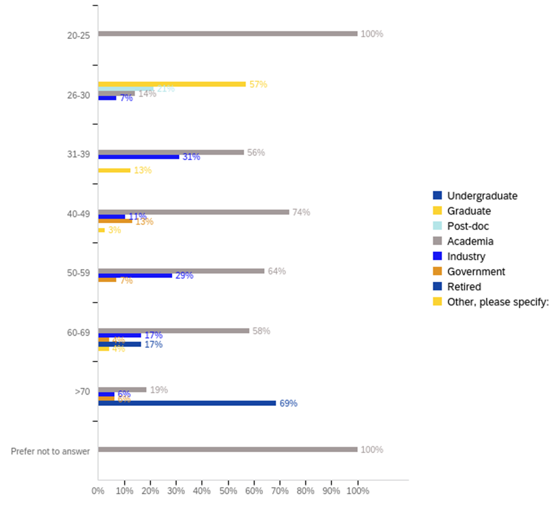
Strategic Planning Report: G3-S2
American Chemical Society Division of Polymer Chemistry
ExComm Winter Meeting, Orlando, FL 01/27/2024

Slide 8
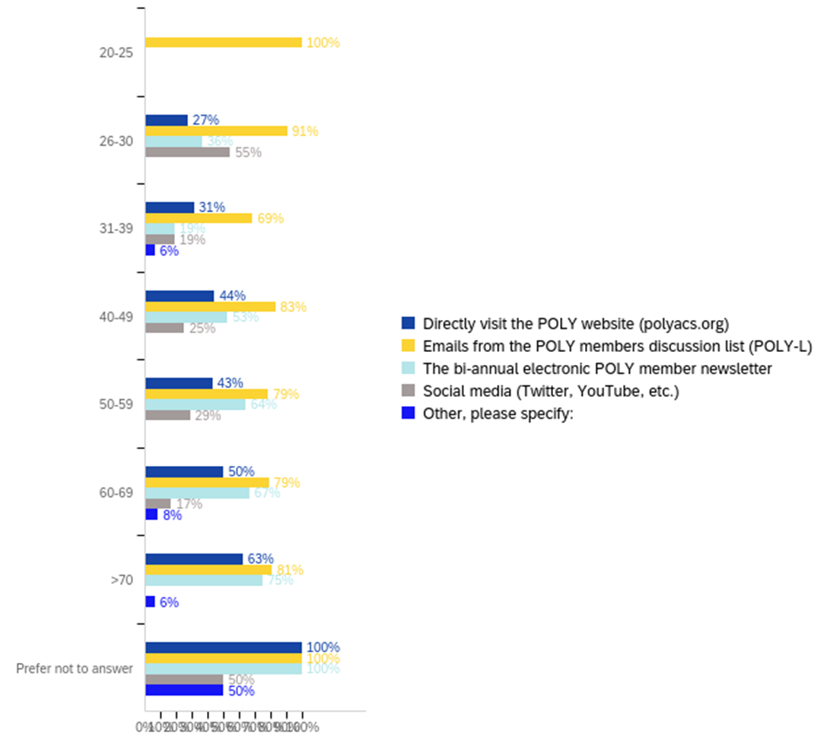
Strategic Planning Report: G3-S2
American Chemical Society Division of Polymer Chemistry
ExComm Winter Meeting, Orlando, FL 01/27/2024

Slide 9
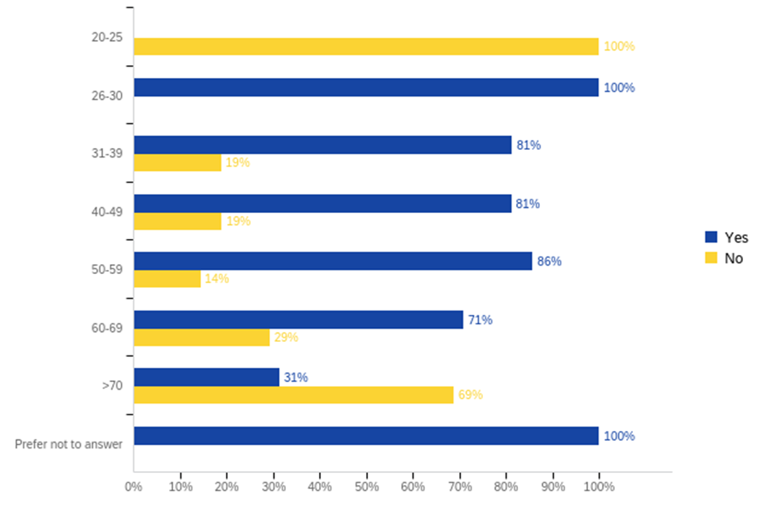
Strategic Planning Report: G3-S2
American Chemical Society Division of Polymer Chemistry
ExComm Winter Meeting, Orlando, FL 01/27/2024

Slide 10
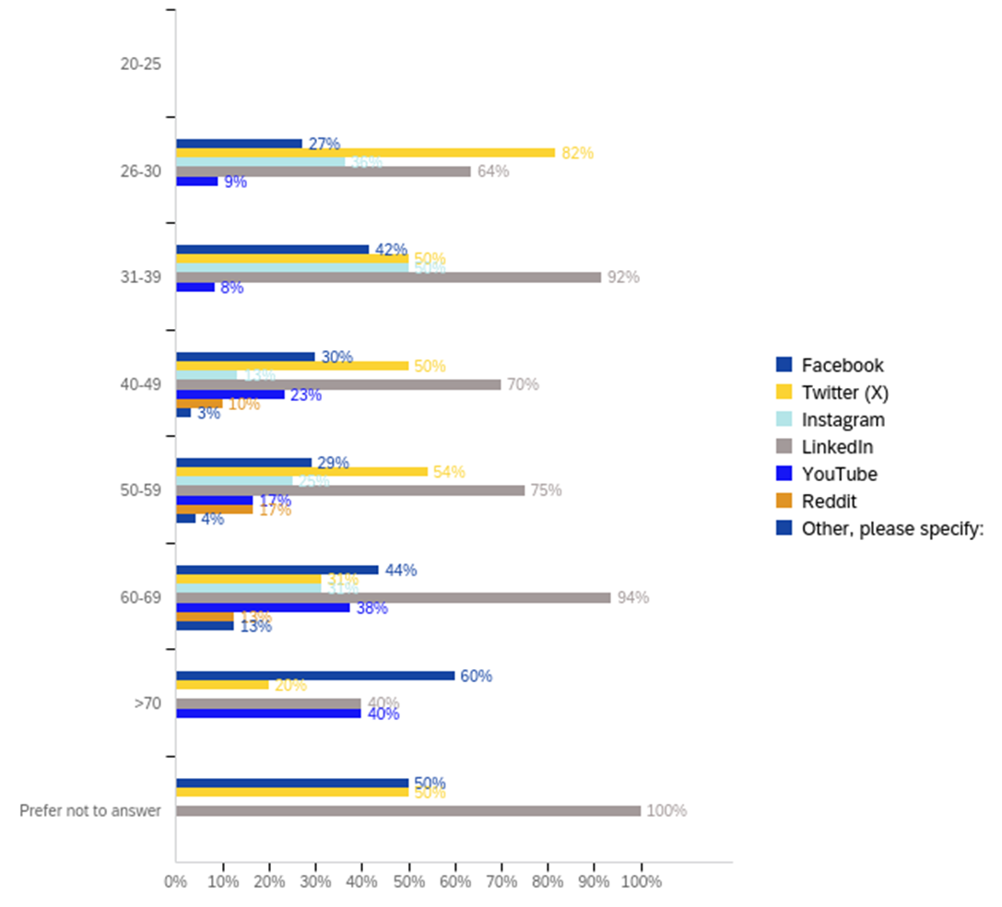
Strategic Planning Report: G3-S2
American Chemical Society Division of Polymer Chemistry
ExComm Winter Meeting, Orlando, FL 01/27/2024

Slide 11
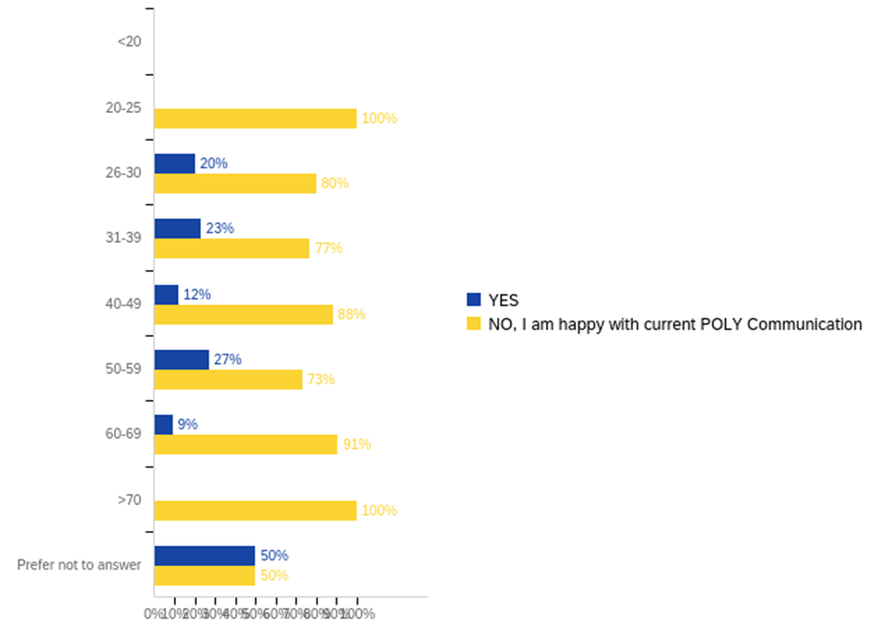
Strategic Planning Report: G3-S2
American Chemical Society Division of Polymer Chemistry
ExComm Winter Meeting, Orlando, FL 01/27/2024

Slide 12
Strategic Planning Report: G3-S2
(AGE)
(31-39)
(40-49)
(26-30)
(31-39)
(60-69)
(50-59)
(50-59)
(40-49)
(50-59)
(NR)
(50-59)
(60-69)
(40-49)

Slide 13
Strategic Planning Report: G3-S2
Final Thoughts: I’d like to brainstorm ideas on how we can get a larger survey sample size for age <30.
NGRPC with a nice raffle prize?
STUDENT ONLY RAFFLE @ ACS? (maybe at the student social?)
American Chemical Society Division of Polymer Chemistry
ExComm Winter Meeting, Orlando, FL 01/27/2024

