Slide 1

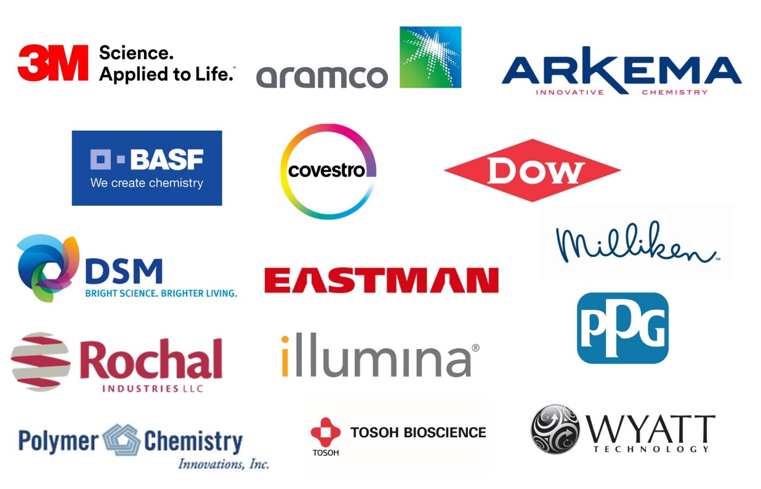
POLY Industrial Advisory Board
Annual dues: $1,500
Chair: Corinne Lipscomb (3M)
Vice Chair: Peter Boul (Aramco)

Slide 2
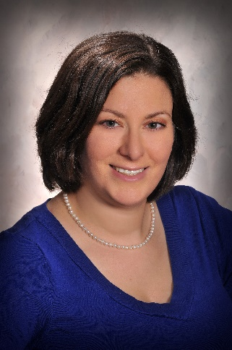
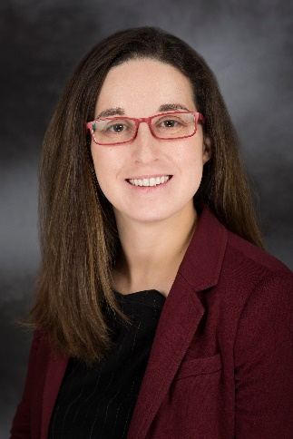
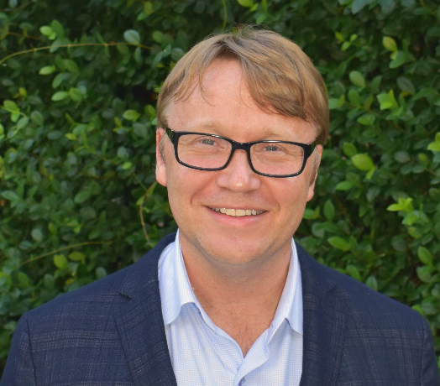
IAB Mission & Officers 2021
Chair: Corinne Lipscomb
(3M Company)
Co-Chair: Hayley Brown
(Dow)
Co-Chair: Peter Boul
(Aramco)
Networking
Finance & Reporting
Bulletin
IPS & YIPS Support
New Initiatives
Succession Planning
Programming
Grants & External Funding
Membership
“Enhance and foster industrial engagement and support to develop
programming, education, recognition & awards
within the ACS Division of Polymer Chemistry.”

Slide 3
In 2021-
 | Proposed | Actual, year-end
Income | 24,000.00 | 22,825.20
Expenses
Networking | 7,000.00 | 3,463.64
Meetings | 8,000.00 | 254.00
Awards | 6,200.00 | 6.930.00
Programming … virtual, future webshops | 3,200.00 | 8,000.00
Other (shirts, pins) | 1,600.00 | 0
subtotal | 26,000.00 | 18,647.64
Bal | -2,000.00 | +4,277.56
Budget

Slide 4
In 2022-
 | Proposed
Income | 23,000.00
Expenses
Networking | 10,000.00
Meetings | 11,000.00
Awards (prepaid in 2021) | 1,200.00
Programming (no virtual) | 2,000.00
Other (shirts, pins) | 1,800.00
subtotal | 26,000.00
Bal | -3,000.00
Budget

Slide 5
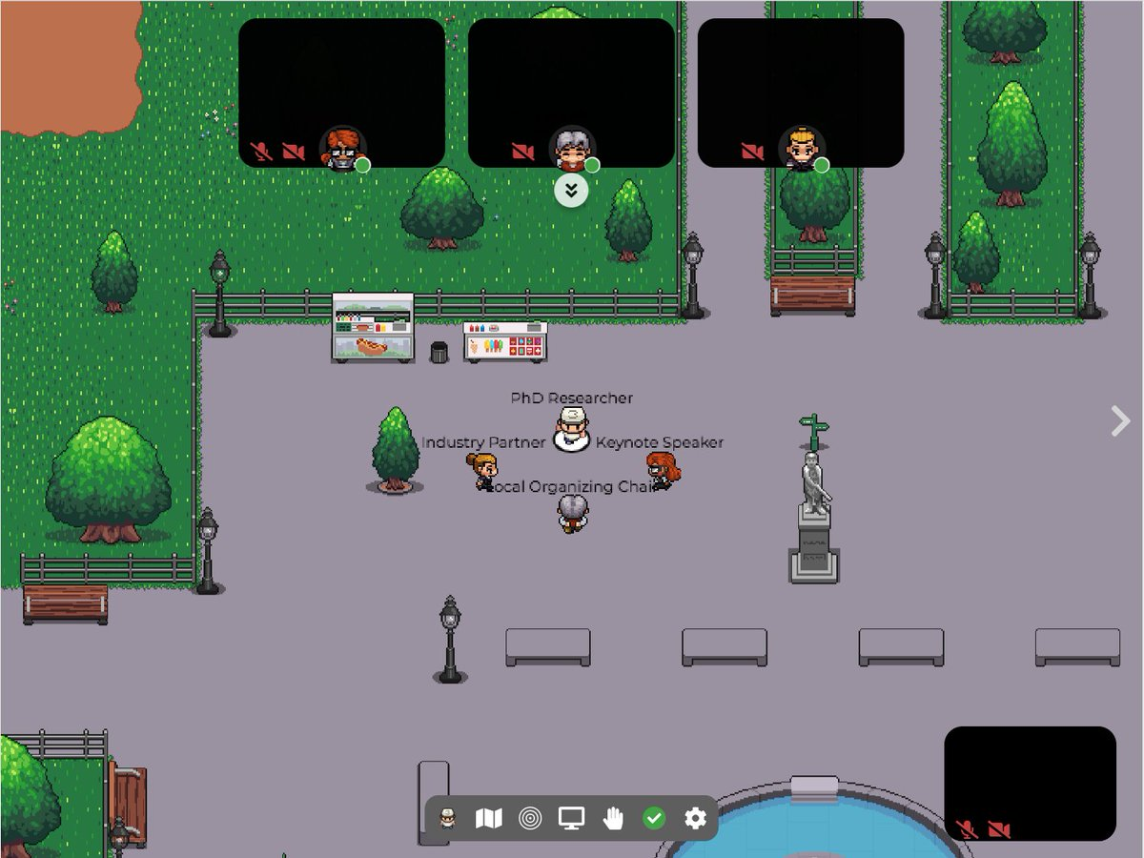
Networking
No networking in the spring
Virtual networking in late fall via gather.town (recommended by IAB members and used by VA Tech for the Graduate Research Polymer Conference)
Platform free for less than 25 attendees (set up by Hayley Brown)
Shipped networking items, cost less than 2K
20 registered to participate
Significant positive feedback
Plans are for a live event at the Spring ACS Meeting

Slide 6
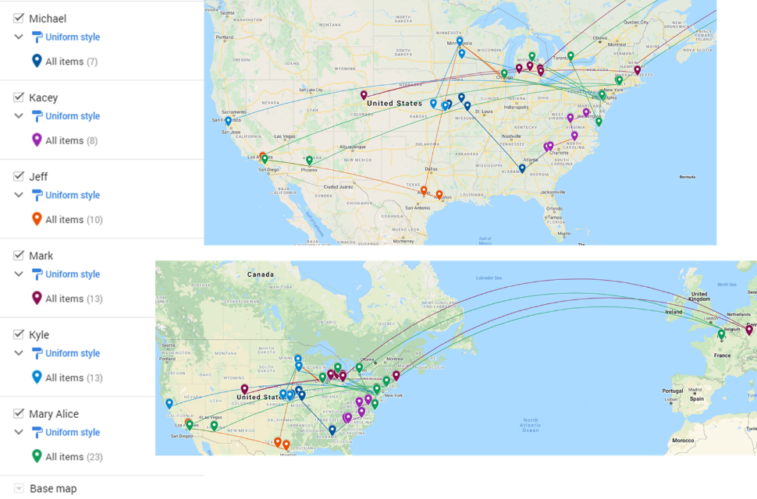



Networking, also in 2021-
New Industry Employee Networking – Pilot 4 Session Framework
Introduction Session & Get to Know You Activity – February
Organized by Michael Minkler, Milliken Chemical
Unwritten Rules to Industry Success Panel Discussion - April
Organized by Jeff Ting, 3M Company
YIPS Winner Discussion – August/September
Mark Schwartzlander, BASF
Kyle Snow, Citrine Informatics
Mary Upshur, Dow Chemical
Kacey Hall, Milliken Chemical

Slide 7
Regional Meeting Networking in 2021-
Rocky Mountain RM October 2021 – Industrial Networking
Introduction Session & Get to Know You Activity – February
Organized by Michael Minkler, Milliken Chemical
Unwritten Rules to Industry Success Panel Discussion - April
Organized by Jeff Ting, 3M Company
Other sessions TBD, which organization by:
Mark Schwartzlander, BASF
Kyle Snow, Citrine Informatics
Mary Upshur, Dow Chemical
Kacey Hall, Milliken Chemical

Slide 8
2021 Programming - other
Webinars
POLY Webshops
Regional Meeting
Spring ACS Webinar: Solving the Plastic Waste Problem
IAB’s Peter Boul moderated this event.
IAB sponsored speaker honoraria
Spring Webshop on Stimulus-Responsive Polymers and Liquid Crystal Elastomers
IAB’s Peter Boul moderated this event.
IAB sponsored speaker honoraria
2021 Rocky Mountain Regional Meeting.
October 28 – 30, 2021
Organized by IAB Member Laura Stratton
Joint session/webinar
Fall ACS Webinar: Polymers and Nanomaterials for Low Carbon Energy
Organized by Peter Boul.
To continue to support of these and other programming opportunities, IAB will identify if initiatives help to achieve supporting the interests of its industrial members.

Slide 9
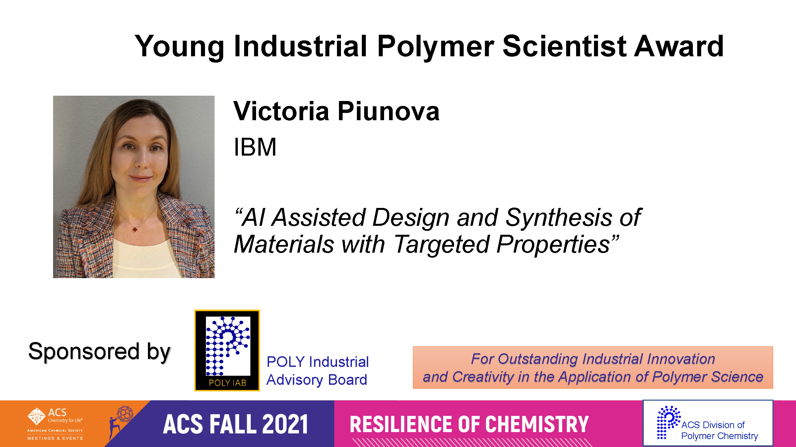
Awards supported in 2021

Slide 10
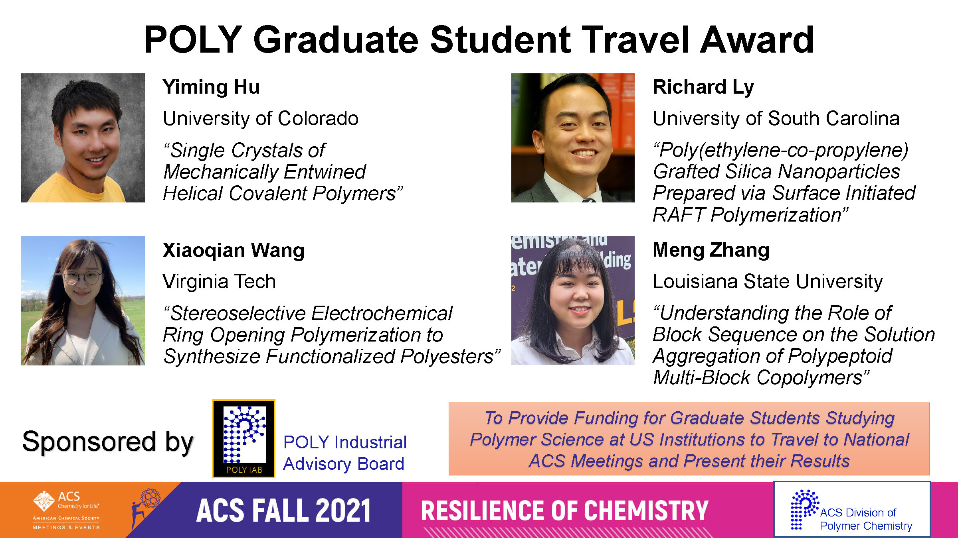
Awards supported in 2021

Slide 11
ACS Programming in 2021
Spring ACS
IIPS - Industrial Innovations in Polymer Science, Spring virtual ACS Meeting, April 8, 2021. The session was chaired by Michael Abrams (Arkema), Peter Boul (AramcoAmericas), and Bradley Rodier (Rochal).
Fall ACS
IIPS - Industrial Innovations in Polymer Science: Sustainable Materials, Fall virtual piece of ACS Meeting, August 23, 2021, The session was chaired by James Bohling, Organizer, The Dow Chemical Company; Wei Gao, Organizer, The Dow Chemical Company; Michael Minkler, Organizer, Miliken

Slide 12
Awards in 2022
Continue to support 4 POLY Graduate Student Travel Awards ($750 each)
Industrial Polymer Scientist Award (IPS) is endowed by POLY and will not be paid out through this budget; however, IAB will reach out to IAB members to support the organizers of the fall symposium.

Slide 13
IAB Focuses for 2022
Maintain programming, awards support
Return to in-person meetings
IAB Networking Sessions
IAB meeting
Understanding value IAB provides in long-term hybrid environment
Driving new memberships

Slide 14
ACS Programming in 2022
Spring ACS
IIPS – Spring 2022, Bonding Through Chemistry, March 20 – 24, San Diego, CA. Organizers/chairs: Michael Minkler (Milliken), Michael Liu (Glaukos), Manesh Sekharan (Dow), Hayley Brown (Dow)
Graduate Research Symposium support, March 20 – 24, San Diego, CA
Undergraduate Research Symposium support, March 20 – 24, San Diego, CA
Fall ACS
IIPS – Fall 2022, Sustainability in a Changing World, August 21 – 25, Chicago, IL. Organizers/chairs: Michael Petr (Dow), Daniel Abebe (Dow), Hayley Brown (Dow)
IPS Award in Honor of Margaret Sheridan (3M) – Award announced and organizers TBD

Slide 15
Thank you
Industrial Advisory Board
Plans are to demonstrate an in-person presence at the Spring ACS Meeting. See you there!

Slide 16
Notes and previous slides:

Slide 17
In 2020-
Programming
Meetings
Networking
Virtual
- IIPS13 San Francisco (Fall 2020): P. Boul, K. Knauer, D. Germack
Monday, Aug 17 10:00 AM
“Chemistry from Bench to Market”
- Q&A through POLY
- IAB Meeting in both the Spring and Fall
Fall IAB Networking Reception (3 opportunities offered)
December Young Industrial Employee virtual networking sessions (2 opportunities offered)

Slide 18
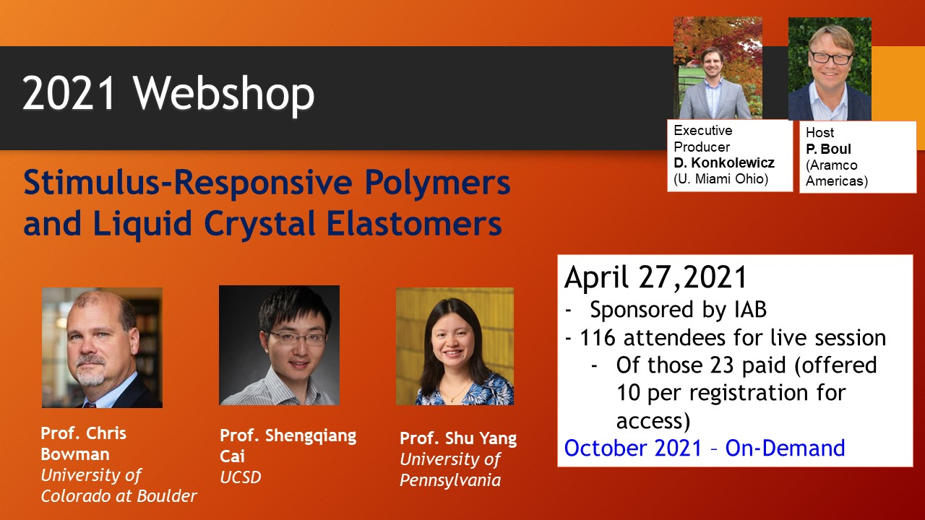
2021 – IAB Virtual Events, POLY Webshops
At least 37 industrial attendees

Slide 19
In 2020-
 | Proposed |  | Actual
Income | 40,500.00 |  | 19,681.65
Expenses
Networking | 10,000.00 |  | 680.32
Meetings | 10,800.00 |  | 400.00
Awards | 5,200.00 |  | 5,099.00
Programming … virtual, future webshops | 2000.00 |  | 10,695.00
Other (shirts, pins) | 1,600.00 |  | 648.82
subtotal | 30,100.00 |  | 17,523.14
Bal |  |  | 2158.51
Budget
Some 2021 items were pre-paid during 2020
38% drop-off in funds collection in 2020

