Slide 1

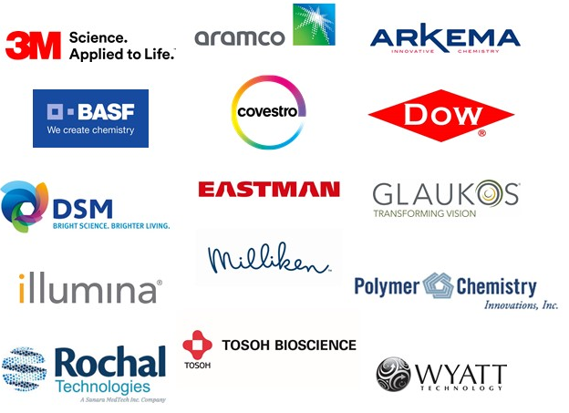
POLY Industrial Advisory Board
Annual dues: $1,500
Chair: Corinne Lipscomb (3M)
Vice Chair: Hayley Brown (Dow, Inc)

Slide 2
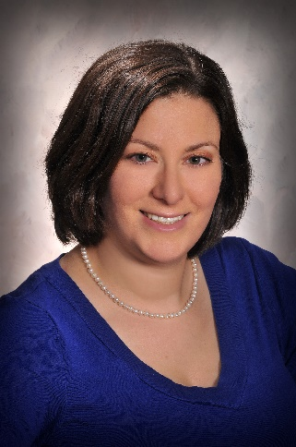
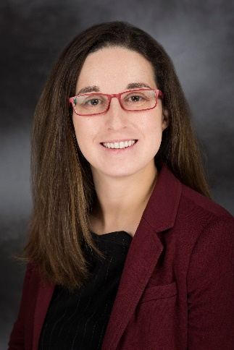
IAB Mission & Officers 2022
Chair: Corinne Lipscomb
(3M Company)
Co-Chair: Hayley Brown
(Dow)
Networking
Finance & Reporting
Bulletin
IPS & YIPS Support
New Initiatives
Succession Planning
Membership
Programming
“Enhance and foster industrial engagement and support to develop programming, education, recognition & awards within the ACS Division of Polymer Chemistry.”

Slide 3
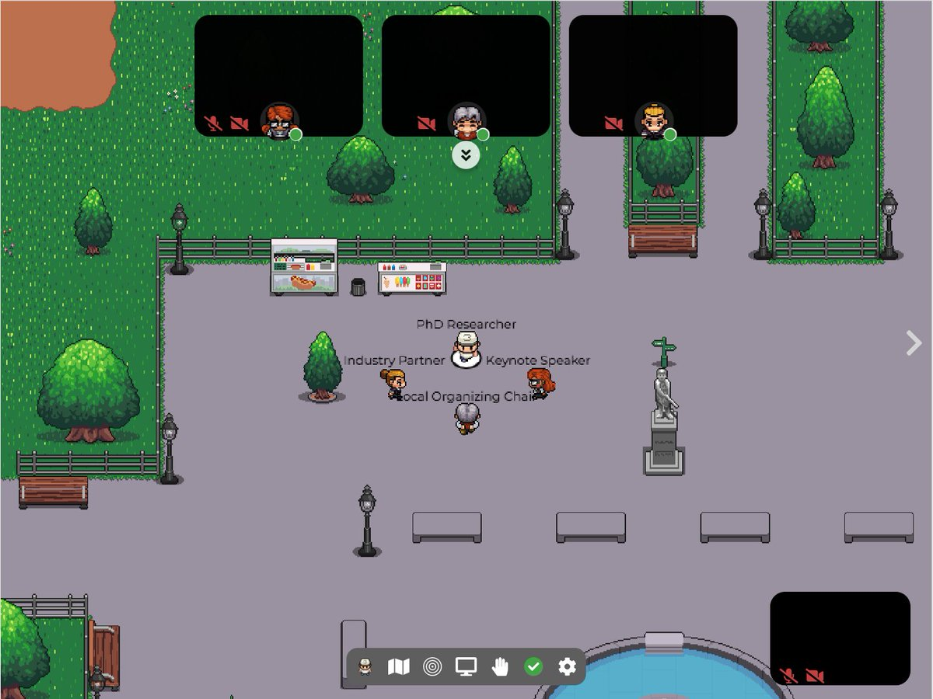
Networking
No networking in the spring
Virtual networking in late fall via gather.town (recommended by IAB members and used by VA Tech for the Graduate Research Polymer Conference)
Platform free for less than 25 attendees (set up by Hayley Brown)
Shipped networking items, cost less than 2K
20 registered to participate
Significant positive feedback
Plans are for a live event at the Spring ACS Meeting

Slide 4
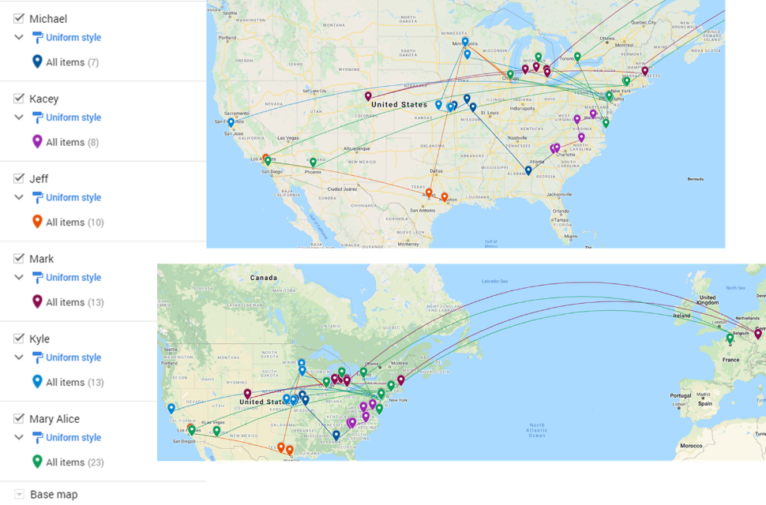



Networking, also in 2021-
New Industry Employee Networking – Pilot 4 Session Framework
Introduction Session & Get to Know You Activity – February
Organized by Michael Minkler, Milliken Chemical
Unwritten Rules to Industry Success Panel Discussion - April
Organized by Jeff Ting, 3M Company
YIPS Winner Discussion – August/September
Mark Schwartzlander, BASF
Kyle Snow, Citrine Informatics
Mary Upshur, Dow Chemical
Kacey Hall, Milliken Chemical

Slide 5
Regional Meeting Networking in 2021-
Rocky Mountain RM October 2021 – Industrial Networking
Introduction Session & Get to Know You Activity – February
Organized by Michael Minkler, Milliken Chemical
Unwritten Rules to Industry Success Panel Discussion - April
Organized by Jeff Ting, 3M Company
Other sessions TBD, which organization by:
Mark Schwartzlander, BASF
Kyle Snow, Citrine Informatics
Mary Upshur, Dow Chemical
Kacey Hall, Milliken Chemical

Slide 6
2021 Programming - other
Webinars
POLY Webshops
Regional Meeting
Spring ACS Webinar: Solving the Plastic Waste Problem
IAB’s Peter Boul moderated this event.
IAB sponsored speaker honoraria
Spring Webshop on Stimulus-Responsive Polymers and Liquid Crystal Elastomers
IAB’s Peter Boul moderated this event.
IAB sponsored speaker honoraria
2021 Rocky Mountain Regional Meeting.
October 28 – 30, 2021
Organized by IAB Member Laura Stratton
Joint session/webinar
Fall ACS Webinar: Polymers and Nanomaterials for Low Carbon Energy
Organized by Peter Boul.
To continue to support of these and other programming opportunities, IAB will identify if initiatives help to achieve supporting the interests of its industrial members.

Slide 7
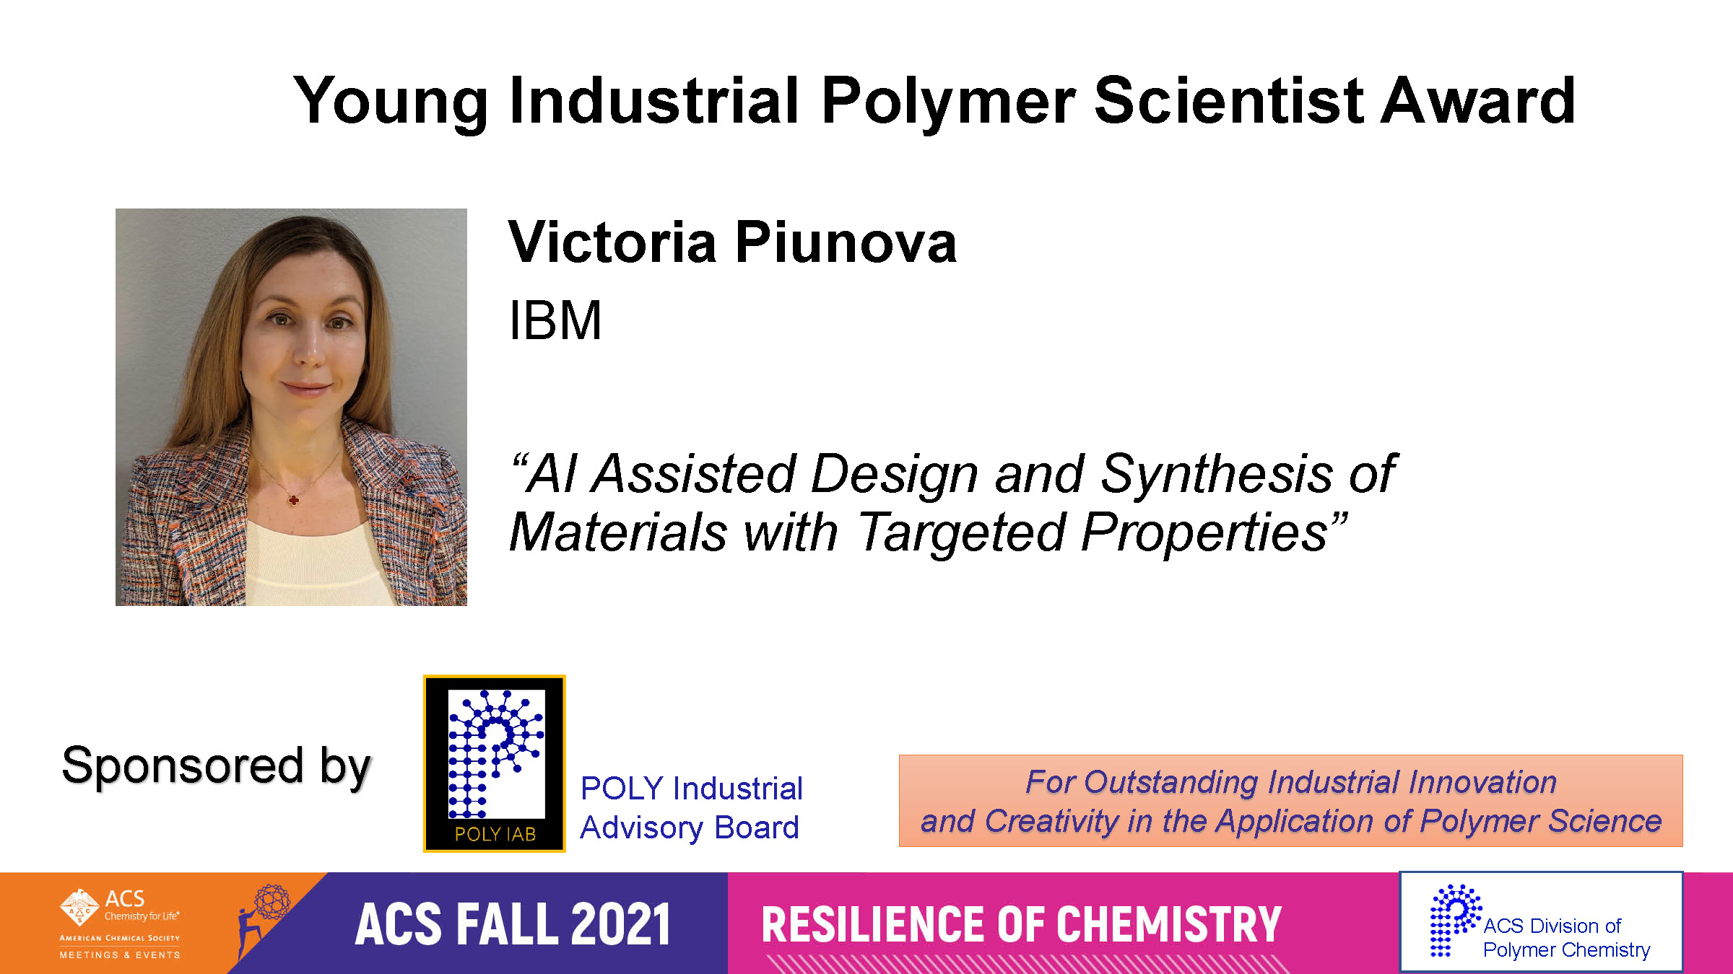
Awards supported in 2021

Slide 8
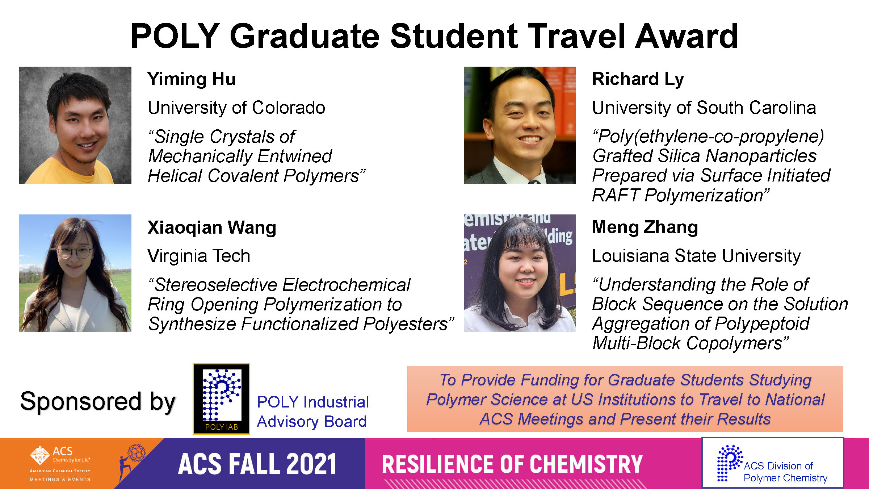
Awards supported in 2021

Slide 9
ACS Programming in 2021
Spring ACS
IIPS - Industrial Innovations in Polymer Science, Spring virtual ACS Meeting, April 8, 2021. The session was chaired by Michael Abrams (Arkema), Peter Boul (AramcoAmericas), and Bradley Rodier (Rochal).
Fall ACS
IIPS - Industrial Innovations in Polymer Science: Sustainable Materials, Fall virtual piece of ACS Meeting, August 23, 2021, The session was chaired by James Bohling, Organizer, The Dow Chemical Company; Wei Gao, Organizer, The Dow Chemical Company; Michael Minkler, Organizer, Miliken

Slide 10
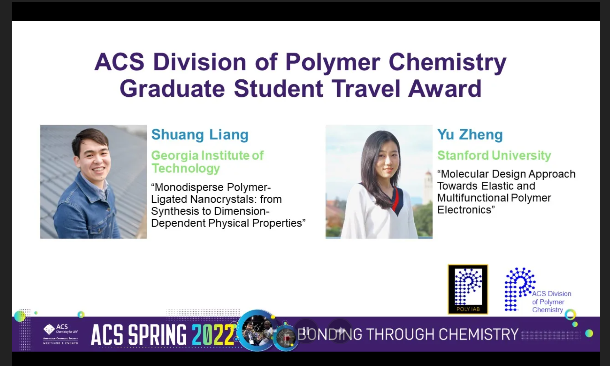
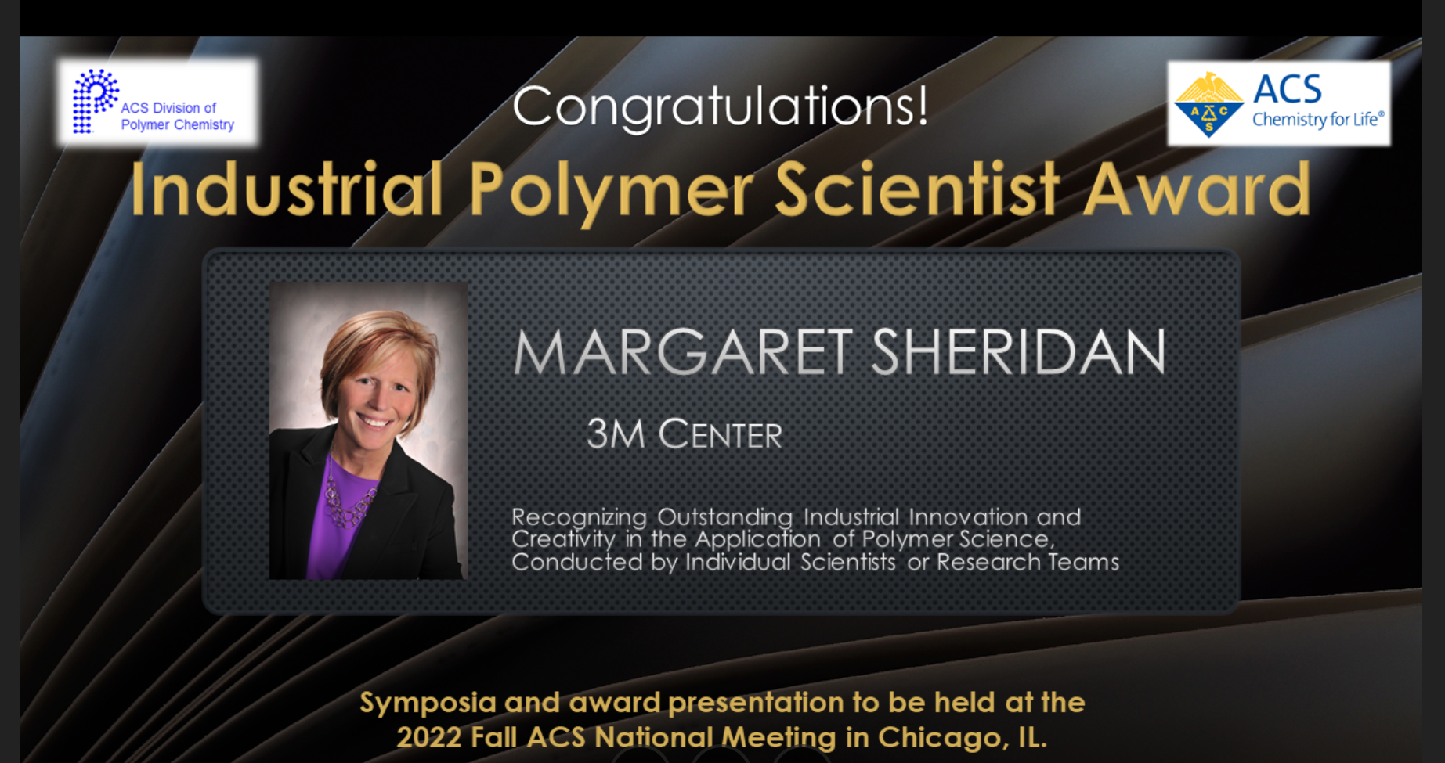
Awards in 2022
Continue to support 4 POLY Graduate Student Travel Awards ($750 each)
Industrial Polymer Scientist Award (IPS) IAB provides assistance to support the organizers of the fall symposium.

Slide 11
IAB Focuses for 2022
Maintain programming, awards support
Return to in-person meetings
IAB Networking Sessions
IAB meeting
Understanding value IAB provides in long-term hybrid environment
Driving new memberships

Slide 12
ACS Programming in 2022
Spring ACS
IIPS – Spring 2022, Bonding Through Chemistry, March 20 – 24, San Diego, CA. Organizers/chairs: Michael Minkler (Milliken), Michael Liu (Glaukos), Manesh Sekharan (Dow), Hayley Brown (Dow)
Graduate Research Symposium support, March 20 – 24, San Diego, CA
Undergraduate Research Symposium support, March 20 – 24, San Diego, CA
Fall ACS
IIPS – Fall 2022, Sustainability in a Changing World, August 21 – 25, Chicago, IL. Organizers/chairs: Michael Petr (Dow), Daniel Abebe (Dow), Hayley Brown (Dow)
IPS Award in Honor of Margaret Sheridan (3M) – Award announced and organizers TBD

Slide 13
Organized at this ACS Meeting – Join us!!!
IAB Events
IAB Programming
Monday 21 March at 6:30 pm
IAB Networking Reception (all Exec, IAB Companies, and their invitees)
Location: Mister A's (https://www.asrestaurant.com/)
2550 Fifth Avenue Twelfth Floor, San Diego, CA 92103
East Patio
Consider getting a taxi/Uber
Tuesday 22 March 7:30 am
Industrial Advisory Board (IAB and ExCom Only)
In-person breakfast meeting
The Nolen (http://thenolenrooftop.com/)
Rooftop Lounge (inside Courtyard Marriott)
453 6th Ave.
San Diego, CA 92101
Thursday 24 March starting at 08:00am - 12:05pm PT,
Polymer Science (IIPS) at the next two ACS Meetings.
Location: Pacific Ballroom: Section 15 (Marriott Marquis San Diego Marina) Hayley Brown, Organizer, Presider; Michael Minkler, Organizer; Manesh Sekharan, Organizer, Presider

Slide 14
Thank you
Industrial Advisory Board

