Slide 1

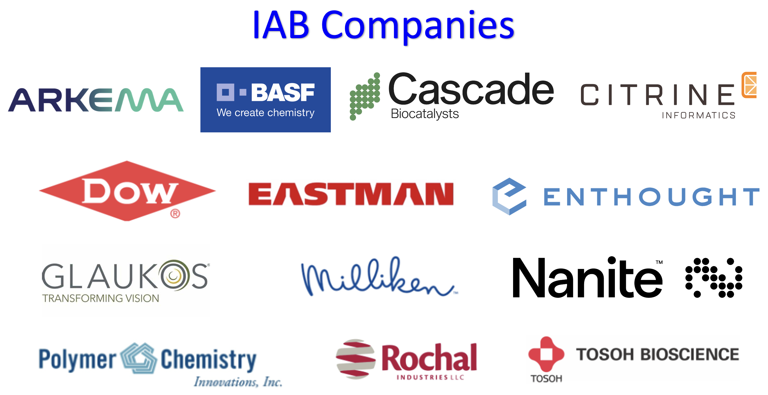
POLY Industrial Advisory Board
Annual dues: $1,500
Small company dues: $500
Chair: Hayley Brown (Dow)
Co-Chair: Jeff Ting (Nanite)

Slide 2
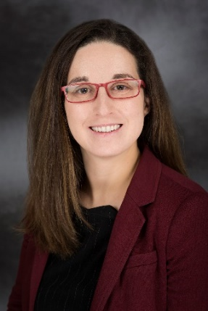

IAB Mission & Officers 2024
Chair: Hayley Brown
(Dow)
Co-Chair: Jeff Ting
(Nanite)
Networking
Monday networking hour
Tuesday morning breakfast
Finance & Reporting
IAB business meetings
Bulletin
Succession Planning
Industrial Awards (IPS & YIPS) Support
Membership Recruitment & Retainment
Ongoing New Initiatives
Symposium Organizing
New Industry Networking Group: Spotlight Series
Programming
IIPS
Other industrial programming
“Enhance and foster industrial engagement and support to develop programming, education, recognition & awards within the ACS Division of Polymer Chemistry.”

Slide 3
Budget- Income ( $18,000 projected for 2024)
Projected | Received | Company
$ 1,500.00 |  | 3M
$ 1,500.00 |  | Aramco Services
$ 1,500.00 | $ 1,500.00 | Arkema
$ 1,500.00 | $ 1,500.00 | BASF
$ 500.00 | $ 500.00 | Citrine Informatics
$ 1,500.00 |  | Covestro
$ 1,500.00 | $1,500.00 | The Dow Chemical Company
$ 1,500.00 | $1,500.00 | Eastman Chemical
$ 1,500.00 |  | Gelest
$ 1,500.00 | $1,500.00 | Glaukos
$ 1,500.00 |  | Kraton
$ 1,500.00 |  | Lyten
$ 1,500.00 | $ 1,500.00 | Milliken
$ 500.00 | $ 500.00 | Nanite
$ 500.00 | $ 500.00 | Polymer Chemistry Innovations
$ 1,500.00 |  | PPG Industries
$ 1,500.00 | $ 1,500.00 | Rochal Technologies
$ 1,500.00 | $ 1,500.00 | Tosoh Biosciences
$ 500.00 | $ 500.00 | Enthought
$ 500.00 | $ 500.00 | Cascade Biocatalysts
4,000 | $6000 | Voided in checks from 2022
$ 29,000.00 | $ 22,500.00
Model with individual contacts for IAB companies encountering difficulties
General industry move away from generic support to specific sponsorship
Small companies initiative working well

Slide 4
Budget- Expenses ($25,000 projected 2024)
Activity | Category | Anticipated 2023 | Actual Expense 2023 | Planned 2024
Spring Networking | Networking | $ 4,000.00 | $2,266.76 | $3,500.00
Fall Networking | Networking | $ 5,000.00 | $11,876.00 | $3,500.00
Spring Breakfast | Meetings | $ 4,000.00 | $2,800.18 | $2,500.00
Fall Breakfast | Meetings | $ 4,000.00 | $3,699.66 | $2,500.00
Staff travel support | Meetings | $ 2,000.00 | $0.00 | $0.00
Additional Meetings Spring | Meetings | $ 300.00 | $75.98 | $100.00
NERM | Meetings |  | $2,000.00
Additional Meetings Fall | Meetings | $ 500.00 | $0.00
Constant Contact/media access | Meetings | $ 200.00 | $0.00
YIPS Award (Fall Odd Yrs) |  | $ 2,000.00 | $2,000.00
YIPS Travel (Fall Odd Yrs) | Awards | $ 4,000.00 | $2,000.00
IPS Award (Fall Even Yrs) | Awards | $ - | $0.00 | $0.00
Graduate Student Travel Award #1 Spring | Awards | $ 750.00 | $750.00 | $750.00
Graduate Student Travel Award #2 Spring | Awards | $ 750.00 | $750.00 | $750.00
Graduate Student Travel Award #1 Fall | Awards | $ 750.00 | $750.00 | $750.00
Graduate Student Travel Award #2 Fall | Awards | $ 750.00 | $750.00 | $750.00
Grad Student Travel Awd Poster | Awards | $ 200.00 | $0.00
Identify Award Opportunity | Awards | $ 1,000.00 | -
Spring - Graduate Research Symp. | Programming | $ 1,000.00 | $1,000.00 | $1,000.00
Spring- Undergraduate Research Symp. | Programming | $ 1,000.00 | $1,000.00 | $1,000.00
IIPS Symposia (Fall) | Programming | - | -
NGRPC (UMICH) | Meetings | $ 2,000.00 | $2,000.00
Other |  | $ -
 | TOTAL EXP | $ 34,200.00 | $33,718.58 | $17,100.00

Slide 5
New Initiatives in 2024
Company Recruitment & Retainment
New Symposium at Fall ACS 2024
Emphasize strategic opportunities for joining IAB:
Global Visibility to one of the largest and most active non-profit, international groups devoted to the advancement of Polymer Science (credibility, potential partnerships, networking) – especially valuable to smaller companies
Sustained Growth to recruit top talent in the polymer science and engineering community
Direct Research Exposure to influence ACS POLY programming, events, and awards that highlight technical areas of interest to the company – example to the right →
Establish centralized IAB value proposition information sheet
Subcommittee working on revising small company IAB recruitment handout
Useful for handoff to upper management in justifying value
“Elevating the Power of Data for Materials and Chemical Scientists in Industry,” co-organized by 3 IAB member company reps at Nanite, Enthought, and Dow
Cross-listed with PMSE, CINF divisions
Motivation: no real “home base” for chemists, material scientists, and engineers working with polymers in industry to discuss challenges and best practices for the AI and digitalization movement
Aiming to invite only industrial speakers with diverse backgrounds and technology expertise
Form NING Spotlight Series to support early career scientists
Kickoff with invited ACS Polymers Au editorial: “Finding Professional Growth and Fulfillment for Early Career Polymer Scientists and Engineers in Industry”

Slide 6
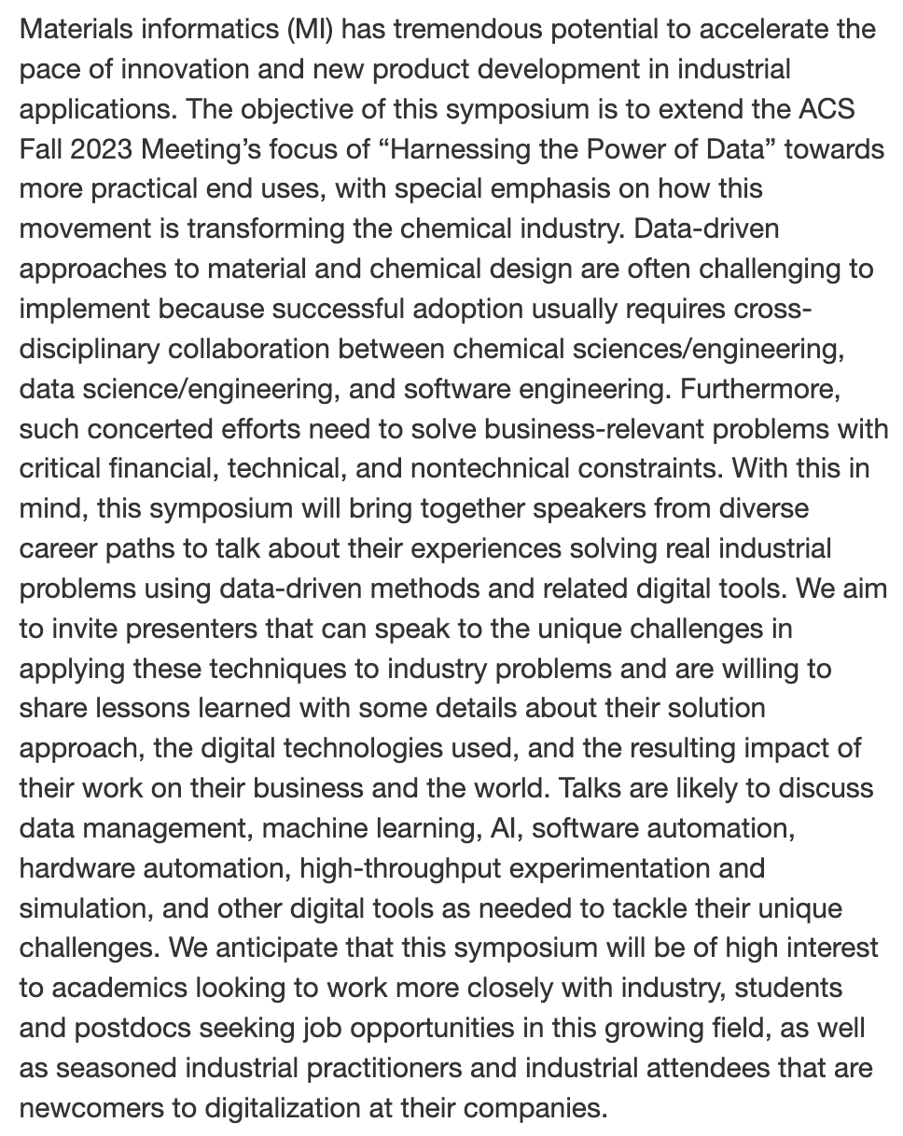
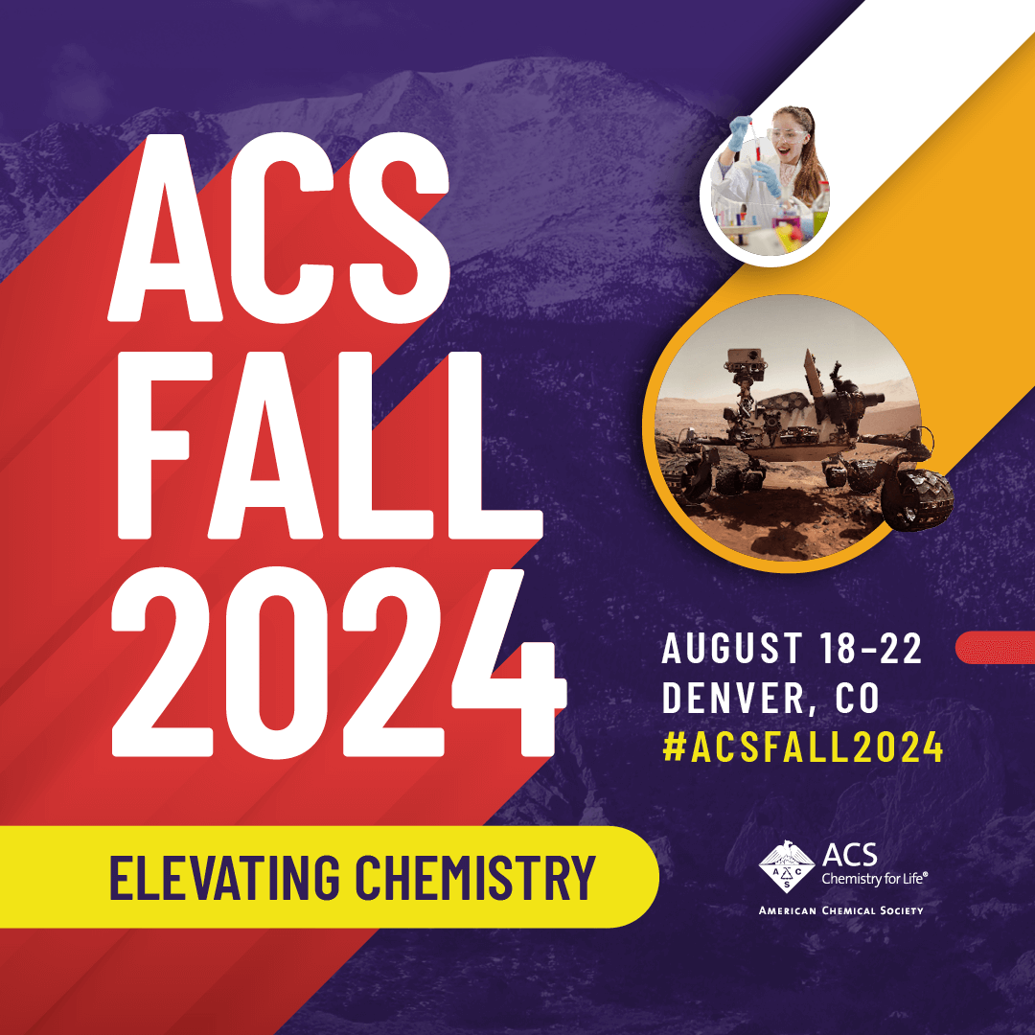

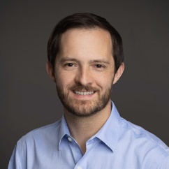
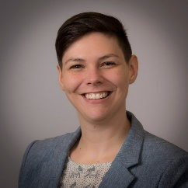
“Elevating the Power of Data for Materials and Chemical Scientists in Industry”
Re-connected with Mike Heiber (Materials Informatics Leader at Enthought, which focuses on digitalization in materials science/chemistry, life science, semiconductor, energy industries)
Connection to Alix Schmidt (Senior Data Scientist, R&D Model Deployment Strategy Leader at Dow)
Learned that they previously organized a session at the spring AIChE Meeting (chemical engineering annual meeting)
Disorganized advertising, not the right fit for attendees
Discussed lessons learned and focused symposium description to reach targeted speakers and audience
Cross-listed with PMSE ($ support) and CINF divisions for advertisement to members

Slide 7

“Finding Professional Growth and Fulfillment for Early Career Polymer Scientists and Engineers in Industry”
What it means to be a professional polymer scientist has undergone rapid and dramatic recent changes that have introduced important questions to ponder as one develops their early career…
Where is the potential to further create value from mature commodity plastics? What are the gaps in legacy materials that can be filled by higher-performing, yet still economically viable products? How can we as an industry realistically address the continued growth of plastics waste and the dependence of the industry on petroleum-derived resources? How are software-driven tools reshaping the R&D process?
And in the background of these technical challenges, the early-career polymer scientist must also contend with questions related to the business of developing and selling polymer materials. For example, what are the practical realities of a corporate R&D career in the de-risked business environment of the post-global financial crisis world? What opportunities do startups offer that large companies do not, and vice versa?
Indeed, finding a fulfilling career in polymer science is no longer as simple as deciding between academia and industry, and in the case of the latter, defaulting to a career at one of a handful of large chemical conglomerates. Considering these questions that will soon confront many PhD graduates, we write this Editorial to share our thoughts and experiences related to navigating our first years in the polymer industry.

