Slide 1

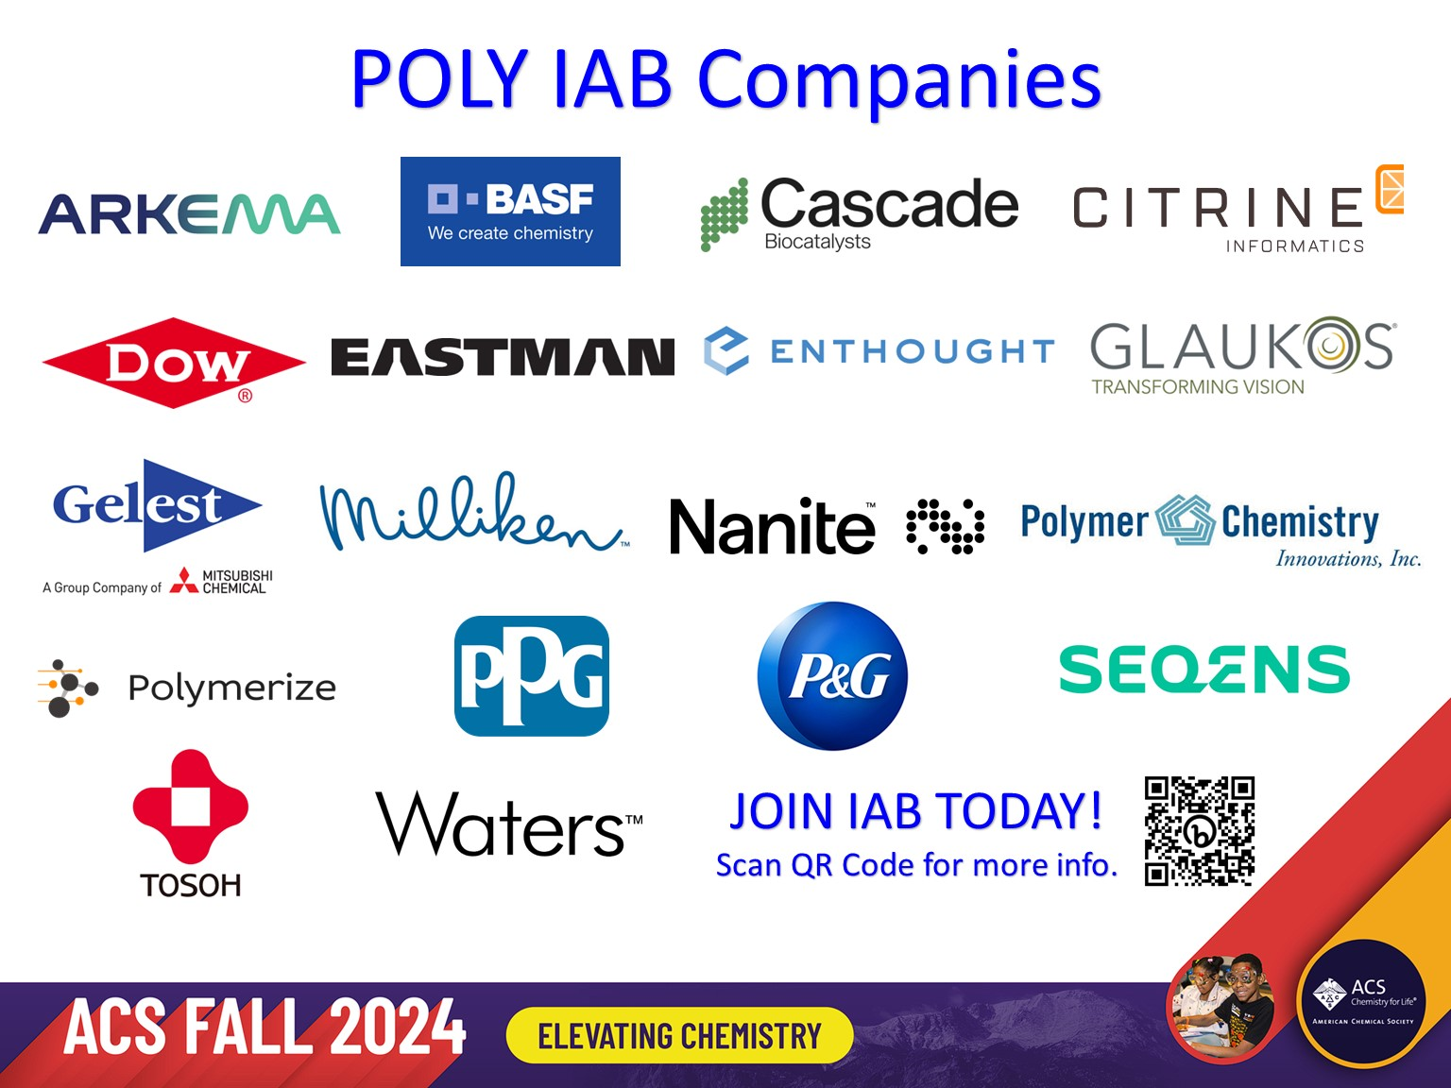
POLY Industrial Advisory Board
Annual dues: $1,500
Small company dues: $500
Chair: Hayley Brown (Dow)
Co-Chair: Jeff Ting (Nanite)

Slide 2
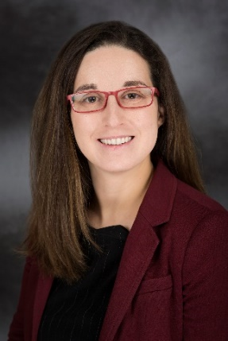

IAB Mission & Officers 2024
Chair: Hayley Brown
(Dow)
Co-Chair:
Networking
Monday networking hour
Tuesday morning breakfast
Finance & Reporting
IAB business meetings
Bulletin
Succession Planning
Industrial Awards (IPS & YIPS) Support
New Initiatives
New Industry Networking Group
Regional Meetings
Membership
Programming
IIPS
Other industrial programming
“Enhance and foster industrial engagement and support to develop programming, education, recognition & awards within the ACS Division of Polymer Chemistry.”

Slide 3
IAB Focuses for 2024
Maintain programming & awards support within budget
Deliver on member company initiatives
IAB Networking Sessions
IAB meeting
Integrate smaller company members while retaining long term larger member companies
Understanding value POLY and IAB provide in long-term hybrid environment
How to balance representing IAB member companies with generally representing “Industry” in POLY

Slide 4
Budget
Income on track with member company dues at 50% of completion vs. 2023
Multiple new companies welcomed!
~$9k collected and $10k outstanding
Working on budget control and planning
No AV Spring meeting well received and avoided potential inadvertent AV invoicing- planning to continue in Fall meeting
Holding off on 2025 symposium and award commitments until reassured of member company support

Slide 5
Budget- Expenses
Activity | Category | Planned 2024 | Actual 2024
Spring Networking | Networking | $3,500.00 | $5,206
Fall Networking | Networking | $3,500.00
Spring Breakfast | Meetings | $2,500.00 | $1,358
Fall Breakfast | Meetings | $2,500.00
Staff travel support | Meetings | $0.00
Additional Meetings Spring | Meetings | $100.00 | $31
NERM | Meetings
Additional Meetings Fall | Meetings
Constant Contact/media access | Meetings
YIPS Award (Fall Odd Yrs)
YIPS Travel (Fall Odd Yrs) | Awards
IPS Award (Fall Even Yrs) | Awards | $0.00
Graduate Student Travel Award #1 Spring | Awards | $750.00 | $750
Graduate Student Travel Award #2 Spring | Awards | $750.00 | $750
Graduate Student Travel Award #1 Fall | Awards | $750.00
Graduate Student Travel Award #2 Fall | Awards | $750.00
Grad Student Travel Awd Poster | Awards
Identify Award Opportunity | Awards
Spring - Graduate Research Symp. | Programming | $1,000.00 | $1000
Spring- Undergraduate Research Symp. | Programming | $1,000.00 | $1000
IIPS Symposia (Fall) | Programming
NGRPC (UMICH) | Meetings
Other
 | TOTAL EXP | $17,100.00 | $10,096

Slide 6
Fall 2024 Programming, Networking, and Awards
Industrial Polymer Scientist Award in honor of Carl L. Willis
Monday, August 19th
Organizers: Richard Spontak
Governor's Square 10 (Sheraton Denver Downtown Hotel)
“Industrial Innovations in Polymer Science” symposium
Organizers: Michael Petr, Julienne Regele, Dayton Street
Monday, August 19th
Governor's Square 10 (Sheraton Denver Downtown Hotel)
“Elevating the Power of Data for Materials and Chemical Scientists”
Organizers: Michael Heiber, Alix Schmidt, Jeffrey Ting
Wednesday, August 21st
Grand Ballroom I (Sheraton Denver Downtown Hotel)
IAB Networking Reception
Monday, August 19th , 6:00-8:00 pm
The Corner Office Restaurant & Martini Bar
(1401 Curtis Street, Denver, CO 80202)
Industrial Advisory Board Meeting
Tuesday, August 20th (continental breakfast), 7:30 am
Beverly Room (Sheraton Denver Downtown Hotel)
IAB and ExCom Members only
Reminder that YIPS Award deadline is October 31, 2024

Slide 7


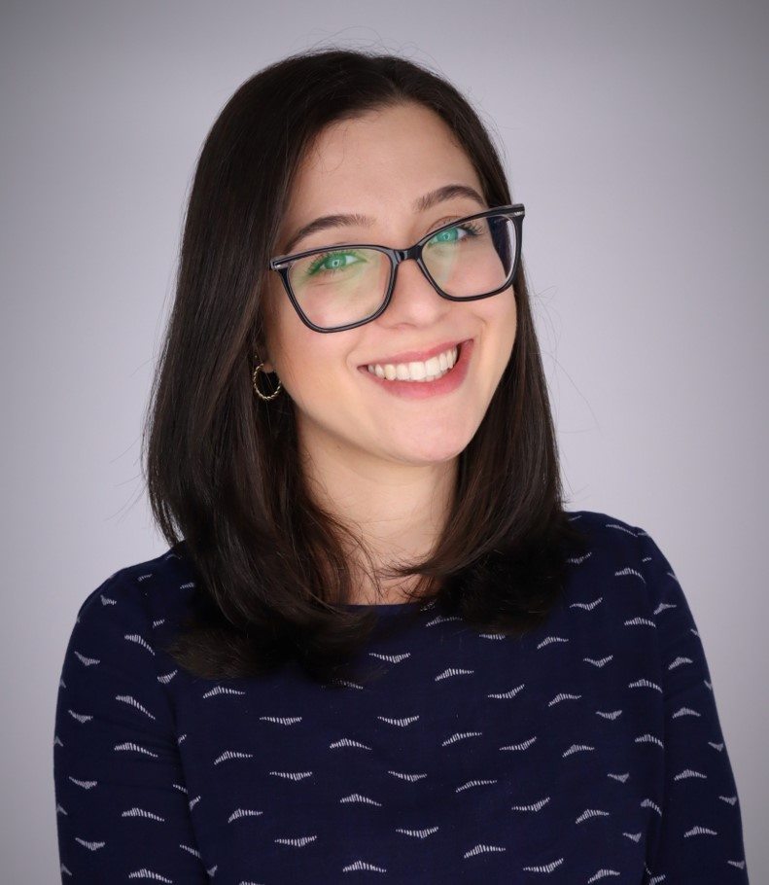
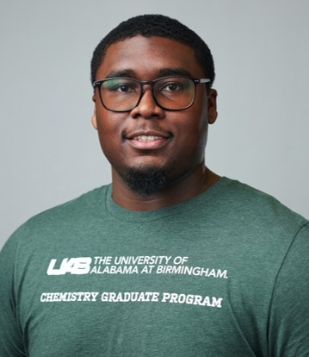
2024 Fall POLY Graduate Student Travel Award
Isabel Coutinho
Virginia Tech
Daniel Inman
University of Alabama
at Birmingham
Provides funding for graduate students studying polymer science at US institutions
to travel to national ACS meetings and present their results (poster or oral presentation).

Slide 8
New Initiatives in 2024
Company Recruitment & Retainment
Form NING Spotlight Series to support early career scientists
Kickoff with invited ACS Polymers Au editorial: “Finding Professional Growth and Fulfillment for Early Career Polymer Scientists and Engineers in Industry”
Establish centralized IAB value proposition information sheet
Subcommittee working on revising small company IAB recruitment handout
Useful for handoff to upper management in justifying value
Emphasize strategic opportunities for joining IAB:
Global Visibility to one of the largest and most active non-profit, international groups devoted to the advancement of Polymer Science (credibility, potential partnerships, networking) – especially valuable to smaller companies
Sustained Growth to recruit top talent in the polymer science and engineering community
Direct Research Exposure to influence ACS POLY programming, events, and awards that highlight technical areas of interest to the company – example to the right →

Slide 9
Thank you
Industrial Advisory Board

Slide 10
Notes

Slide 11
Spring 2024 Programming and Networking
“Industrial Innovations in Polymer Science” symposium
Organizers: Daniel Abebe, Kelli Ogawa, Farihah Haque
Monday, March 18th
Mardi Gras Blrm Salon C, New Orleans Marriott
IAB Networking Reception
Monday, March 18th , 6:00-7:00 pm
Henry’s Gin Bar, 317 Baronne St, New Orleans LA 70112
Industrial Advisory Board Meeting
Tuesday, March 19th (continental breakfast), 7:30 am
New Orleans Marriott, Studio ½
IIAB and EcCom Members only

Slide 12
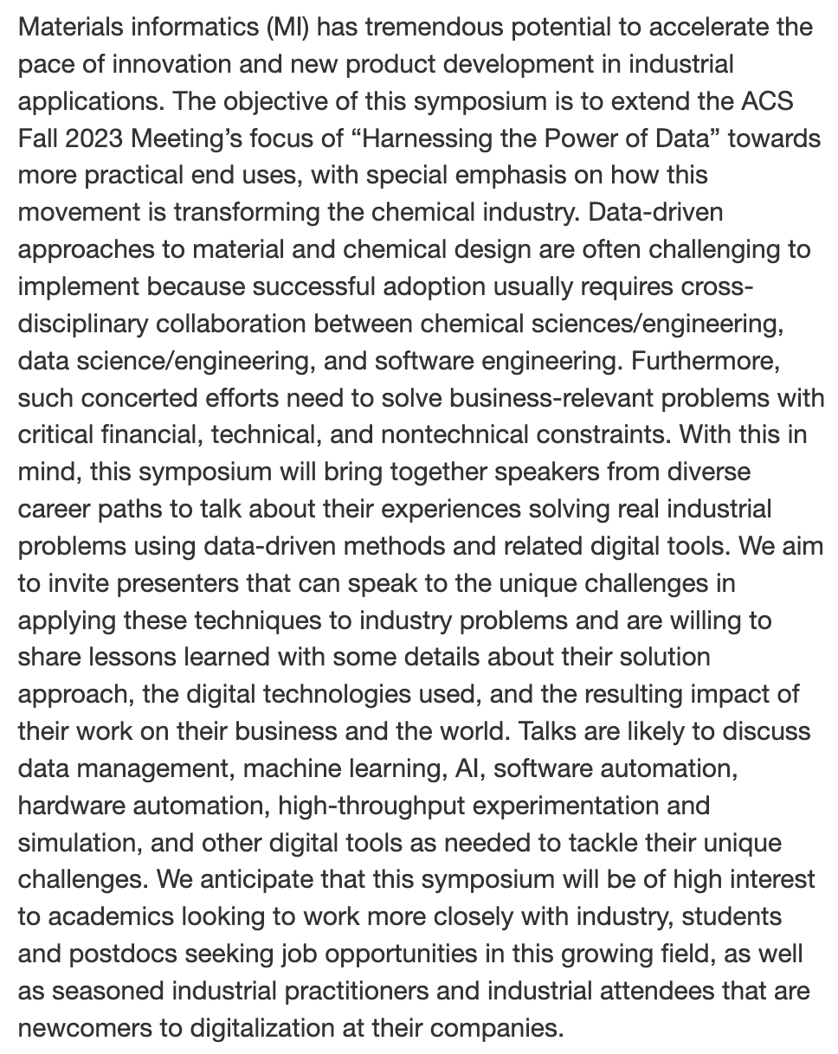
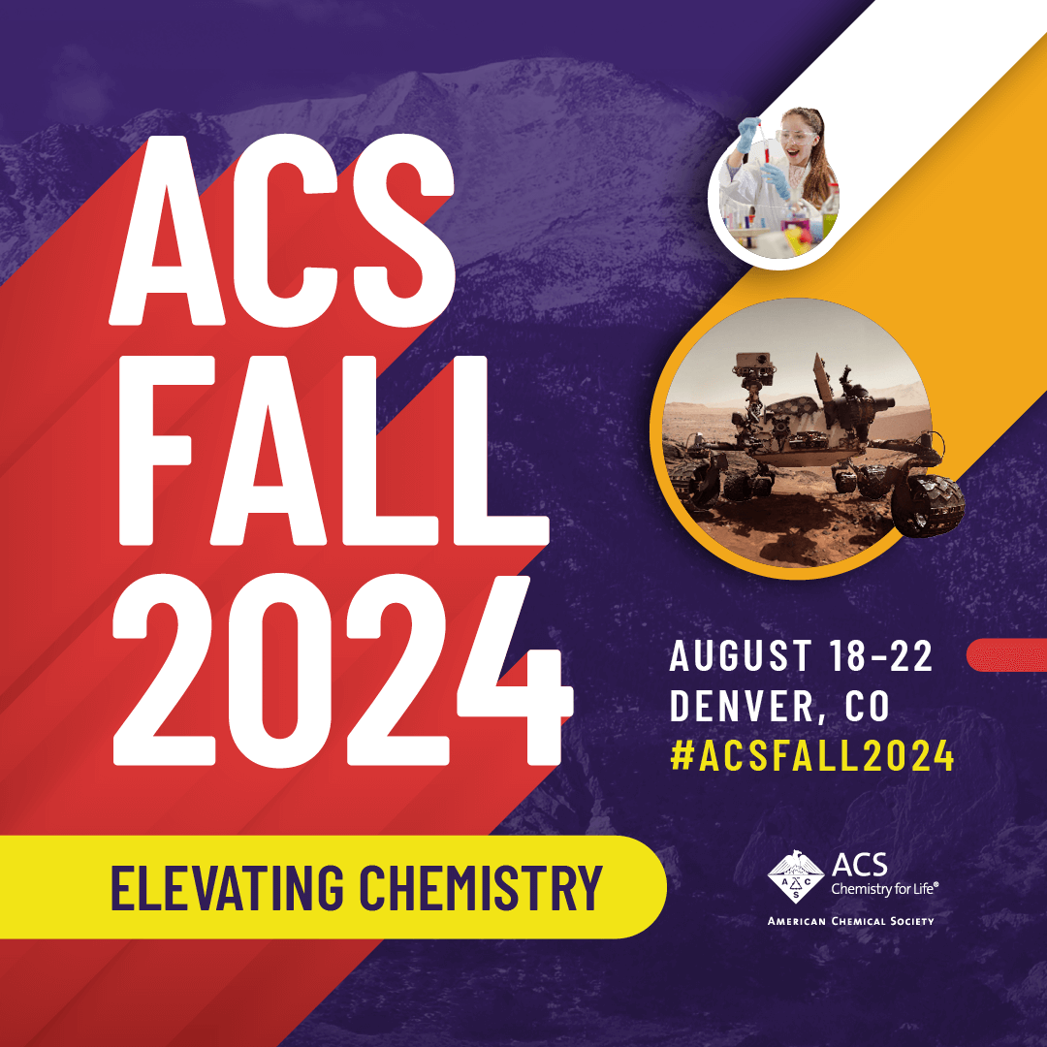

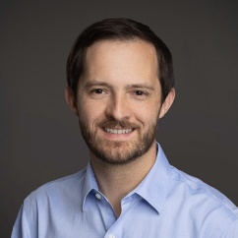
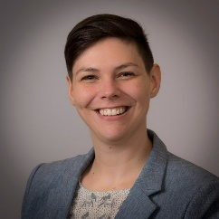
“Elevating the Power of Data for Materials and Chemical Scientists in Industry”
Re-connected with Mike Heiber (Materials Informatics Leader at Enthought, which focuses on digitalization in materials science/chemistry, life science, semiconductor, energy industries)
Connection to Alix Schmidt (Senior Data Scientist, R&D Model Deployment Strategy Leader at Dow)
Learned that they previously organized a session at the spring AIChE Meeting (chemical engineering annual meeting)
Disorganized advertising, not the right fit for attendees
Discussed lessons learned and focused symposium description to reach targeted speakers and audience
Cross-listed with PMSE ($ support) and CINF divisions for advertisement to members

Slide 13

“Finding Professional Growth and Fulfillment for Early Career Polymer Scientists and Engineers in Industry”
What it means to be a professional polymer scientist has undergone rapid and dramatic recent changes that have introduced important questions to ponder as one develops their early career…
Where is the potential to further create value from mature commodity plastics? What are the gaps in legacy materials that can be filled by higher-performing, yet still economically viable products? How can we as an industry realistically address the continued growth of plastics waste and the dependence of the industry on petroleum-derived resources? How are software-driven tools reshaping the R&D process?
And in the background of these technical challenges, the early-career polymer scientist must also contend with questions related to the business of developing and selling polymer materials. For example, what are the practical realities of a corporate R&D career in the de-risked business environment of the post-global financial crisis world? What opportunities do startups offer that large companies do not, and vice versa?
Indeed, finding a fulfilling career in polymer science is no longer as simple as deciding between academia and industry, and in the case of the latter, defaulting to a career at one of a handful of large chemical conglomerates. Considering these questions that will soon confront many PhD graduates, we write this Editorial to share our thoughts and experiences related to navigating our first years in the polymer industry.

Slide 14

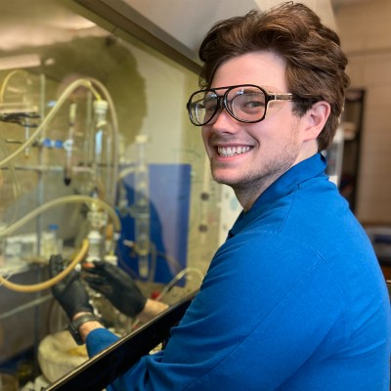
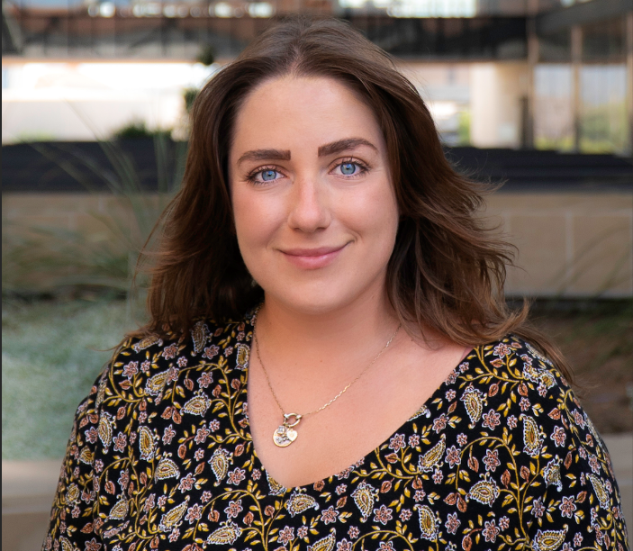
2024 POLY
Graduate Student Travel Award
William W. Johnson
Mississippi State University
Lynn Stevens
University of Texas at Austin
To provide funding for graduate students studying polymer science at
US institutions to travel to national ACS meetings and present their results

