Slide 1

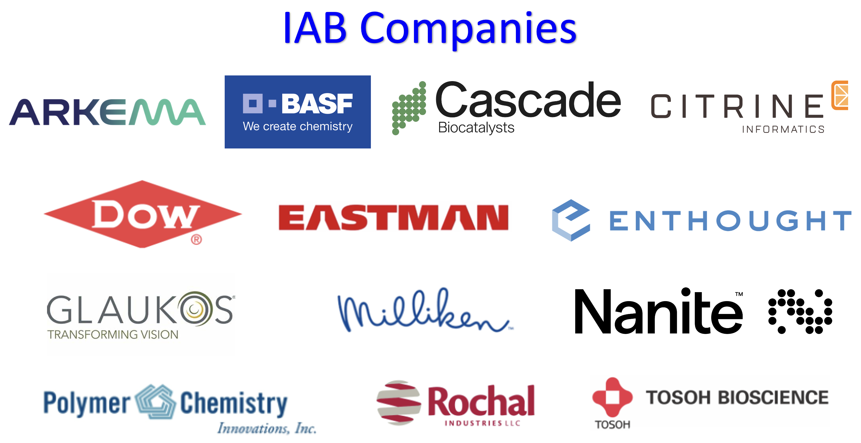
POLY Industrial Advisory Board
Annual dues: $1,500
Small company dues: $500
Chair: Hayley Brown (Dow)
Co-Chair: Jeff Ting (Nanite)

Slide 2
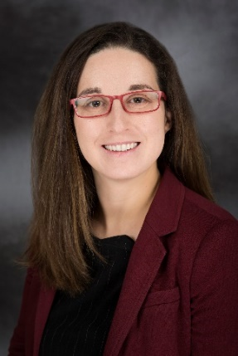

IAB Mission & Officers 2023
Chair: Hayley Brown
(Dow)
Co-Chair:
Networking
  Monday networking hour
  Tuesday morning breakfast
Finance & Reporting
  IAB business meetings
Bulletin
Succession Planning
Industrial Awards (IPS & YIPS) Support
New Initiatives
  New Industry Networking Group
  Regional Meetings
Membership
Programming
  IIPS
  Other industrial programming
“Enhance and foster industrial engagement and support to develop programming, education, recognition & awards within the ACS Division of Polymer Chemistry.”

Slide 3
IAB Focuses for 2024
Maintain programming & awards support within budget
Deliver on member company initiatives
  IAB Networking Sessions
  IAB meeting
Integrate smaller company members while retaining long term larger member companies
Understanding value POLY and IAB provide in long-term hybrid environment
  How to balance representing IAB member companies with generally representing “Industry” in POLY

Slide 4
Budget- Expenses ($25,000 projected 2024)
Activity | Category | Anticipated 2023 | Actual Expense 2023 | Planned 2024
Spring Networking | Networking | $ 4,000.00 | $2,266.76 | $3,500.00
Fall Networking | Networking | $ 5,000.00 | $11,876.00 | $3,500.00
Spring Breakfast | Meetings | $ 4,000.00 | $2,800.18 | $2,500.00
Fall Breakfast | Meetings | $ 4,000.00 | $3,699.66 | $2,500.00
Staff travel support | Meetings | $ 2,000.00 | $0.00 | $0.00
Additional Meetings Spring | Meetings | $ 300.00 | $75.98 | $100.00
NERM | Meetings |  | $2,000.00
Additional Meetings Fall | Meetings | $ 500.00 | $0.00
Constant Contact/media access | Meetings | $ 200.00 | $0.00
YIPS Award (Fall Odd Yrs) |  | $ 2,000.00 | $2,000.00
YIPS Travel (Fall Odd Yrs) | Awards | $ 4,000.00 | $2,000.00
IPS Award (Fall Even Yrs) | Awards | $ - | $0.00 | $0.00
Graduate Student Travel Award #1 Spring | Awards | $ 750.00 | $750.00 | $750.00
Graduate Student Travel Award #2 Spring | Awards | $ 750.00 | $750.00 | $750.00
Graduate Student Travel Award #1 Fall | Awards | $ 750.00 | $750.00 | $750.00
Graduate Student Travel Award #2 Fall | Awards | $ 750.00 | $750.00 | $750.00
Grad Student Travel Awd Poster | Awards | $ 200.00 | $0.00
Identify Award Opportunity | Awards | $ 1,000.00 | -
Spring - Graduate Research Symp. | Programming | $ 1,000.00 | $1,000.00 | $1,000.00
Spring- Undergraduate Research Symp. | Programming | $ 1,000.00 | $1,000.00 | $1,000.00
IIPS Symposia (Fall) | Programming | - | -
NGRPC (UMICH) | Meetings | $ 2,000.00 | $2,000.00
Other |  | $ -
 | TOTAL EXP | $ 34,200.00 | $33,718.58 | $17,100.00

Slide 5
Spring 2024 Programming and Networking
“Industrial Innovations in Polymer Science” symposium
Organizers: Daniel Abebe, Kelli Ogawa, Farihah Haque
Monday, March 18th
Mardi Gras Blrm Salon C, New Orleans Marriott
IAB Networking Reception
Monday, March 18th , 6:00-7:00 pm
Henry’s Gin Bar, 317 Baronne St, New Orleans LA 70112
Industrial Advisory Board Meeting
Tuesday, March 19th (continental breakfast), 7:30 am
New Orleans Marriott, Studio ½
IIAB and EcCom Members only

Slide 6


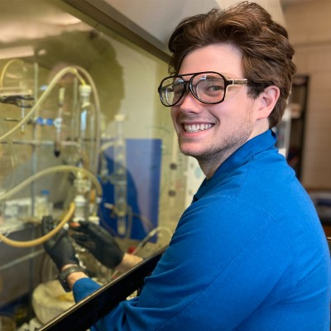
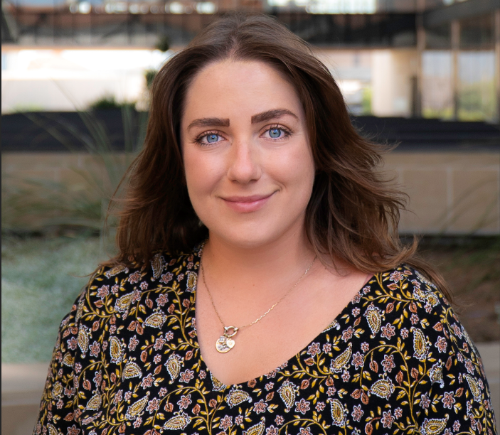
2024 POLY
Graduate Student Travel Award
William W. Johnson
Mississippi State University
Lynn Stevens
University of
Texas at Austin
To provide funding for graduate students studying polymer science at
US institutions to travel to national ACS meetings and present their results

Slide 7
New Initiatives in 2024
Company Recruitment & Retainment
New Symposium at Fall ACS 2024
Emphasize strategic opportunities for joining IAB:
  Global Visibility to one of the largest and most active non-profit, international groups devoted to the advancement of Polymer Science (credibility, potential partnerships, networking) – especially valuable to smaller companies
  Sustained Growth to recruit top talent in the polymer science and engineering community
  Direct Research Exposure to influence ACS POLY programming, events, and awards that highlight technical areas of interest to the company – example to the right →
Establish centralized IAB value proposition information sheet
  Subcommittee working on revising small company IAB recruitment handout
  Useful for handoff to upper management in justifying value
“Elevating the Power of Data for Materials and Chemical Scientists in Industry,” co-organized by 3 IAB member company reps at Nanite, Enthought, and Dow
  Cross-listed with PMSE, CINF divisions
  Motivation: no real “home base” for chemists, material scientists, and engineers working with polymers in industry to discuss challenges and best practices for the AI and digitalization movement
  Aiming to invite only industrial speakers with diverse backgrounds and technology expertise
Form NING Spotlight Series to support early career scientists
  Kickoff with invited ACS Polymers Au editorial: “Finding Professional Growth and Fulfillment for Early Career Polymer Scientists and Engineers in Industry”

Slide 8
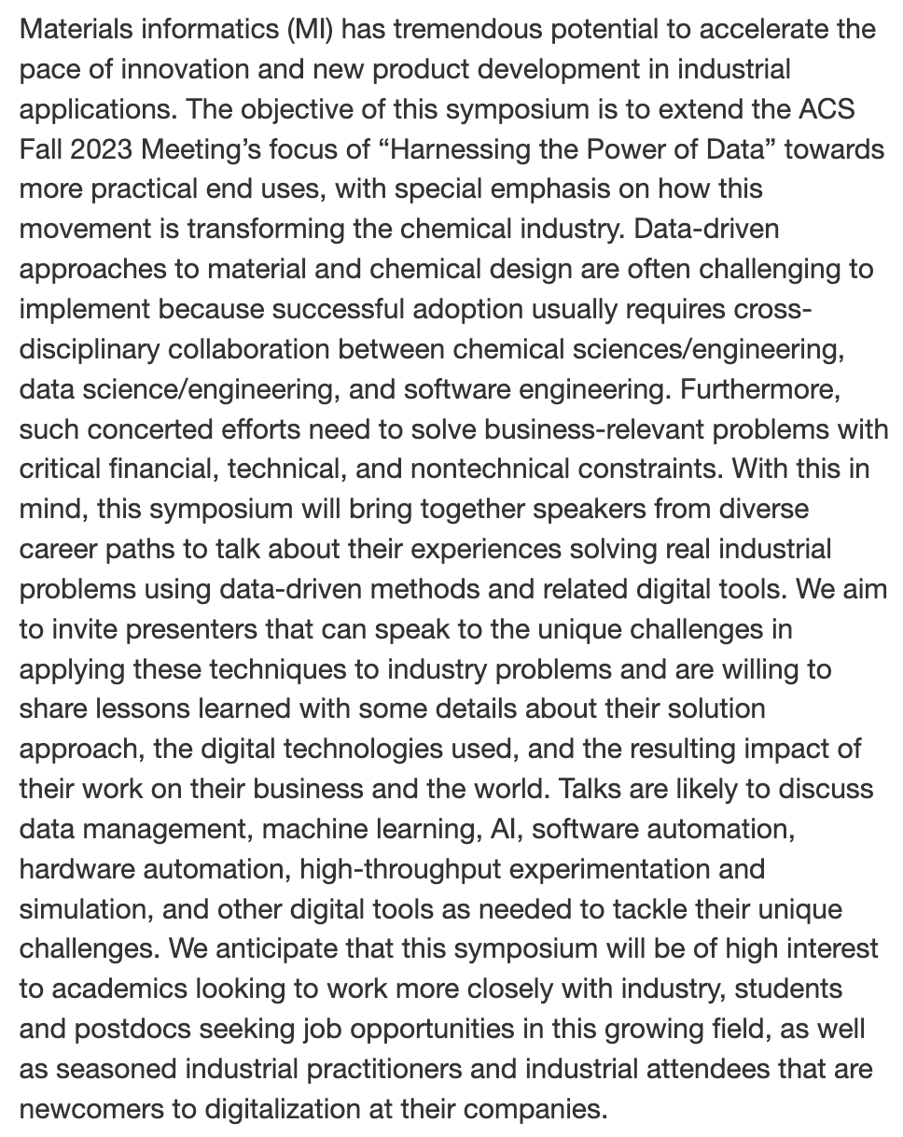
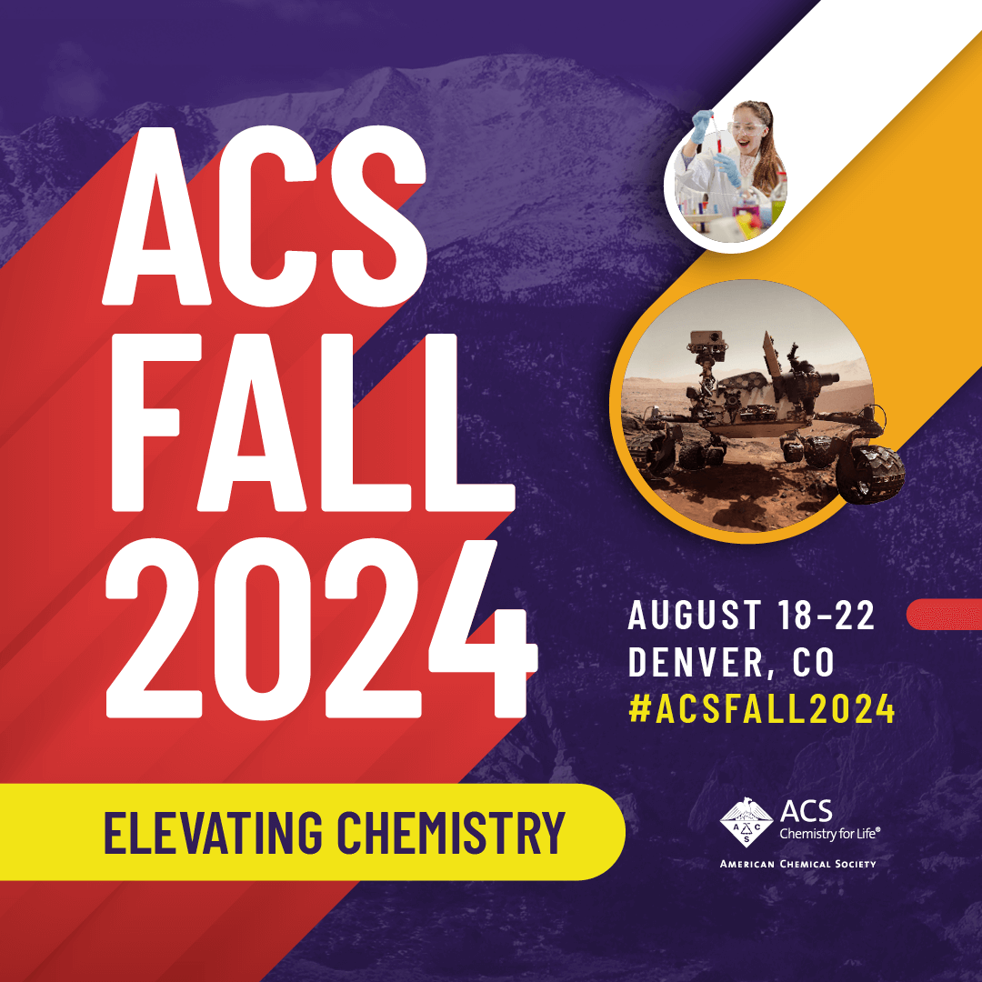

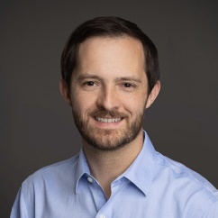
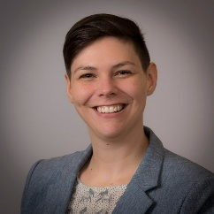
“Elevating the Power of Data for Materials and Chemical Scientists in Industry”
Re-connected with Mike Heiber (Materials Informatics Leader at Enthought, which focuses on digitalization in materials science/chemistry, life science, semiconductor, energy industries)
Connection to Alix Schmidt (Senior Data Scientist, R&D Model Deployment Strategy Leader at Dow)
  Learned that they previously organized a session at the spring AIChE Meeting (chemical engineering annual meeting)
  Disorganized advertising, not the right fit for attendees
  Discussed lessons learned and focused symposium description to reach targeted speakers and audience
Cross-listed with PMSE ($ support) and CINF divisions for advertisement to members

Slide 9

“Finding Professional Growth and Fulfillment for Early Career Polymer Scientists and Engineers in Industry”
What it means to be a professional polymer scientist has undergone rapid and dramatic recent changes that have introduced important questions to ponder as one develops their early career…
Where is the potential to further create value from mature commodity plastics? What are the gaps in legacy materials that can be filled by higher-performing, yet still economically viable products? How can we as an industry realistically address the continued growth of plastics waste and the dependence of the industry on petroleum-derived resources? How are software-driven tools reshaping the R&D process?
And in the background of these technical challenges, the early-career polymer scientist must also contend with questions related to the business of developing and selling polymer materials. For example, what are the practical realities of a corporate R&D career in the de-risked business environment of the post-global financial crisis world? What opportunities do startups offer that large companies do not, and vice versa?
Indeed, finding a fulfilling career in polymer science is no longer as simple as deciding between academia and industry, and in the case of the latter, defaulting to a career at one of a handful of large chemical conglomerates. Considering these questions that will soon confront many PhD graduates, we write this Editorial to share our thoughts and experiences related to navigating our first years in the polymer industry.

Slide 10
Thank you
Industrial Advisory Board

Slide 11
Notes

Slide 12
Fall 2024 Programming and Networking
Industrial Advisory Board Networking Reception
Industrial Advisory Board Meeting (Breakfast)
Industrial Innovations in Polymer Science
Organizers: Michael Petr, Julienne Regele, Dayton Street
Industrial Polymer Scientist Award in honor of Carl L. Willis
Organizers: Richard Spontak

