Slide 1

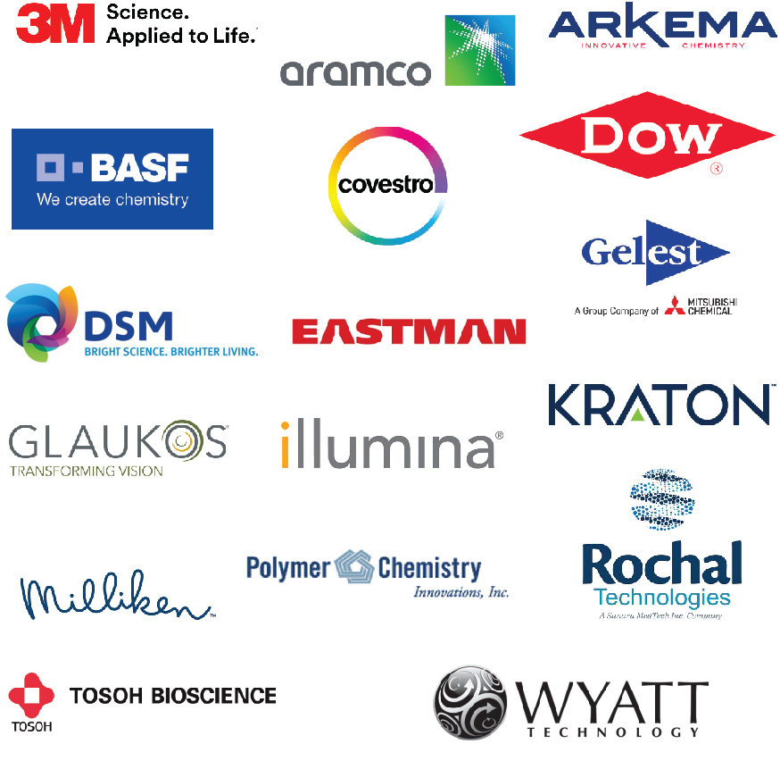
POLY Industrial Advisory Board
Adding updated logos!
Annual dues: $1,500
Small company dues: $500
Chair: Hayley Brown (Dow)
Co-Chair- TBD

Slide 2
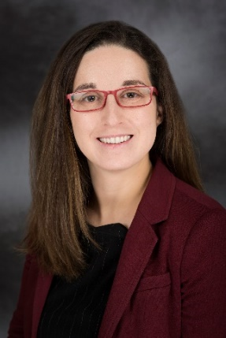
IAB Mission & Officers 2023
Chair: Hayley Brown
(Dow)
Co-Chair:
Networking
  Monday networking hour
  Tuesday morning breakfast
Finance & Reporting
  IAB business meetings
Bulletin
Succession Planning
Industrial Awards (IPS & YIPS) Support
New Initiatives
  New Industry Networking Group
  Regional Meetings
Membership
Programming
  IIPS
  Other industrial programming
“Enhance and foster industrial engagement and support to develop programming, education, recognition & awards within the ACS Division of Polymer Chemistry.”

Slide 3

IAB Mission & Officers 2023
Chair: Hayley Brown
(Dow)
Co-Chair:
Networking
  Monday networking hour
  Tuesday morning breakfast
Finance & Reporting
  IAB business meetings
Bulletin
Succession Planning
Industrial Awards (IPS & YIPS) Support
New Initiatives
  New Industry Networking Group
  Regional Meetings
Membership
Programming
  IIPS
  Other industrial programming
“Enhance and foster industrial engagement and support to develop programming, education, recognition & awards within the ACS Division of Polymer Chemistry.”

Slide 4
IAB Focuses for 2023
Maintain programming & awards support
Deliver on member company initiatives
  IAB Networking Sessions
  IAB meeting
Integrate smaller company members
Understanding value POLY and IAB provide in long-term hybrid environment
  How to balance representing IAB member companies with generally representing “Industry” in POLY
Balance with business office changes

Slide 5
In 2022-
 | Final 2022 | Proposed 2023
Income | 25,000.00 | 27,000.00
Expenses
Networking | 5,588.51 | 9,000.00
Meetings | 7,026.56 | 10,000.00
Awards (prepaid in 2021) | 7,000.00 | 11,000.00
Programming (no virtual) | 4,000.00 | 4,000.00
Other (shirts, pins) | 926.51 | 0
subtotal | 24,541.58 | 32,000.00
Bal | 458.42 | -7,000.00
Budget

Slide 6
Spring 2023 Programming and Networking
“Industrial Innovations in Polymer Science” symposium
Organizers:Ashleigh Dahlstrom, Michael Minkler, Wenjun Wu
Monday, March 27th - AM & PM Sessions
Regency Blrm E, Hyatt Regency Indianapolis
IAB Networking Reception
Monday, March 27th, 6:00-9:00 pm
Mesh –Indianapolis
725 Massachusetts Ave, Indianapolis, IN 46204
Industrial Advisory Board Meeting
Tuesday, March 28th (continental breakfast), 7:30 am
Hyatt Regency Indianapolis: Network Room

Slide 7
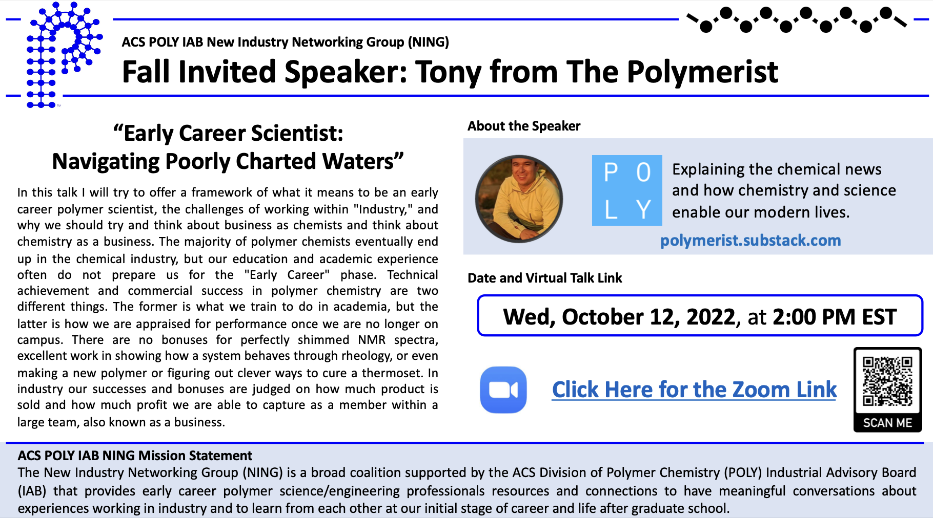

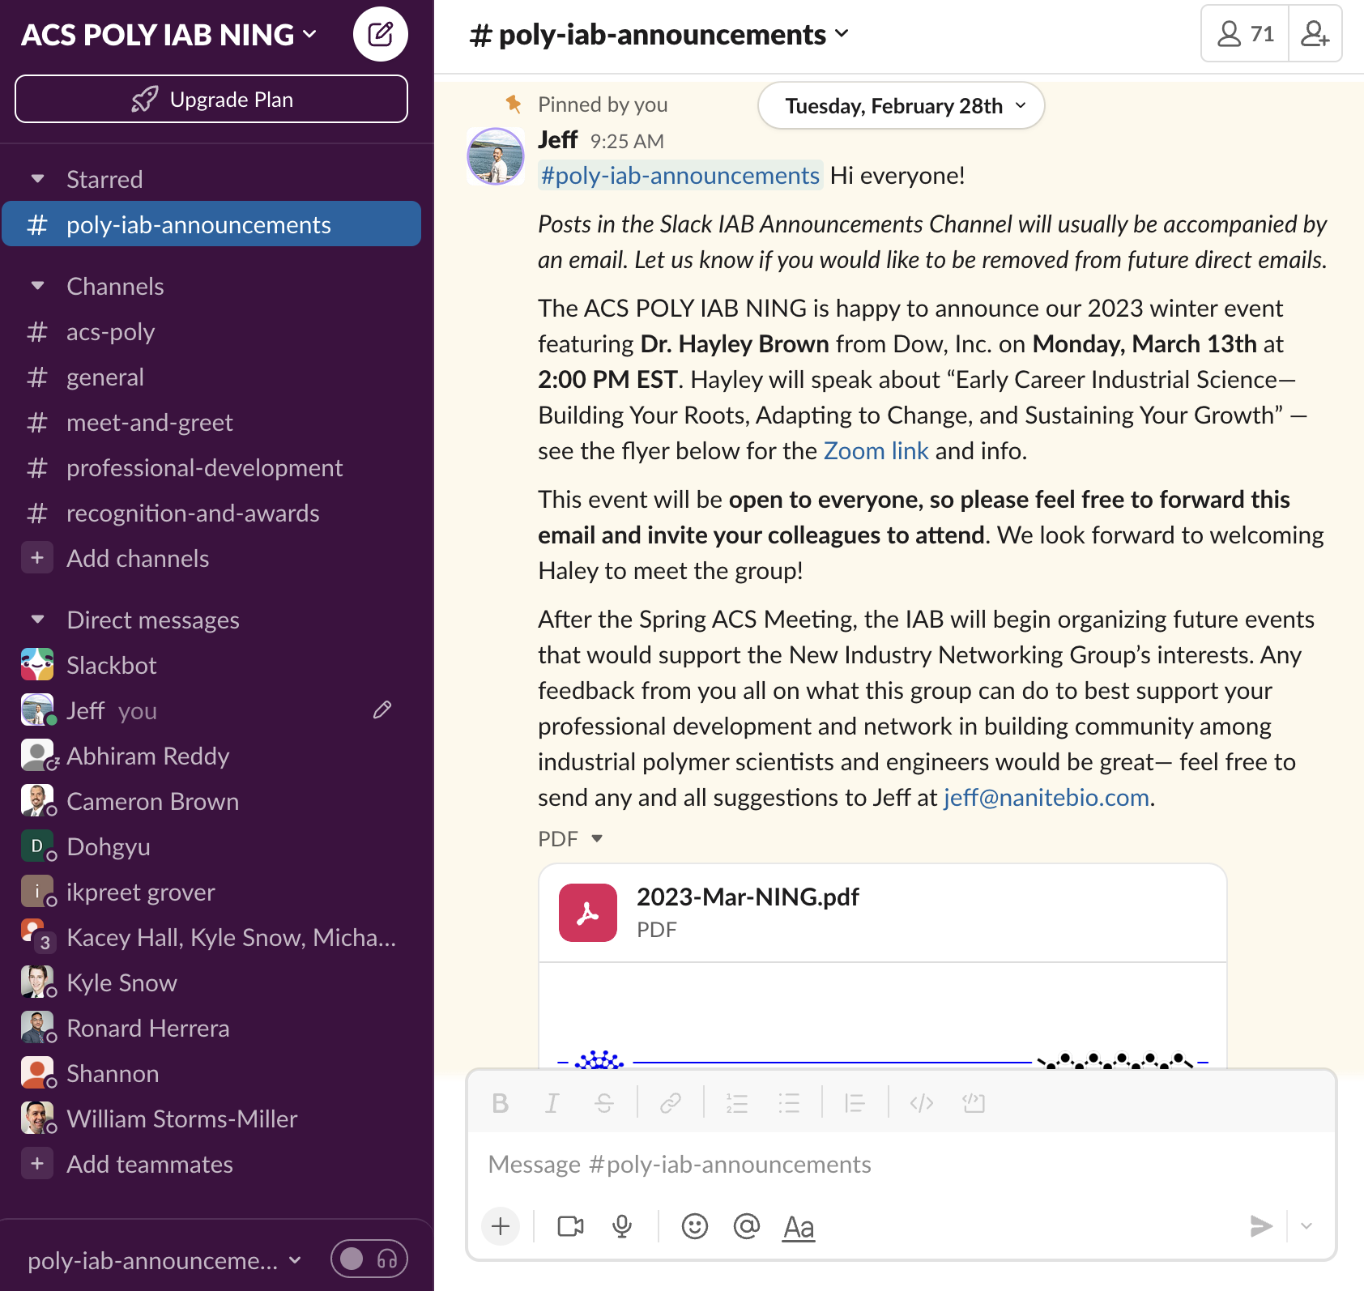
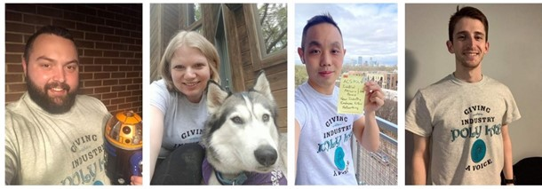
New Industry Networking Group (NING)
Mission Statement
The New Industry Networking Group (NING) is a broad coalition supported by the ACS Division of Polymer Chemistry (POLY) Industrial Advisory Board (IAB) that provides early career polymer science/engineering professionals resources and connections to have meaningful conversations about experiences working in industry and to learn from each other at our initial stage of career and life after graduate school.
Who We Are
We are a self-organizing organization run by diverse, early career industrial professionals, affiliated with the ACS POLY, that seek to strengthen our professional network and build community among members in the IAB companies.
What We Do
Provide an informal gathering place for early career industrial scientists and engineers through Slack (70+ members to date)
Host bimonthly virtual seminars featuring accomplished industrial scientists and engineers
Assist with ongoing efforts of the ACS POLY IAB in programming, education, recognition, and awards
Founded in 2021

Slide 8





New Initiatives in 2023
Small Company Recruitment
ACS Northeast Regional Meeting
Subcommittee to reach out to small companies /startups
Emphasize strategic opportunities for joining IAB:
  Global Visibility to one of the largest and most active non-profit, international groups devoted to the advancement of Polymer Science (credibility, potential partnerships, networking)
  Sustained Growth to recruit top talent in the polymer science and engineering community
  Direct Research Exposure to influence ACS POLY programming, events, and awards that highlight technical areas of interest to the company
Lunch Panel: Navigating Startups with Early Career Polymer Scientists
[Finalizing]

Slide 9
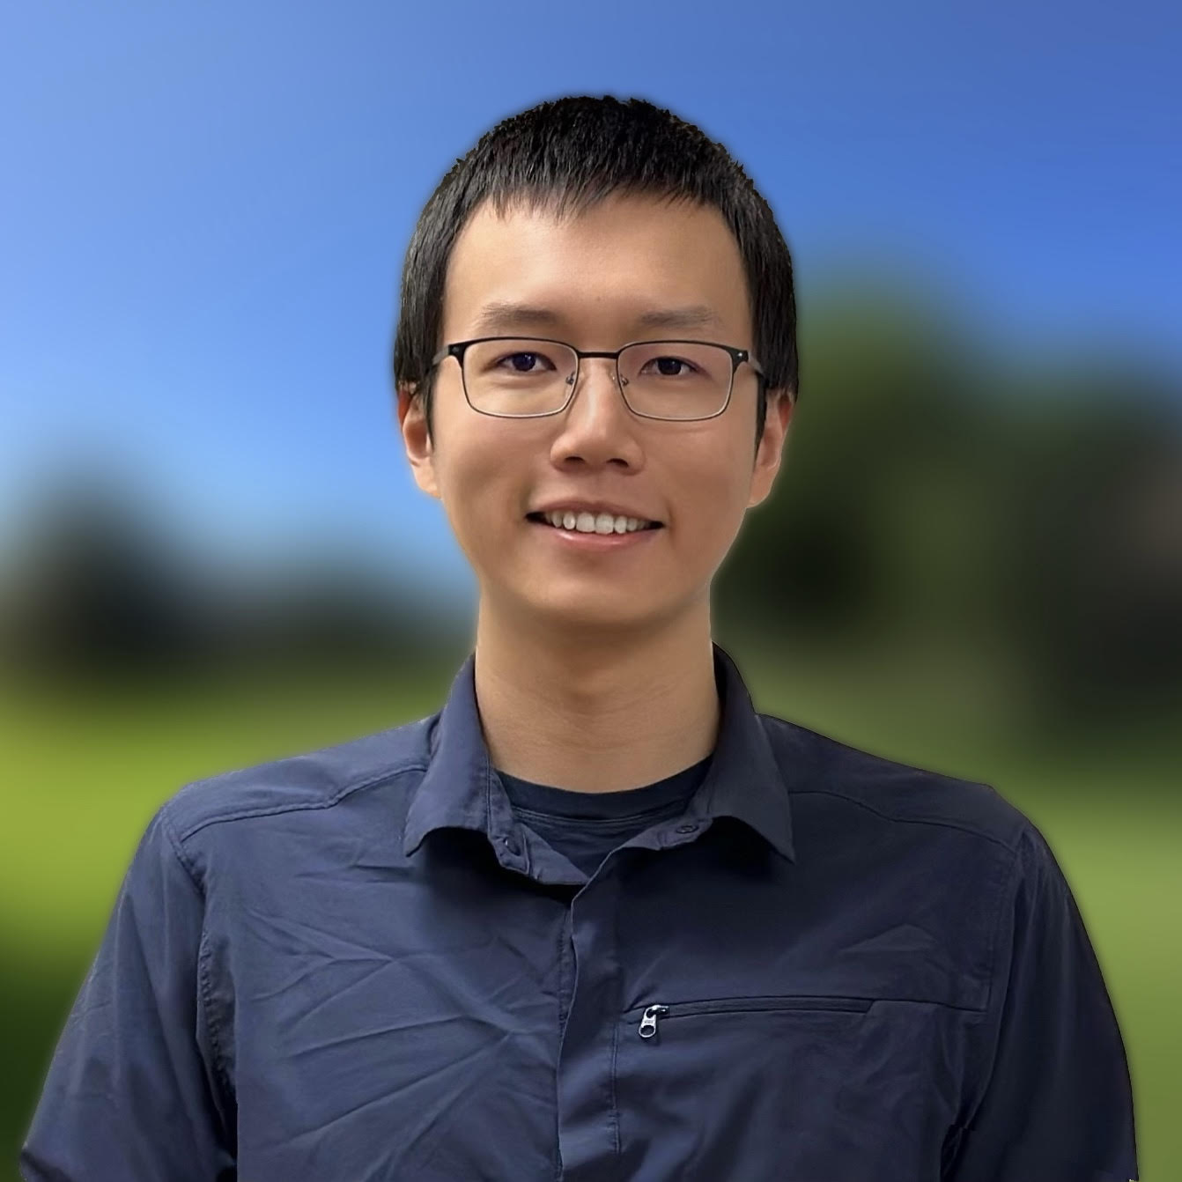
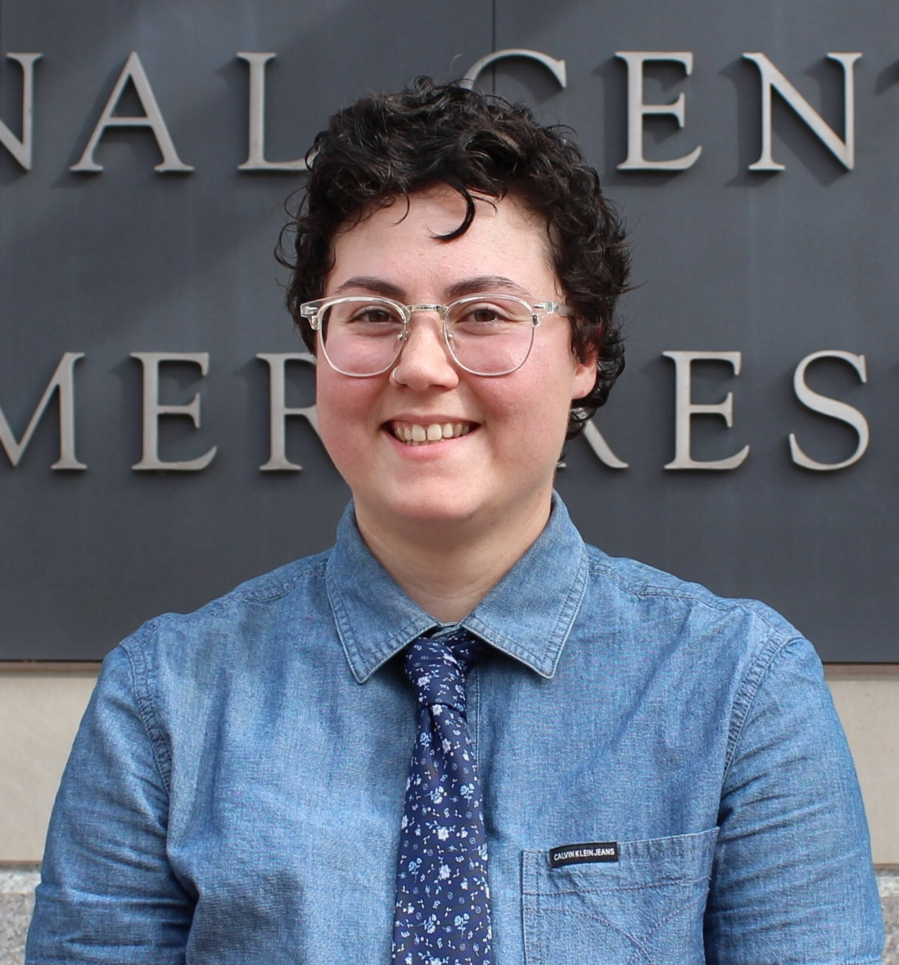
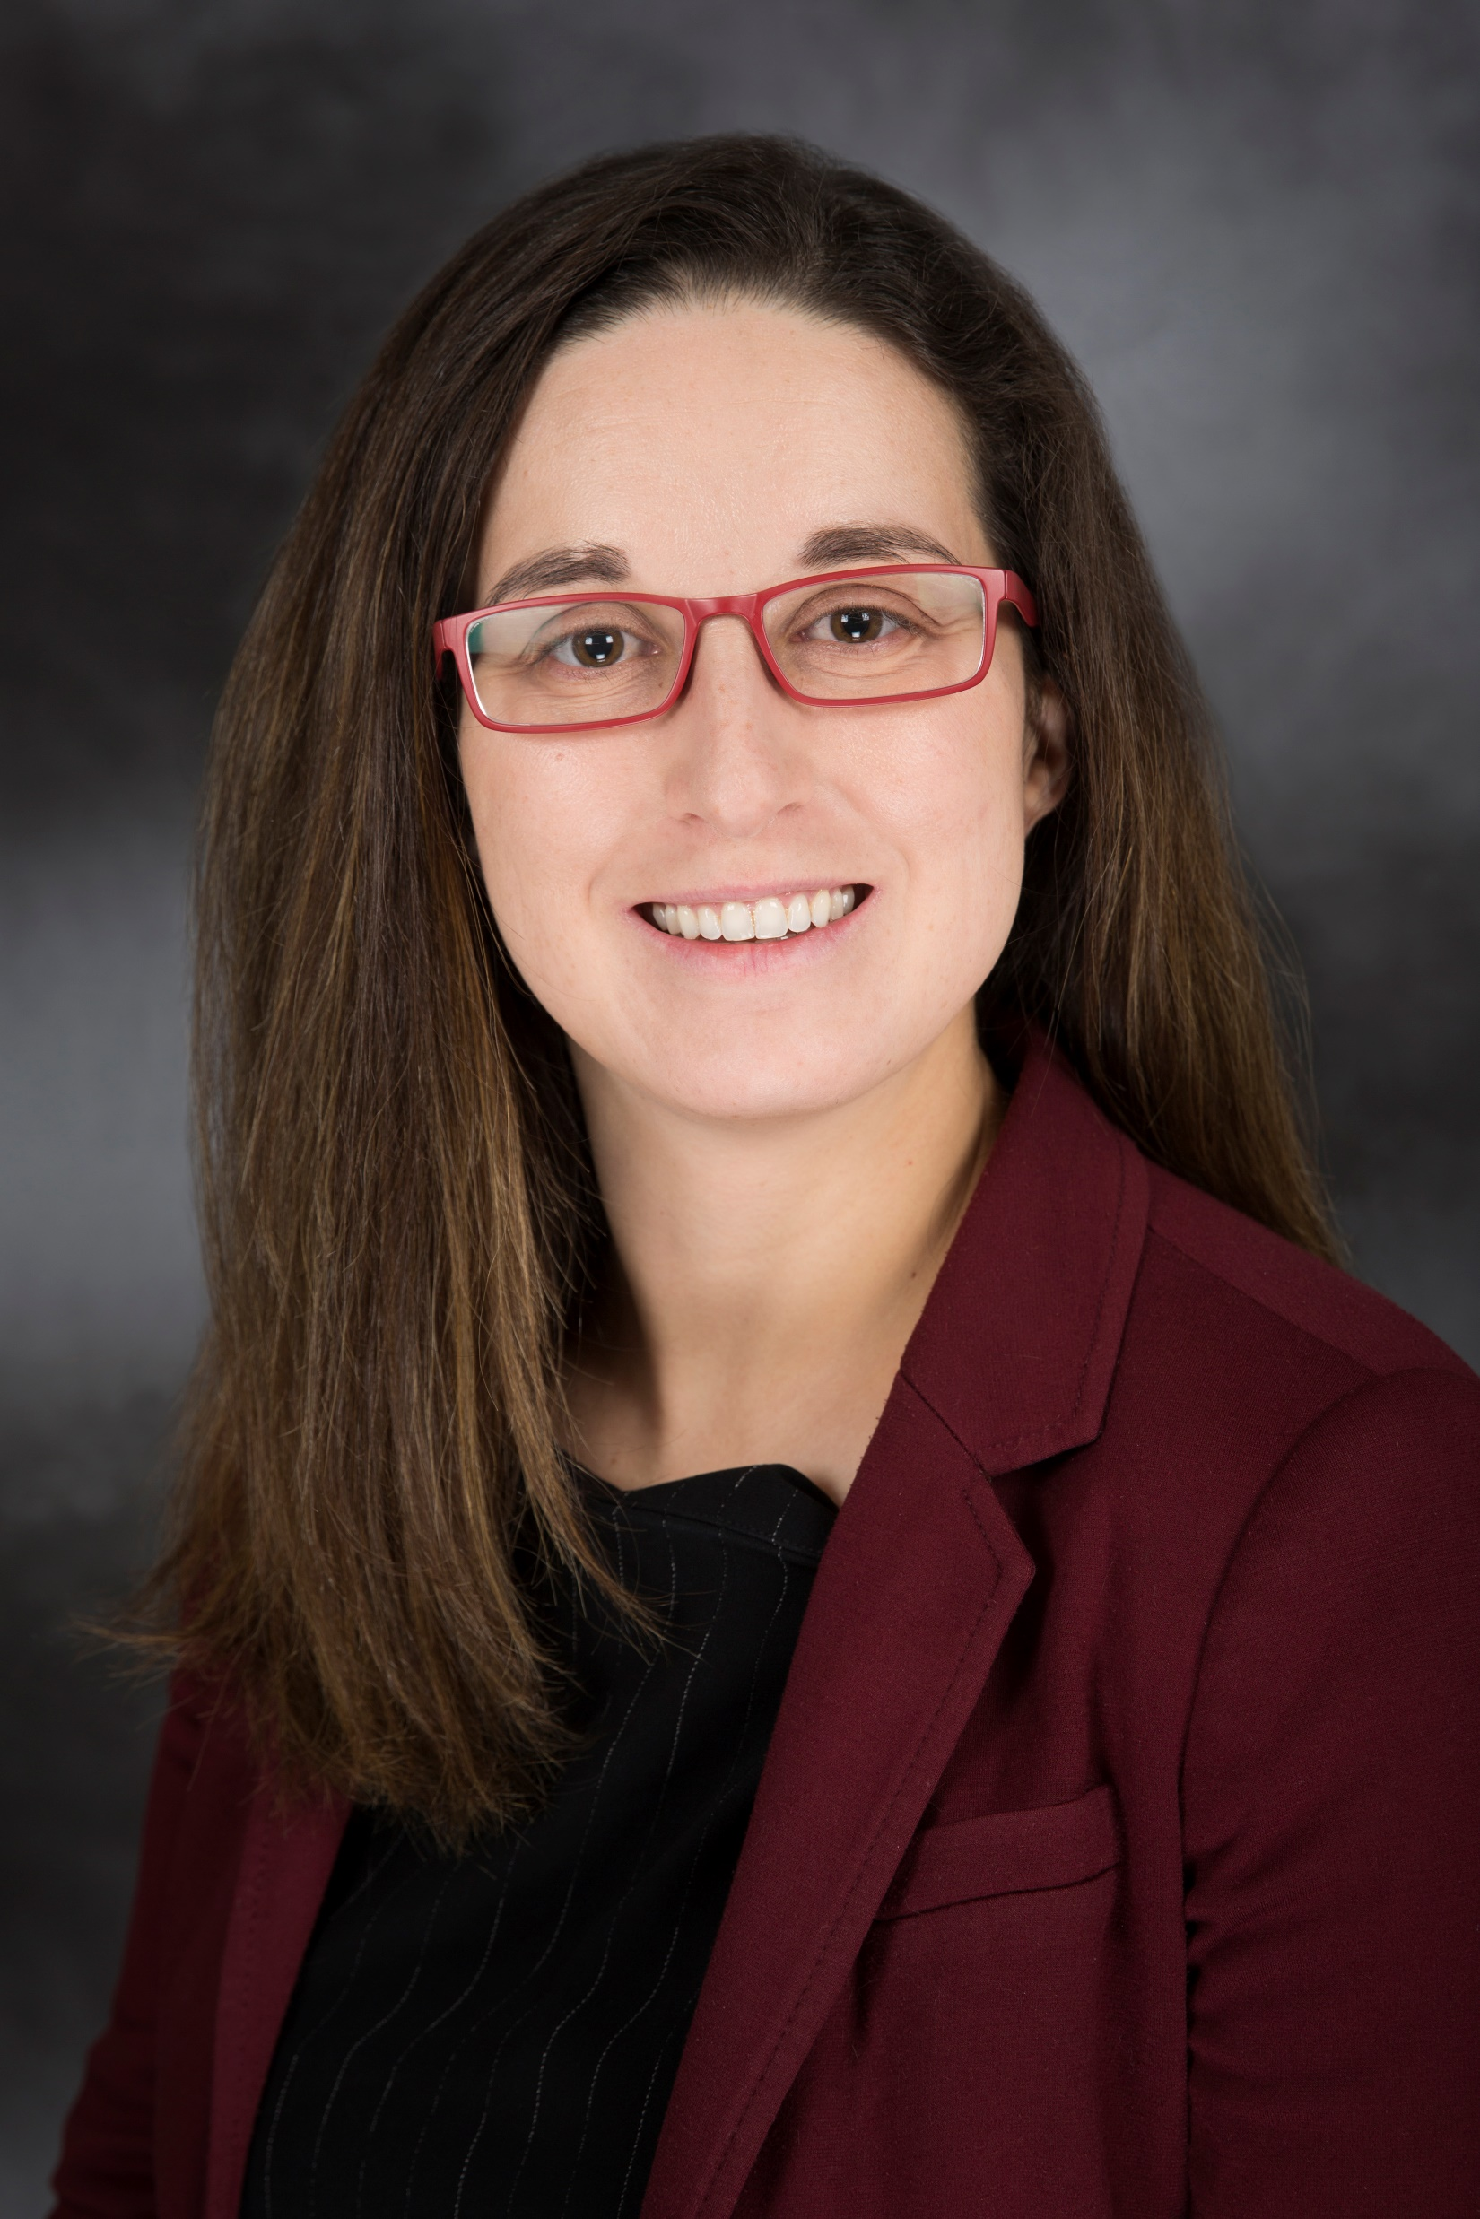
Awards Supported in 2023
POLY Graduate Student Travel Award
Zepeng Lei
University of Colorado, Boulder
“Recyclable and Malleable Thermosets enabled by Dynamic Nucleophilic
Aromatic Substitution”
Autumn Mineo
University of Massachusetts, Amherst
“Universal Additive Monomers for Reprocess-able Thermoplastics
and Thermosets”
POLY Young Industrial Polymer Scientist
Hayley Brown
The Dow Chemical Company
Symposium to be held Fall 2023

Slide 10
CALL FOR AWARD SUBMISSIONS
IPS AWARD
Industrial Polymer Scientist
Award Deadline: 7/31/2022
Purpose: Recognize outstanding industrial innovation and creativity in the application of Polymer Science.
https://polyacs.org/awards/

Slide 11
Thank you
Industrial Advisory Board

Slide 12
Notes

Slide 13
In 2022-
 | Proposed | To date - Aug
Income | 23,000.00 | 17,500.00
Expenses
Networking | 10,000.00 | 3,340.25
Meetings | 11,000.00 | 1,082.82
Awards | 1,200.00 | 1,500.00
Programming (no virtual) | 2,000.00 | 2,000.00
Other (shirts, pins) | 1,800.00 | 0
subtotal | 26,000.00 | 7,923.07
Bal | -3,000.00 | 9,576.93
Budget

Slide 14
In 2021-
 | Proposed | Actual, year-end
Income | 24,000.00 | 22,825.20
Expenses
Networking | 7,000.00 | 3,463.64
Meetings | 8,000.00 | 254.00
Awards | 6,200.00 | 6.930.00
Programming … virtual, future webshops | 3,200.00 | 8,000.00
Other (shirts, pins) | 1,600.00 | 0
subtotal | 26,000.00 | 18,647.64
Bal | -2,000.00 | +4,277.56
Budget

Slide 15

Awards supported in 2021

Slide 16

Awards supported in 2021

