Slide 1
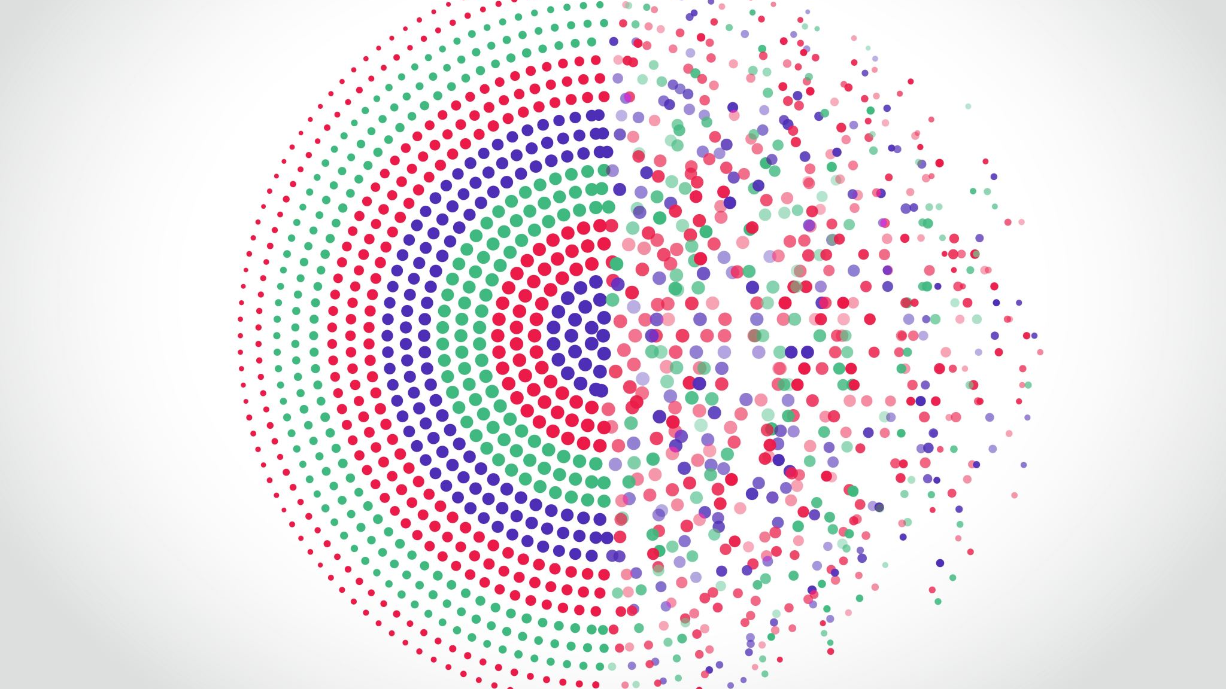
International

Slide 2

November 1 - 4, 2021
Riveria Maya, Mexico

