Slide 1
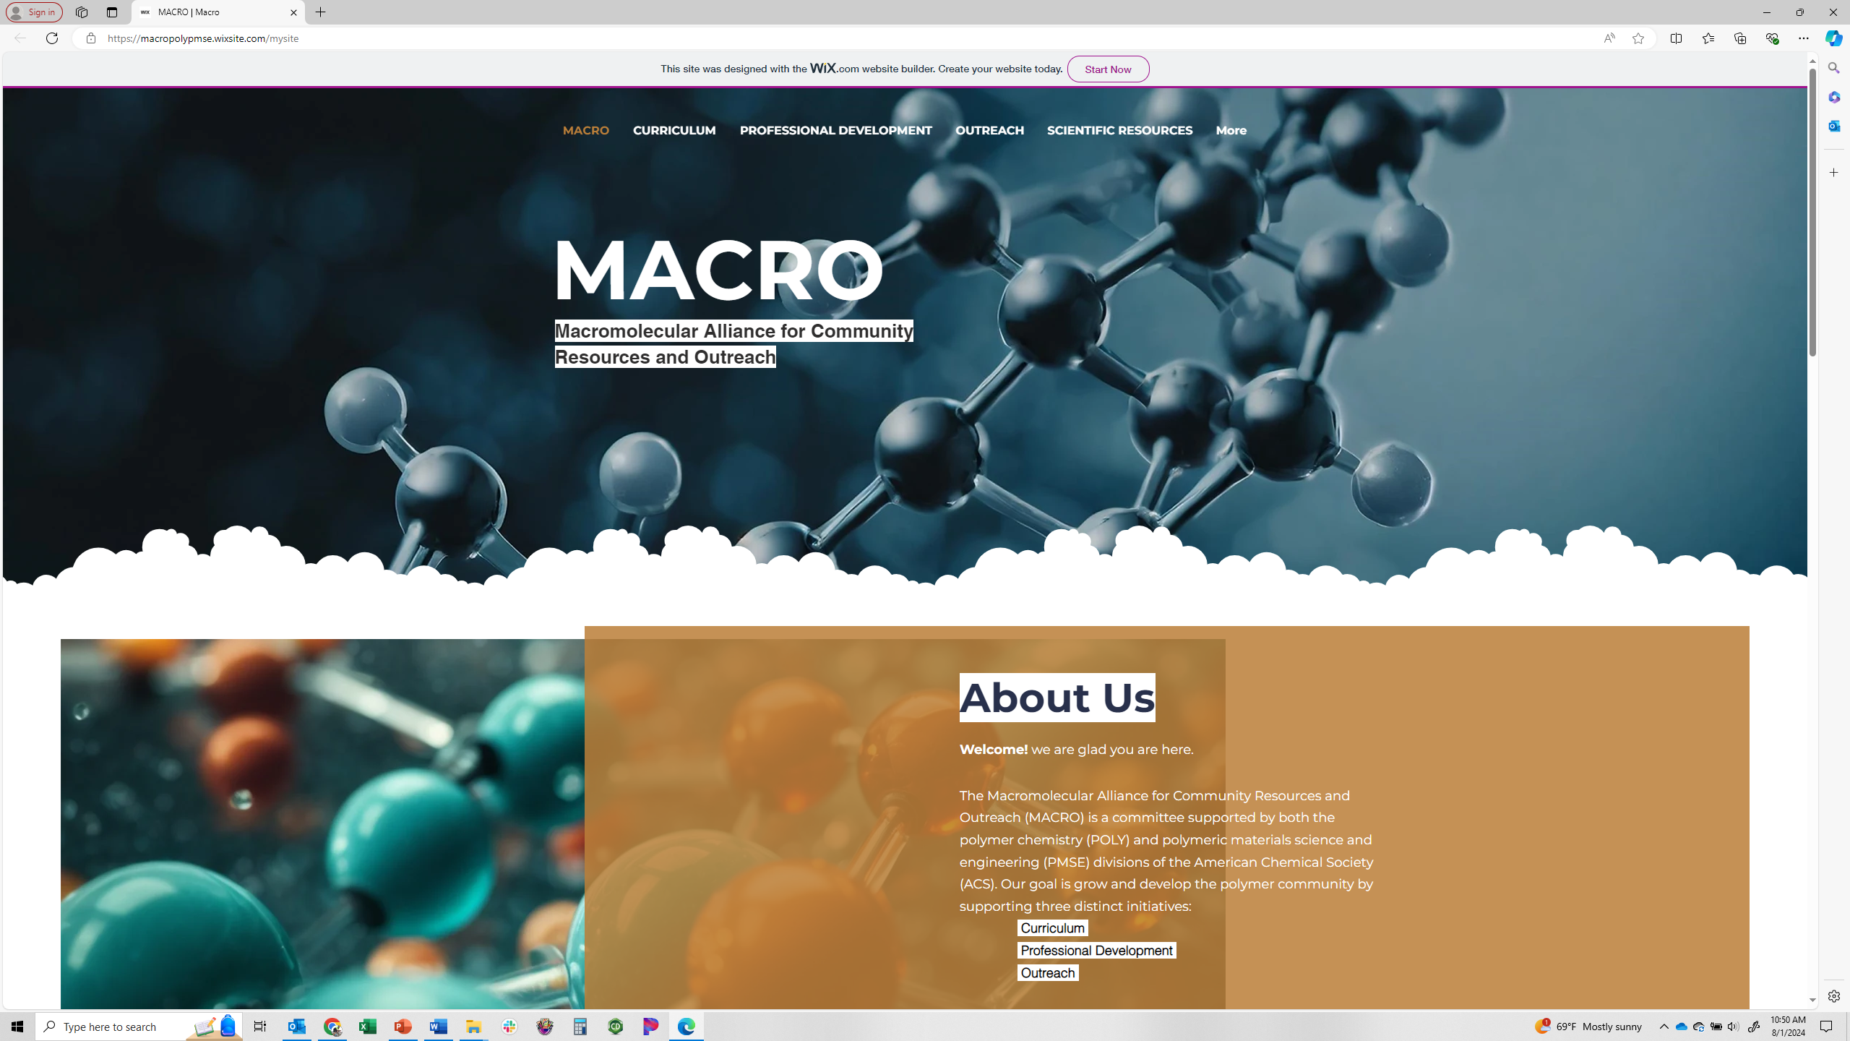
MACRO update
Website has been updated!
Uses same address
Please review and share your thoughts
Youtube channel : Liz Sterner @ LVC

Slide 2
Curriculum: 2024
Video equipment purchased and acquired. Belongs to “MACRO”
Currently maintained by Liz Sterner
Post in various formats (instructor & student; slides & videos)
New modules (determined by feedback from 2022 ACS symposium):
Describing Polymer Molar Mass: M_{N}, M_{W}, and Ð (Student & Instructor versions)
Methods for Determining Polymer Molecular Weight (Student & Instructor versions
Introduction to Polymer Viscoelasticity and Rheology (Student & Instructor versions
Modules currently in development:
Ring-opening polymerization
Reversible deactivation polymerization
Introduction to natural polymers/biopolymers (title still in development)
Soliciting ideas for new topics (email: pcostanz@calpoly.edu or esterner@lvc.edu)
Free radical vs reversible activation deactivation polymerization
Polymer topics in physical chemistry

Slide 3
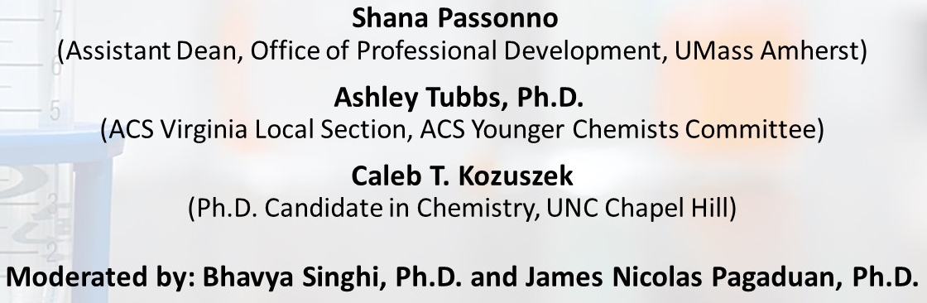
Professional Development: 2024
Web Panels
“Growth and Volunteer Opportunities Outside the Lab” (Jul 2024)
About 25 people registered and 10 attended the web panel
3 panelists and 2 moderators
Additional session expected Nov 2024
Plan to continue these panels in the future as we have received positive feedback and interest.
Please suggest other topics of interest to:
Phil Costanzo (pcostanz@calpoly.edu)
Bhavya Singhi (bsinghi@zeusinc.com)

Slide 4
Outreach: 2024
Spring 2024 National ACS meeting in New Orleans
"Integrating Polymer Science in the Classroom“
2 half day sessions
K-14
Provided funds for 50 kits to 50 teachers
Outreach Competition (model after AlChe STEM outreach)
Only two entries
Currently soliciting activities / Difficult to collect information
Creating a funding mechanism for the POLY/PMSE student chapters to apply for funding (up to $1000)
Deliverables to include website content
Applications & templates available

Slide 5
Future plans
Implementing a sustainable methodology for generating new content
Current model
At least one new post per quarter
At least one new post per section per year
Curriculum - video content
Professional development - panels
Outreach - polymer activities
Please send any feedback to:
pcostanz@calpoly.edu
esterner@lvc.edu

