Slide 1
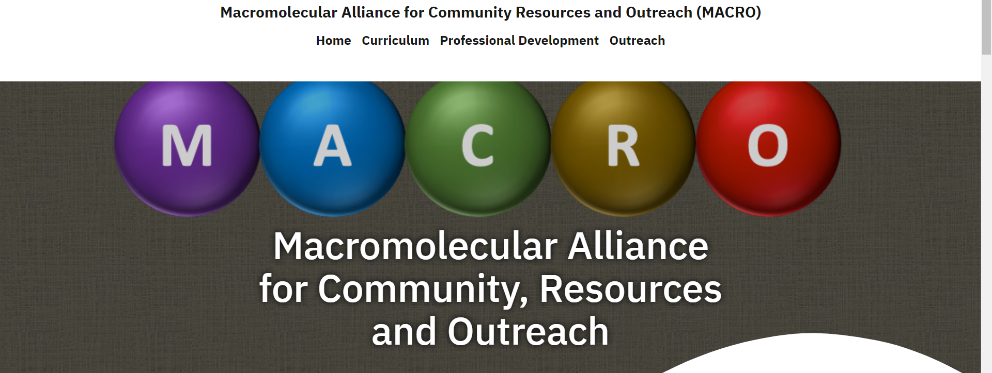
MACRO update
Website traffic is up from 2020 to 2021
2020: 1926 page views, 742 visitors
2021: 3387 page views, 1945 visitors
https://macro-poly-pmse.org/
Need to create a Twitter and Youtube channel.

Slide 2
Curriculum: 2021
Posted 4 modules in various formats (instructor, student, slides, videos)
Introductory
Acyl substitution
Stereochemistry
Alkene chemistry
Video equipment purchased and acquired. Belongs to “MACRO”
Currently maintained by Liz Sterner
Future work: create new video content
Advanced content (reversible deactivation radical polymerization)
Polymer analytical techniques (DSC, GPC - TOSOH contribution)

Slide 3
Professional Development: 2021
New Content
Career in Industry or Academia
Dr. Madhura Pade (Materia Inc.) and Prof Dominik Konkolewicz
CV’s vs Resume
Dr. Andrea Armani and Dr. Dominik Konkolewicz
Updates
Tips for writing a paper

Slide 4
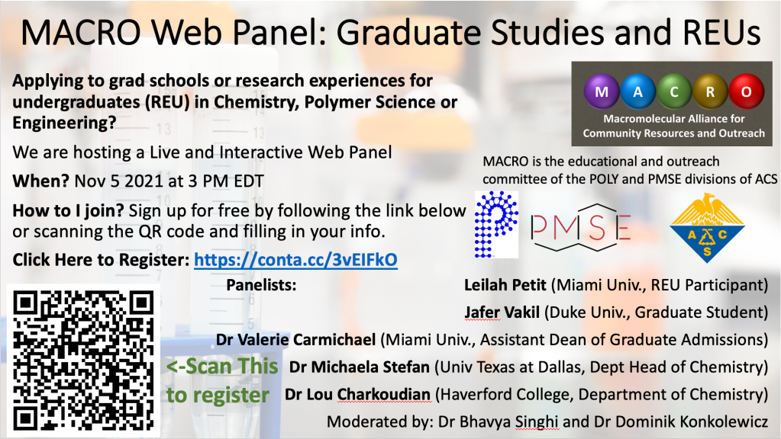
Professional Development: 2021
Held a REU and Grad School panel (5 NOV 2021)
Future plans
Panel?
Additional website content?

Slide 5
Outreach: 2021
Total of 5 activities posted
Silly Putty
Slime
Bouncy Balls
BYOP
STEM Career education
Currently soliciting activities
Difficult to collect information
Using Gamma Zeta chapter of Alpha Chi Sigma
Plan to create a searchable database once 10 activities are loaded

Slide 6
Scientific Resources: 2021
Various “calculators”
Peak deconvolution
DSC
GPC Hark Houwink corrections
Have received multiple inquires to post other materials
Have declined initial requests

Slide 7
Future plans
Implementing a sustainable methodology for generating new content
Current model
At least one new post per quarter
At least one new post per section per year
Spring 2021 National ACS meeting in San Diego
"Integrating Polymer Science in the Classroom“
2 half day sessions
K-14
Undergraduate & Graduate curriculum
Plan to transform conference contributions into website content

