Slide 1
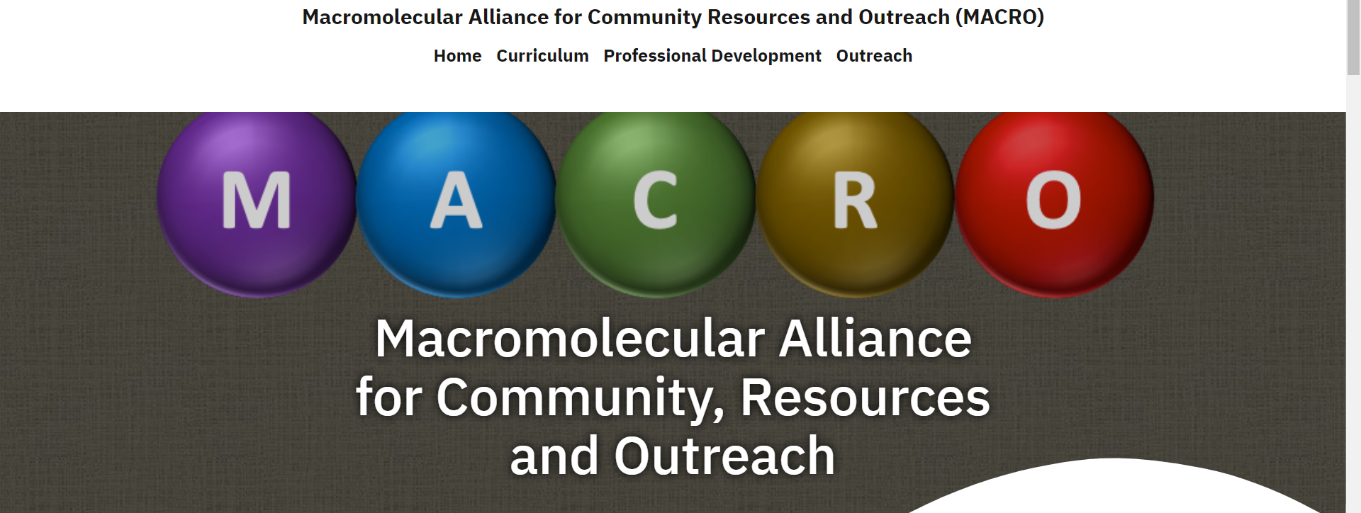
MACRO update
Website traffic continues to grow
2020: 1926 page views, 742 visitors
2021: 4839 page views, 2834 visitors
2022: 4990 page views, 3136 visitors
https://macro-poly-pmse.org/
Youtube channel : Liz Sterner @ LVC

Slide 2
Curriculum: 2023
Video equipment purchased and acquired. Belongs to “MACRO”
Currently maintained by Liz Sterner
Post in various formats (instructor & student; slides & videos)
New modules (determined by feedback from 2022 ACS symposium):
Describing Polymer Molar Mass: M_{N}, M_{W}, and Ð (Student & Instructor versions)
Methods for Determining Polymer Molecular Weight (Student & Instructor versions
Introduction to Polymer Viscoelasticity and Rheology (Student & Instructor versions
Soliciting ideas for new topics (email: pcostanz@calpoly.edu or esterner@lvc.edu)
Free radical vs reversible activation deactivation polymerization
Reversible deactivation polymerization
Ring-opening polymerization
Polymer topics in physical chemistry

Slide 3
Professional Development: 2023
Held/planning several panels
“Non-academic career paths” (APR 2023)
“Navigating Grad studies” (AUG 2023)
Additional session expected NOV 2023 on applying to REU programs
Plan to continue these panels in the future.
Please provide any other topics
pcostanz@calpoly.edu
Bhava Singhi (bsinghi@zeusinc.com)

Slide 4
Outreach: 2023
Currently soliciting activities
Difficult to collect information
Using Gamma Zeta chapter of Alpha Chi Sigma
Propose to offer a $175 stipend for each submission
Plan to create a searchable database once 10 activities are loaded
Spring 2024 National ACS meeting in New Orleans
"Integrating Polymer Science in the Classroom“
2 half day sessions
K-14
Outreach Competition (model after AlChe STEM outreach)
Plan to transform conference contributions into website content

Slide 5
Future plans
Implementing a sustainable methodology for generating new content
Current model
At least one new post per quarter
At least one new post per section per year
Curriculum - video content
Professional development - panels
Outreach - polymer activities
Please send any feedback to:
pcostanz@calpoly.edu
esterner@lvc.edu

