Slide 1

Workshops, Meetings, & International
Workshop Report (Marc provided report by Zoom during pre-meeting)
2025 Fluoropolymer Workshop Proposal (Vote Required)
Review Potential Workshop Chair Change
Past Chair Attendance Experience / Future ExComm Officer Discount (Allan G.)
National Graduate Research Polymer Conference (Vote Required)
PoWers: POLY Business Office Support
International Committee (PPC18) (more detailed update at Spring ACS)
Regional and other Meeting Support, Webinars (no report, will update at Spring ACS)
Feb 8 - First 2024 webinar “Better Ion Transport Through Polymer Chemistry: Polymer Electrolytes and Ion-conducting Membranes”
American Chemical Society Division of Polymer Chemistry

Slide 2
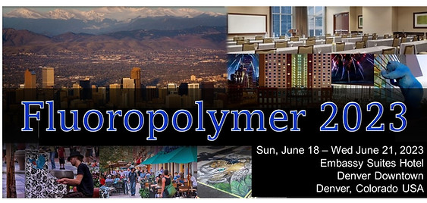

2023 POLY Workshops
Organizers:
Scott Iacono, US Air Force Academy
Bruno Ameduri, Charles Gerhardt Inst.
Jenna McCullum, University of Colorado
87 Total Attendees 35 Speakers 18+ Posters 9 Sponsors | Budget Overview: $62,972 Income $62,637 Expenses (including 15k Admin Fee) $335 Meeting Gains to POLY
81 Total Attendees 32 Speakers 35 Posters 12 Sponsors | Budget Overview: $76,848 Income $67,145 Expenses (including15k Admin Fee) $9,703 Meeting Gains to POLY
Notes:
Fluoropolymers
This fall a $1000 sponsor payment came in which we had given up on.
Hotel sent an unexpected refund $572

Slide 3
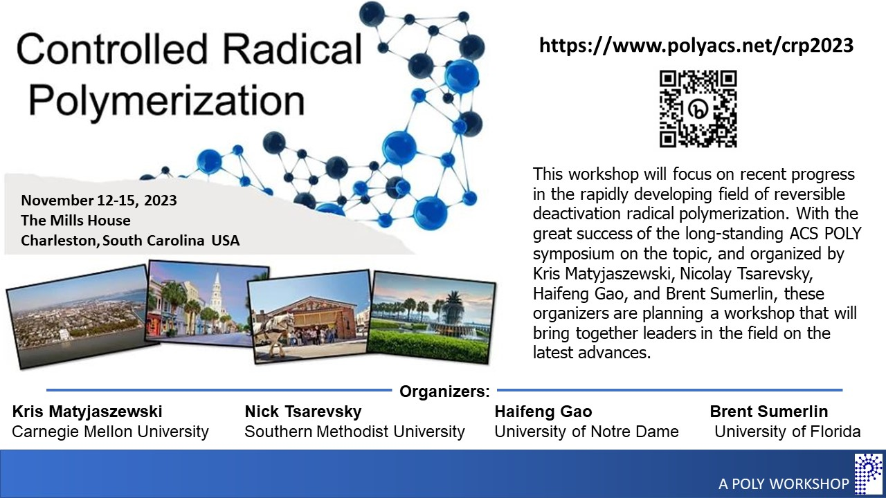
2023 POLY Workshops
2023 workshops
summary:
+$335
+$9703
-$7360
= $2678 ($6678)
76 Total Attendees 35 Speakers 26 Posters 3 Sponsors | Budget Overview: $56,150 Income $63,510 Expenses (including 15k Admin Fee) $-7,360 Meeting Gains donated to POLY $4,000 Pending Sponsor Payment

Slide 4
Annual Workshop Budgets (January-December) Represents Multiple Workshops with Ongoing Activity For Multiple Workshops
For example . . .
2023 ACTUAL EXPENSE INCOME
2015 Medicine and Biology $2,500
2022 Biomedical $6,248 $5,748
2023 Controlled Radical $41,469 $53,960
2023 Fluoropolymers $29,979 $60,120
2023 Sustainable Polymers $47,383 $75,095
2024 APO $4,948 -
2024 Fire and Polymers $13,957 $17,445
TOTAL $143,982 $214,868
2024 PROJECTED ACTIVITY PROJECTION EXPENSE INCOME
2023 Sustainable Polymers $3,000
2023 Controlled Polymers $4,000
2024 APO $52,000 $88,000
2024 Fire & Polymers 45,000 60,000
2025 Spring Workshops $9,000
2025 Spring Workshops $4,000
TOTAL $ 110,000 $ 155,000
Notes:
The real budget picture crosses years -

Slide 5
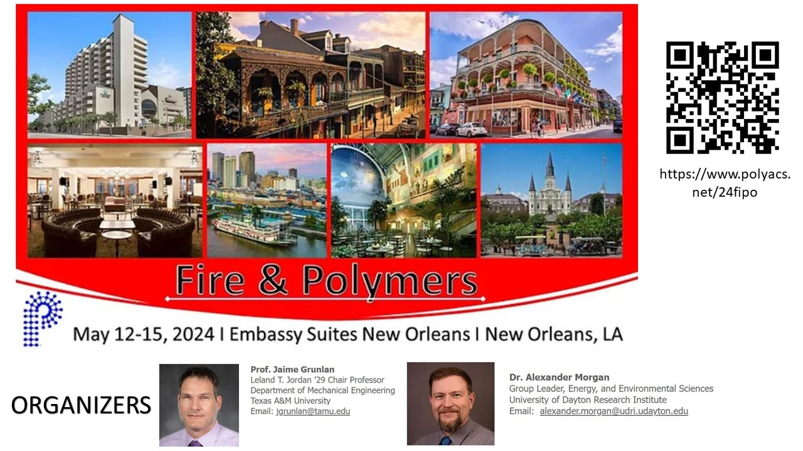
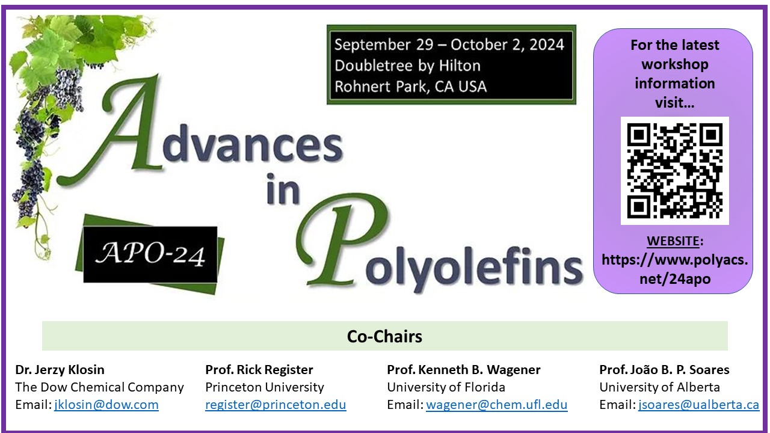
2024 POLY Approved Workshops (2)
Time frames for these workshops works perfectly with POLY business office travel calendars
Fire & Polymers
3½ Months Away
At least 6 Confirmed Sponsors ($16,000)
Registration Opened January 16th
8 Months Away
At least 2 Confirmed Sponsors ($6,000)
Registration to Open Shortly

Slide 6
2025 Workshops
Polymer Upcycling and Circularity Spring 2025 Org: Helms, Korley, Knauer | Ex-Comm Approved
Fluoropolymers 2025 (uploaded to ExComm meeting site) (12th Biennial POLY Workshop) Org: Jena McCollum and Dr. Bruno Ameduri, New Org: Cameron Parrish, Frank Leibfarth Potential Location: East Coast (Philly, Savannah, or Charleston) | Requires ExComm Approval At Winter Meeting
Soliciting Proposals for one other workshop for Fall of 2025 | Ready for ExComm Review March 2024
POLY NGRPC (next slide) National Graduate Research Polymer Conference | Requires ExComm Approval At Winter Meeting
POSTPONED LiKELY TO 2026
Reminder:
2 Workshops Recommended Per Year (reduced from the typical 4+)
Workshop will be scheduled May/June or October/November (6-8 weeks post-ACS Meetings)

Slide 7
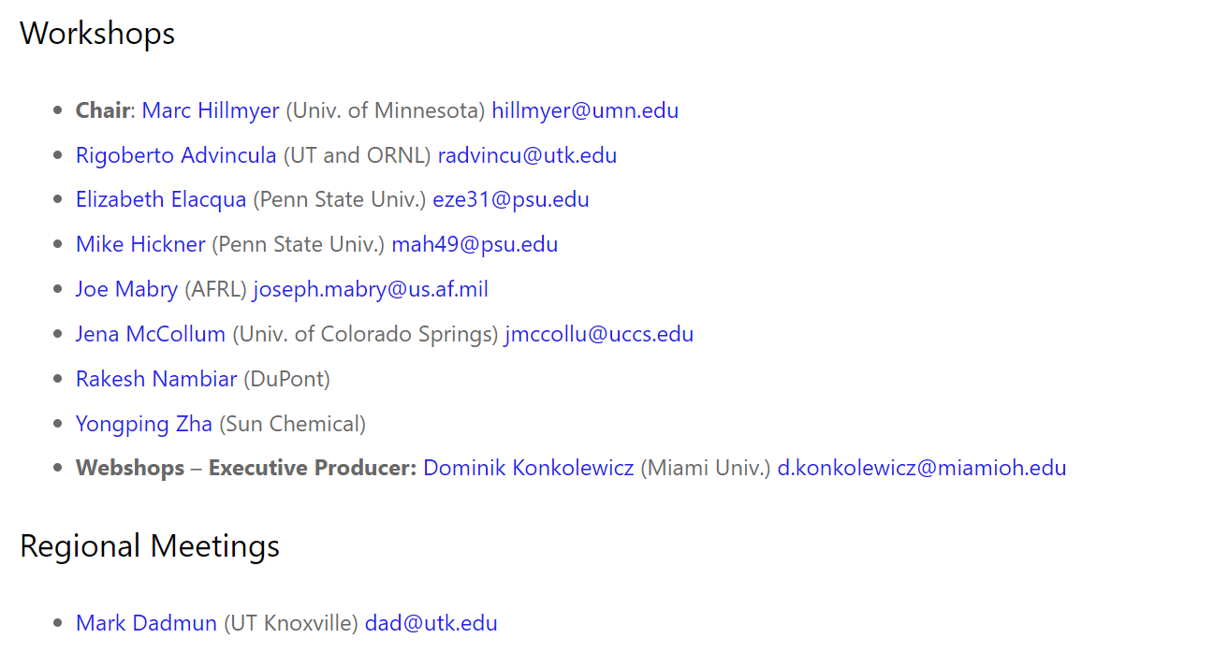
Review Potential Workshop Chair Change
American Chemical Society Division of Polymer Chemistry

Slide 8
National Graduate Research Polymer Conference
POLY 2025 NGRPC Winner:
Arizona State University (uploaded to ExComm meeting site)
Very strong and comprehensive proposal
runner-up in the last competition
capable and experienced organizers
west coast location
Previously Graduate Conferences
Penn State, 1994
Virginia Tech, 1996
University of Akron, 1998
Southern Mississippi Univ., 2000
Lehigh, 2003
UMASS, 2005
UT Knoxville, 2007
Univ. of NC at Chapel Hill, 2010
Case Western Reserve Univ., 2012
Louisiana State Univ., 2014
University of Akron, 2016
University of Minnesota, 2018
Virginia Tech (virtual), 2021
University of Michigan 2023
American Chemical Society Division of Polymer Chemistry

Slide 9
PoWers – June 2024
Meeting goal: Create a leading conference supporting women and gender minorities in the field of polymer science.
POLY offered to support:
Provide website registration site & collection
Promote the meeting via Emails/Twitter/Facebook
Collect Sponsor Support
Distribution refunds for the meeting
In Exchange:
Charge 1k Admin Fee
10% Sponsor Collection Fee
Organizing Team: Julia Kalow (Northwestern), Jill Alty (MIT), Symone Alexander (Auburn), Helen Tran (Toronto), Sara Orski (NIST), and Katie Houston (Eastman)
 | Projected Budget
$5,000 | Sponsor Support
$5,000 | Registration Collection
$8,000 | ACS IPG Grant (received in 2023)
$1,000 | Admin Fee
10% | Sponsor Collection Fee
American Chemical Society Division of Polymer Chemistry

Slide 10
PoWers – June 2024
POLY offered to support:
Registration: A Registration website will be developed and a link provided for your attendees to register. Please provide your registration rates to set up the site in January. A registration list will be sent to you 1 week before the meeting, one month before, and 8 weeks before. (3x’s total). (limited access)
Sponsor Support: POLY will be glad to collect sponsor support of $1,000 or higher by credit card. Once contact and arrangements for sponsorship have been made by your team, email Kathy with the contact information and she will invoice and collection support. Updates will be posted on the website noted below.
Staff Participation: You are welcome to contact the staff with meeting organization questions by email or phone, as needed. Staff will not be available for monthly meetings.
Meeting Promotion: POLY staff will be circulating PoWers meeting announcements to the POLY membership approximately every 6 weeks leading up to the event using the information on your website. (I encourage you to reach out to PMSE to do something as well)
American Chemical Society Division of Polymer Chemistry

Slide 11
PoWers – June 2024
POLY offered to support:
Refund Distribution: Collect all required receipts, names for refund checks, and mailing addresses per person. Send the list to Kathy (KATHYL@VT.EDU). Sending out less than 20 checks is preferable. Sending in the request for refunds in a lump about 1-3 times is preferable. (Suggestion: Once in February, April, and post-meeting). POLY can provide a refund check without receipts for $550 or less. If a refund is higher, receipts are required (copies are fine – this is for tax purposes).
POLY Policy: POLY operates on money-in before money-out. Anticipated income cannot be distributed until received. A 10% collection fee for sponsor support will be applied. POLY will charge a $1,000 admin fee for services. This will be deduced from funds received in POLY. Credit card processing charges are applied by the collection agency and will be deducted from the total. (usually 5% of the charge). See the website link below for details. I understand any remaining support collected by POLY that is unspent by 8/15/2024 will be released by PoWers and donated to POLY for division operation use. No funding will be carried forward for future use nor distributed for purposes other than to support the 2024 PoWers Meeting.
Funding Status: The Sponsor support status, registration fees collected, POLY fees, and grant funding can be found online. This is updated weekly.
American Chemical Society Division of Polymer Chemistry

Slide 12
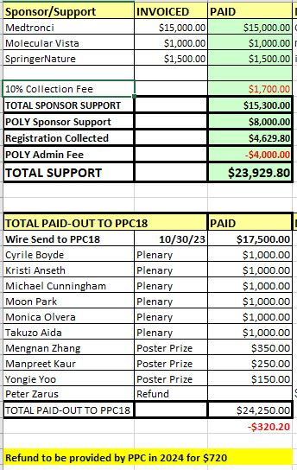
PPC18 - December 2023
POLY offered to support PPC18:
Provide website registration site & collection
Promote the meeting via Emails/Twitter/Facebook
Collect Sponsor Support
Distribution of Plenary Speakers & Poster award support
Sponsoring the event 8K
In Exchange:
Charge 4k Admin Fee
10% Sponsor Collection Fee
2024 - Almost complete!
POLY needs to process one registration refund
PPC will send $720 refund which will close out the budget
American Chemical Society Division of Polymer Chemistry

