Slide 1

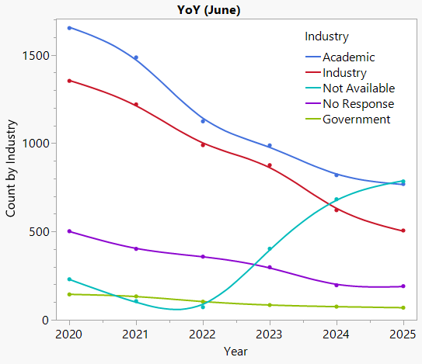
POLY Membership Status – June 2025
New ACS membership format
2,373 current members
2,363 members last month
2,457 members last June 2024
Uptick in N/A category coincides with ACS’s new membership model. (now 32% of our members)
Consistent loss in academic and private sector members.

Slide 2
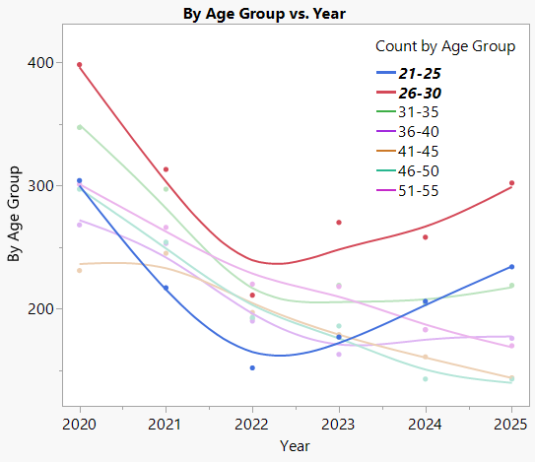
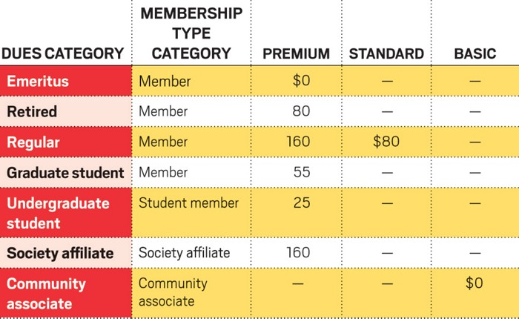
POLY Membership since new ACS membership model
Avg 50 % increase in 21 – 30 year age group
Avg 25% loss in 31+
Fees 2022 - present
43%
54%
https://cen.acs.org/acs-news/comment/ACS-Comment-Welcome-future-membership/100/i21

Slide 3
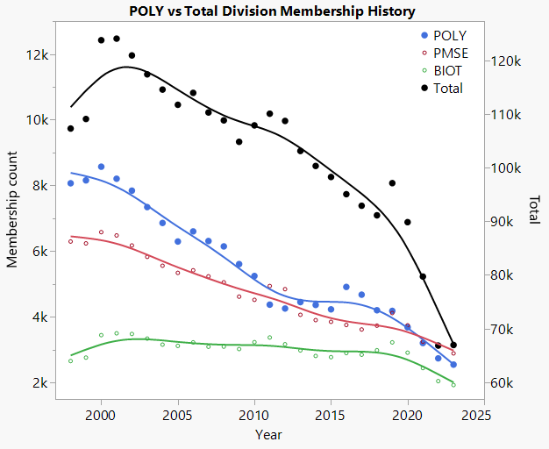
Membership is decreasing across all ACS Divisions
ACS initiated a Division Membership Working Group in June 2025
Mission:
To foster ACS division success through actively expanding membership and enhancing member engagement.
Goals:
Identify Division Membership Value proposition
Outline strengths and weaknesses for recruiting new division membership
Determine retention practices for division members
Develop a harmonized communication strategy

Slide 4
What Works? What Doesn’t?
Working Group Survey – Division Related Highlights
Access to C&EN, InChemistry, technical sessions, and newsletters
Opportunities for networking, career advancement, and publishing
Local sections and divisions’ role in community and leadership engagement
Transparency in division dues
Unclear differences between Society Affiliate and Community Associate
Not enough support for new member onboarding
Lack of clear engagement paths (especially low-effort or entry-level involvement)
No clear outreach to industry or support for managers encouraging ACS membership
Benefits & Value
Quarterly newsletters and technical updates help keep members informed
Transparency in division dues (with some exceptions)
Insufficient messaging around why someone should join — mission, impact, and purpose under-communicated
Few examples of impact stories, metrics, or testimonials to convey real member value
Communications

Slide 5
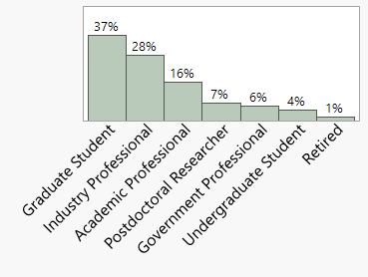
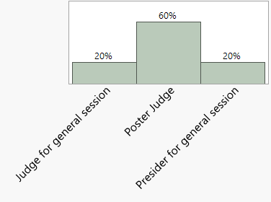
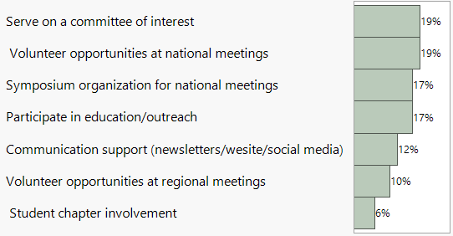
How is the Membership Committee contributing?
Poly Volunteer Interest Form* (started in Jul 2024) Colleen Scott, Volunteer Coordinator
collaboration with
Jeff Ting, Tayler Hebner, Publicity Team
Total of 68 new volunteers in 1 year
Majority
Grad Students and Industry Professionals
Want serve as a poster judge
Volunteer coordination streamlined
9 Sci-Mix Judges
6 POLY Desk volunteers
*Membership not mandatory to volunteer

Slide 6
Let’s collaborate!
Membership committee to collaborate with all other POLY committees
Voice of Membership
Resource to committees
Onboarding through meaningful member-committee-resource connection
MACRO
Poster Awards
Student Chapters
Programming
MEMBERSHIP
IAB
Workshops
International Relations
Regional Meetings

Slide 7

ACS Membership Drive Initiative
Valid until September 2025
30% discount on new and society affiliate memberships
Up to 3 free division membership for new members

Slide 8

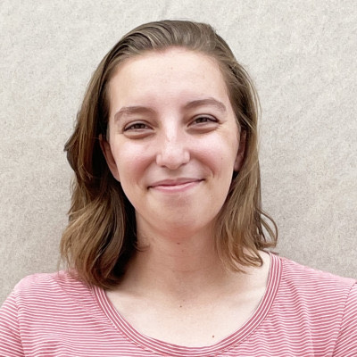
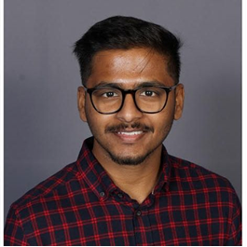
STUDENT CHAPTER HAPPENINGS – Fall 2025 Kaitlyn Crawford, UCF; Sofia Goodrich, BD; POLY: Piril Ertem 3M
1 new student chapter starting in May 2025: University of Illinois, Urbana-Champaign (18 total)
UC Irvine expressed interest in starting a chapter (August 2025)
24-25AY student reports: 10 on time; 2 late; 6 missing (following up with faculty advisors)
New volunteer from Pakistan to help with connecting chapters online
Collaborating with POLY member-at-large, Piril Ertem, to enhance overall student involvement
Fall 2025 travel awardees
Basic Stats (based on 12 reports)
Members: 486 grad, 55 ug, 2 postdocs
Seminars: 30+ (some weekly)
Networking: 30+
Outreach: ~24
Full symposium: 1
Events like: lunch-&-learn, art show, professional development, K-12
Mary Jutze
UMASS Amherst
PI: Reika Katsumata
Dhanush Patil
UC Berkeley
PI: Grace Gu
Notes:
6 missing (FSU, UNH, USC, Uakron, USM, UT)
New for 25-26AY: scheduling, submission formats, online connectivity, strategic planning (Megan and Rob)

