Slide 1

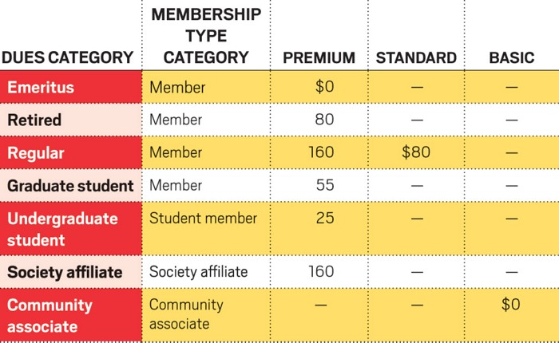
ACS vs POLY Membership
ACS implemented a new membership model in 2022
ACS saw immediate increase in membership, while POLY continued to lose members.
Fees 2022 - present
https://cen.acs.org/acs-news/comment/ACS-Comment-Welcome-future-membership/100/i21

Slide 2
POLY Membership
New ACS membership format
Regular 80%
Uptick in N/A category coincides with ACS’s new membership model. (now 32% of our members)
Consistent loss in academic and private sector members.

Slide 3
POLY Membership – by age
Since the new ACS membership model (2022)
Avg 60% increase in 11 – 30 year age group
Avg 25% loss in 31 and older
126% | 32% | 20% | -15% | -20% | -27% | -32% | -35% | -29% | -30% | -24% | -10%
We are gaining more student/ early career members

Slide 4
POLY Membership – by year of service
Since the new ACS membership model (2022)
Avg 7% increase in 1 – 2 year member count
(note that it has only been 3 years since the change)
Avg 36% loss in ≧ 3 year member count
12% | 3% | -32% | -51% | -70% | -43% | -29% | -40% | -57% | -18% | -19% | -52% | 0% | -10% | -49%

Slide 5
Membership Plans in 2025
POLY and PMSE Membership Committees identified that:
Students ask for more opportunities to network with industry professionals
      2. Government resources beyond large funding opportunities are largely unknown to industry professionals
      3. Non-technical workshops for building soft skills (e.g. project management) could engage broad range of member profile
POLY and PMSE Membership Committees will work together to organize targeted events to address these needs.
The efforts will take collaborative effort with other POLY committees
(e.g. IAB, MACRO, Student Chapters, Workshops and Webinars Committees)

