Slide 1
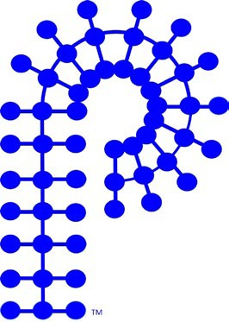
Current Membership
Membership Dues
$30 ACS Member
$10 ACS Student Member
$50 Non-ACS
Sign up through ACS or POLY Website
ACS maintains the roster
History
2024 | 2,450
2023 | 2,574
2022 | 2,766
2021 | 3,226
2020 | 4,133
2019 | 4,164
2018 | 4,641
2017 | 4,560
2016 | 4,254
2015 | 4,302
2014 | 4,489
Regular 80%
Year | Affiliates | Students | Regular
2024 | 47 | 572 | 1,831
2023 | 84 | 495 | 1,995
2022 | 183 | 469 | 2,583
Approximately 40% are 1st Year Members

Slide 2
ACS POLY 2024 Demographic Info (Jan - Dec 2024)
Grad Students
Early Career
Postdocs

Slide 3
ACS POLY 2024 Demographic Info (Jan - Dec 2024)
Significant decrease after first year of membership!
Who are we losing?

Slide 4
ACS Meeting Registration Statistics
Difference in membership demographics and meeting registration.
Is there a correlation?
Source: https://www.acs.org/meetings/acs-meetings/spring/exhibit/registration-statistics.html

Slide 5
ACS vs POLY Membership

Slide 6

Student Chapters
Chapter Location | Advisor
Arizona State University | Jeffrey Self
Case Western Reserve | Gary Wnek
Colorado State University | Megan Hill
Cornell University | Erin Stache
Florida State/FAMU combined | Justin Kennemuer
SW Ohio University | Neil Ayres & Dominik Konkolewicz
Texas A&M University | Quentin Michaudel
Virginia Tech | John Matson
University of Akron | Kevin Cavicchi
University of Florida | Brent Sumerlin
University of Massachusetts, Amherst | Todd Emrick
University of Michigan | Charles McCrory
University of Minnesota | Jessica Lamb
University of South Carolina | Chuanbing Tang
University of Southern Mississippi | Derek Patton
University of Tennessee | Mark Dadmun
University of Utah | Doug Tree & Chen Wang
Inactive Chapters
Cornell University
New Chapter:
University of Utah
Student Chapter Co-Chairs
Kaitlin Crawford
University of Central Florida
kcrawford@ucf.edu
Sofia Goodrich sofia.goodrich@gmail.com

Slide 7
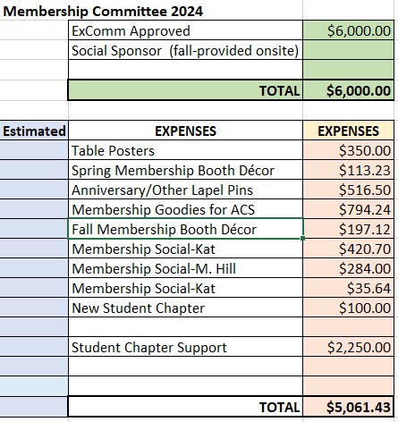
Membership Budget
$6,000 FUNDING BREAKDOWN
Student Chapter Funding
Student Social at ACS
Booth & Give-A-Ways
Lapel Pins
PMSE & POLY jointly support the student social and student chapters

