Slide 1

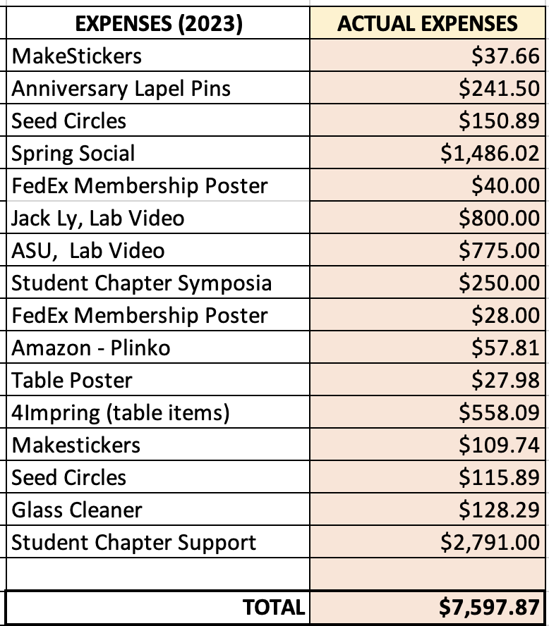
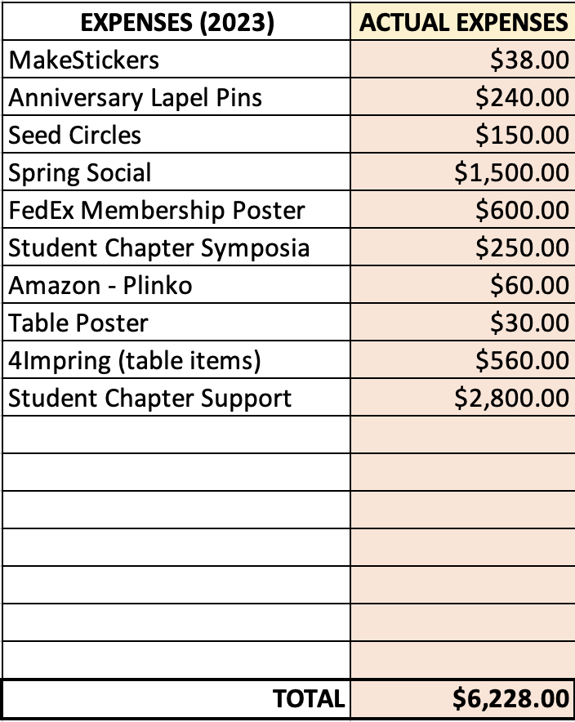
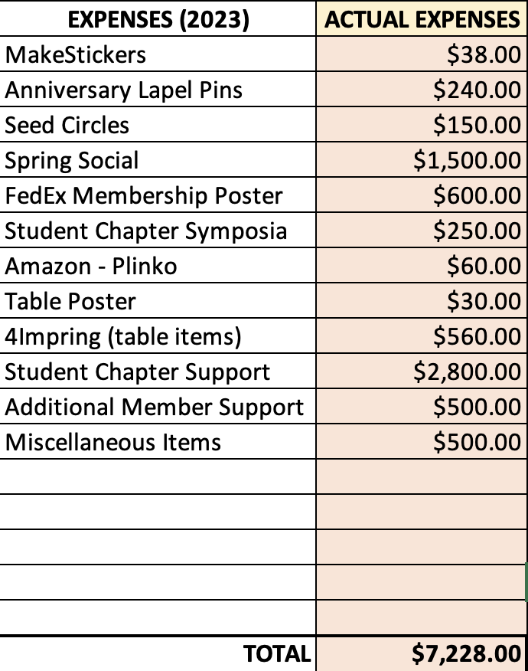
Membership Budget
2023 Actual Expenses
Includes spending remaining IPG funds
Option 1 2024 Budget
This is without company sponsorship for social at Denver
Option 2 2024 Budget
With company sponsorship
Notes:
We are requesting at least Option 1
Option 2 would be best though and safest since we do not know if we will get sponsorship

Slide 2

Student Chapter Updates
Green – Winning chapters
Red – Did not submit a report, but did last year
Chapter Location | Advisor
Arizona State University | Tim Long
Case Western Reserve | Dave Schiraldi
Colorado State University | Megan Hill
Cornell University | Erin Stache
Florida State/FAMU combined | Justin Kennemuer
SW Ohio University | N/A
Texas A&M University | Quentin Michaudel
Virginia Tech | John Matson
University of Akron | Kevin Cavicchi
University of Florida | Brent Sumerlin
University of Massachusetts, Amherst | Laura Bradley / Todd Emrick
University of Michigan | Charles McCrory
University of Minnesota | Theresa Reineke
University of South Carolina | N/A
University of Southern Miss | Derek Patton
Inactive Chapters:
Clemson University
University of Texas, Dallas
University of Delaware
Cornell University
Virginia Tech
University of Southern Miss
New student chapter chair:
Kaitlin Crawford
University of Central Florida
kcrawford@ucf.edu

Slide 3
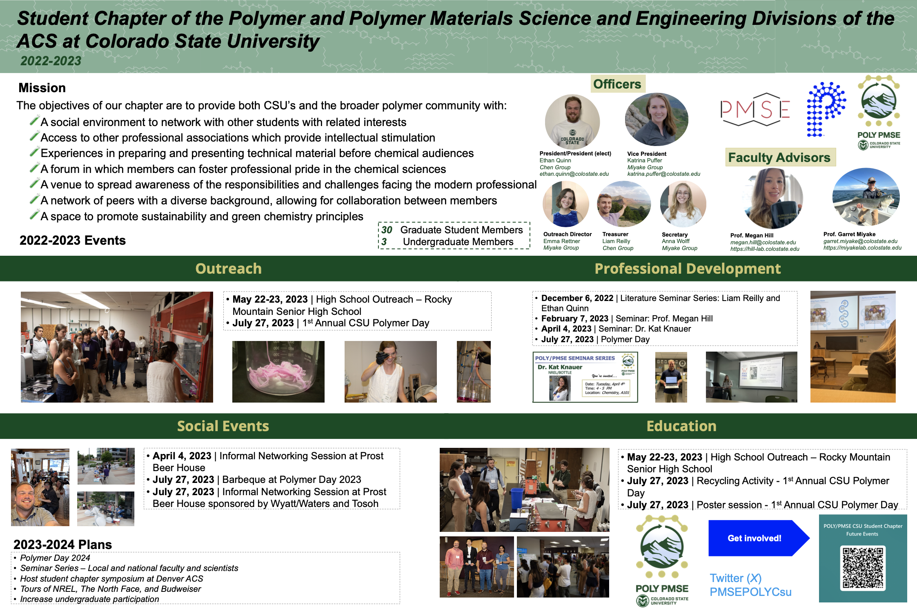
Student Chapter Updates
12 chapters submitted their annual report using the new poster template
The top three winner chapters were:
1st: Colorado State University 2nd: University of Minnesota
3rd: FAMU/FSU
CSU organized a POLY/PMSE quarterly symposium with invited speakers, a “Polymer Day” with local high schools and universities with a poster session and awards, and several social/networking events!
Notes:
Feedback on whether we can print and display the winning posters

Slide 4

Poly(mentor)_{n}
Mentees not limited to students; anyone can sign up as a mentee (no age limit)
We have established a list of criteria for mentors:
                - >7 years outside of most recent degree
                - Currently in an active STEM related position
                - Others? Time to dedicate, length of program, communications in program, feedback loop
                Working on designing a logo for the program
                We plan to launch the pilot program in New Orleans and have information on the program at the POLY table and a sign-up sheet!
                - Start with only 20-30 mentors
MENTORING
ADVISE
TRAINING
SUCCESS
oly(mentor)_{n}
GOAL
DIRECTION
SUPPORT
COACHING
Notes:
Ask for input from ExComm
Meet with NREL mentor program lead for feedback
Meet with Sandia mentor program lead for Sandia

Slide 5
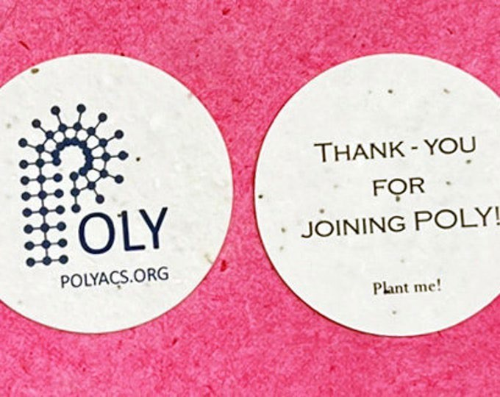
Membership drive activities – ACS New Orleans
Student chapters to ”host” membership tables at ACS meetings (FAMU/FSU assigned for New Orleans, CSU for Denver)
Attending the poster sessions and recruiting members using the pins and seed cards really does make a difference!
The student social will be “cancelled” and merged with the PMSE Centennial Event on Monday evening.
                Bourbon street drinkery
                Monday 3/18, 5:30-7:30
ACS New Orleans: Monday Night – SciMix, PMSE Centennial
Tuesday – Poster Sessions

Slide 6


Special Events - Denver
Launch POLY mentor program
Student social in collaboration with The North Face – Host at TNF labs event space in RiNo
  Additional support from BOTTLE/NREL
  PickAxe workshop by Linda Broadbelt, Northwester University
  Potential NREL tours
  Other ideas?

