Slide 1

Current Membership
Affiliates
History
December 2023 | 2,574
December 2022 | 2,766
December 2021 | 3,226
January 2020 | 4,133
January 2019 | 4,164
January 2018 | 4,641
January 2017 | 4,560
January 2016 | 4,254
January 2015 | 4,302
January 2014 | 4,489
January 2013 | 4,886
Students
Regular 80%
Year | Affiliates | Students | Regular
2023 | 84 | 495 | 1,995
2022 | 183 | 469 | 2,583
2021 | 143 | 515 | 2,568

Slide 2
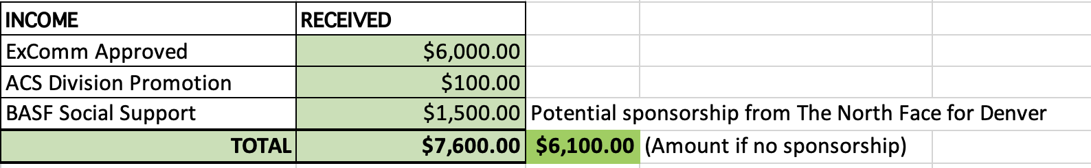
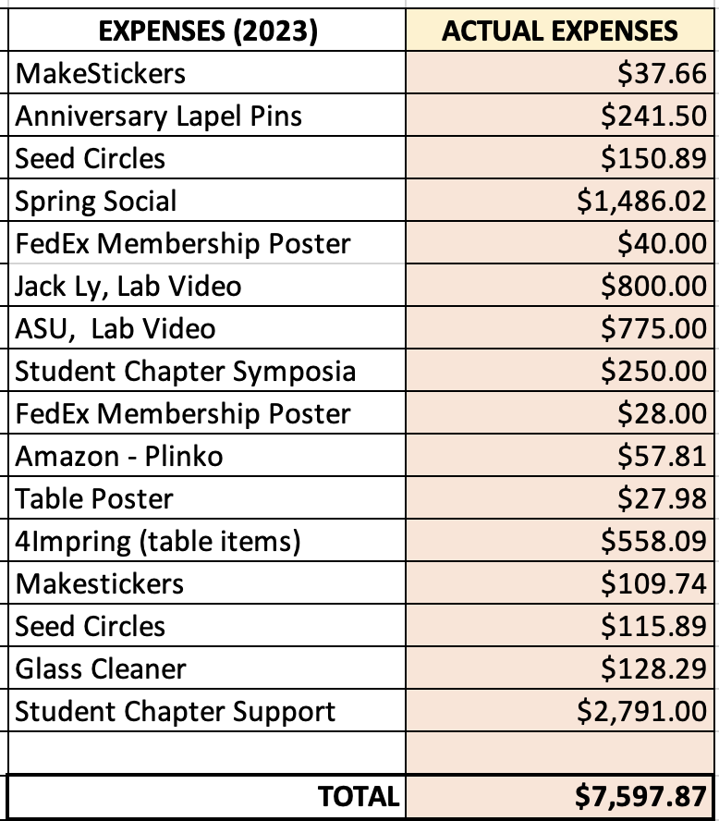
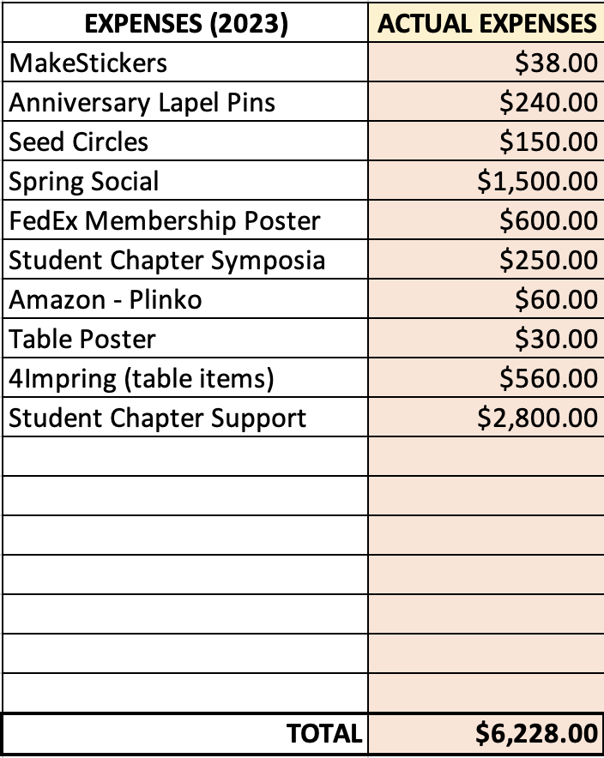
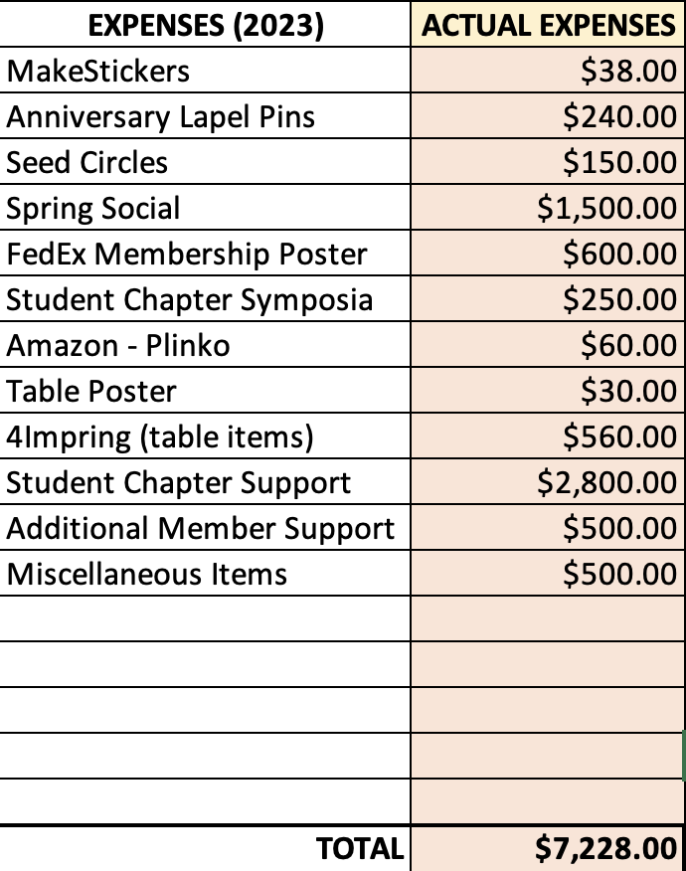
Membership Budget
2023 Actual Expenses
Includes spending remaining IPG funds
Option 1 2024 Budget
This is without company sponsorship for social at Denver
Option 2 2024 Budget
With company sponsorship
Notes:
We are requesting at least Option 1
Option 2 would be best though and safest since we do not know if we will get sponsorship

Slide 3

Student Chapter Updates
Green – Winning chapters
Red – Did not submit a report, but did last year
Chapter Location | Advisor
Arizona State University | Tim Long
Case Western Reserve | Dave Schiraldi
Colorado State University | Megan Hill
Cornell University | Erin Stache
Florida State/FAMU combined | Justin Kennemuer
SW Ohio University | N/A
Texas A&M University | Quentin Michaudel
Virginia Tech | John Matson
University of Akron | Kevin Cavicchi
University of Florida | Brent Sumerlin
University of Massachusetts, Amherst | Laura Bradley / Todd Emrick
University of Michigan | Charles McCrory
University of Minnesota | Theresa Reineke
University of South Carolina | N/A
University of Southern Miss | Derek Patton
Inactive Chapters:
Clemson University
University of Texas, Dallas
University of Delaware
Cornell University
Virginia Tech
University of Southern Miss
New student chapter chair:
Kaitlin Crawford
University of Central Florida
kcrawford@ucf.edu

Slide 4
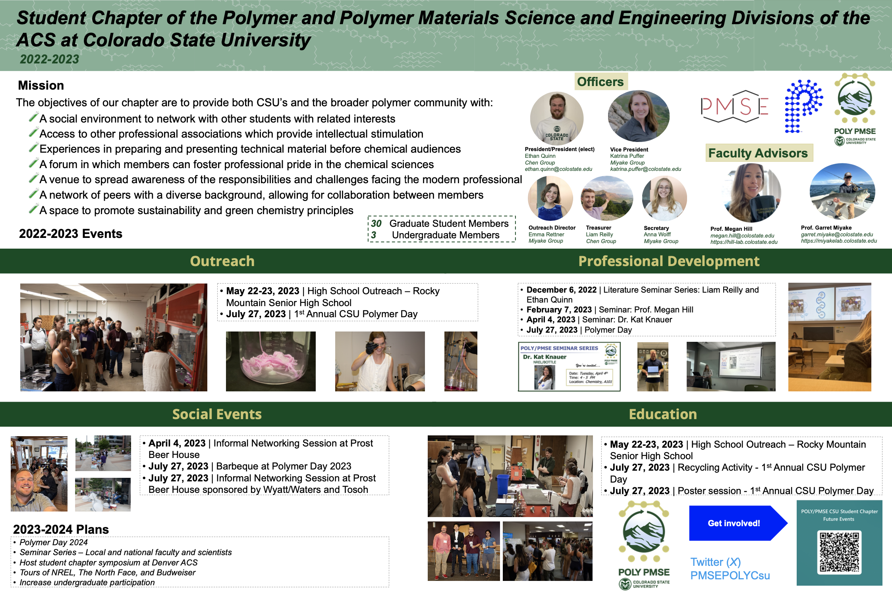
Student Chapter Updates
12 chapters submitted their annual report using the new poster template
We propose to print the top three posters to display at ACS New Orleans!
The top three winner chapters were:
1st: Colorado State University 2nd: University of Minnesota
3rd: FAMU/FSU
CSU organized a POLY/PMSE quarterly symposium with invited speakers, a “Polymer Day” with local high schools and universities with a poster session and awards, and several social/networking events!
Notes:
Feedback on whether we can print and display the winning posters

Slide 5

Poly(mentor)_{n}
Mentees not limited to students; anyone can sign up as a mentee (no age limit)
We have established a list of criteria for mentors:
                - >7 years outside of most recent degree
                - Currently in an active STEM related position
                - Others? Time to dedicate, length of program, communications in program, feedback loop
                Working on designing a logo for the program
                We plan to launch the pilot program in New Orleans and have information on the program at the POLY table and a sign-up sheet!
                - Start with only 20-30 mentors
                - We need to design a small poster for this!
MENTORING
ADVISE
TRAINING
SUCCESS
oly(mentor)_{n}
GOAL
DIRECTION
SUPPORT
COACHING
Notes:
Ask for input from ExComm
Meet with NREL mentor program lead for feedback
Meet with Sandia mentor program lead for Sandia

Slide 6
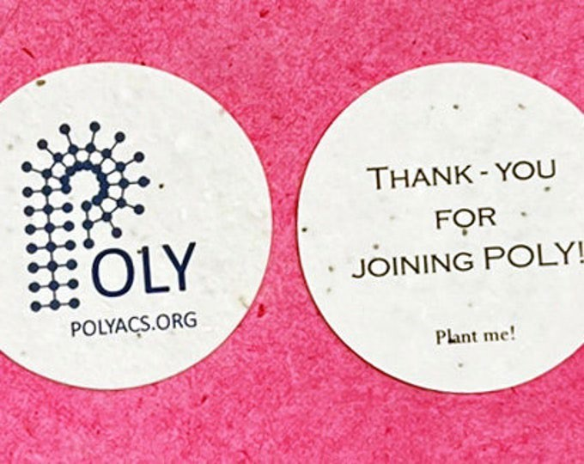
Membership drive activities – ACS New Orleans
Will Justin K.’s group take on the POLY table? There was discussion about this before! Maybe they can tag team with USM?
Attending the poster sessions and recruiting members using the pins and seed cards really does make a difference!
The student social will be “cancelled” and merged with the PMSE Centennial Event on Monday evening. We need to make sure this is advertised effectively at the POLY table!
ACS New Orleans: Monday Night – SciMix
Tuesday Night – Poster Session

