Slide 2
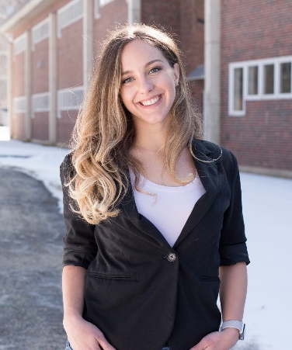
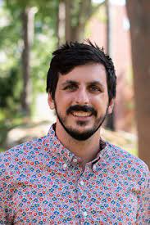
POLY Student Chapters Big 3 Update Partnering with PMSE to Create an Inclusive, Student-led Community
Student advisory board: three meetings based on academic calendar
First meeting will be Thursday, 9/15/2022
Student-planned symposium in Chicago
Organized by Rachel Bianculli (VT), Daniel Verrico (Case Western), Sofia Goodrich (UFL)
8:00 – 12:00 PM; 8/23/22
Annual Reports – change to poster form
Chapters will share during fall SAB meeting to allow students to learn from more established groups
Best chapter will be announced at that time
Bonus: New Chapters for 2022
Student Chapter Chair
Dan Savin-PMSE
Elizabeth Bright-POLY
ebright@mmm.com
Nate Oldenhuis Nathan.Oldenhuis@unh.edu

Slide 3





Welcoming new POLY/PMSE student chapters in 2022!
Florida State & FAMU
University of Akron
University of Tennessee, Knoxville
Colorado State University
SW Ohio

Slide 4

Membership Drive Activities – ACS
POLY/PMSE Student Social
50/50 sponsorhsip
Monday, August 22nd 6:00 pm
Krolls South Loop
POLY recruiting table with sign up
Icebreaking/networking games
Pint glass prizes
Organized by Melanie Chu and Kat Knauer

Slide 5

Membership Drive Activities – ACS
POLY/PMSE Student Poster Session
Kat and Coralie will walk around with IPADs and sign-up students
Student who agree to sign up for POLY membership will receive a POLY pin and wildflower gardening seeds
Any other volunteers?

Slide 6

Membership Drive Activities – ACS
We are asking POLY leaders to consider adding 1-2 slides at the end of their ACS talks to encourage attendees to sign up for POLY membership!
Email Kat Knauer at katrina.knauer@nrel.gov for the template.

Slide 7
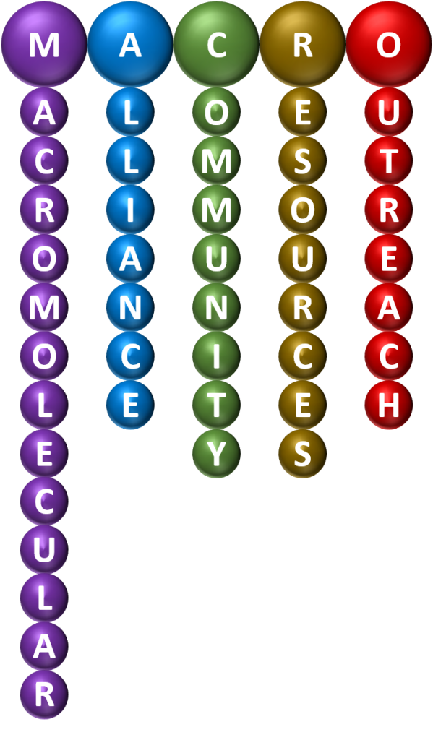


Membership Drive Activities – POLY/PMSE/MACRO
Polymer science lab/classroom demo competition where members design a polymer science education demo, film the demo, and upload the video to social media.
~3-4 winners (at least 1 student, 1 industry, and 1-2 academia/national lab winners). Winners will receive free registration and travel support for the Spring ACS meeting in Indianapolis.
Selection criteria
Must be a POLY and/or PMSE member
Number of likes on the video
Number of shares of the video
Scientific impact
Other suggestions?
MACRO has confirmed support and PMSE will match funds!

Slide 8

Membership Drive Activities – WRM-ACS Meeting in Las Vegas
October 19-22, 2022
Planning for a strong POLY attendance
POLY Networking/Social
Organizer – Kat Knauer
Other volunteers?
Working on industrial sponsorship
IPG funds
PMSE co-fund?
Can we consider having a POLY member table for recruiting?

Slide 9
Membership Committee Meeting
Monday, August 22
12:00 pm
Virtual & in person
McCormick S102d
Contact: Katrina.knauer@nrel.gov

Slide 10

POLY Social Media Growth: 2016 - 2022
Date | Twitter | Facebook | LinkedIn
Jan 2017 | 796 | 2,113 | 1,089
Jan 2018 | 1,210 | 2,169 | 1,087
Dec 2019 | 2,758 | 2,511 | 1,092
Dec 2020 | 3,527 | 2,532 | 1,106
Dec 2021 | 4,091 | 2,535 | 1,107
Aug 2022 | 4,382 | 2,573 | 1,150
- Administered mainly by Bus. Office
- Facebook and LinkedIn are gradually growing (LinkedIn is now an open group)
- Twitter continues to grow

Slide 11
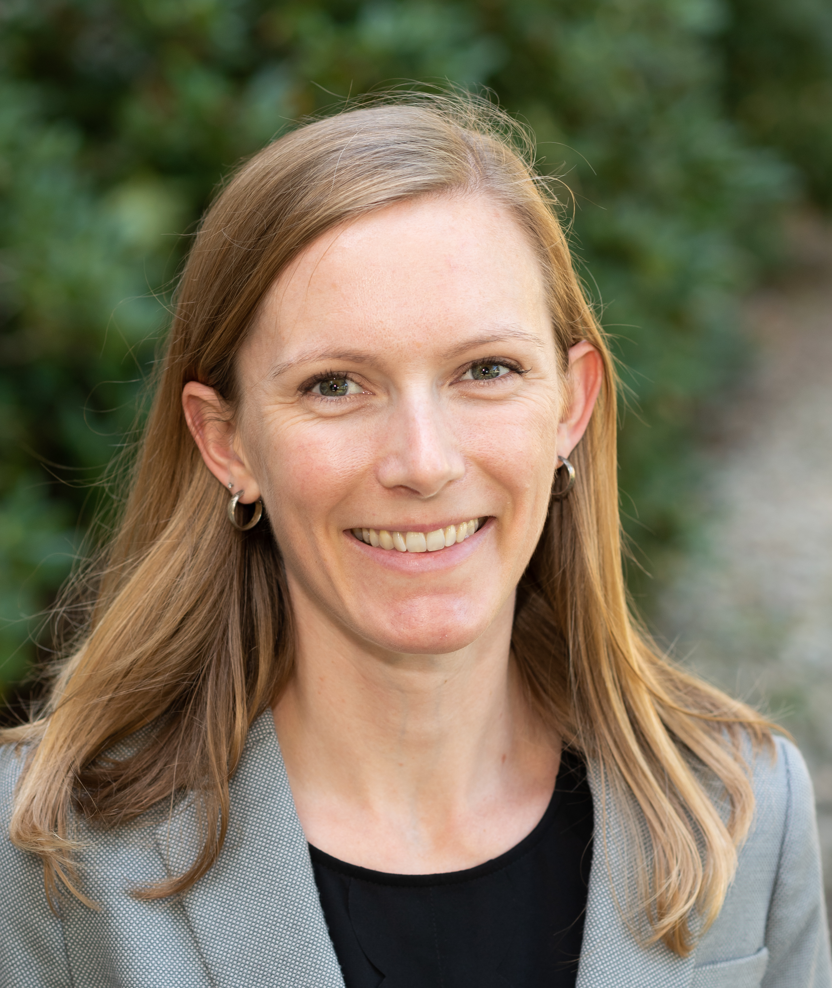
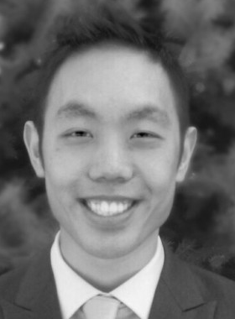
POLY website and social media
Recruited!
Jeff Ting
(Twitter master)
“stealth start up”
backlunc@gmail.com
General upkeep and updating of website content
Coordinating updates with the business office
Reflecting the membership committees efforts
Engaging the community through weekly twitter activity
Immediate Goal: create a list of what to advertise over the months
Items for advertisement (nominations, volunteers*, organizers, etc.) are welcomed!

Slide 12
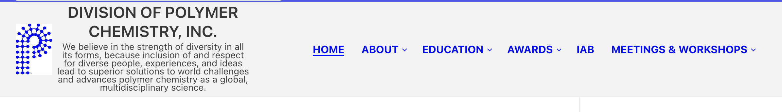
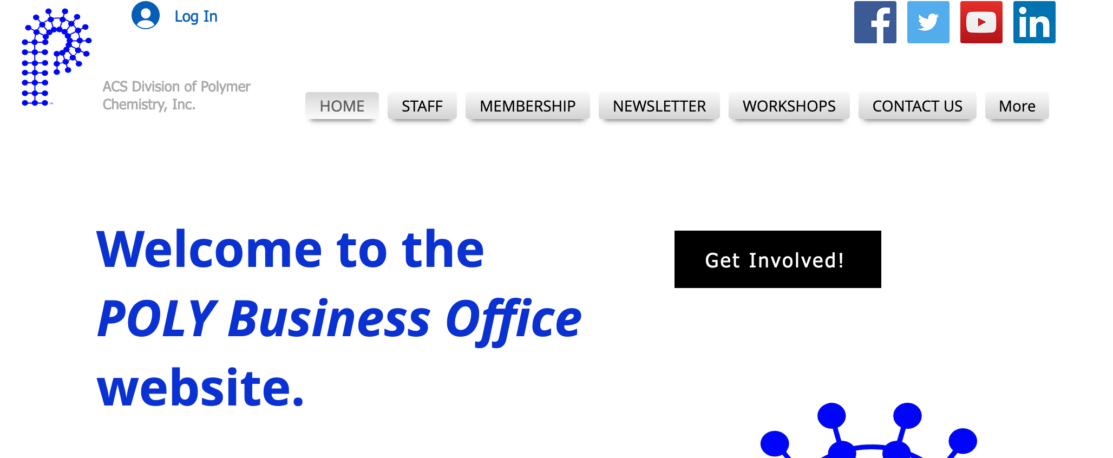
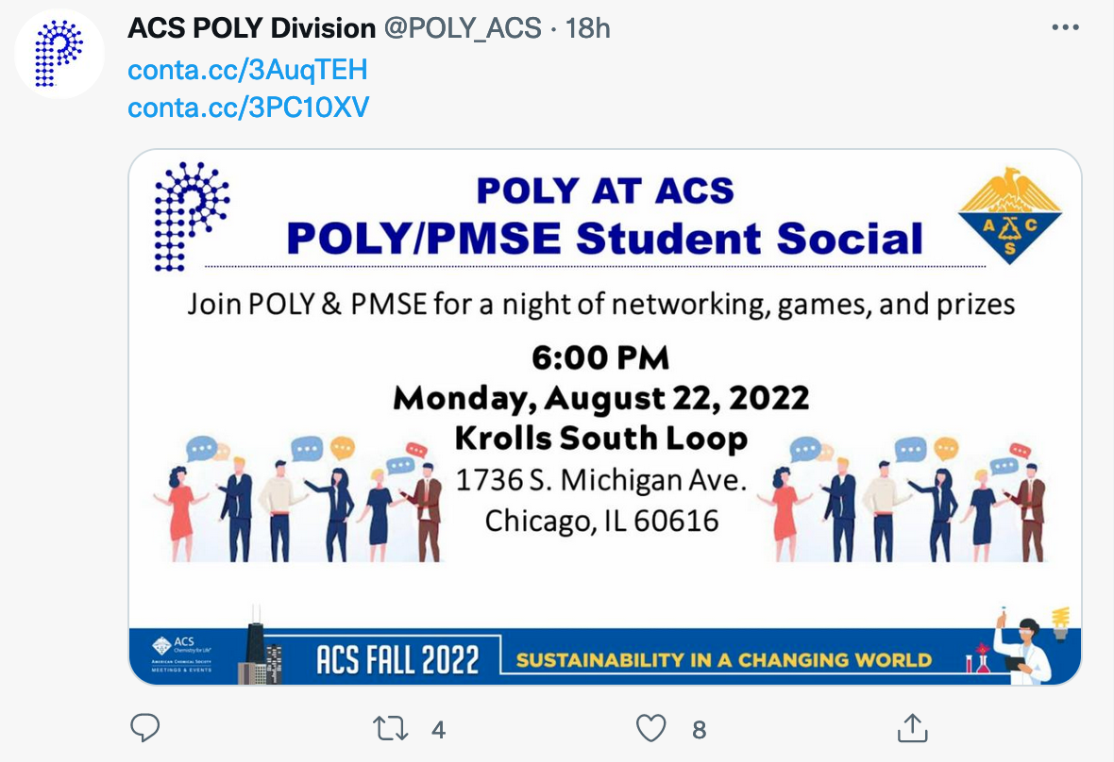
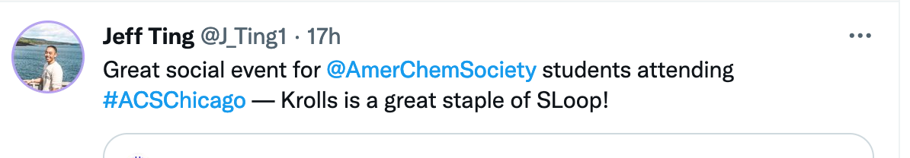
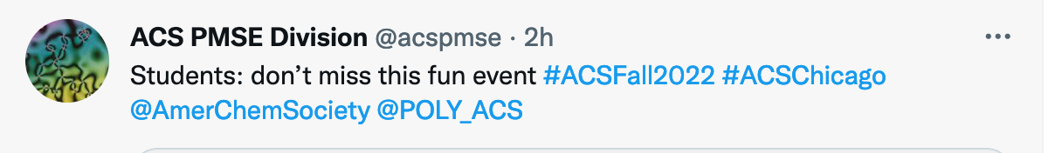
Points to Address
Parallel websites are being managed
Polyacs.org (Coralie): award deadlines,
Polyacs.net (Business Office)
Consistent branding/organization of social media engagement.

