Slide 1
POLY Programming Happy Hour
Fall 2021 National Meeting

Slide 2
Overview
General Programming Updates-Hayley (Programming Committee Chair)
Reporting- Rob (Spring 2021)
Recognition- Sara (Fall 2021)
Recruitment- Levi (Spring 2022) and Rob (Fall 2022)
Special thanks to Kathy!

Slide 3
POLY Programming
Timeline for symposia planning
Typically planning 1 to 1.5 years in advance
Atlanta meeting abstracts open
Soliciting proposals for Chicago
https://polyacs.org/symposium-proposal-online-form/
Chicago theme is “Sustainability in a Changing World”
Deadlines have been shifting, so check the live ACS website
Model is coach (Programing Chair) and players (Symposium Organizers) working together
Coach’s job is to help you with ACS broadly- come ask us for help directly!
Next meetings: San Diego Spring 2022, Chicago Fall 2022, Indianapolis Spring 2023

Slide 4
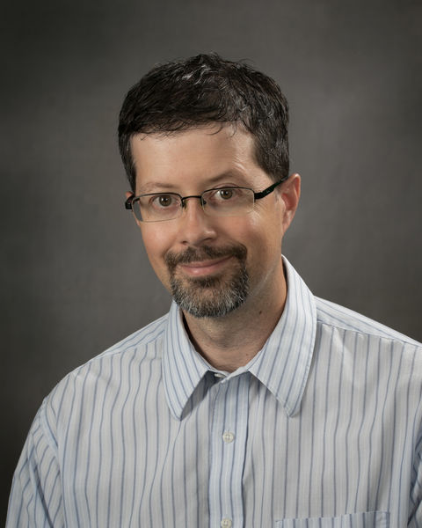
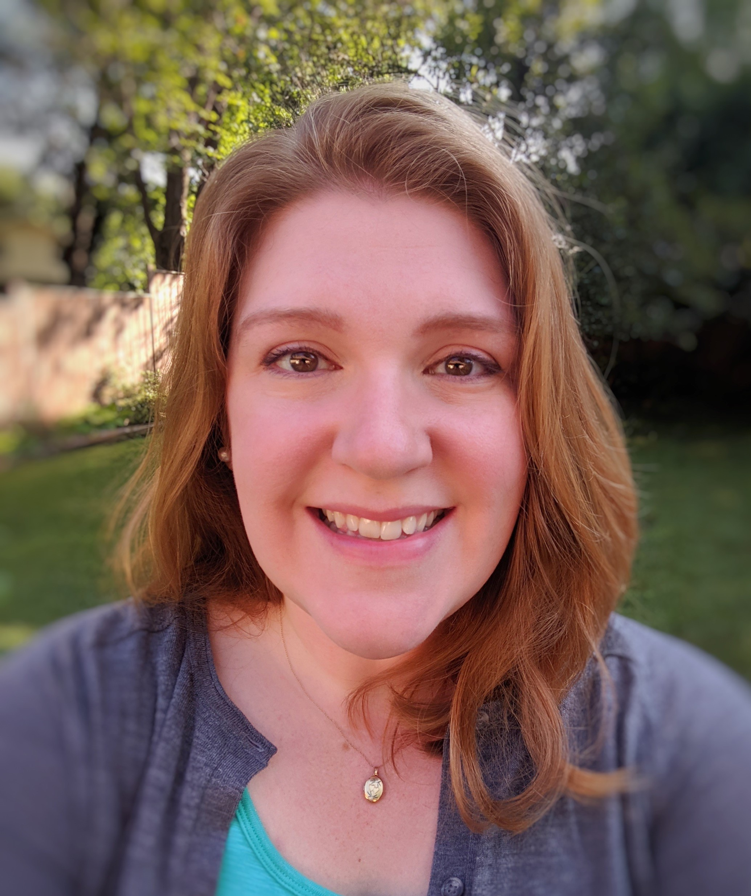
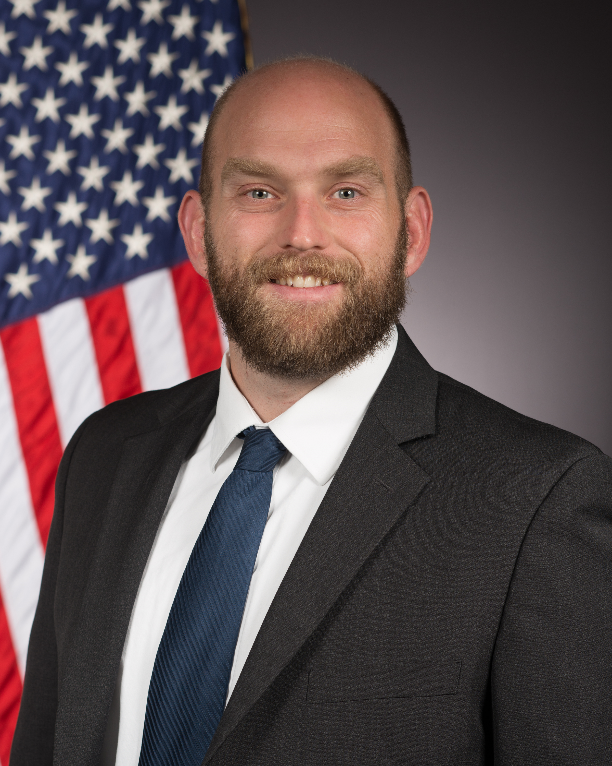
POLY Program Chairs Rotation Schedule
Date (Location) | Rob Mathers Penn State | Sara Orski NIST | Levi Moore AFRL | Industrial Chair Danniebelle Haase (Dow)
Spring 2021 (San Antonio) | LEAD | SHADOW | SHADOW
Fall 2021 (Atlanta) | SUPPORT | LEAD | SHADOW
Spring 2022 (San Diego) | SUPPORT | SUPPORT | LEAD | SHADOW
Fall 2022(Chicago) | LEAD | SUPPORT | SUPPORT | SHADOW
Spring 2023 (Indianapolis) |  | LEAD | SUPPORT | LEAD
Fall 2023 (San Francisco) |  |  | LEAD | SUPPORT
Spring 2024 (New Orleans) |  |  |  | SUPPORT

Slide 5
Virtual San Antonio – Spring 2021
Symposium Title | Symposium Organizer
General Topics: New Synthesis and Characterization of Polymers | Dana Garcia
Industrial Innovations in Polymer Science | Michael Abrams
The Joseph C. Salamone Symposium – Revolutionary Innovation | Dana Garcia
Carl S. Marvel Creative Polymer Chemistry Award in honor of Richard Hoogenboom | Craig Hawker
ACS Award in Polymer Chemistry in honor of Ken Wagener | Brent Sumerlin
ACS Award in Pure Chemistry in honor of Rebekka Klausen | Emily Pentzer
Paul Flory Education Award in honor of Kris Matyjaszewski | Rigoberto Advincula
POLY/PMSE Plenary Lecture | Andrea Kasko
Undergraduate Research in Polymer Science | Sarah Morgan
Excellence in Graduate Polymer Research | HN Cheng
Colloids: Synthesis, Analysis, Modeling, & Application | Wei Gao
Celebrating Underrepresented Groups in Polymer Science | Christopher Hobbs
Frontiers in Conjugated Polymer Design & Synthesis | Kevin Noonan
Macromolecular Science at the Dawn of its Second Century | Tim Lodge
Meeting Theme: Macromolecular Chemistry: The Second Century
MPPG Chairs: Tim Lodge and Kris Matyjaszewski

Slide 6
Spring 2021 Review and Report Summary
Spring “Attendance” values
POLY meeting presentation final upload counts still pending from ACS
Overall reduced participation vs. the original Philadelphia 2020 plan ( not unexpected)

Slide 7
Atlanta– Fall 2021
Presentation Stats as of 8/16:
537 sessioned talks/posters
50 withdrawn
Meeting Theme: The Resilience of Chemistry
MPPG Contacts: David Heldebrant & Joe Pickel
Symposium Title | Symposium Organizer
POLY 001 - Industrial Innovations in Polymer Science | Mike Minkler, James Bohling, Wei Gao
POLY 002 - ACS Macro Letters/Biomacromolecules/Macromolecules Young Investigator Award (Invited) | Jitesh Soares, Majumder Paulomi
POLY 003 - 2020 Mark Scholars Senior Award in honor of Karen Winey (Invited) | Craig Hawker, Edwin Thomas, Hayley Brown
POLY 004 - 2020 Mark Scholars Award in honor of Luis Campos (Invited) | Craig Hawker, E.J. Meijer
POLY 005 - Herman F. Mark Award in honor of Kristi Anseth (Invited) | Nicholas Peppas, Jeffrey Hubbell
POLY 006 - Overberger International Prize in Honor of Zhenan Bao (Invited) | Julie Pollak, Jinsang Kim
POLY 007 - Young Industrial Polymer Scientist Award in honor of Victoria Piunova (Invited) | Jim Hedrick
POLY 008 - DSM Science & Technology Award (Invited) | Judith Van Gorp, Rolf Van Benthem
POLY 009 - Henkel Award for Outstanding Graduate Research in Polymer Science & Engineering Honoring Austin Evans (PMSE co-sponsored) | Will Dichtel, Mahesh Mahanthappa
POLY 011 - Circular Economy of Polymers | Dimitris Collias, Martin James, John Layman
POLY 015 - Structure to Function in Supramolecular Polymers & Materials | John Matson, Pol Besenius, Roxanne Kieltyka
POLY 017 - Fourth CME NASA Symposium: Chemistry for Resilient Human Space Exploration | Robert Nolan, George Rodriguez, Mike Meador, Ksenia Takhistova
POLY 021 - General Topics: New Synthesis & Characterization of Polymers | Dana Garcia, Yongfu Li, Ferenc Horkay
POLY 023 - POLY/PMSE Awards and Plenary Presentation | Sara Orski, Andrea Kasko, Hayley Brown, Rob Mathers, Levi Moore
Contact Info: sara.orski@nist.gov, @saraorski, (301) 683-8272

Slide 8
Atlanta Grid – Fall 2021

Slide 9
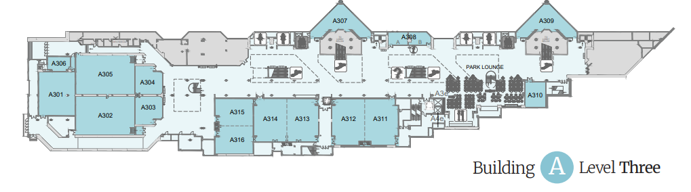
Where POLY will be in Atlanta
Standard Room
Broadcast Room
Room Capacities are all ≥ 135 persons with COVID social distancing

Slide 10
San Diego– Spring 2022
Symposium Title | Symposium Organizer
General Topics: New Synthesis and Characterization of Polymers (8 half day sessions) | Ferenc Horkay, Yongfu Li
Polymer Plenary and Awards Ceremony (PMSE-POLY co-sponsored) | POLY Programming Team
Industrial Innovations in Polymer Science (1 half day sessions) | Michael Minkler, Manesh Sekharan, Hayley Brown
ACS Awards (Possible) (3 half days possible)
Carl S. Marvel Award for Creative Polymer Chemistry (1 half day)
Paul J Flory Polymer Education in honor of Timothy Long (1 half day) | Robert Allen, Ann Fornof
Excellence in Graduate Polymer Research (6 half day sessions) | H.N. Cheng, Christine Coltrain, Christopher Ellison, Tim Long
Undergraduate Research in Polymer Science (4 half day sessions) | Sarah Morgan, Sergei Nazarenko, Heather Broadhead
Translational Polymer Research (2 half day sessions) | Carmen Scholz, Tim Long
Industrial Developments in Polyolefin Macromolecular Design (rescheduled) (1 half day) | Kyle Anderson, Andrew Young, Gursu Culcu
From Staudinger Macromolecules to the Genome of Macromolecules (rescheduled) (6 half day) | Virgil Percec, Michael Klein
Virtual Graduate Students Symposium in Asia-Pacific Region on Polymer Chemistry | Yanli Feng, Chunxiao Zheng
50 Years of Polymer Science and Engineering at Southern Miss (rescheduled) (2 half day sessions) | Yoan Simon, Sarah Morgan
Engineering Functionality into Bio(memetic) Polymers (rescheduled) (2 half day sessions) | Abigail Knight, Allie Obermeyer
Incorporating Polymer Science into the classroom (2 half day sessions) | Sarah Morgan, Heather Broadhead
Meeting Theme: Bonding Through Chemistry
MPPG Contacts:

Slide 11
Chicago – Fall 2022 (Aug 21-25)
Symposium Title | Symposium Organizer
General Topics: New Synthesis and Characterization of Polymers
Industrial Innovations in Polymer Science
POLY/PMSE Plenary (Listed under PMSE / POLY co-sponsored)
Henkel Outstanding Graduate Research in Polymer Science and Engineering (PMSE session/POLY co-sponsored)
ACS Macro Letters/Biomacromolecule/Macromolecules Young Investigator
Industrial Polymer Scientist Award
DSM Science & Technology Award
2022 Mark Scholar Young Award in honor of
2022 Mark Scholar Award in honor of
2022 Mark Scholar Senior Award in honor of
Next-generation synthesis and structure for pi-conjugated polymers | Nag Gavvalapalli
Dynamic Covalent and Supramolecular Polymer Networks | Svetlana Morozova (sam381@case.edu)
Characterization of Sustainable Polymers | Yujing Tan (ytan@dow.com)
Safety Across the Chemical Disciplines (CHAS session / POLY co-sponsored) | Dan Kuespert
Federally Funded Research for Polymer Circularity | Kate Paretti (DOE), Kate Beers (NIST)
Reminders:
POLY policy is that award symposia are now limited to one, half-day session each
Meeting Theme: Sustainability in a Changing World
MPPG Contacts:

Slide 12
Consideration of DEIR Principles for Programming: Letter to Symposium Organizers
(DEIR = Diversity, Equity, Inclusion, and Respect)
from POLY 2021 Chair, Andrea Kasko, endorsed by all of the POLY programming committee
“…2020, marked the 100th anniversary of the advent of polymer science. As the ACS division of polymer chemistry (POLY) celebrates a century of scientific achievements in macromolecular chemistry, we must also reflect on the past, present, and future of polymer science, not only in terms of innovation and research, but in the diverse array of polymer scientists that have been, and continue to be, essential to our function within the community and critical to foster scientific innovation from multiple viewpoints.
ACS and POLY believe in the strength of diversity in all its forms, because inclusion of and respect for diverse people, experiences, and ideas lead to superior solutions to world challenges and advances chemistry as a global, multidisciplinary science. ACS has compiled a list of resources and links to learn more about supporting diversity, equity, inclusion & respect here:”
https://www.acs.org/content/acs/en/membership-and-networks/acs/welcoming/diversity.html
What you can do to help:
Tell us about the great work people in POLY you know are doing that may not be getting recognized through traditional channels
Nominate those people for awards
Feedback and advice is critical to we understand what work we need to do and where we can improve
Share best practices from DEIR efforts in your other professional organizations

Slide 13
Helpful Links and More Information
https://polyacs.org/symposium-proposal-online-form/
https://polyacs.org/wp-content/uploads/2018/07/Guidelines-for-symposia-organizers-and-chairs.pdf
https://www.acs.org/content/acs/en/membership-and-networks/td/manuals/future-meeting-deadlines.html
https://www.acs.org/content/acs/en/meetings/programming-resources/symposia-organizers.html

