Slide 1




Needs analysis & assessment
ACS Division of Polymer Chemistry, Inc.

Slide 2
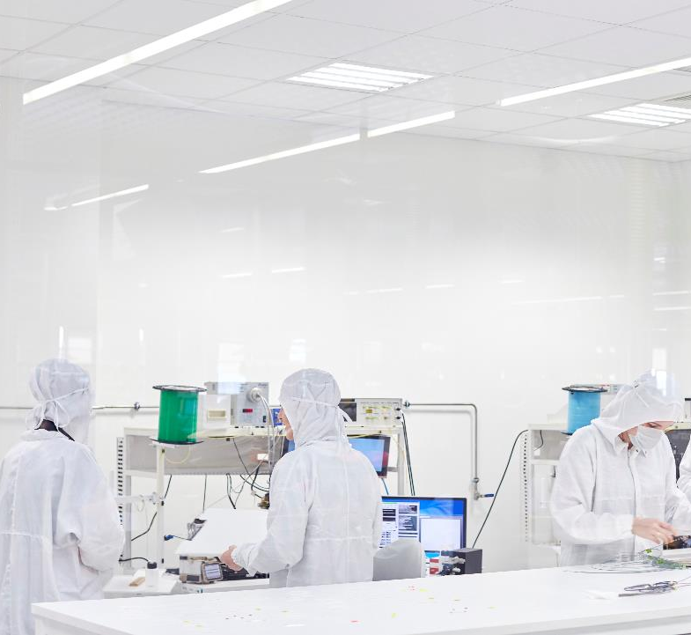
Elements
CONTEXT
PERFORMANCE
GAP
GAP
IN
RESULTS
FINDINGS
&
PRIORITIZATION OF FINDINGS
RECOMMENDATIONS
Notes:
This presentation is going to review POLY’s work this spring to complete a survey to check in with members are specific needs of the division.

Slide 3


What is the needs assessment story?
Partnered with ODU (for Lesia’s Masters) involving a program needs assessment
Reviewed previous surveys
Completed a 2021 Survey
Student Focus Group with POLY/PMSE Student Chapters
Staff Force Field Analysis
Notes:
During the winter executive meeting, POLY proposed a new survey to check in with its members. Of particular interest during this original meeting involved member benefits, the use of a member site, and answering the call when it came to diversity equity and inclusion.
This spring, POLY partnered with Lesia of the POLY Business office involving the completion of a full POLY needs assessment. This included reviewing previous surveys from 2013 and 2018, completing a new survey this year, and scheduling a live virtual focus group with student chapters. This assessment also checked in with the POLY staff using a force field analysis for discussing resources required of any recommendations.
***
The ACS Division of Polymer Chemistry (POLY) is one of the thirty-three divisions of the American Chemical Society (ACS). In addition to a paid membership to ACS, individuals may also become paid members of specific divisions under this umbrella. The organization's business office is located on campus at Virginia Tech and is financially supported by annual cash flow and investments. Its members are geographically located throughout the world. Its membership dues and associated allocations make up thirty-eight percent of the overall POLY budget income.
POLY presently has 3,639 members. Members join as ACS Professional Member (30.00 annually), ACS Student Member ($20.00 annually), non-ACS/Affiliate Members ($50.00 annually). The current membership number is thirteen percent less than five years ago and is concerning. This area of concern is problematic because this reduced number equates to a deficit in POLY’s membership and allocation line-item within its overall annual budget. Without reversing the downward trend, the organization will not be able to sustain its present function as a premier division.

Slide 4

Performance gap
Deficit in membership & Lack of membership retention
Notes:
As with a typical needs analysis: POLY agrees to a needs assessment and analysis to examine the gap in the current member offerings with what is needed to achieve the desired results. The POLY Business Office describes the need as identifying what would attract members (thirteen percent in five years) to the organization and maintain the members they have.

Slide 5
Findings & Prioritization of findings
Monitor Member Drop-off
Governance
Student Matters
Summary of Benefits
Publications
Connections to ACS Mtg
Communication
Networking
… and other considerations
Notes:
Upon review of data collection tools and feedback from the NAC (a needs assessment committee consisting of staff of ODU students, eight sub-areas demonstrate common themes for bolstering POLY Membership. They are a lack of monitoring member drop-off, governance, students, a summary of benefits, publications and resources, ACS Meetings, communication, and networking. These results align with the needs originally described by the NAC.

Slide 6
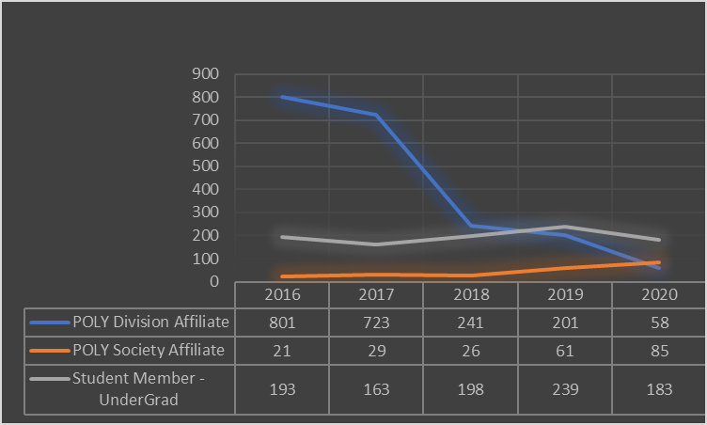
Member Drop-off
5-Year Trend
5,100 unique individuals dropped in 5 years
Review lists annually for inviting individuals back
Notes:
Common themes across data collection are demonstrated on this and the next few slides.
1. Lack of monitoring member drop-off. POLY staff took 15 hours to compare lists from the last 5 years and identified 5100 uniqu individuals who have dropped from the POLY roster. Many of them are divisional affiliates. This particular category may be partly described by the Dec 2015 Hawaii meeting where attendees (a large number) were added to the POLY roster. However, POLY’s membership has been dropping for more than a decade and this trend is concerning.
What should be: Identify members who drop off annually
What is now: No monitoring as members drop
Possible solution:
Review lists annually
Possible solution: Create a member site (or something of value) that is lost annually if membership is not renewed

Slide 7

Governance
Members do not know how to get involved
Create a “get involved” button on POLY website
SURVEY COMMENTS: more networking opportunities to include new members and get more people involved… unclear how I could get more involved in POLY… Involvement with local ACS sections… Highlight avenues for all members to get involved…Note about Student Focus Group: They did not have a sense of what POLY/PMSE were all about and considered them as only a funding source.
Notes:
Common themes across data collection was that members did not know how to get involved. There was concern expressed about the “same ol people” doing all the jobs.
What should be: Understanding how to get involved– LOOK FOR AN EXPERIENCE VOLUNTEER (PAST-CHAIR?) TO HELP MONITOR THIS LIST
What is now: DEI has been a focus for multiple years; however, there is a need to ramp of diverse recruitment especially within the Asian Pacific community.
- No button or clear reference to “how to get involved”
Possible solution: Add “get involved” button to the website rather than word-of-mouth
POLY staff may have some general concerns about the potential volume. However, we may be able to set up a form, see the amount of participation, and then make some decisions about its continued use later in the year. We just want to make sure that we respond to those interested with viable options for being active.

Slide 8
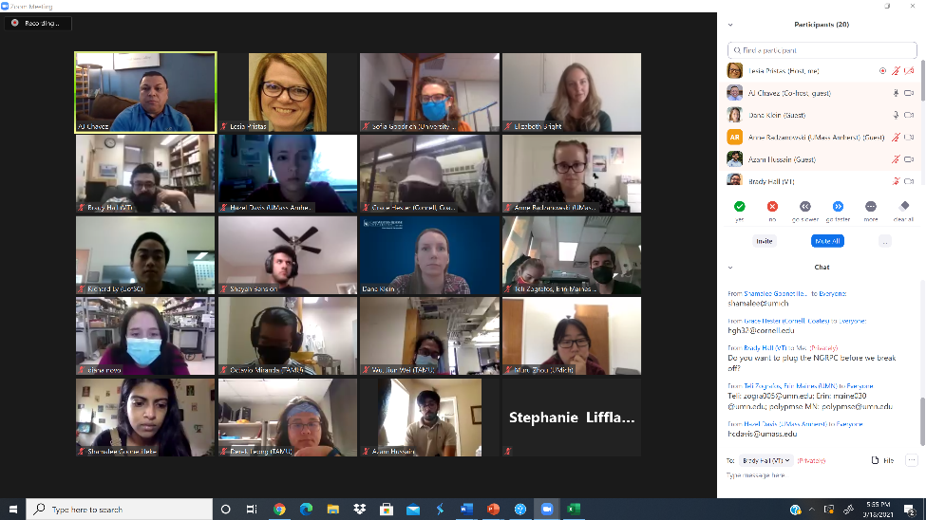
Students
Students want online community, jobs site, understanding of the organization
Create Google Group for Student Chapters (per their request), create student advisory board, publicize offerings
Elizabeth Bright (3M) of Student Chapters expressed interest in POLY developing a Student Advisory Board and has discussed this with PMSE Rep Dan Savin
POLY can establish a Google Group for Student Chapters
Notes:
As the future of POLY Membership, students’ opinions are greatly valued in this need's assessment. Using POLY’s Student Chapters at national universities, this team invited members of this target audience to participate in a focus group. This small group of approximately fifteen provided qualitative data on their perceptions about whether this organization is providing the correct member benefits and help to prioritize what should be added to attract others to the experience. AJ Chavez facilitated the focus group as the outsider to prevent accidental bias by staff due to institutional history. The virtual event was scheduled for March 18, 2021, at 3:30 PM EST. What they shared BECAME A COMMON THESE ACROSS ALL OF THE DATA COLLECTION.
What should be: Students want a community online page, a site for Jobs, and a better understanding of organizational opportunities.
What is now: A student chapter program exists BUT students are uninformed and see POLY as just a grant/funding source. They have a tendency only to join POLY or ACS if they are going to present at a national ACS Meeting/Conference.
Possible solution: Create a Google Group and use it to remind them of what they receive within POLY, create a student advisory board, and regularly publicize student-specific offerings.

Slide 9
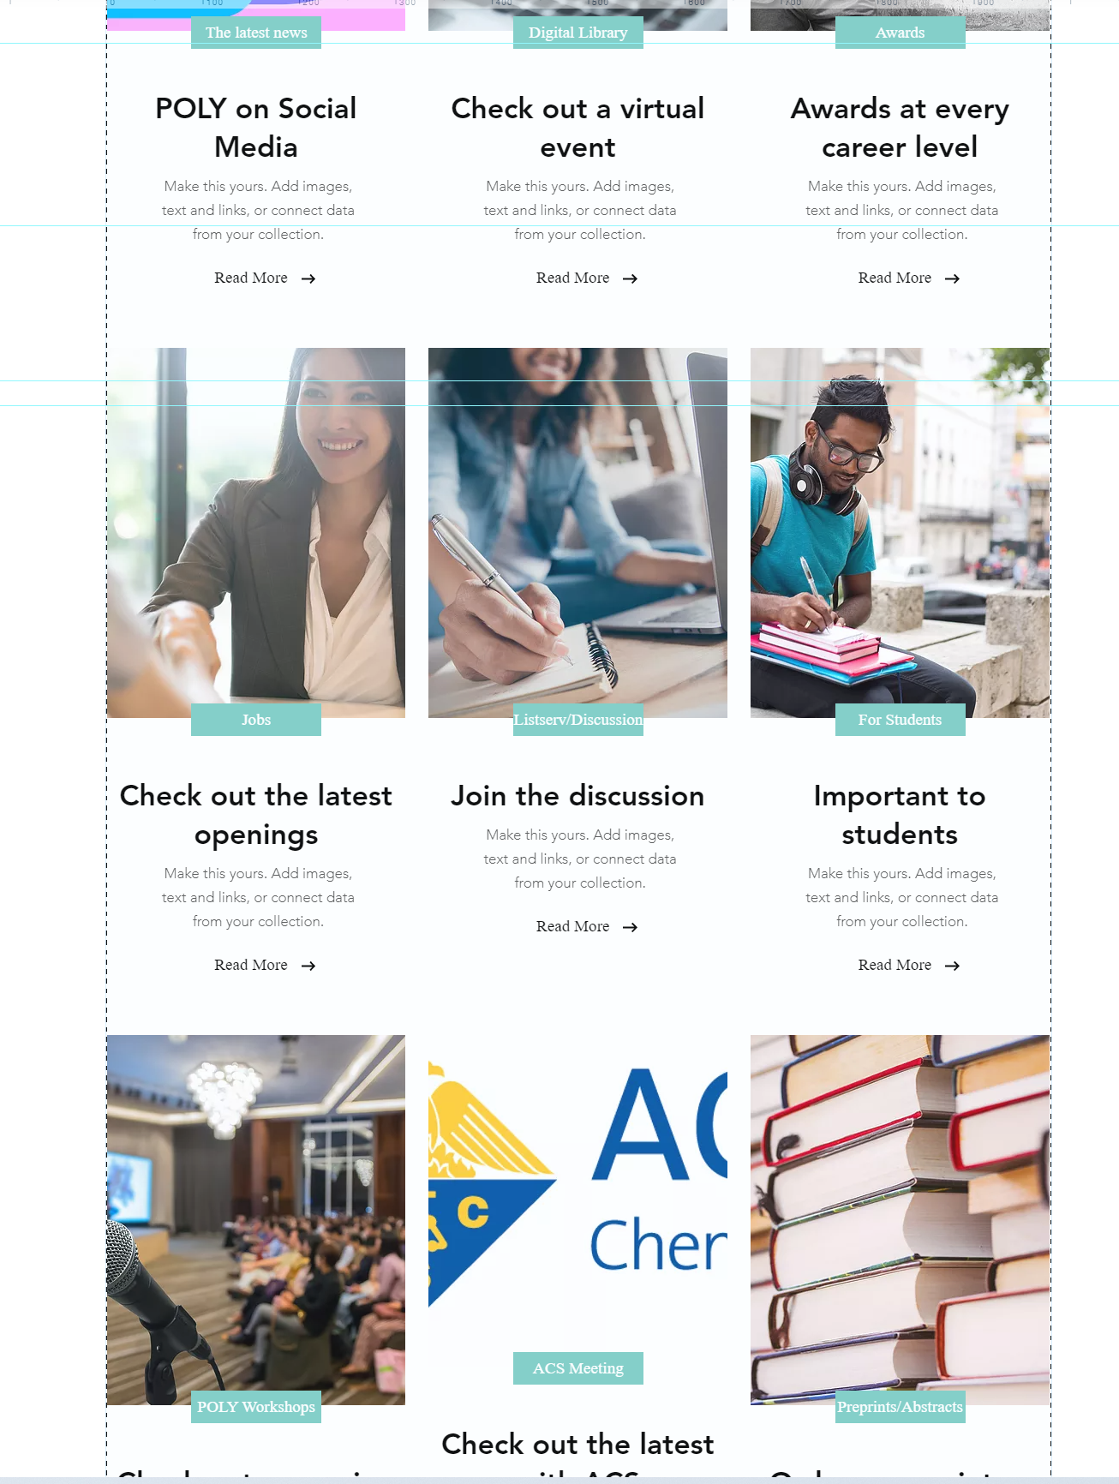
Publication / resource library
Members want to know what they are getting
Create a Member Site?
A specific question was included within the POLY survey regarding a member site.
Notes:
Common themes across data collection: Members want to know more about what they get for becoming a POLY Member
What should be: A one-stop-shop of information
What is now: Members say that want to know more.. Student focus group demonstrated they know little about this organization
Possible solution: Invest in a Member site or at the very least stream-line the website to explain benefits better. A TRIAL VERSION MAY BE BEST TO START AND MUST BE KEPT SIMPLE FOR MANAGING WITHIN POLY. A TRUE RESOLUTION WILL REQUIRE SIGNIFICANT RESOURCES, $$ COSTS TBD.

Slide 10
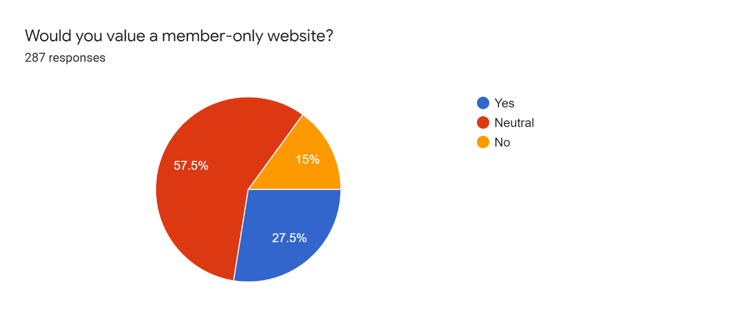
Members can see resources available
A member site would act as a gatekeeper for keeping members on
POLY can draft a trial to identify need/gather feedback regarding viability/ Test for 6 mon to1 year
A truly operational member site would require time and resources not available at this time and would be an investment for the future if found viable
Notes:
So why would we create a member site? This may address the need to make sure that members can see resources available to them. The site site itself could act as a gatekeep for keeping member renewing each year.
What we may need to consider is a draft or trial site and gather feedback for a pocket of time. BUT a truly operational member site would require time and resources not available and would require POLY investments.

Slide 11
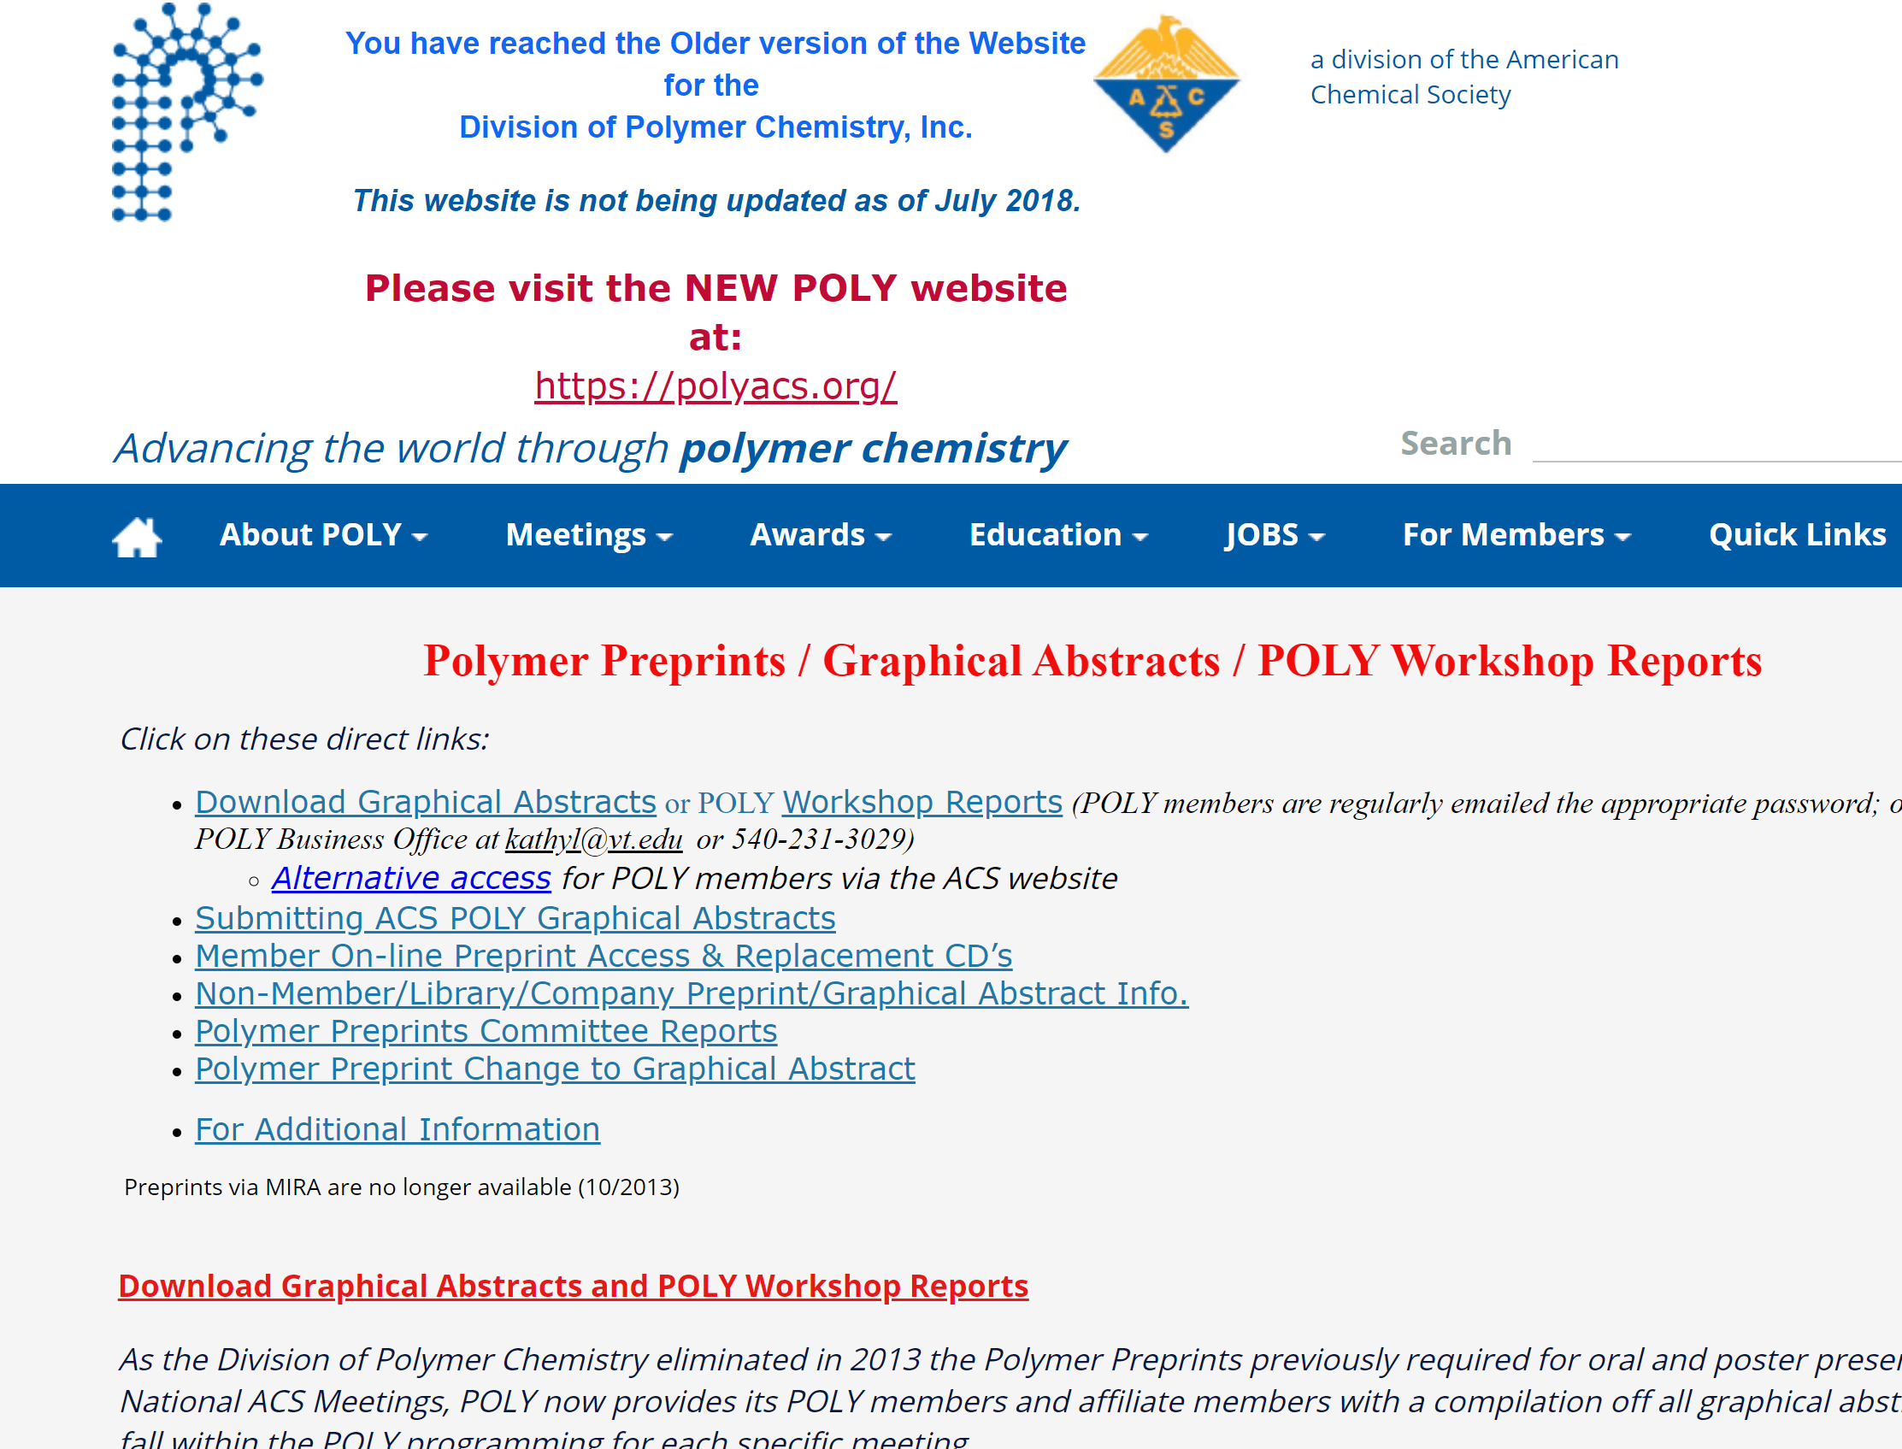
Summary of benefits
Members want something of value, like publication access
Develop a virtual library of existing items grouped effectively
Notes:
It we keep a poly member site in mind
Common themes across data collection: Members want something of value. Many years ago, POLY create a Preprint of full-papers presented at the biannual national meeting (ACS Meeting). Now, something within a virtual library may be of interest.
What should be: More access to data or a one-stop-shop to materials
What is now: Scattered archives and a few online videos on YouTube
Possible solution: There needs to be a designated virtual library and consider a new type of publication.

Slide 12
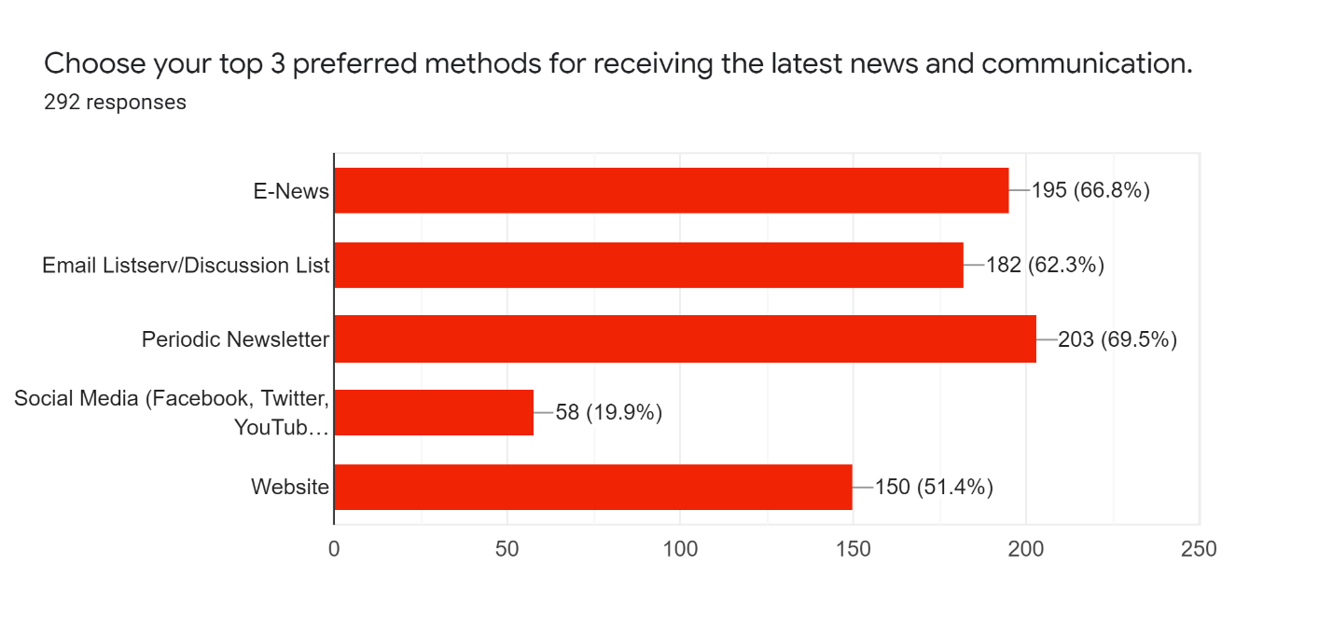
Summary of benefits, cont’d
Website considerations
Past and present surveys indicated that email list-servs and e-News announcements are effective in communicating to the POLY Community periodically. The biannual Newsletter also continues to be ranked high. One notable low ranking is the POLY website. An update to clearly define benefits may enhance future perceptions.
Clarify/clean up benefits on POLY website
Low?

Slide 13

Communication (connecting to the previous slides)
Members value effective communication to help inform benefits
Think about Spotlights (articles or specific target audiences when sending e-News announcements)
Notes:
Common themes across data collection: Members value effective communication that helps to inform benefits. Specifically, students want their needs addressed
What should be: Inform audiences, more focused email lists, online communities
What is now: E-news announcements, broad discussion email
Possible solution: Create specific communities (like student discussion list, blogs, newsletter articles that focus on particular audiences.

Slide 14
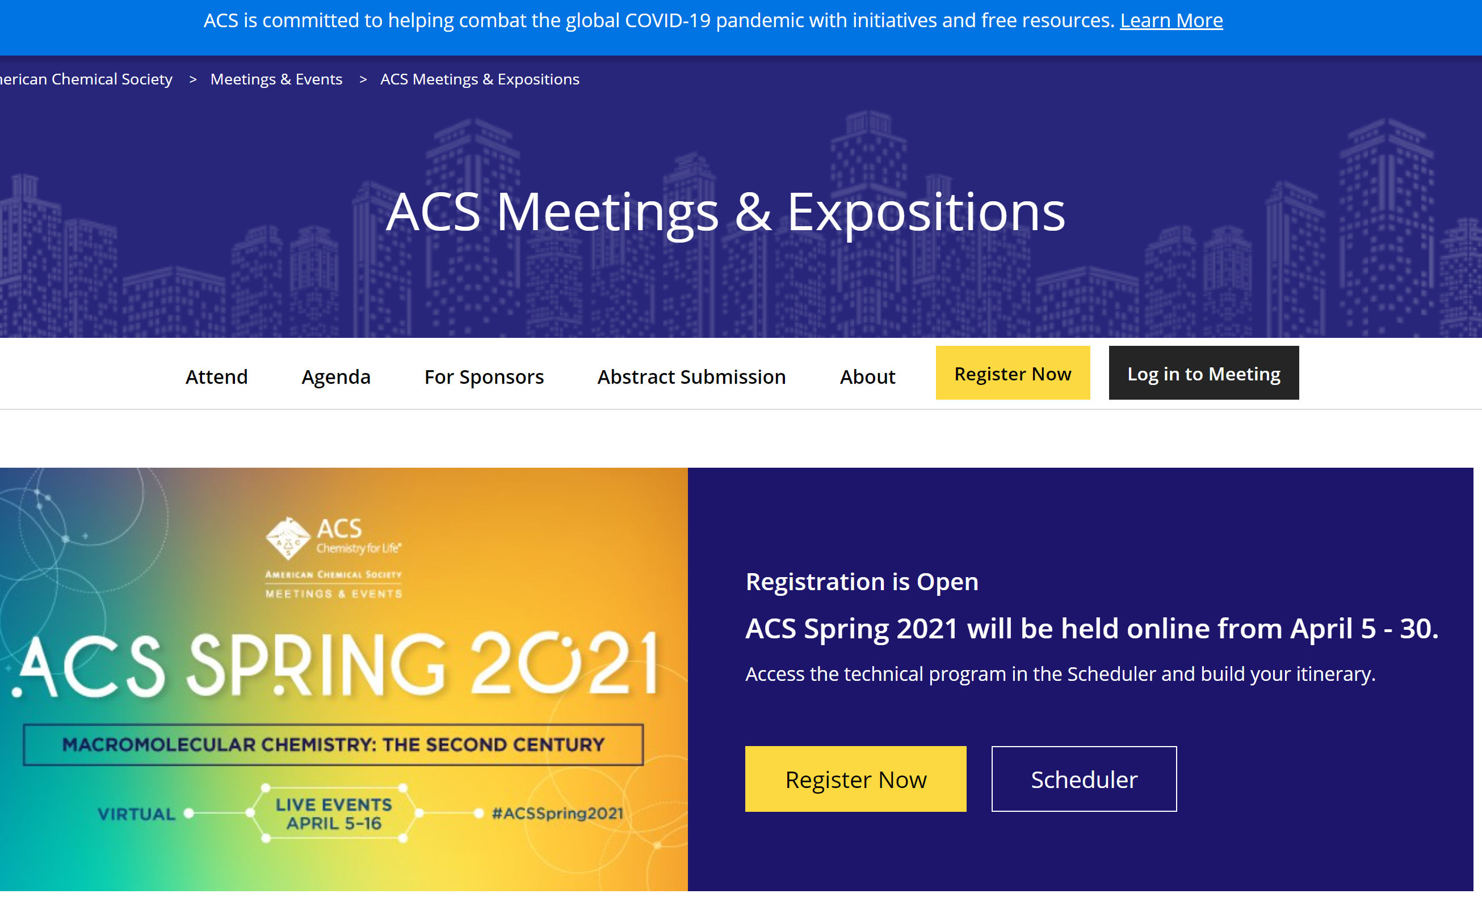
Connecting with ACS
Members value ACS level offerings/connection
Inform about existing offerings and generate a programs, publications, etc. that attract members that way
What are we doing now and what more can we do?
Notes:
Common themes across data collection: Members value offerings at the ACS Meeting (networking, presenting during POLY sessions, posters, etc)
What should be: Connect ACS Meetings with some type of POLY benefit (networking, publication, etc)
What is now: Some positive offerings, travel awards, some speaker support…
Possible solution: Make sure student communications explain offerings, Young scientist offering, the generation of a possible publication as the organization used to do.

Slide 15
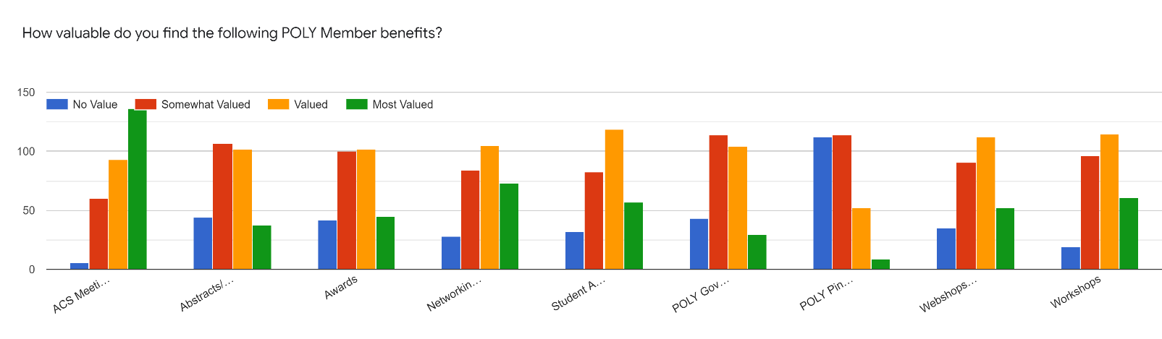
Value of Member Benefits, ACS
ACS Meetings
Note. ACS Meetings, Awards, and Networking seem valued. Preprints/abstracts and POLY tangibles like pins seem least valued at present.

Slide 16
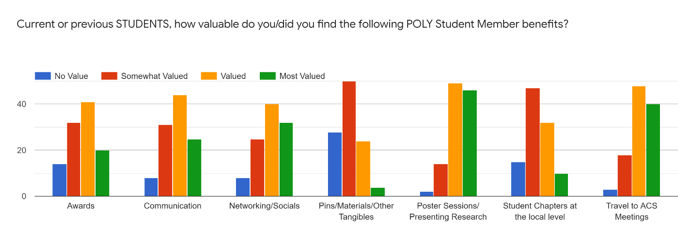
Value of STUDENT Member Benefits, ACS
Note. For students, the ACS Meeting and presenting posters are most valued. This aligns with what was stated at the Focus Group i.e. “The only reason I join ACS is to go to the ACS Meeting”.
ACS Meetings

Slide 17
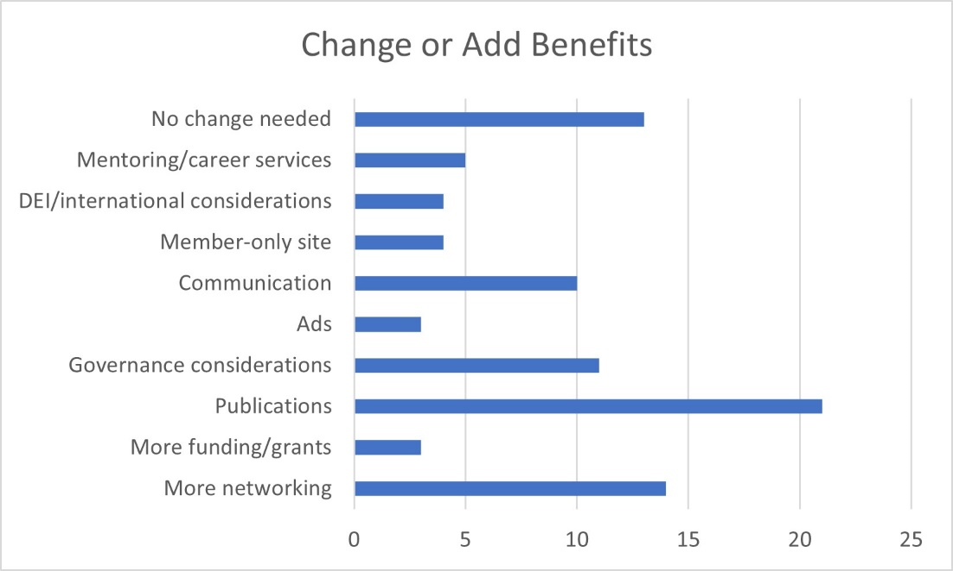
Connecting with ACS…Connecting with a publication for increasing member value ????
from open-ended survey responses
Would POLY be in a position to offer something similar to preprints in the future?
Notes:
Common themes across data collection: Members value the power of networking, both in person and virtually
What should be: More opportunities, make sure POLY keeps some virtual, increase at national ACS conferences
What is now: POLY is very active with networking and has offered some virtually amid the pandemic.
Possible solution: POLY should continue its offerings, keep some virtual and explore at least one more in-person event.

Slide 18
networking
from open-ended survey responses
Members value the power of networking
Maintain existing, keep some virtual, and find one new opportunity
Notes:
Common themes across data collection: Members value the power of networking, both in person and virtually
What should be: More opportunities, make sure POLY keeps some virtual, increase at national ACS conferences
What is now: POLY is very active with networking and has offered some virtually amid the pandemic.
Possible solution: POLY should continue its offerings, keep some virtual and explore at least one more in-person event.

Slide 19

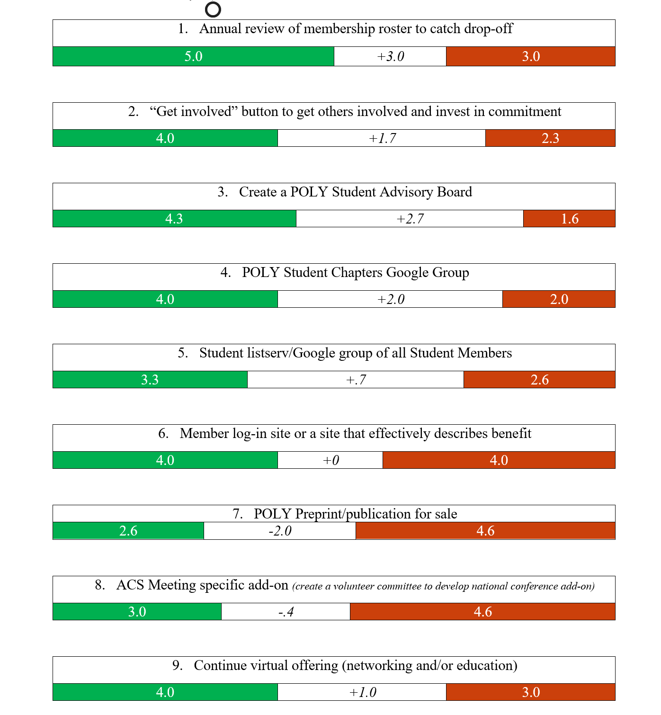
Force field analysis
Prioritization
6, 7, 8: There may be value but staff time and resources with these items are a concern. Would POLY value an investment for the sake of increasing member’s perceived value in POLY?
Notes:
Taking the sub-areas identified, it was time to prioritize areas identified. NAC members received a document to rank common themes starting to formulate and rank the resources it will take to accomplish the changes. Both sides were ranked from 1-5 and then the average of responses are demonstrated here. The POLY Business Office is commonly the drivers of change within the organization and gaining their perception of proposed opportunities (opportunities versus push-back of resources) is highly valued. The committee completed the forms individually and then clarified with us as needed.
By doing this, we were able to prioritize our own specific recommendations.

Slide 20
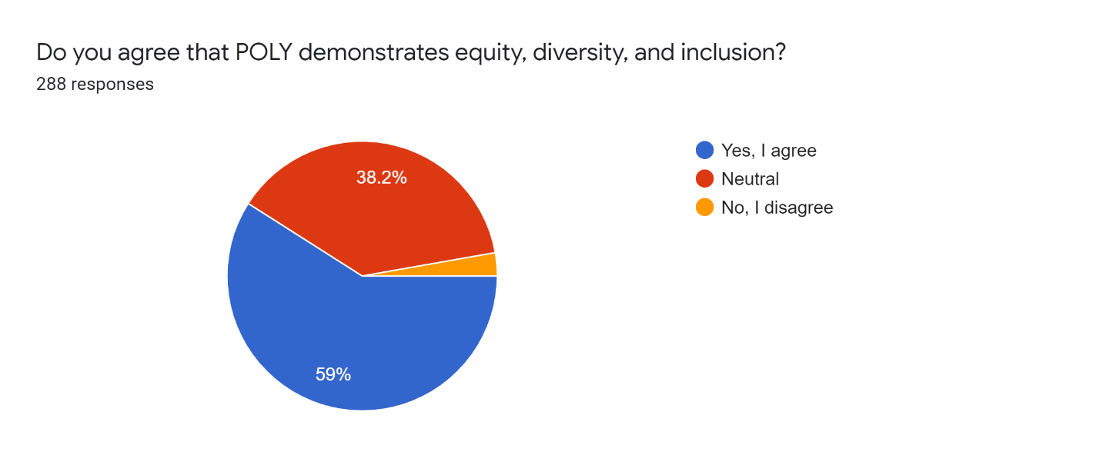
Other considerations, DEI
POLY is committed to DEI and included questions involving respondents’ perceptions on the topic. Ninety-four percent either ranked POLY achieving or neutral for DEI. Six percent had a negative opinion. Qualitative data encourages enhanced inclusion of Asian members comparable to its membership. Program considerations include informing members about how to get involved and ramp up this audience within governance.

Slide 21
Other considerations, Budgetary
24K loss of membership income since 2016
Based on membership breakdown, POLY needs 865 paying members to make up the difference
Where else can funds be saved?

Slide 22
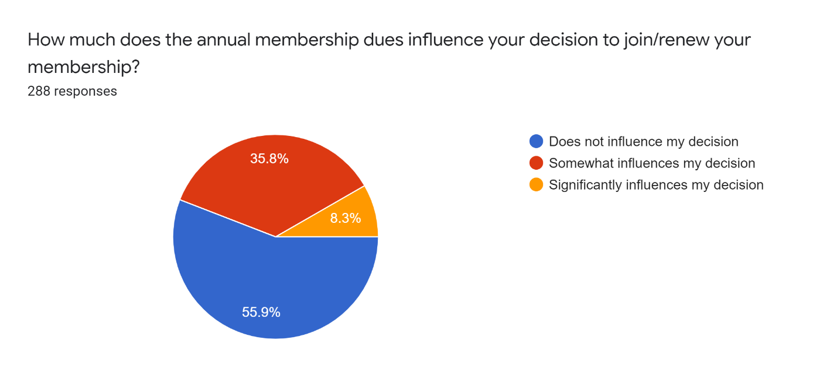
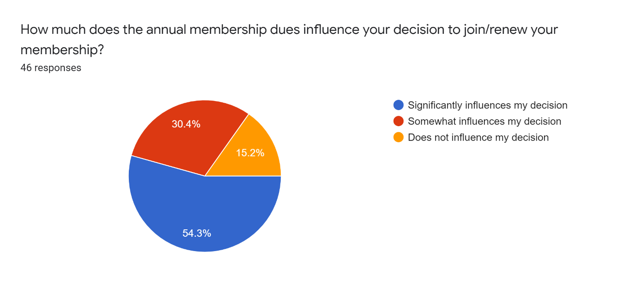
Other considerations, Mem. Fees
How much does the annual membership fees influence your membership?
Members
Nonmembers
Does not…
Significantly influences…

Slide 23
Recommendations

Slide 24
POSSIBLE RECOMMENDATIONS
Short-term
Annual review of membership
Student advisory board and google groups
“get involved”
Networking and communication
Trial member site
Long-term
Permanent member site
Publications????? What is our significant offering?

Slide 25
Questions???

Slide 26

Thank you

