Slide 1
POLY Programming Team Spring Business Lunch 2024
Levi Moore, Danniebelle Haase, Julia Kalow, Sara Orski
Kathy Mitchem (POLY Business Liaison),
and Laura Stratton (2024 ExComm. Liaison)
Notes:
Invite vice chair to participate. But not official duty. Will invite Laura Patton as Dawanne has assumed the role of chair. Haven’t sent invitation out as yet.

Slide 2
Overview
Team Composition
2023 Review
Review of 2023 POLY at ACS National Meeting – San Francisco
Upcoming National Meetings
Program plans and specific needs (& leads)
Spring 2024 - Levi Moore
Fall 2024 – Danniebelle Haase
Spring 2025 – Julia Kalow
Fall 2025
Future of POLY Programming
New initiatives and concepts
Future of ACS Meetings update

Slide 3
Team Composition
Balance of industry/academia/government
Sara’s completed her term at the end of 2023
THANK YOU SO MUCH!!!
Welcome to Prof. Graham Collier!
POLY Program Committee Chair Rotation:
2024 – Levi
2025 – Danniebelle
2026 – Julia

Slide 4
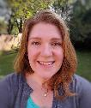
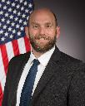

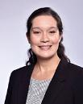
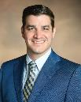
POLY Programming Team Rotation
Date (Location) | Sara Orski NIST | Levi Moore AFRL | Danniebelle Haase Dow | Julia Kalow Northwestern | Graham Collier Southern Miss
Spring 2022 (San Diego) | SUPPORT | LEAD | SHADOW
Fall 2022(Chicago) | SUPPORT | SUPPORT | SUPPORT
Spring 2023 (Indianapolis) | SUPPORT | SUPPORT | LEAD | SHADOW
Fall 2023 (San Francisco) | LEAD | SUPPORT | SUPPORT | SHADOW
Spring 2024 (New Orleans) | CONSULT | LEAD | SUPPORT | SUPPORT
Fall 2024 (Denver) |  | SUPPORT | LEAD | SUPPORT | SHADOW
Spring 2025 (San Diego) |  | CONSULT | SUPPORT | LEAD | SUPPORT

Slide 5

2023 Fall Review and Report Summary
Overview of POLY meeting presentations in San Francisco
Oral presentations
261 in-person (6.3% of ACS)
115 hybrid (3.9% of ACS)
35 virtual (6.5% of ACS)
Poster presentations
83 in-person (2.8% of ACS)
7 virtual (2.3% of ACS)
Brief comparison of POLY and ACS presentations
Year | Total POLY | Total ACS | % POLY
Fall 2023 | 501 | 10801 | 4.6
Spring 2023 | 541 | 11510 | 4.7
Fall 2022 | 537 | 9120 | 6
Notes:
Dear Danniebelle,
Thank you for following up and apologies for the delay.
Total ACS presentations 10,801
Total POLY presentations 501
For POLY, could you help me with the breakdown of the presentations as well?
Oral – Hybrid: 115
Oral – In person: 261
Oral – Virtual: 35
Poster – In person: 83
Poster – Virtual: 7
Total: 501
For ACS, could you help me with the breakdown of the presentations as well?
Oral – Hybrid: 2929
Oral – In person: 4132
Oral – Virtual: 535
Poster – In person: 2923
Poster – Virtual: 282
Total: 10,801
Please let me know if we can assist with anything else.
Best,
Josh Blair Manager, Business Systems Administration | Department of Meetings & Exposition Services 1155 16th St., NW | Washington | DC 20036 E j_blair@acs.org | W www.acs.org

Slide 6
Contributions
Philadelphia 2020- cancelled, Spring 2021 Virtual meeting did not collect division-level stats.

Slide 7
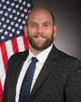
New Orleans – Spring 2024
Levi Moore
Meeting Theme: The Many Flavors of Chemistry
Symposium Title | Symposium Organizer
Undergraduate Research in Polymer Science | S. Morgan, H. Broadhead, S. Nazarenko
Excellence in Graduate Polymer Research | C. Coltrain, J. Self, C. Ellison, T. Long, K. Heifferon, R. Behling
Industrial Innovations in Polymer Science | H. Brown, J. Ting
Driving Sustainable Innovations in the Polymer Industry Through Chemistry and Materials Science | A. Fogel, M. Shete
Paul J. Flory Polymer Education Award in Honor of Charles McCormick | B. Sumerlin
ACS Award in Polymer Chemistry in Honor of Eugenia Kumacheva | M. Rubenstein
National Fresenius Award in Honor of Maxwell J. Robb | B. Fors, W. Gutekunst
Earle B. Barnes Award for Leadership in Chemical Management in Honor of David Parrillo | J. Klozin
Continued on Next Slide
POLY/PMSE Award & Plenary – PMSE Choice in even years

Slide 8
New Orleans – Spring 2024
Levi Moore
Meeting Theme: The Many Flavors of Chemistry
Symposium Title | Symposium Organizer
Polymer binders in highly filled systems | B. Brettmann, J. Kalman, J. McCollum, A. Savage, L. Moore
Structure to Function in Supramolecular Polymers and Materials | J. Matson, P. Besenius, R. Kieltyka
Nonlinear chemical phenomena in polymeric systems | J. Pojman, A. Taylor
Incorporating Polymer Science into the Classroom | S. Morgan, H. Broadhead, P. Costanzo, S. Rukes
Bioinspired Coacervates: Fundamental Studies and Applications | A. Joy
Advances in Ring-Opening Polymerizations/Ring-Closing Depolymerizations | J. Kennemur, J. Wang, Y. Getzler, H. Sun
Many flavors of Polymer Chemistry for 3D Printing | C. Wang, S. Laguizamon, J. Foster
General Topics: New Synthesis and Characterization of Polymers | J. Kalow, F. Horkay, Y. Li
Virtual Graduate Students Symposium in Asia-Pacific Region on Polymer Chemistry
POLY/PMSE Award & Plenary – PMSE Choice in even years

Slide 9
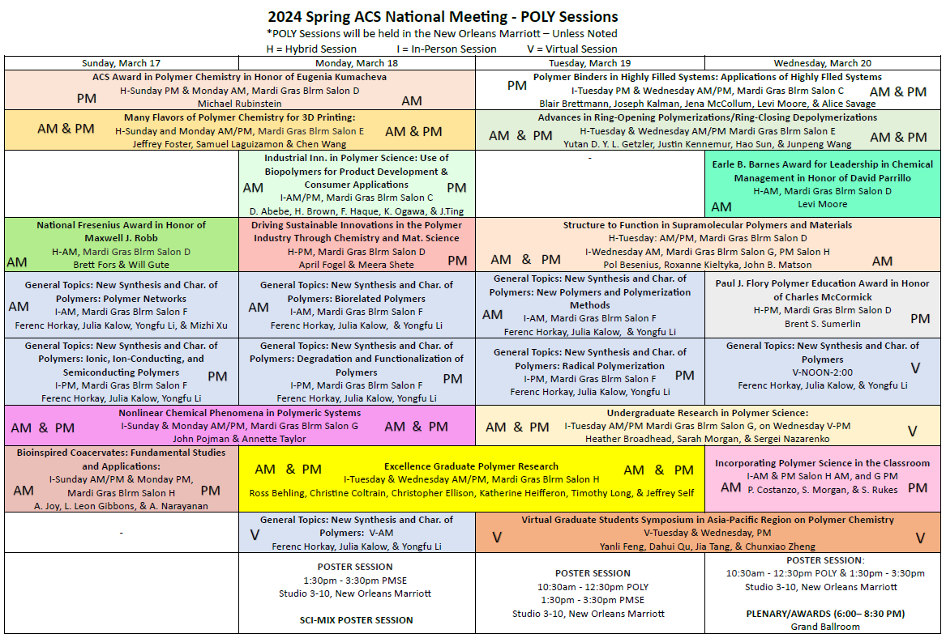

Slide 10
Denver – Fall 2024
Symposium Title | Symposium Organizer
Industrial Innovations in Polymer Science | Michael Petr, Dayton Street, Julienne Regele
General Topics: New Synthesis and Characterization of Polymers | TBD/Julia Kalow, Ferenc Horkay, Yongfu Li
25th Anniversary of ACS Biomacromolecules Journal | Tim Deming, Matthew Becker, Sebastien Lecommandoux and Graham Smeddle
Global Collaborations on Natural Polymers as Substitution of Synthetic Materials | Wei Gao, Jun Wang, Qiong Yuan
Advancing Protection Through Materials Design | Amanda Forster, Joseph M. Dennis, Aaron Forster
Pushing the Limits of Macromolecular Architecture | Adrian Figg, Craig Hawker, Brent Sumerlin
Climbing Macromolecular Ladders: Elevating the Design, Synthesis, Properties, and Applications of Ladder Polymers | Lei Fang, Yan Xia, Fumitaka Ishiwari, Tomoyuki Ikai
Chemistry and Physics of Polymer Interlayers for Solar Cells | Prof. Carlos Graeff , Prof. Morten Madsen, Prof. Martin Heeney, Dr. Roger Hiorns
Polymer Sustainability: Renewable feedstocks and eco-friendly synthetic strategies | Chen Wang, Cori Jenkins, Diego Alzate-Sanchez
Phosphorus-Containing Polymers | Frederik Wurm, Karen Wooley
#Advances in Fluorine Containing Polymers and Composites | Scott Iacono, Abby Jennings
20 years of Virginia Tech Macromolecules Innovation Institute | Tomonori Saito, Robert Moore, Michael Bortner, Timothy Long
* CME-NASA Symposium: Elevating Polymer Chemistry to New Heights-polymers for Future Space Missions | Michael Meador, George Rodriguez, Ksenia Takhistova
Stimuli-Responsive Polymers as Functional Biomaterials | Metin Karayilan, Gregory Peterson, Matthew L. Becker
Performance Advantaged Bioproducts | Nicholas Rorrer, TBD
Elevating Waste Carbon Utilization for a Circular Economy | Yujing Tan, Kat Knauer, Eleftheria Roumeli, Dimitris Collias
Elevating polymer science in the state of Colorado | Ethan Quinn, Lejla Čamdžić, Emma Rettner, Brandon Hosford
Elevating the Power of Data for Materials and Chemical Scientists | Jeffry Ting, Mike Heiber, Alix Schmidt
Meeting Theme: Elevating Chemistry
* Invited only; ! from Spring 2024; # Other constraint

Slide 11
Denver – Fall 2024
Symposium Title | Symposium Organizer
Mark Scholars Young Award in honor of Zachariah Page | Craig Hawker
Mark Scholars Award in honor of Brent Sumerlin | Krzysztof Matyjaszewski
Mark Scholars Senior Award in honor of Heather Maynard | Ellen Sletten
Industrial Polymer Scientist Award in honor of Carl Willis | Richard Spontak
Henkel Award for Outstanding Graduate Research in Polymer Science & Engineering | Jessica Kramer, Charles Paul
ACS Macro Letters/Biomacromolecules/Macromolecules Young Investigator Award | P. Majumder, S. Lecommandoux, M. Hillmyer, S. Rowan
25th Anniversary of ACS Biomacromolecules Journal | Tim Deming, Matthew Becker, Sebastien Lecommandoux and Graham Smeddle
Danniebelle Haase
Meeting Theme: Elevating Chemistry

Slide 12
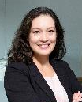
San Diego – Spring 2025
Julia Kalow
jkalow@
northwestern.edu
Recruiting Symposia & Organizers!
Meeting Theme: Transformative Chemistry
Symposium Title | Symposium Organizer
Industrial Innovations in Polymer Science | H. Brown, J. Ting
Excellence in Polymer Graduate Research | C. Coltrain, J. Self, C. Ellison, T. Long, K. Heifferon
Undergraduate Research in Polymer Science | S. Morgan, H. Broadhead, S. Nazarenko
Carl S. Marvel Creative Polymer Chemistry | Alan Hopkins (awards committee) & awardee designee (TBD)
Molecule to Material Insights in Polymer Networks | R. Klausen, A. Nelson, S. Craig
Modern Approaches to Post-Polymerization Modification | A. Teator, J. Brantley, R. B. Moore, B. Sumerlin
Polymers with Inorganic Fillers | Z. Qiang, D. Patton, K. Fu
5th Symposium on Poly(2-oxazoline)s and Related Polymers | R. Hoogenboom, E. Benetti, R. Becer
Modern Organic Methods in Polymer Chemistry | J. Lamb, N. Romero
General Topics | Newest program chair , Y. Li, F. Horkay
POLY/ PMSE Award and Plenary | D. Hasse, J. Kalow, K. Mitchem
Notes:
Depending on national awards, have at most 18 half-day symposia left-–definitely room for more submissions!
Remind people that cosponsoring with another division (ideally, having a coorganizer from that division) will make it easier in the new meetings format
Cannot guarantee more than 4 half-day sessions (polyoxazolines did request 6 and at this point I think that will still be fine)
Deadline is Jun 1 for submission to the Google form on POLY website
Contact Julia for any questions

Slide 13
Washington, DC—Fall 2025
Recruiting Symposia & Organizers!

Slide 14
New/Continuing Initiatives
Knowledge continuity in business office/ program chair liaison (Thanks Kathy!) & with ExComm (2024, Laura Stratton)
Programming event to thank current organizers, reporting out on Programming, and recruiting new organizers
Recognition paths
Reporting paths
Recruitment paths
Programming Workshop of Best Practices – July 2023; Learnings to be summarized in a document (In progress)
Continuing discussions & initiatives regarding DEIR in POLY Programming

Slide 15
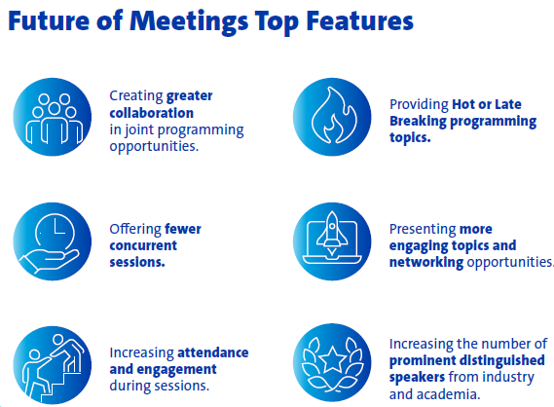
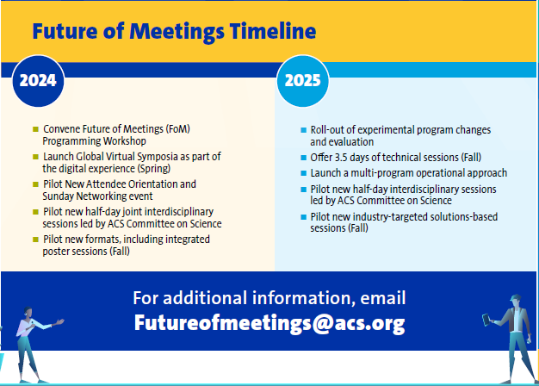
Future of Meetings Rollout
Current close cooperative symposium partners (among others):
BIOT, CELL, PMSE
All divisions welcome—think outside the box!

Slide 16
Future of Meetings - 2025
Division/ Program Area | Proposed Total Assignments Beginning Spring 2025 (4.5 days) - Based on Session Averages from 2016-2023. Sessions from Sunday - Thursday |  |  |  |  |  | Proposed Total Assignments Beginning Fall 2025 (3.5 days) - Based on Session Averages from 2016-2023. Sessions from Monday - Thursday
 | Proposed Total # of 1/2 day Sessions per Division | # Non Joint Sessions per Division (from total #) | # of Required Joint Sessions per Division -(from Total #) Goal is 8% | Max Hybrid/Digital Experience per Division (from Total #) - Goal is 5% | *Max Session Rooms/ Constructed Rooms based on 4.5 days (per Division) |  | Proposed Total # of 1/2 day Sessions per Division | # Non Joint Sessions per Division (from total #) | # of Required Joint Sessions per Division (from Total #) - Goal is 10% | Max Hybrid/ Digital Experience Sessions per Division (from Total #) - Goal is 25% | *Max Session Rooms/ Constructed Rooms based on 3.5 days (per Division)
POLY | 53 | 49 | 4 | 3 | 6 |  | 36 | 32 | 4 | 9 | 5
Shift to a more concentrated footprint and 3.5 days of programming (NO Sunday Tech Programming)
Total HDS for Fall 2025 reduced to 595 at the Washington, DC meeting
The Spring Meetings will remain similar in size to what ACS has typically offered

Slide 17
Thank you!

