Slide 1
POLY Programming Team Winter ExComm Discussion 2024
Levi Moore, Danniebelle Haase, Julia Kalow, Sara Orski
Kathy Mitchem (POLY Business Liaison),
and Dawanne Poree (2023 ExComm. Liaison)
Notes:
Invite vice chair to participate. But not official duty. Will invite Laura Patton as Dawanne has assumed the role of chair. Haven’t sent invitation out as yet.

Slide 2
Overview
2023 Review
Review of 2023 POLY at ACS National Meeting – Indianapolis
Upcoming National Meetings
Program plans and specific needs (& leads)
Spring 2024 - Levi Moore
Fall 2024 – Danniebelle Haase
Spring 2025 – Julia Kalow
Future of POLY Programming
Team composition and recommendations
New initiatives and concepts
Future of ACS Meetings update

Slide 3
2023 Spring Review and Report Summary
Overview of Spring POLY meeting presentations in Indianapolis
Oral presentations
278 in-person (6.3 % of ACS)
121 hybrid (4.0 % of ACS)
36 virtual (6.3 % of ACS)
Poster presentations
94 in-person (2.9 % of ACS)
12 virtual (3.6 % of ACS)
Brief comparison of POLY and ACS presentations
Year | Total POLY | Total ACS | % POLY
Spring 2023 | 541 | 11510 | 4.7
Fall 2022 | 537 | 9120 | 6
* Fall 2023 data will be shared by ACS in the coming weeks

Slide 4
Contributions
Philadelphia 2020- cancelled, Spring 2021 Virtual meeting did not collect division-level stats.

Slide 5
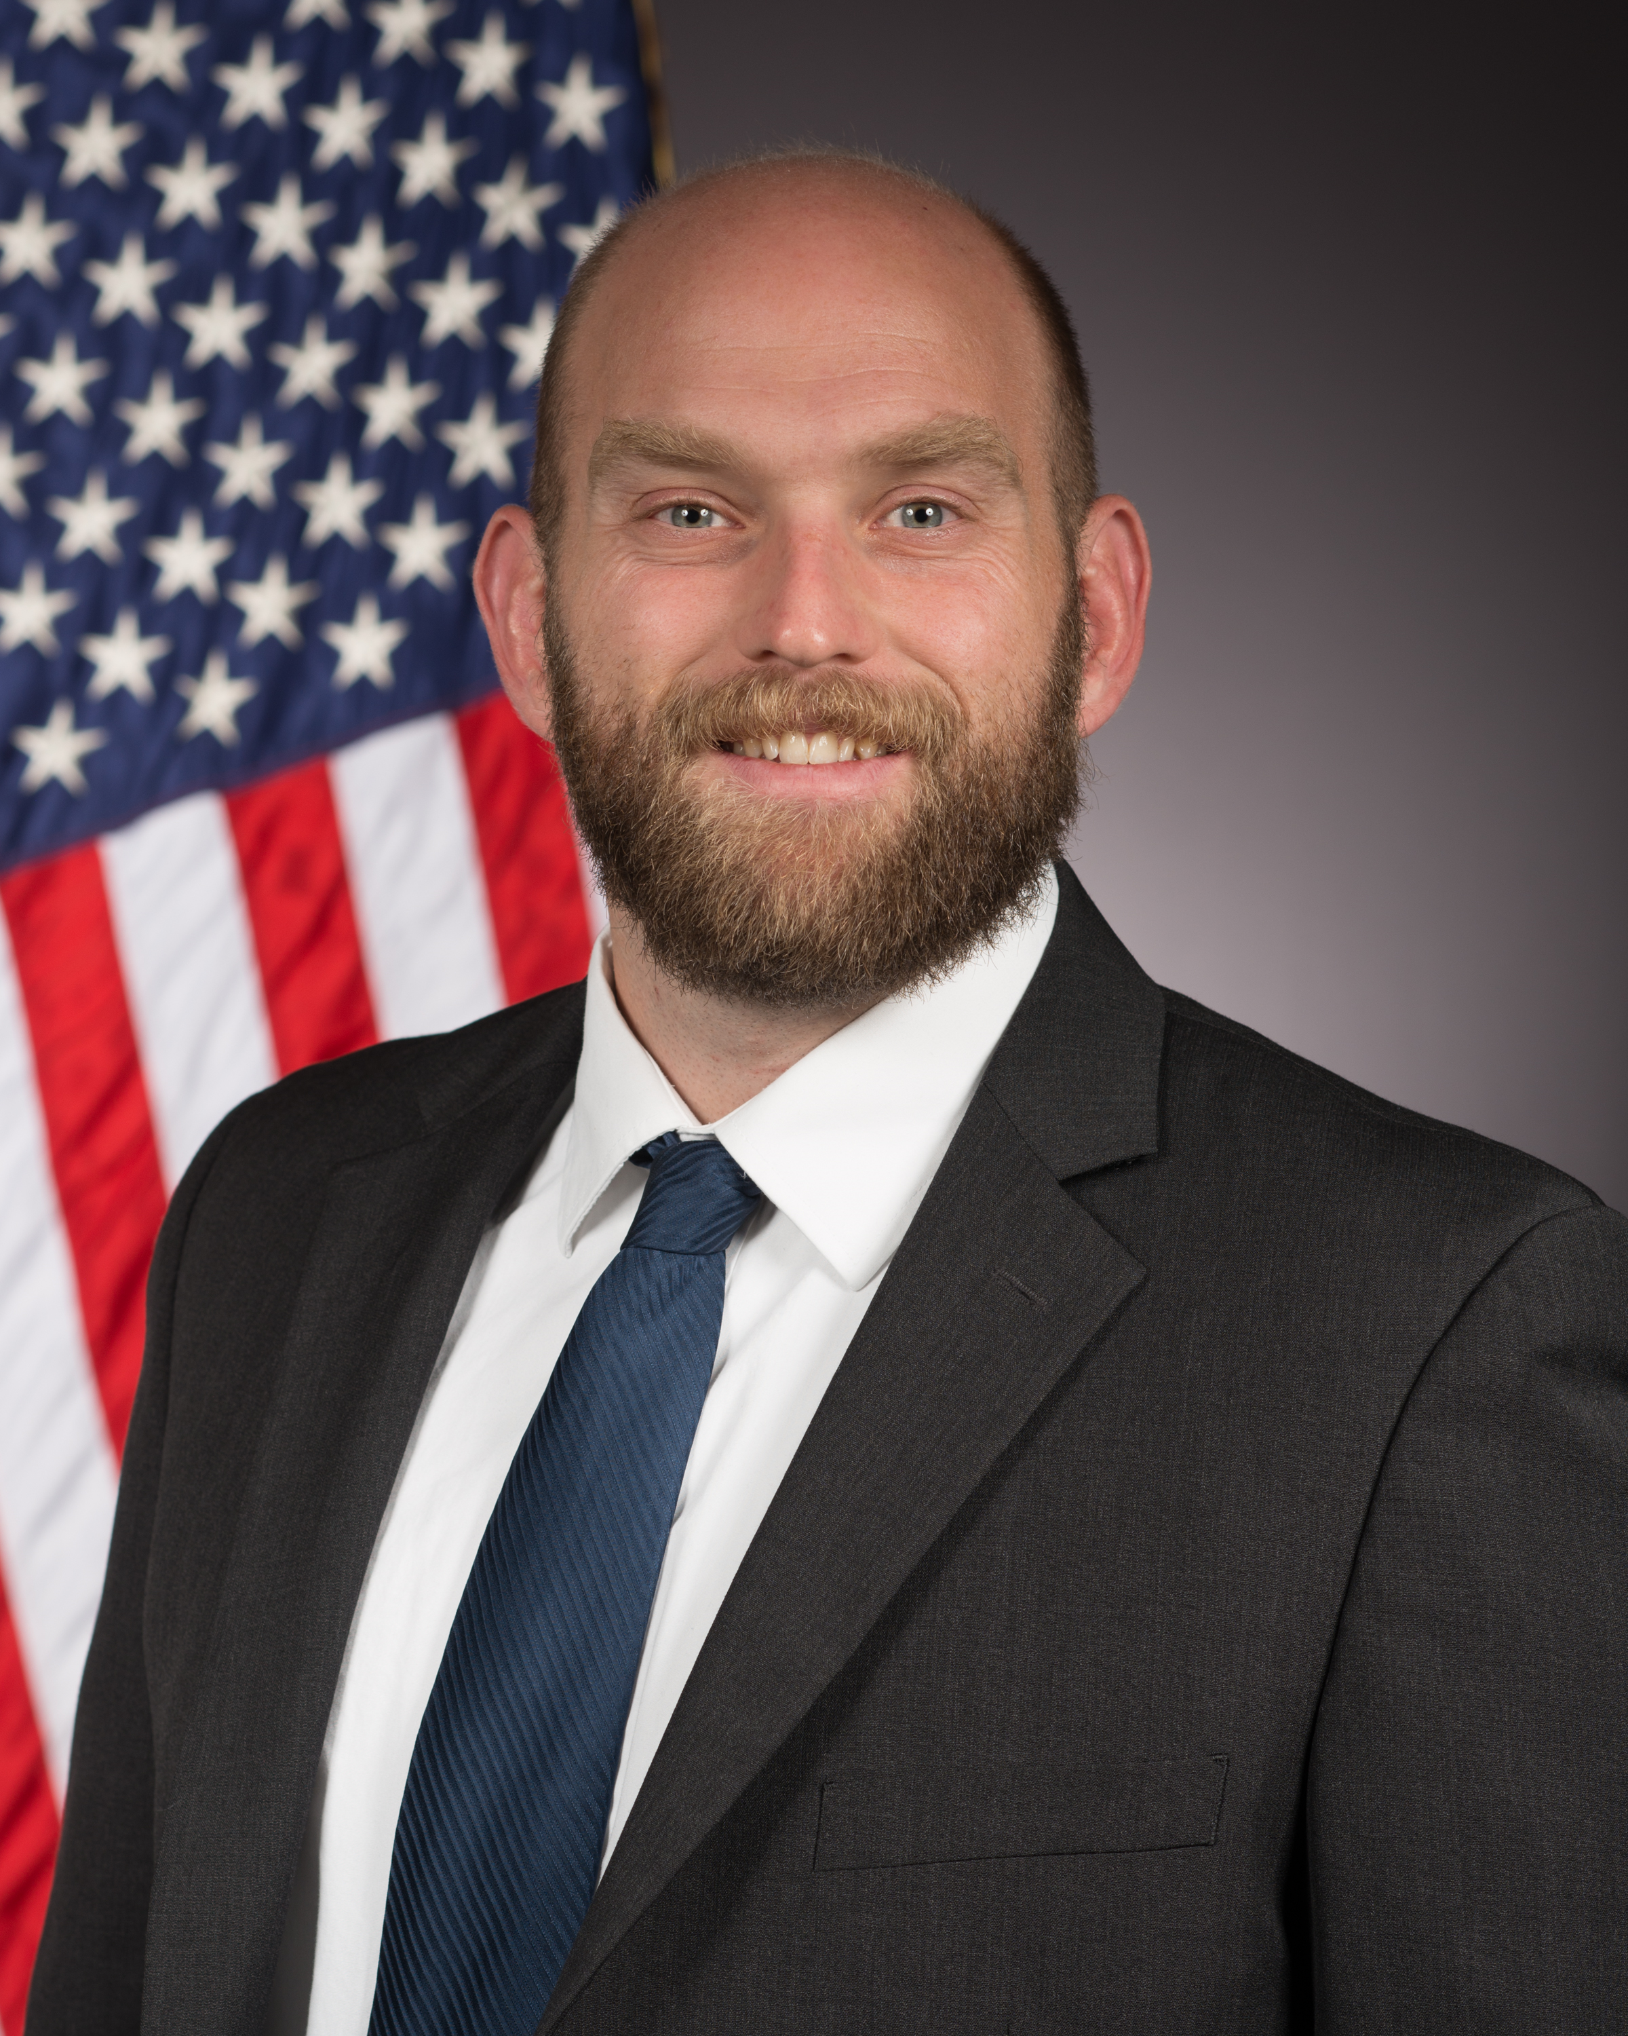
New Orleans – Spring 2024
Levi Moore
Meeting Theme: The Many Flavors of Chemistry
Symposium Title | Symposium Organizer
Undergraduate Research in Polymer Science | S. Morgan, H. Broadhead, S. Nazarenko
Excellence in Graduate Polymer Research | C. Coltrain, J. Self, C. Ellison, T. Long, K. Heifferon
Industrial Innovations in Polymer Science | H. Brown, J. Ting
Polymer Industry in the Southern U.S.: Global Impact, Local Flavor | A. Fogel, M. Shete
Paul J. Flory Polymer Education Award
Polymer binders in highly filled systems | B. Brettmann, J. Kalman, J. McCollum, A. Savage, L. Moore
Structure to Function in Supramolecular Polymers and Materials | J. Matson, P. Besenius, R. Kieltyka
Nonlinear chemical phenomena in polymeric systems | J. Pojman, A. Taylor
Incorporating Polymer Science into the Classroom | S. Morgan, H. Broadhead
Bioinspired Coacervates: Fundamental Studies and Applications | A. Joy
Advances in Ring-Opening Polymerizations/Ring-Closing Depolymerizations | J. Kennemur, J. Wang, Y. Getzler, H. Sun
Many flavors of Polymer Chemistry for 3D Printing | C. Wang, S. Laguizamon, J. Foster
General Topics: New Synthesis and Characterization of Polymers | J. Kalow, F. Horkay, Y. Li
POLY/PMSE Award & Plenary – PMSE Choice in even years

Slide 6
 | Sun 3/17 | Mon 3/18 | Tue 3/19 | Wed 3/20 | Thu 3/21
HYBRID
AM: 8:00 AM
PM: 2:00 PM
AM: 8:00 AM
PM: 2:00 PM
IN-PERSON
AM: 8:00 AM
PM: 2:00 PM
AM: 8:00 AM
PM: 2:00 PM
AM: 8:00 AM
PM: 2:00 PM
AM: 8:00 AM
PM: 2:00 PM
AM: 8:00 AM
PM: 2:00 PM
VIRTUAL
AM: 10:00 AM
PM: 3:00 PM
3D Printing
3D Printing
Supramolecular
Parrillo
3D Printing
3D Printing
Supramolecular
McCormick
Robb
Kumacheva
Ring-Opening
Ring-Opening
Kumacheva
Sustainable
Ring-Opening
Ring-Opening
Kumacheva requested Sunday PM and Monday AM
Sustainable requested a hybrid slot
Binders requested MT or TW with PM/AM/PM spacing
Ring-opening requested SM or TW
Excellence requested MT AM&PM in historical slot
Undergraduate requested T
Robb requested S or M
Excellence A
Excellence C
Classroom A
Excellence B
Excellence D
Classroom B
IIPS A
Undergrad
IIPS B
Undergrad
GT A
GT C
GT E
Supramolecular
GT B
GT D
GT F
Supramolecular
Coacervates
Coacervates
GT G
Binders
Coacervates
Coacervates
Binders
Binders
Nonlinear
Nonlinear
Nonlinear
Nonlinear

Slide 7
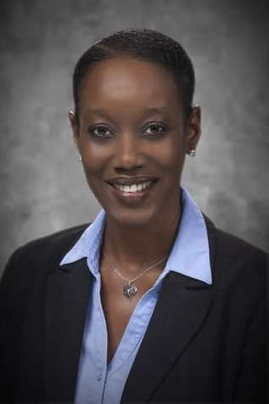
Denver – Fall 2024
Symposium Title | Symposium Organizer
General Topics: New Synthesis and Characterization of Polymers | TBD/Julia Kalow, Ferenc Horkay, Yongfu Li
Undergraduate Research in Polymer Science | Sarah Morgan, Heather Broadhead, Sergei Nazarenko
Excellence in Graduate Polymer Research | Christine Coltrain, Jeffrey Self, Chris Ellison, Timothy Long, Katherine Heifferon
Industrial Innovations in Polymer Science | Michael Petr, Dayton Street, Julienne Regele
Advancing Protection Through Materials Design | Amanda Forster, Joseph M. Dennis, Aaron Forster
Pushing the Limits of Macromolecular Architecture | Adrian Figg, Craig Hawker, Brent Sumerlin
Climbing Macromolecular Ladders: Elevating the Design, Synthesis, Properties, and Applications of Ladder Polymers | Lei Fang, Yan Xia, Fumitaka Ishiwari, Tomoyuki Ikai
Chemistry and Physics of Polymer Interlayers for Solar Cells | Prof. Carlos Graeff , Prof. Morten Madsen, Prof. Martin Heeney, Dr. Roger Hiorns
Polymer Sustainability: Renewable feedstocks and eco-friendly synthetic strategies | Chen Wang, Cori Jenkins, Diego Alzate-Sanchez
Phosphorus-Containing Polymers | Frederik Wurm, Karen Wooley
#Advances in Fluorine Containing Polymers and Composites | Scott Iacono, Abby Jennings
20 years of Virginia Tech Macromolecules Innovation Institute | Tomonori Saito, Robert Moore, Michael Bortner, Timothy Long
* CME-NASA Symposium: Elevating Polymer Chemistry to New Heights-polymers for Future Space Missions | Michael Meador, George Rodriguez, Ksenia Takhistova
Stimuli-Responsive Polymers as Functional Biomaterials | Metin Karayilan, Gregory Peterson, Matthew L. Becker
Performance Advantaged Bioproducts | Nicholas Rorrer, TBD
Elevating Waste Carbon Utilization for a Circular Economy | Yujing Tan, Kat Knauer, Eleftheria Roumeli, Dimitris Collias
Elevating polymer science in the state of Colorado | Ethan Quinn, Lejla Čamdžić, Emma Rettner, Brandon Hosford
Elevating the Power of Data for Materials and Chemical Scientists | Jeffry Ting, Mike Heiber, Alix Schmidt
Meeting Theme: Elevating Chemistry
* Invited only; ! from Spring 2024; # Other constraint

Slide 8
Denver – Fall 2024
Symposium Title | Symposium Organizer
Mark Scholars Young Award | Alan Hopkins (awards committee) & awardee designee (TBD)
Mark Scholars Award | ibid. Alan Hopkins (awards committee) & awardee designee (TBD)
Mark Scholars Senior Award | Alan Hopkins (awards committee) & awardee designee (TBD)
Industrial Polymer Scientist Award in honor of Carl Willis | Richard Spontak
Henkel Award for Outstanding Graduate Research in Polymer Science & Engineering | Jessica Kramer, Charles Paul
ACS Macro Letters/Biomacromolecules/Macromolecules Young Investigator Award | P. Majumder, S. Lecommandoux, M. Hillmyer, S. Rowan
25th Anniversary of ACS Biomacromolecules Journal | Tim Deming, Matthew Becker, Sebastien Lecommandoux and TBD
Danniebelle Haase
Meeting Theme: Elevating Chemistry

Slide 9
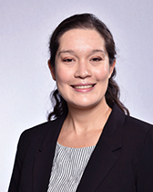
San Diego – Spring 2025
Julia Kalow
Recruiting Symposia & Organizers!
Meeting Theme: Transformative Chemistry
Symposium Title | Symposium Organizer
Industrial Innovations in Polymer Science | H. Brown, J. Ting
Excellence in Polymer Graduate Research | Alan Hopkins (awards committee) & awardee designee (TBD)
Undergraduate Research in Polymer Science | ibid.
Carl S. Marvel Creative Polymer Chemistry | ibid.
Molecule to Material Insights in Polymer Networks | R. Klausen, A. Nelson, S. Craig
Modern Approaches to Post-Polymerization Modification | A. Teator, J. Brantley, R. B. Moor, B. Sumerlin
General Topics | Newest program chair , Y. Li, F. Horkay
POLY/ PMSE Award and Plenary | D. Haase, L. Moore, J. Kalow, K. Mitchem

Slide 10
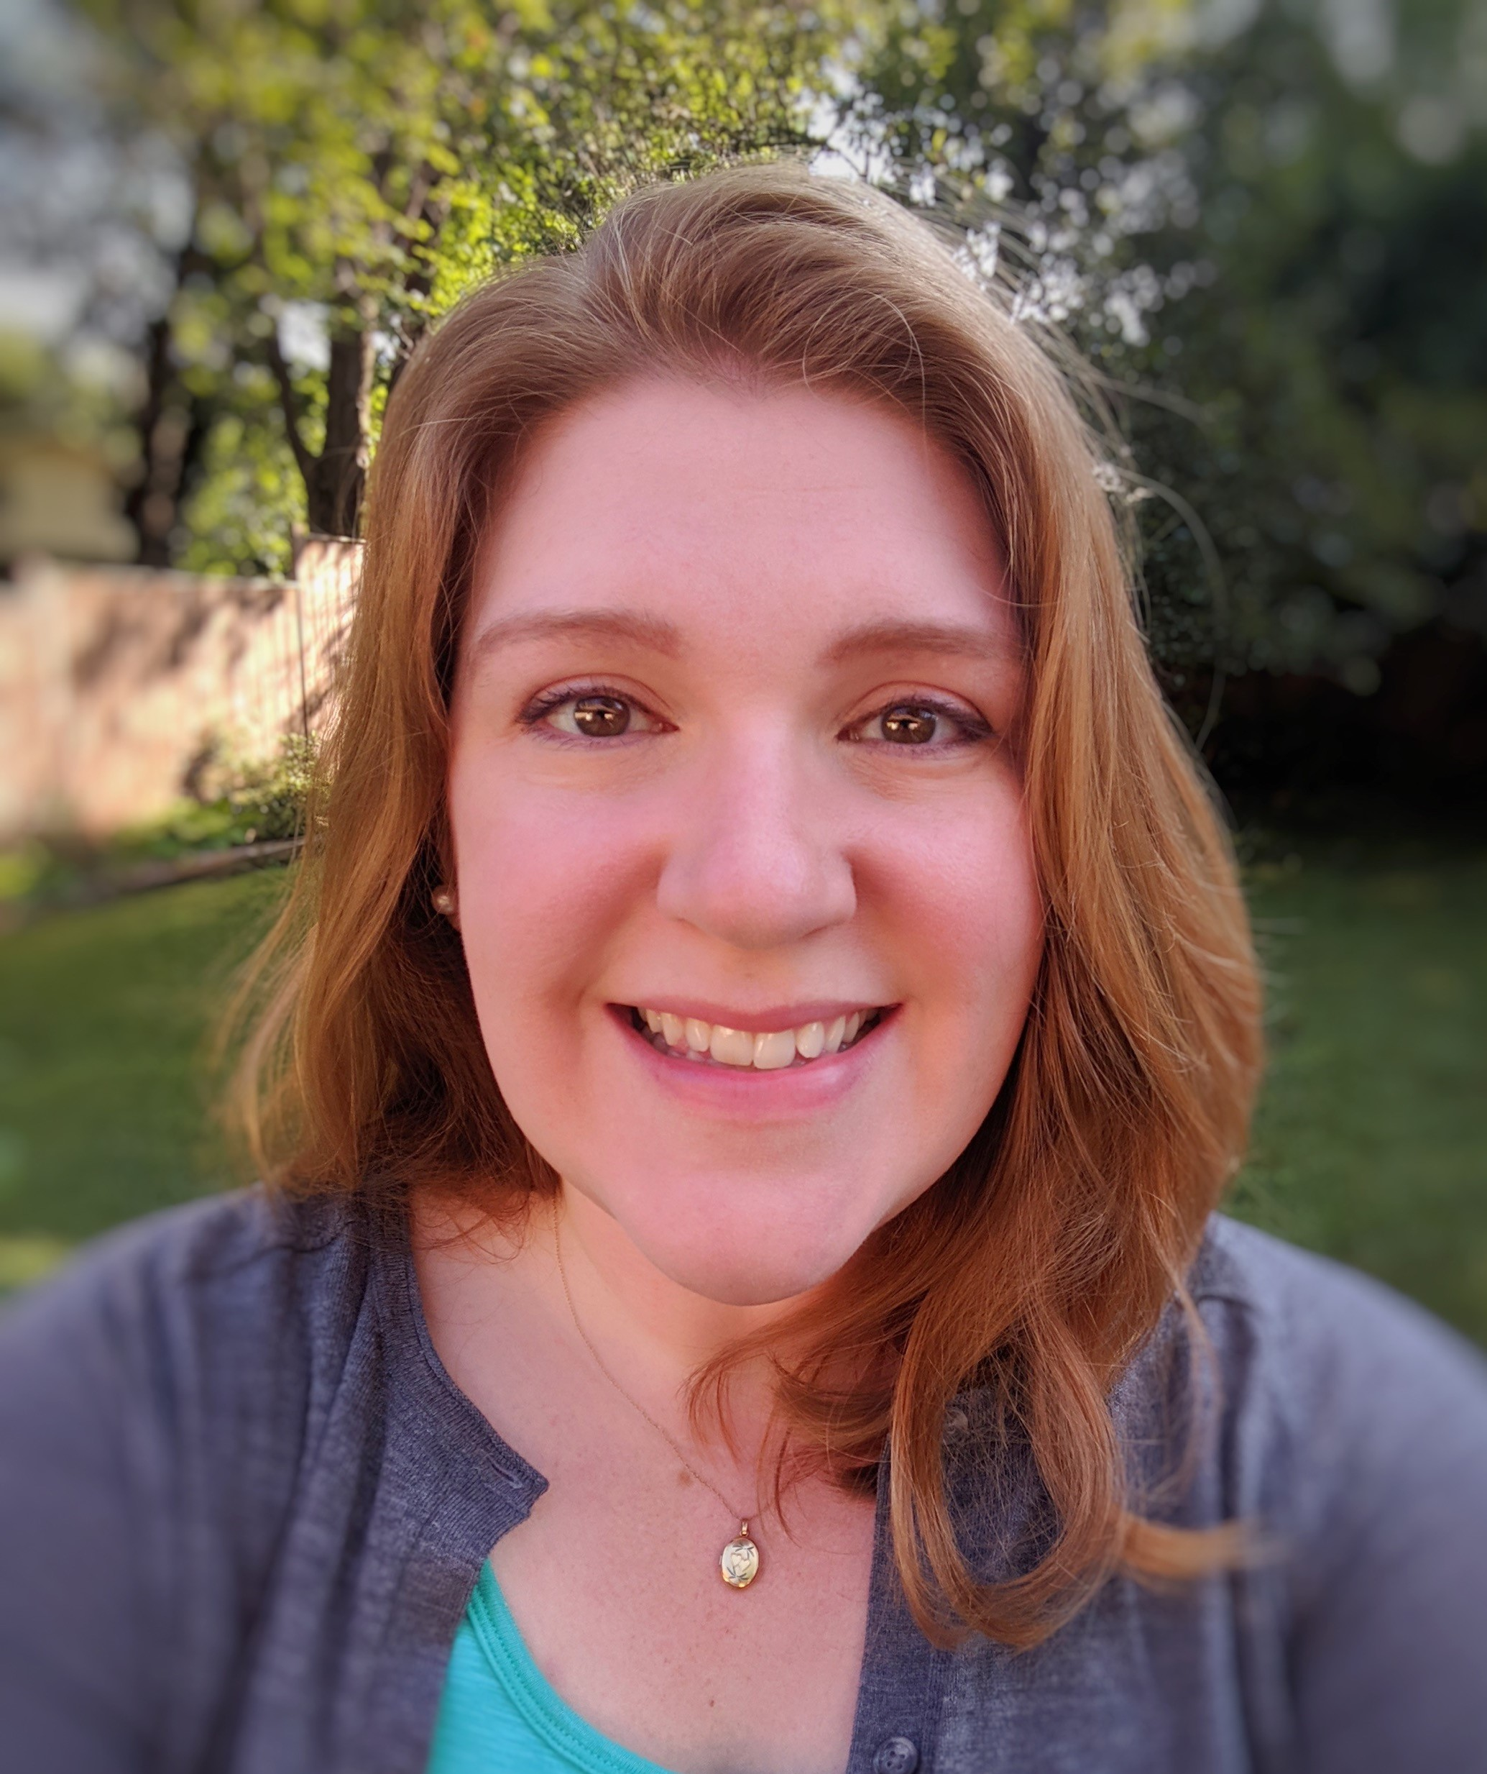

POLY Programming Team Rotation
Date (Location) | Sara Orski NIST | Levi Moore AFRL | Danniebelle Haase Dow | Julia Kalow Northwestern | Currently recruiting
Spring 2022 (San Diego) | SUPPORT | LEAD | SHADOW
Fall 2022(Chicago) | SUPPORT | SUPPORT | SUPPORT
Spring 2023 (Indianapolis) | SUPPORT | SUPPORT | LEAD | SHADOW
Fall 2023 (San Francisco) | LEAD | SUPPORT | SUPPORT | SHADOW
Spring 2024 (New Orleans) | CONSULT | LEAD | SUPPORT | SUPPORT
Fall 2024 (Denver) |  | SUPPORT | LEAD | SUPPORT | SHADOW?
Spring 2025 (San Diego) |  | CONSULT | SUPPORT | LEAD | SUPPORT

Slide 11
Team Composition
Balance of industry/academia/government
Sara’s completed her term at the end of 2023
THANK YOU SO MUCH!!!
Actively recruiting a new programming chair
Allan has identified a possible academic chair
POLY Program Committee Chair Rotation:
2024 – Levi
2025 – Danniebelle
2026 – Julia

Slide 12
New/Continuing Initiatives
Knowledge continuity in business office/ program chair liaison (Thanks Kathy!) & with ExComm (2024, Laura Patton)
Programming event to thank current organizers, reporting out on Programming, and recruiting new organizers
Recognition paths
Reporting paths
Recruitment paths
Programming Workshop of Best Practices – July 2023; Learnings to be summarized in a document (In progress)
Continuing discussions & initiatives regarding DEIR in POLY Programming

Slide 13
POLY Programming Workshop
Discussion Phase: gather best practices of several past program chairs (PC)
Questions discussed at workshop:
What works well in POLY programming?
What can be improved? What’s not working?
What are some ideas you have that would help POLY innovate with regards to programming?
What would have been helpful for you to know as a new program chair that you’d want to share with future program chairs?
What were some of the best technical symposia that you programmed? Why were they successful?
What have you observed makes the community eager to present in POLY? What helps motivate you to present? What helps students and early career chemists present?
Special topic on innovation within general topics symposia
Findings and best practices will be summarized in growing POLY Program Chair Guidebook - an ongoing document summarizing findings of workshop and addition input by champions

Slide 14
Future of Meetings - 2025
Division/ Program Area | Proposed Total Assignments Beginning Spring 2025 (4.5 days) - Based on Session Averages from 2016-2023. Sessions from Sunday - Thursday |  |  |  |  |  | Proposed Total Assignments Beginning Fall 2025 (3.5 days) - Based on Session Averages from 2016-2023. Sessions from Monday - Thursday
 | Proposed Total # of 1/2 day Sessions per Division | # Non Joint Sessions per Division (from total #) | # of Required Joint Sessions per Division -(from Total #) Goal is 8% | Max Hybrid/Digital Experience per Division (from Total #) - Goal is 5% | *Max Session Rooms/ Constructed Rooms based on 4.5 days (per Division) |  | Proposed Total # of 1/2 day Sessions per Division | # Non Joint Sessions per Division (from total #) | # of Required Joint Sessions per Division (from Total #) - Goal is 10% | Max Hybrid/ Digital Experience Sessions per Division (from Total #) - Goal is 25% | *Max Session Rooms/ Constructed Rooms based on 3.5 days (per Division)
POLY | 53 | 49 | 4 | 3 | 6 |  | 36 | 32 | 4 | 9 | 5
Shift to a more concentrated footprint and 3.5 days of programming (NO Sunday Tech Programming)
Total HDS for Fall 2025 reduced to 595 at the Washington, DC meeting
The Spring Meetings will remain similar in size to what ACS has typically offered

Slide 15
Voting Items
Organizer recognition/retention proposals:
Continuing Resolution on proposal to continue to produce and distribute “POLY National Meeting Symposium Organizer” recognition pins and organizational “care packages” to organizers as a method of recognition and retention
Programming Recruitment Funding proposal: est. $12k/year (increase due to inflation?)
for pins, bags/supplies, and postage
coffee/happy hour programming meetings to recruit organizers
ACS foresees virtual component to meetings long-term: shorter timeframe later in the day will accommodate time zones and hybrid scheduling
Notes:
$12k penciled into Christine’s budget
(no postage if in person, )

