Slide 1
POLY Programming Team Winter ExComm Discussion 2025
Danniebelle Haase, Julia Kalow, Graham Collier, Alice Savage
Kathy Mitchem (POLY Business Liaison),
and Derek Patton (2025 ExComm. Liaison)

Slide 2
Overview
2024 Review
  Review of 2024 POLY at ACS National Meeting – New Orleans & Denver
Upcoming National Meetings
  Program plans and specific needs (& leads)
    Spring 2025 – Julia Kalow
    Fall 2025 – Graham Collier
    Spring 2026 – Alice Savage
Future of POLY Programming
  Team composition and recommendations
  New initiatives and concepts
  Future of ACS Meetings update

Slide 3
2024 Review and Report Summary
  Brief Snapshot
  Future of Meetings at Fall 2024
    Five Innovative Sessions (Different formats – live polling, interactive features during talks, industry focus and policy related)
    Integrated poster pilot (Sunday)
    Escape room pilot
    Hybrid Session format
    Pre-record/upload eliminated
    Poster sessions are in-person only
Year | Total POLY | Total ACS | % POLY
* Fall 2024 |  | 11065
Spring 2024 | 553 | 11779 | 4.7
Fall 2023 | 501 | 10801 | 4.6
Spring 2023 | 541 | 11510 | 4.7
* Fall 2024 data will be shared by ACS in the coming weeks

Slide 4
Historical Contributions
Philadelphia 2020- cancelled, Spring 2021 Virtual meeting did not collect division-level stats.

Slide 5
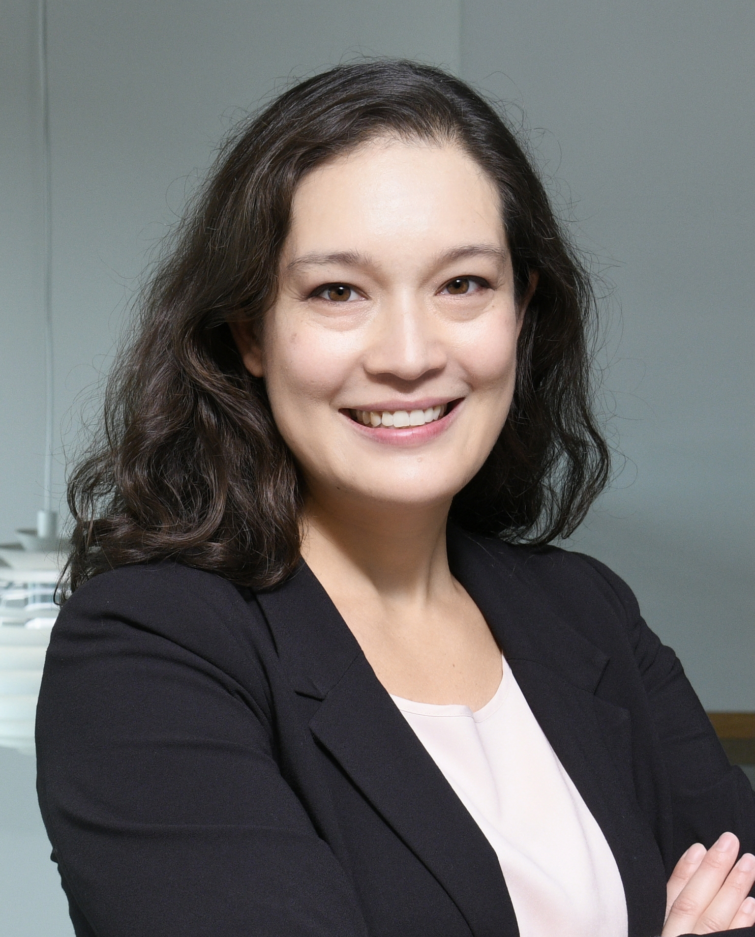
San Diego – Spring 2025
“Transformative Chemistry”
Symposium Title (Co-Organizing Divisions) | Symposium Organizers | In-Person ½-Day Sessions
Industrial Innovations in Polymer Science | J. Wu, M. Liu, L. Macdougall | 2
Excellence in Polymer Graduate Research | C. Coltrain, J. Self, C. Ellison, T. Long, K. Heifferon, R. Behling | 4
Undergraduate Research in Polymer Science | S. Morgan, H. Broadhead, S. Nazarenko | 2
Carl S. Marvel Creative Polymer Chemistry | T. Nelson (awards committee) & awardee designee (TBD) | 1
POLY/ PMSE Award and Plenary | D. Haase, J. Kalow, G. Collier, K. Mitchem | 1
General Topics | G. Collier, Y. Li, F. Horkay | ~8
5th Symposium on Poly(2-oxazoline)s and Related Polymers | R. Hoogenboom, E. Benetti, R. Becer | 6
Molecule to Material Insights in Polymer Networks | R. Klausen, A. Nelson, S. Craig | 4
Modern Approaches to Post-Polymerization Modification | A. Teator, J. Brantley, R. B. Moore, B. Sumerlin | 4
Polymers with Inorganic Materials | Z. Qiang, D. Patton, K. Fu | 4
Chemical Recycling and Upcycling of Polymers (PMSE, CATL) | T. Saito, B. Helms, M. Dadmun, B. Long, H. Toraman, K. Alexopoulos | 4
Modern Organic Methods in Polymer Chemistry (ORGN) | J. Lamb, N. Romero | 2
Polymers for Energy and Sustainability | C. Letko, C. Cooper | 2
Joe DeSimone 60th Birthday Celebration | M. Bortner, M. Dulay, C. Farrell, J. Perry | 2
Biomedical Technologies: Delivery and Targeting of Therapeutics (BIOT) | S. Chollangi, S. Dutta, D. Upadhyay, W. Suh, I. Sinha | 1

Slide 6
San Diego – Spring 2025
“Transformative Chemistry”
Global Virtual Symposia and Poster-Only
Symposium Title (Co-Organizing Divisions) | Symposium Organizers | Format
Virtual Graduate Students Symposium in Asia-Pacific Region on Polymer Chemistry | C. Zheng, D. Qu | Virtual
Global Virtual Symposium in Polymers for Biomedical Applications | P. De, A. Sanyal, E. Gillies | Virtual
GSSPC: Bonds That Matter: Soft Materials for a Sustainable World (CELL, CHED, PMSE) | D. Smith, S. Fisher | Poster

Slide 7
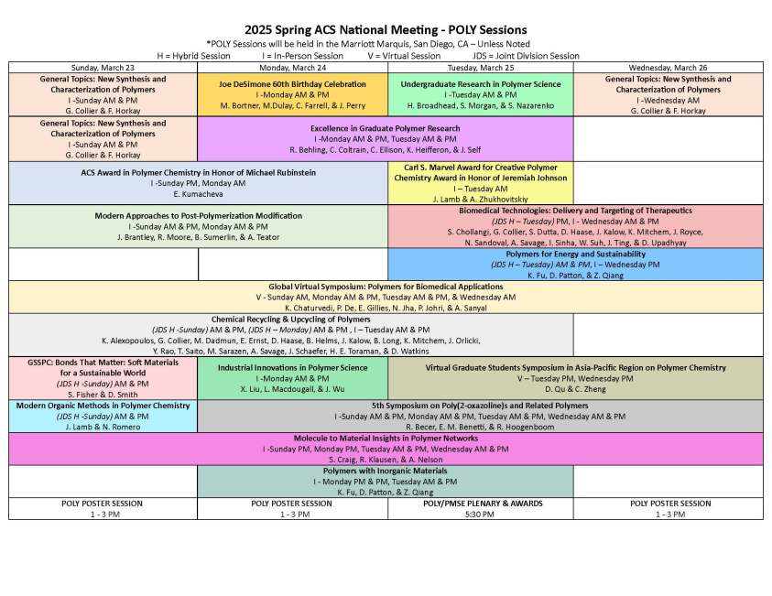

Slide 8
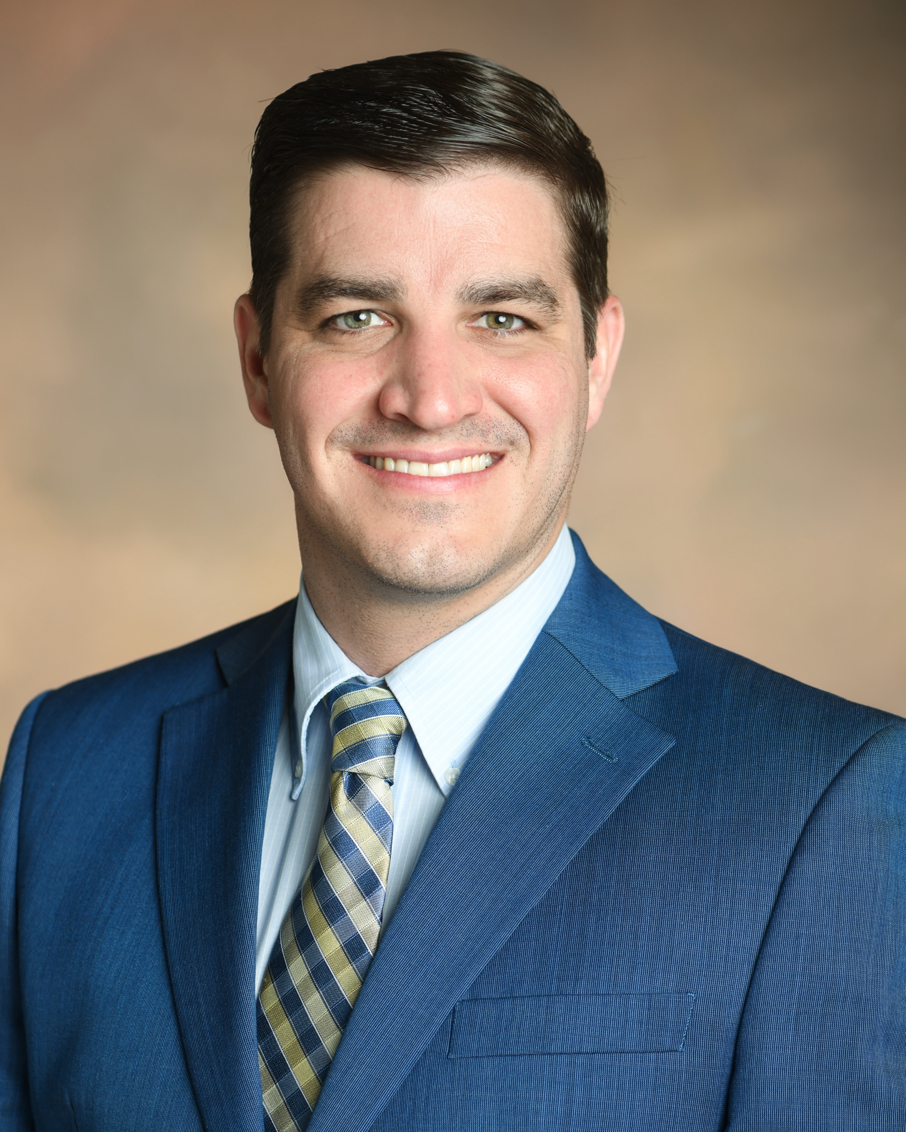
Washington, DC – Fall 2025
Symposium Title | Symposium Organizer
The Herman Mark Award | Toby Nelson/TBD
Overberger International Prize | Toby Nelson/TBD
Young Industrial Polymer Scientist Award in honor of Jeff Ting | Toby Nelson/TBD
Henkel Award for Outstanding Graduate Research in Polymer Science & Engineering | Toby Nelson/TBD
ACS Macro Letters/Biomacromolecules/Macromolecules Young Investigator Award | Toby Nelson/TBD
POLY/ PMSE Award and Plenary | D. Haase, J. Kalow, G. Collier, A. Savage, K. Mitchem
Industrial Innovations in Polymer Science | TBD
General Topics: New Synthesis and Characterization of Polymers | A. Savage, Y. Li, F. Horkay
CME-NASA Symposium | TBD
Conjugated Polymers: Past, Present, and Future | Wei You, Barry Thompson, Christine Luscombe
Polymers for Defense Applications: Sustainable, Adaptable, and Functional | Alice Savage, Timothy Pruyn, Peter Zarras, Dawanne Poree, Jessica Cash, Robert Lambeth
Polymers for a circular economy: recent advances and challenges | Colleen Scott
Pride in Polymers | Adrian Figg, Brett Helms, Athina Anastasaki
Green Polymer Chemistry and Sustainability | H. N. Cheng
Next Generation Materials Discovery and Production | Mike Sims

Slide 9
Additional Collaboration for Fall 2025
The USNC/IUPAC and BCST will be co-hosting a PFAS Townhall with POLY, PMSE and other stakeholders (more to come soon)
  IUPAC Definitions
  Perspectives from Federal, Local, Industry, Community Advocates

Slide 10
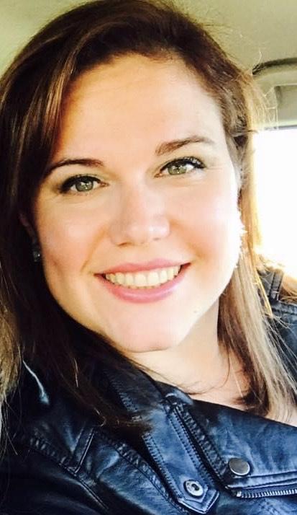
Atlanta – Spring 2026
Recruiting Symposia & Organizers!
Symposium Title | Symposium Organizer
Industrial Innovations in Polymer Science | J. Ting/TBD
Excellence in Polymer Graduate Research | Toby Nelson (awards committee) & awardee designee (TBD)
Undergraduate Research in Polymer Science | ibid.
Carl S. Marvel Creative Polymer Chemistry | ibid.
POLY/ PMSE Award and Plenary | J. Kalow, G. Collier, A. Savage, K. Mitchem, TBD
*Circular Economy of Polymers: Bio-derived/biodegradable, Recycled, and Waste feedstocks and Chemistries | Y. Tan, E. Roumeli, E. Liu, K. Knauer, D. Collias
*Capturing the Power of Data for Materials and Chemical Scientists in Industry | A. Schmidt, M. Heiber, R. Shaffer, C. Szczepanski
Academic Entrepreneurship and Tech Transfer: Turning Research into Revenue | S. Dishari, C. Szczepanski , C. Wirth
General Topics | Newest program chair , Y. Li, F. Horkay
* Symposium overflow from Fall 2025. The additional Fall 2025 overflows will be slated for Fall 2026.

Slide 11
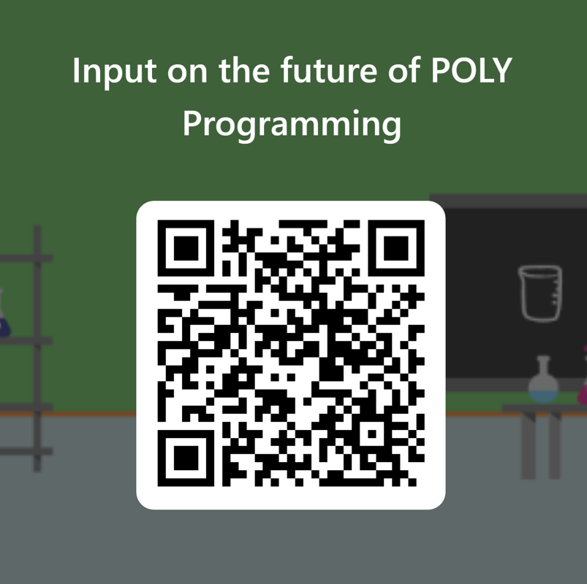
Prospective 2025 Programming Goals
Symposium Selection guidelines
Enhance stakeholder communication

Slide 12
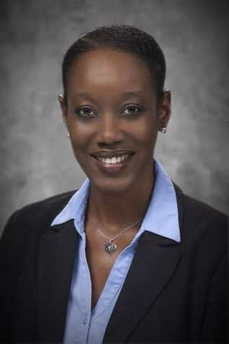

POLY Programming Team Rotation
Date (Location) | Danniebelle Haase Dow | Julia Kalow Northwestern | Graham Collier USM | Alice Savage ARL | Industry
Fall 2022(Chicago) | SUPPORT
Spring 2023 (Indianapolis) | LEAD | SHADOW
Fall 2023 (San Francisco) | SUPPORT | SHADOW
Spring 2024 (New Orleans) | SUPPORT | SUPPORT
Fall 2024 (Denver) | LEAD | SUPPORT | SHADOW
Spring 2025 (San Diego) | CONSULT | LEAD | SUPPORT | SHADOW
Fall 2025 (Washington, DC) | CONSULT | SUPPORT | LEAD | SUPPORT | SHADOW
Spring 2026 (Atlanta, GA) |  | CONSULT | SUPPORT | LEAD | SUPPORT

Slide 13
Team Composition
Balance of industry/academia/government
  Levi completed his term at the end of 2024
  Actively recruiting a new programming chair
    Laura will name a possible industry chair
  POLY Program Committee Chair Rotation:
    2025 – Danniebelle
    2026 – Julia
    2027 – Graham
    2028 – Alice

Slide 14
New/Continuing Initiatives
Knowledge continuity in business office/ program chair liaison (Thanks Kathy!) & with ExComm (2024, Laura Stratton & 2025, Derek Patton)
Continuing Programming event to thank current organizers, reporting out on Programming, and recruiting new organizers
  Recognition paths
  Reporting paths
  Recruitment paths
Programming Workshop of Best Practices – July 2023; Learnings to be summarized in a document (In progress; FOM impact to be incorporated)
Continuing discussions & initiatives regarding DEIR in POLY Programming

Slide 15
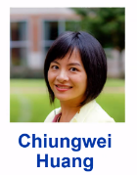
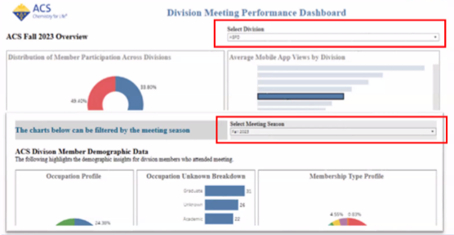
New ACS Programming Resources
Programming Support Contact
Division Data Dashboard
(Included in Leadership Institute Activities)

Slide 16
Thank you!
Questions?

Slide 17
Back Up Slides

Slide 18
POLY Programming Workshop
Discussion Phase: gather best practices of several past program chairs (PC)
Questions discussed at workshop:
  What works well in POLY programming?
  What can be improved? What’s not working?
  What are some ideas you have that would help POLY innovate with regards to programming?
  What would have been helpful for you to know as a new program chair that you’d want to share with future program chairs?
  What were some of the best technical symposia that you programmed? Why were they successful?
  What have you observed makes the community eager to present in POLY? What helps motivate you to present? What helps students and early career chemists present?
  Special topic on innovation within general topics symposia
Findings and best practices will be summarized in growing POLY Program Chair Guidebook - an ongoing document summarizing findings of workshop and addition input by champions

Slide 19
Voting Items & Items for Evaluation
  (Voting) Organizer recognition/retention proposals:
    Continuing Resolution on proposal to continue to produce and distribute “POLY National Meeting Symposium Organizer” recognition pins and organizational “care packages” to organizers as a method of recognition and retention
  (Consideration) Programming Recruitment Funding: With a reduced meeting footprint, what is the appropriate level of financial support?
      For pins, bags/supplies, and postage
      Coffee/happy hour programming meetings to recruit organizers
        ACS foresees virtual component to meetings long-term
Notes:
$12k penciled into Christine’s budget
(no postage if in person, )

Slide 20
Future of Meetings - 2025
Division/ Program Area | Proposed Total Assignments Beginning Spring 2025 (4.5 days) - Based on Session Averages from 2016-2023. Sessions from Sunday - Thursday |  |  |  |  |  | Proposed Total Assignments Beginning Fall 2025 (3.5 days) - Based on Session Averages from 2016-2023. Sessions from Monday - Thursday
 | Proposed Total # of 1/2 day Sessions per Division | # Non Joint Sessions per Division (from total #) | # of Required Joint Sessions per Division -(from Total #) Goal is 8% | Max Hybrid/Digital Experience per Division (from Total #) - Goal is 5% | *Max Session Rooms/ Constructed Rooms based on 4.5 days (per Division) |  | Proposed Total # of 1/2 day Sessions per Division | # Non Joint Sessions per Division (from total #) | # of Required Joint Sessions per Division (from Total #) - Goal is 10% | Max Hybrid/ Digital Experience Sessions per Division (from Total #) - Goal is 25% | *Max Session Rooms/ Constructed Rooms based on 3.5 days (per Division)
POLY | 53 | 49 | 4 | 3 | 6 |  | 36 | 32 | 4 | 9 | 5
Shift to a more concentrated footprint and 3.5 days of programming (NO Sunday Tech Programming)
Total HDS for Fall 2025 reduced to 595 at the Washington, DC meeting
The Spring Meetings will remain similar in size to what ACS has typically offered

Slide 21
Future of Meetings – Features of Meetings in 2025 and Beyond
Reduced session allotments
  More joint programming is an expectation
    Joint Programming Detail Intake Form required; Structure to be refined
  How should award sessions be handled?
    Working group established
No hydrid meetings (In-Person or Global Sessions only)
Enhanced/Integrated poster sessions
Innovative Sessions

