Slide 1
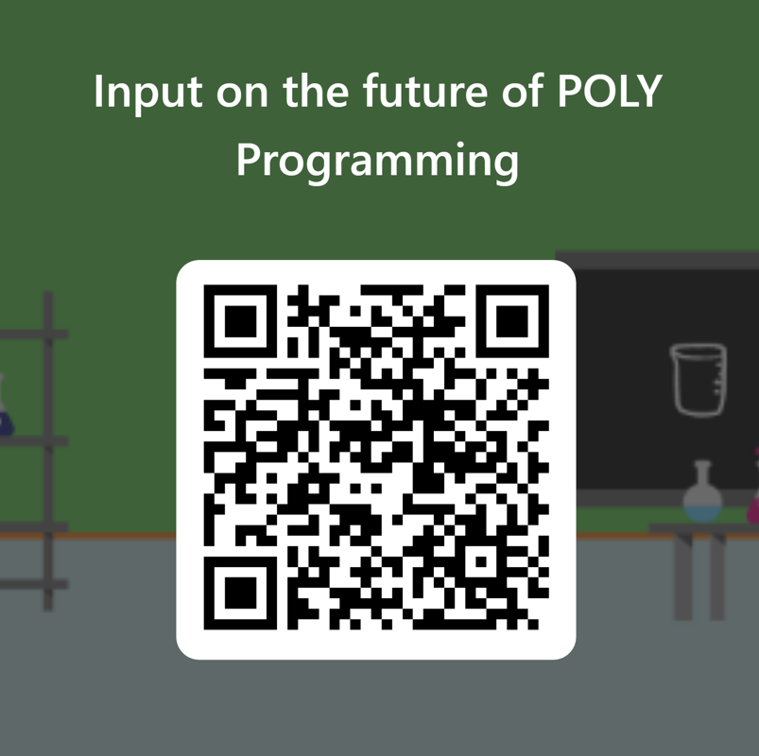

Slide 2
POLY Programming 2024 ACS Fall Meeting
Danniebelle Haase, Julia Kalow, Graham Collier, Levi Moore
Kathy Mitchem (POLY Business Liaison),
and Laura Stratton (2024 ExComm. Liaison)
Notes:
Invite vice chair to participate. But not official duty.

Slide 3
Overview
Review of POLY at the ACS
Partial review of the 2024 ACS Spring Meeting – New Orleans
Upcoming National Meetings
Program plans and specific needs (& leads)
Fall 2024 – Danniebelle Haase
Spring 2025 – Julia Kalow
Fall 2025 – Graham Collier
Future of POLY Programming
Team composition and recommendations
New initiatives and concepts
Future of ACS Meetings update
Additional Items

Slide 4


2023 Fall & Partial 2024 Review and Report Summary
Overview of POLY meeting presentations in San Francisco
Oral presentations
261 in-person (6.3% of ACS)
115 hybrid (3.9% of ACS)
35 virtual (6.5% of ACS)
Poster presentations
83 in-person (2.8% of ACS)
7 virtual (2.3% of ACS)
Brief comparison of POLY and ACS presentations
Year | Total POLY | Total ACS | % POLY
Spring 2024 |  | 11779
Fall 2023 | 501 | 10801 | 4.6
Spring 2023 | 541 | 11510 | 4.7

Slide 5
Contributions
Philadelphia 2020- cancelled, Spring 2021 Virtual meeting did not collect division-level stats.

Slide 6
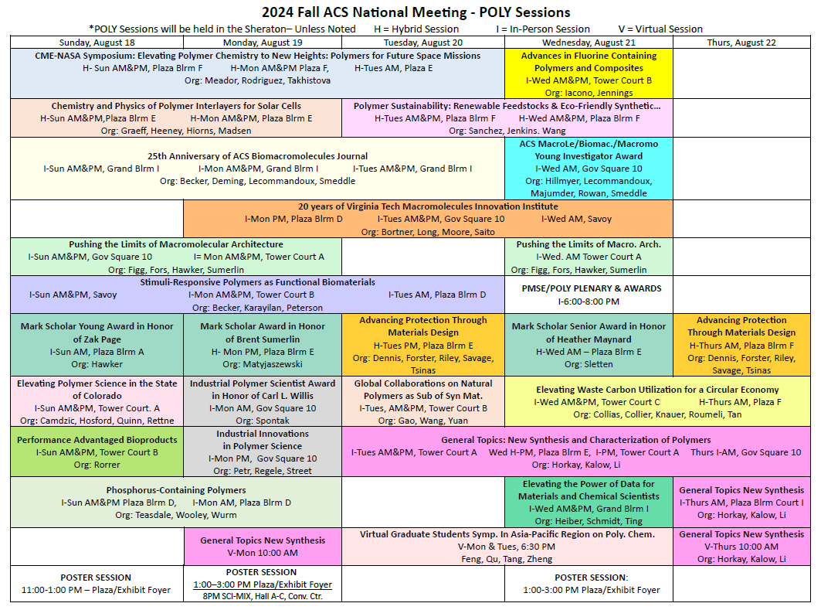

Slide 7
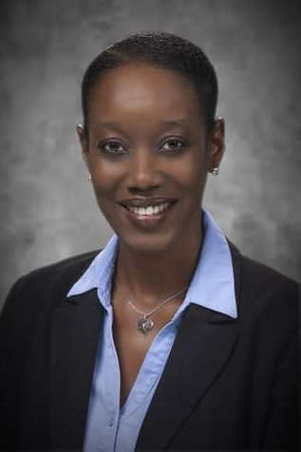
Denver – Fall 2024
Symposium Title | Symposium Organizer
Industrial Innovations in Polymer Science | Michael Petr, Dayton Street, Julienne Regele
General Topics: New Synthesis and Characterization of Polymers | Julia Kalow, Graham Collier, Ferenc Horkay, Yongfu Li
25th Anniversary of ACS Biomacromolecules Journal | Tim Deming, Matthew Becker, Sebastien Lecommandoux and Graham Smeddle
Global Collaborations on Natural Polymers as Substitution of Synthetic Materials | Wei Gao, Jun Wang, Qiong Yuan
Advancing Protection Through Materials Design | Amanda Forster, Joseph M. Dennis, Michael Riley, Zois Tsinas, Alice Savage
Pushing the Limits of Macromolecular Architecture | Adrian Figg, Craig Hawker, Brent Sumerlin
Chemistry and Physics of Polymer Interlayers for Solar Cells | Prof. Carlos Graeff , Prof. Morten Madsen, Prof. Martin Heeney, Dr. Roger Hiorns
Polymer Sustainability: Renewable feedstocks and eco-friendly synthetic strategies | Chen Wang, Cori Jenkins, Diego Alzate-Sanchez
Phosphorus-Containing Polymers | Frederik Wurm, Karen Wooley
#Advances in Fluorine Containing Polymers and Composites | Scott Iacono, Abby Jennings
20 years of Virginia Tech Macromolecules Innovation Institute | Tomonori Saito, Robert Moore, Michael Bortner, Timothy Long
* CME-NASA Symposium: Elevating Polymer Chemistry to New Heights-polymers for Future Space Missions | Michael Meador, George Rodriguez, Ksenia Takhistova
Stimuli-Responsive Polymers as Functional Biomaterials | Metin Karayilan, Gregory Peterson, Matthew L. Becker
Performance Advantaged Bioproducts | Nicholas Rorrer, TBD
Elevating Waste Carbon Utilization for a Circular Economy | Yujing Tan, Kat Knauer, Eleftheria Roumeli, Dimitris Collias
Elevating polymer science in the state of Colorado | Ethan Quinn, Lejla Čamdžić, Emma Rettner, Brandon Hosford
Elevating the Power of Data for Materials and Chemical Scientists | Jeffry Ting, Mike Heiber, Alix Schmidt
Meeting Theme: Elevating Chemistry
* Invited only; ! from Spring 2024; # Other constraint

Slide 8
Denver – Fall 2024
Symposium Title | Symposium Organizer
Mark Scholars Young Award in honor of Zachariah Page | Craig Hawker
Mark Scholars Award in honor of Brent Sumerlin | Krzysztof Matyjaszewski
Mark Scholars Senior Award in honor of Heather Maynard | Ellen Sletten
Industrial Polymer Scientist Award in honor of Carl Willis | Richard Spontak
ACS Macro Letters/Biomacromolecules/Macromolecules Young Investigator Award | P. Majumder, S. Lecommandoux, M. Hillmyer, S. Rowan
Danniebelle Haase
Meeting Theme: Elevating Chemistry

Slide 9
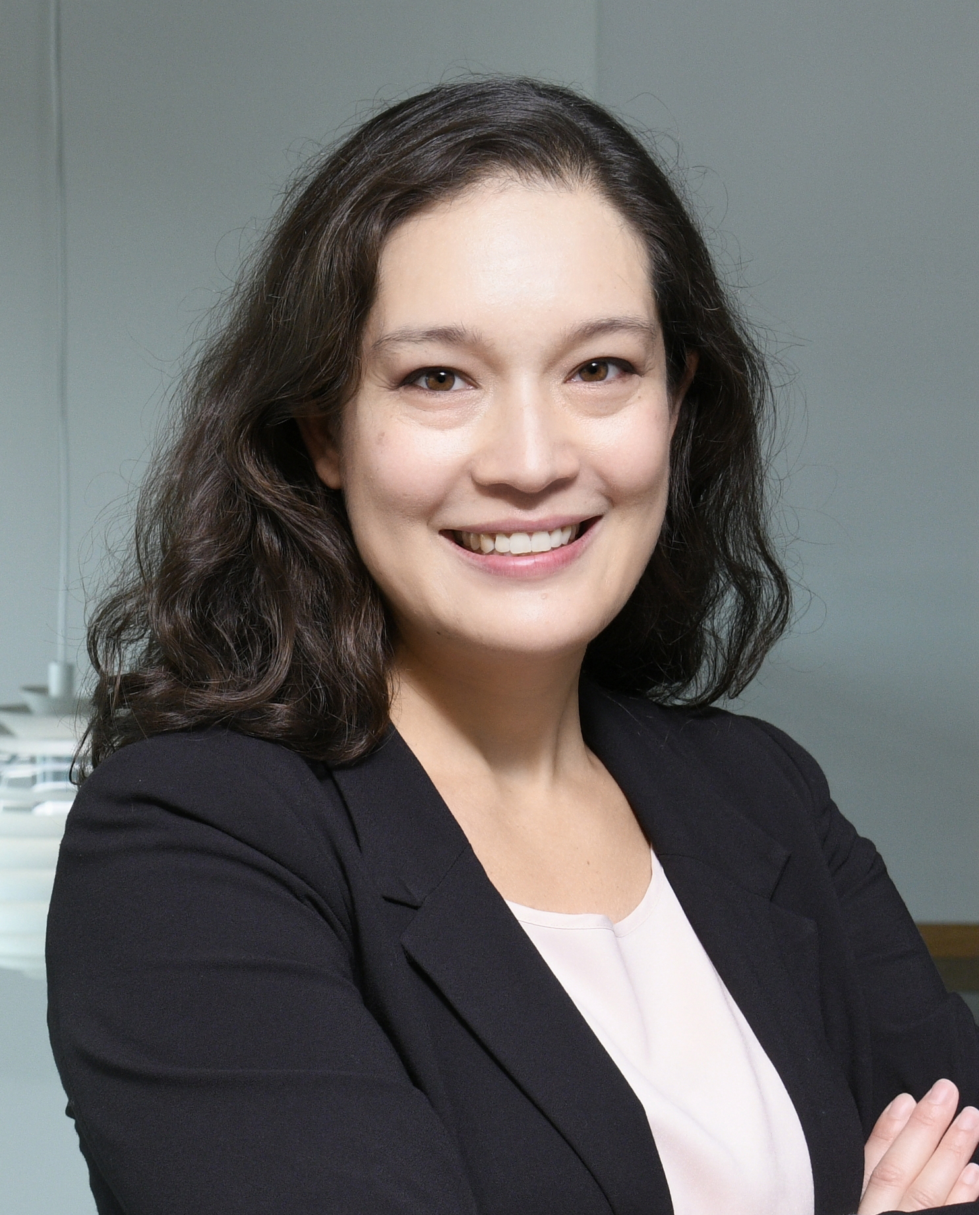
San Diego – Spring 2025
Symposium Title (Co-Organizing Divisions) | Symposium Organizers | In-Person ½-Day Sessions
Industrial Innovations in Polymer Science | J. Wu, M. Liu, L. Macdougall | 2
Excellence in Polymer Graduate Research | C. Coltrain, J. Self, C. Ellison, T. Long, K. Heifferon, R. Behling | 4
Undergraduate Research in Polymer Science | S. Morgan, H. Broadhead, S. Nazarenko | 2
Carl S. Marvel Creative Polymer Chemistry | T. Nelson (awards committee) & awardee designee (TBD) | 1
POLY/ PMSE Award and Plenary | D. Hasse, J. Kalow, G. Collier, K. Mitchem | 1
General Topics | G. Collier, Y. Li, F. Horkay | ~8
5th Symposium on Poly(2-oxazoline)s and Related Polymers | R. Hoogenboom, E. Benetti, R. Becer | 6
Molecule to Material Insights in Polymer Networks | R. Klausen, A. Nelson, S. Craig | 4
Modern Approaches to Post-Polymerization Modification | A. Teator, J. Brantley, R. B. Moore, B. Sumerlin | 4
Polymers with Inorganic Materials | Z. Qiang, D. Patton, K. Fu | 4
Chemical Recycling and Upcycling of Polymers (PMSE, CATL) | T. Saito, B. Helms, M. Dadmun, B. Long, H. Toraman, K. Alexopoulos | 4
Modern Organic Methods in Polymer Chemistry (ORGN) | J. Lamb, N. Romero | 2
Polymers for Energy and Sustainability | C. Letko, C. Cooper | 2
Joe DeSimone 60th Birthday Celebration | M. Bortner, M. Dulay, C. Farrell, J. Perry | 2
Biomedical Technologies: Delivery and Targeting of Therapeutics (BIOT) | S. Chollangi, S. Dutta, D. Upadhyay, W. Suh, I. Sinha | 1

Slide 10
San Diego – Spring 2025
Global Virtual Symposia and Poster-Only
Symposium Title (Co-Organizing Divisions) | Symposium Organizers | Format
Virtual Graduate Students Symposium in Asia-Pacific Region on Polymer Chemistry | C. Zheng, D. Qu | Virtual
Global Virtual Symposium in Polymers for Biomedical Applications | P. De, A. Sanyal, E. Gillies | Virtual
GSSPC: Bonds That Matter: Soft Materials for a Sustainable World (CELL, CHED, PMSE) | D. Smith, S. Fisher | Poster

Slide 11
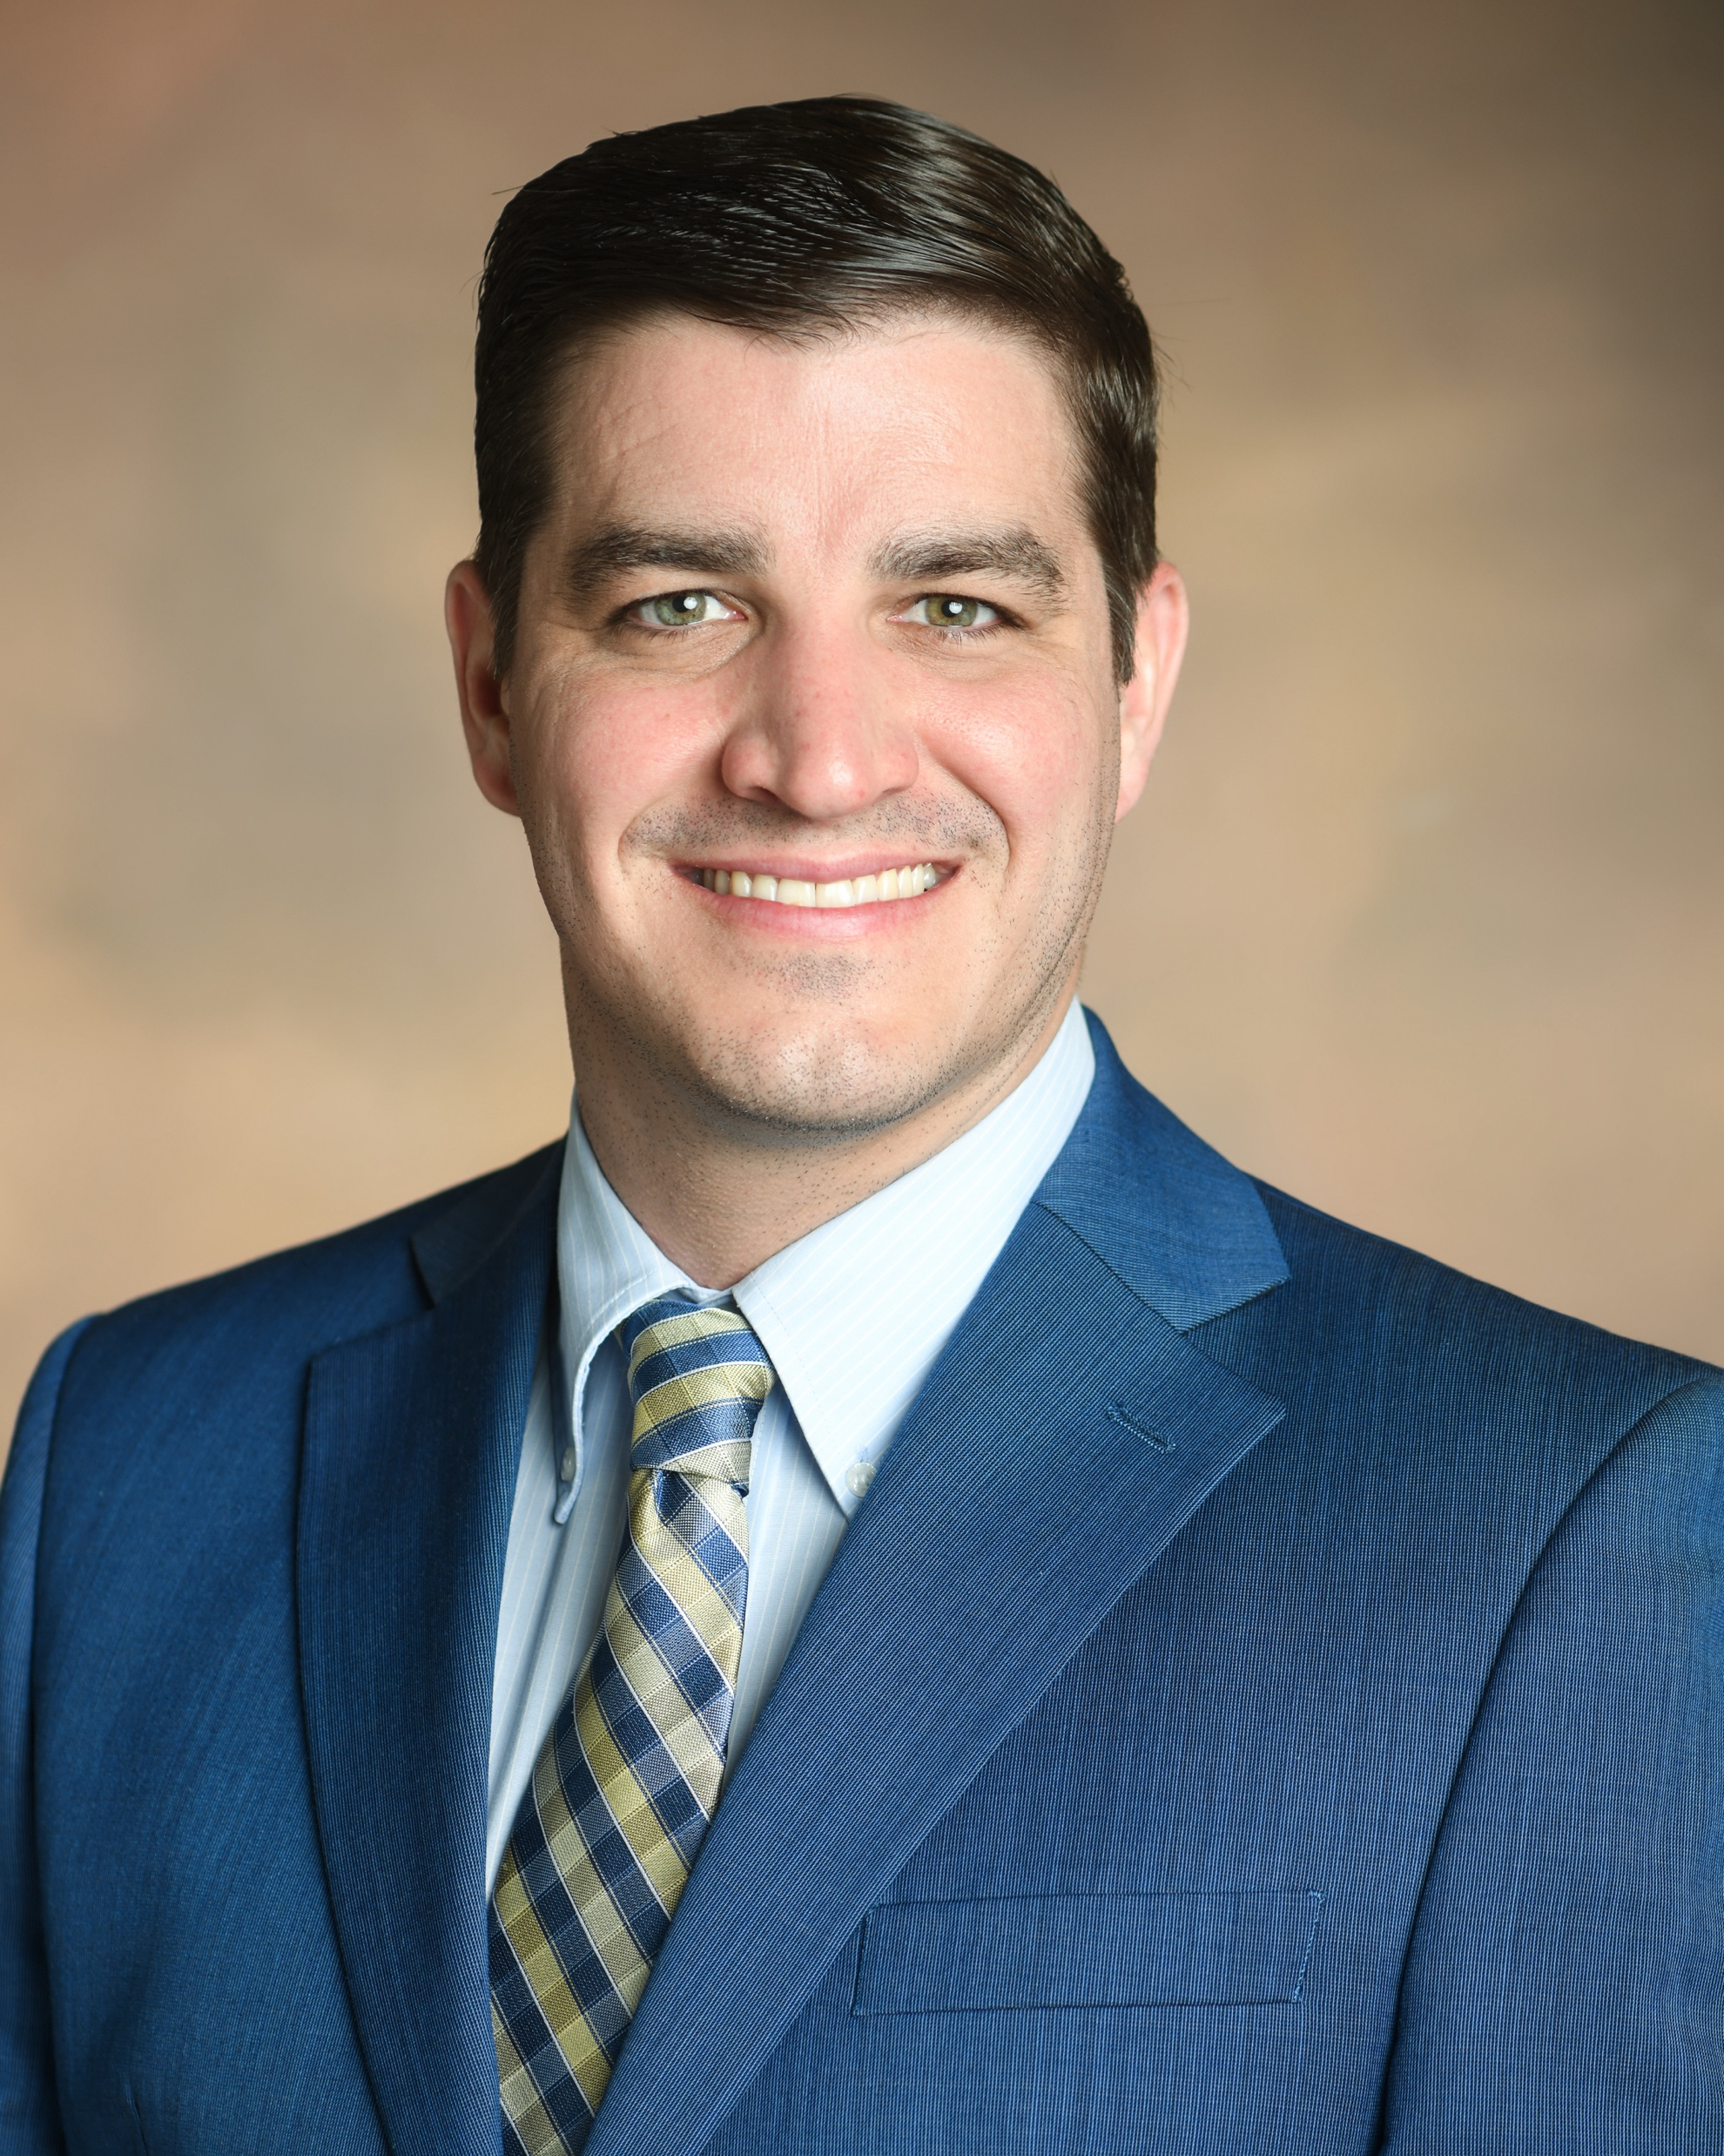
Washington, DC—Fall 2025
Symposium Title | Symposium Organizer
The Herman Mark Award | Toby Nelson/TBD
Overberger International Prize | Toby Nelson/TBD
Industrial Polymer Scientist Award | Toby Nelson/TBD
Henkel Award for Outstanding Graduate Research in Polymer Science & Engineering | Toby Nelson/TBD
ACS Macro Letters/Biomacromolecules/Macromolecules Young Investigator Award | Toby Nelson/TBD
Industrial Innovations in Polymer Science | TBD
General Topics: New Synthesis and Characterization of Polymers | TBD
CME-NASA Symposium | TBD
Conjugated Polymers: Past, Present, and Future | Wei You, Barry Thompson, Christine Luscombe
Polymers for Defense Applications: Sustainable, Adaptable, and Functional | Alice Savage, Timothy Pruyn, Peter Zarras, Dawanne Poree, Jessica Cash, Robert Lambeth
Recruiting Symposia & Organizers!
Graham Collier
graham.collier@usm.edu

Slide 12
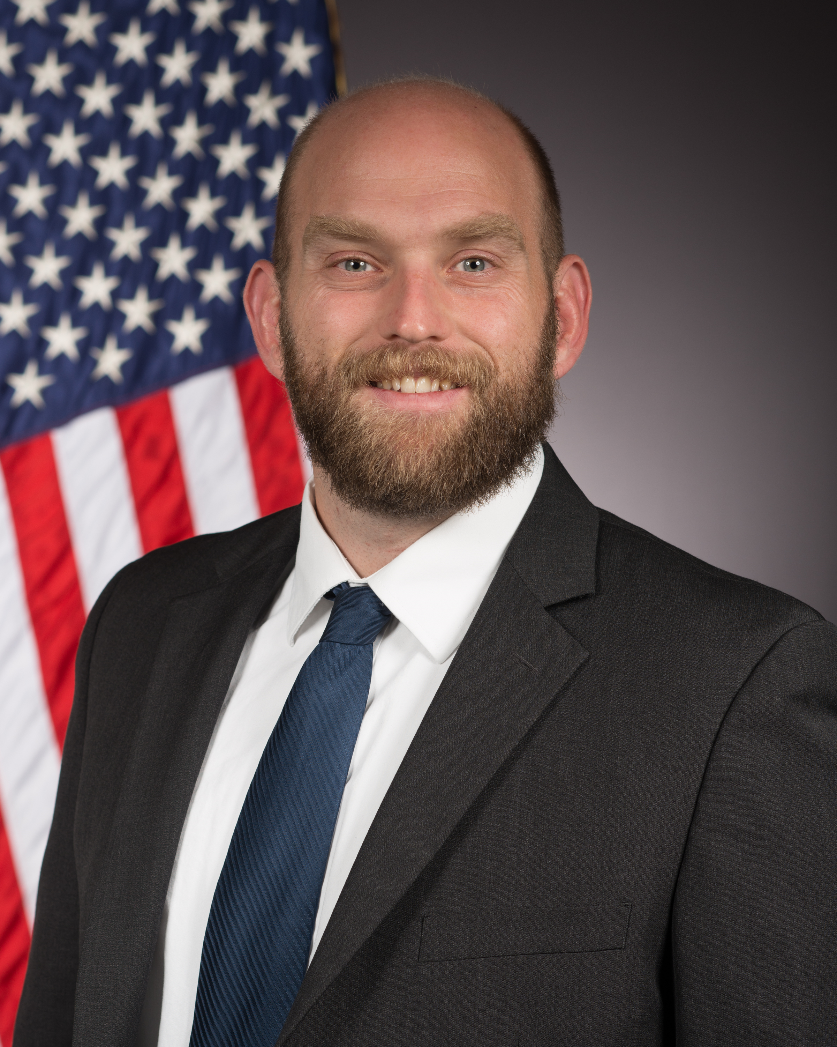

POLY Programming Team Rotation
Date (Location) | Levi Moore AFRL | Danniebelle Haase Dow | Julia Kalow Northwestern | Graham Collier USM | You?
Spring 2022 (San Diego) | LEAD | SHADOW
Fall 2022(Chicago) | SUPPORT | SUPPORT
Spring 2023 (Indianapolis) | SUPPORT | LEAD | SHADOW
Fall 2023 (San Francisco) | SUPPORT | SUPPORT | SHADOW
Spring 2024 (New Orleans) | LEAD | SUPPORT | SUPPORT
Fall 2024 (Denver) | CONSULT | LEAD | SUPPORT | SHADOW
Spring 2025 (San Diego) |  | CONSULT | LEAD | SUPPORT | SHADOW
Fall 2025 (Washington, DC) |  | CONSULT | SUPPORT | LEAD | SUPPORT

Slide 13
Team Composition
Balance of industry/academia/government
Sara completed her term at the end of 2023
THANK YOU SO MUCH!!!
Actively recruiting a new programming chair
Dawanee will identify a new program chair
POLY Program Committee Chair Rotation:
2024 – Levi
2025 – Danniebelle
2026 – Julia
2027 – Graham

Slide 14
New/Continuing Initiatives
Knowledge continuity in business office/ program chair liaison (Thanks Kathy!) & with ExComm (2024, Laura Stratton)
Programming event to thank current organizers, reporting out on Programming, and recruiting new organizers
Recognition paths
Reporting paths
Recruitment paths
Programming Workshop of Best Practices – July 2023; Learnings to be summarized in a document (In progress)
Continuing discussions & initiatives regarding DEIR in POLY Programming

Slide 15
POLY Programming Workshop
Discussion Phase: gather best practices of several past program chairs (PC)
Questions discussed at workshop:
What works well in POLY programming?
What can be improved? What’s not working?
What are some ideas you have that would help POLY innovate with regards to programming?
What would have been helpful for you to know as a new program chair that you’d want to share with future program chairs?
What were some of the best technical symposia that you programmed? Why were they successful?
What have you observed makes the community eager to present in POLY? What helps motivate you to present? What helps students and early career chemists present?
Special topic on innovation within general topics symposia
Findings and best practices will be summarized in growing POLY Program Chair Guidebook - an ongoing document summarizing findings of workshop and addition input by champions

Slide 16
Future of Meetings - 2025
Division/ Program Area | Proposed Total Assignments Beginning Spring 2025 (4.5 days) - Based on Session Averages from 2016-2023. Sessions from Sunday - Thursday |  |  |  |  |  | Proposed Total Assignments Beginning Fall 2025 (3.5 days) - Based on Session Averages from 2016-2023. Sessions from Monday - Thursday
 | Proposed Total # of 1/2 day Sessions per Division | # Non Joint Sessions per Division (from total #) | # of Required Joint Sessions per Division -(from Total #) Goal is 8% | Max Hybrid/Digital Experience per Division (from Total #) - Goal is 5% | *Max Session Rooms/ Constructed Rooms based on 4.5 days (per Division) |  | Proposed Total # of 1/2 day Sessions per Division | # Non Joint Sessions per Division (from total #) | # of Required Joint Sessions per Division (from Total #) - Goal is 10% | Max Hybrid/ Digital Experience Sessions per Division (from Total #) - Goal is 25% | *Max Session Rooms/ Constructed Rooms based on 3.5 days (per Division)
POLY | 53 | 49 | 4 | 3 | 6 |  | 36 | 32 | 4 | 9 | 5
Shift to a more concentrated footprint and 3.5 days of programming (NO Sunday Tech Programming)
Total HDS for Fall 2025 reduced to 595 at the Washington, DC meeting
The Spring Meetings will remain similar in size to what ACS has typically offered

Slide 17
Future of Meetings – Features of Meetings in 2025 and Beyond
Reduced session allotments
More joint programming is an expectation
Joint Programming Detail Intake Form required; Structure to be refined
How should award sessions be handled?
Working group established
No hydrid meetings (In-Person or Global Sessions only)
Enhanced/Integrated poster sessions
Innovative Sessions

Slide 18
Future of Meetings – Features at Fall 2024 Denver
Five Innovative Sessions (Different formats – live polling, interactive features during talks, industry focus and policy related)
Integrated poster pilot (Sunday)
Escape room pilot
Hybrid Session format
Pre-record/upload eliminated
Poster sessions are in-person only

Slide 19
Voting Items & Items for Evaluation
(Voting) Organizer recognition/retention proposals:
Continuing Resolution on proposal to continue to produce and distribute “POLY National Meeting Symposium Organizer” recognition pins and organizational “care packages” to organizers as a method of recognition and retention
(Consideration) Programming Recruitment Funding: With a reduced meeting footprint, what is the appropriate level of financial support?
For pins, bags/supplies, and postage
Coffee/happy hour programming meetings to recruit organizers
ACS foresees virtual component to meetings long-term
Notes:
$12k penciled into Christine’s budget
(no postage if in person, )

Slide 21
Thank you!
Questions?

