Slide 1


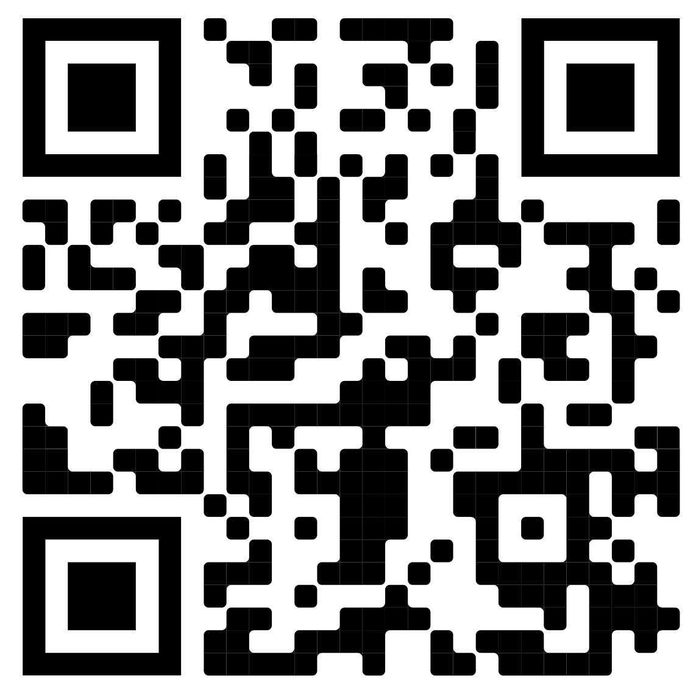
JOIN POLY TODAY
1st Year Membership
FREE
The Division of Polymer Chemistry, Inc., (POLY) is a diverse community of scientists and engineers from academia, industry, and government, as well as fans and supporters of polymers.
Mission: Advance the broader polymer enterprise and its practitioners to meet the global challenges of today and the future.
Vision: Be the premier professional organization promoting polymer science and its value to society.

Slide 2
POLY Programming
Coffee Hour
POLY Programming Committee
Fall 2022 Meeting

Slide 3
Overview
General Programming Updates-Sara (Programming Committee Chair)
POLY Technical Programming:
  Reporting- Levi (2021)
  Recognition- Rob (Fall 2022)
  Recruitment- Danniebelle (Spring 2023) & Sara (Fall 2023)
Collaborations with PMSE/BIOT
Nomination (ask Semra/Allan – if this is ok to solicit new volunteers) new programming chairs
Special thanks to Kathy!

Slide 4
POLY Programming
Timeline for symposia planning
  Typically planning 1 to 1.5 years in advance
  Indianapolis meeting abstracts open
  Soliciting proposals for San Francisco & New Orleans
    https://polyacs.org/symposium-proposal-online-form/
    SF theme is “Harnessing the Power of Data”
    Deadlines have been shifting, so check the live ACS website
    Model is coach (Programing Chair) and players (Symposium Organizers) working together
    Coach’s job is to help you with ACS broadly- come ask us for help directly!
  Next meetings: Indianapolis Spring 2023, San Francisco Fall 2023, New Orleans Spring 2024

Slide 5
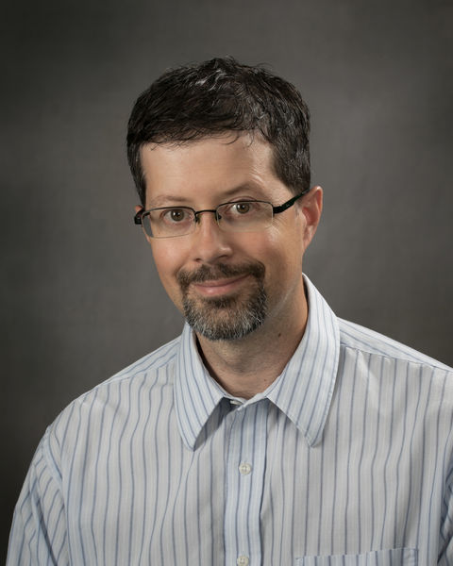
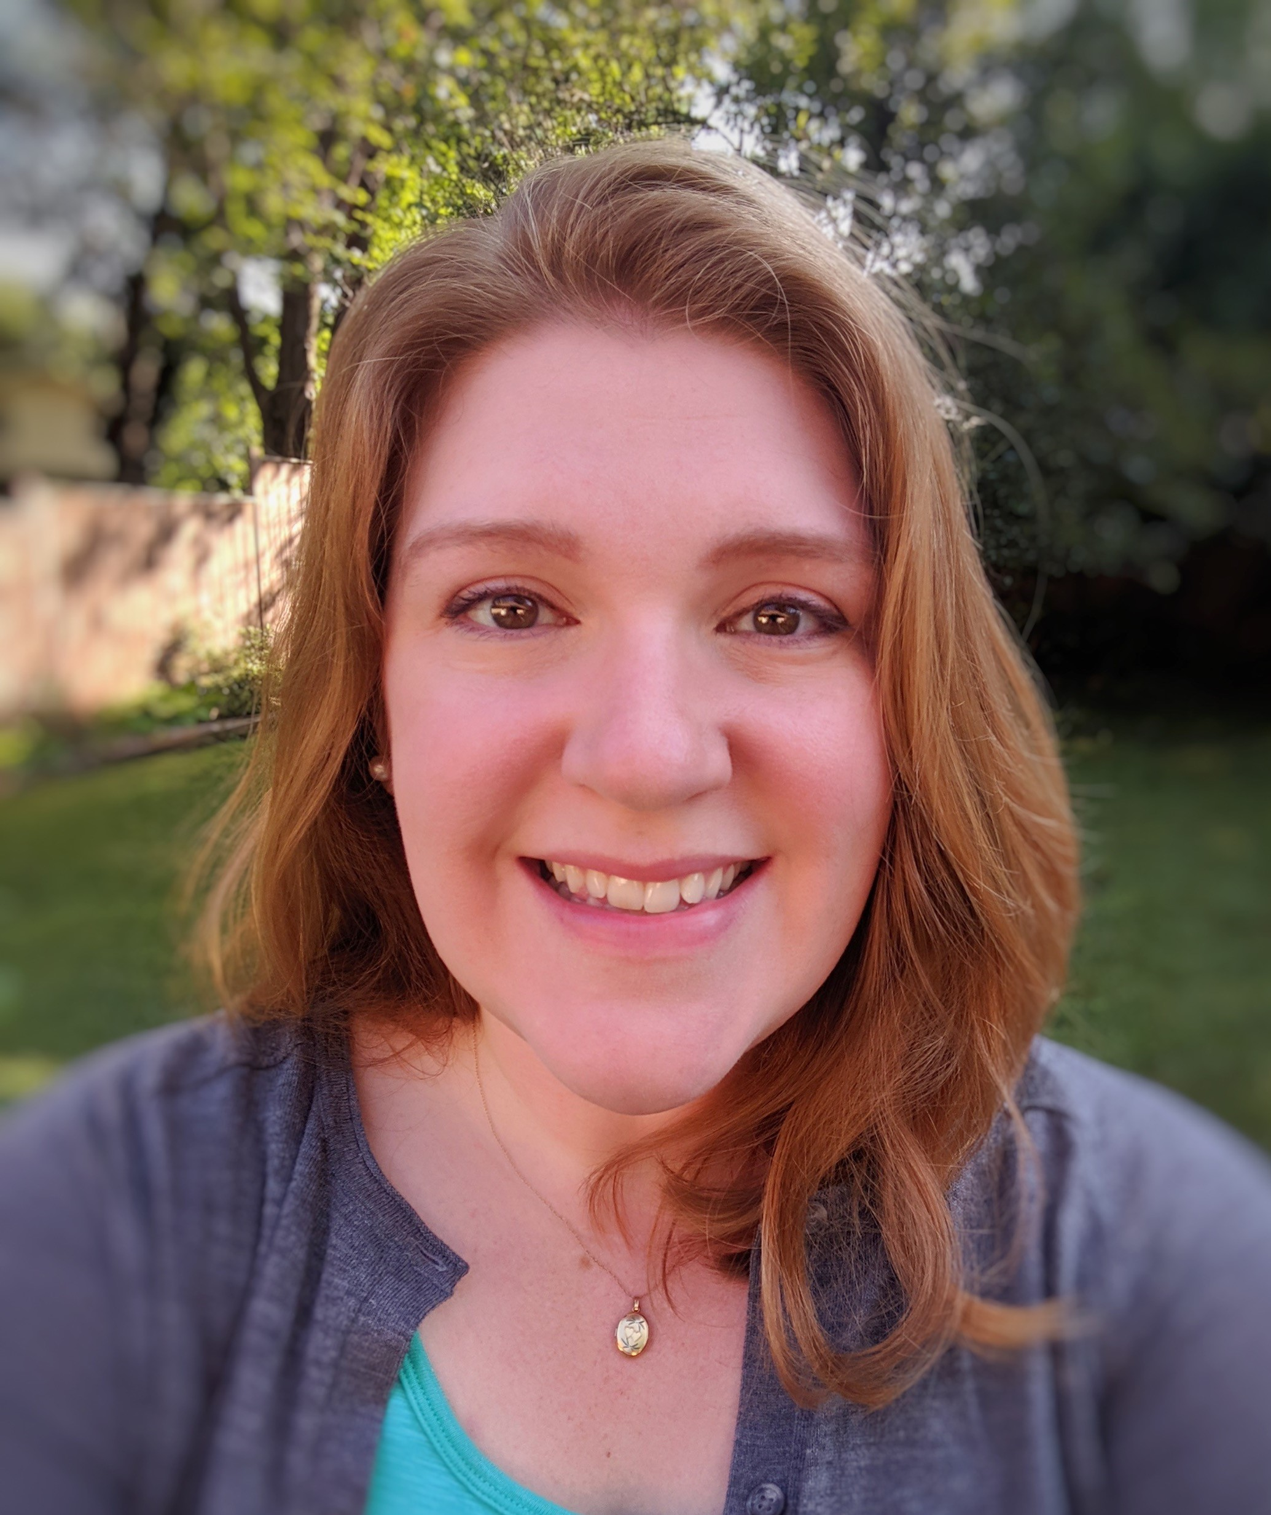
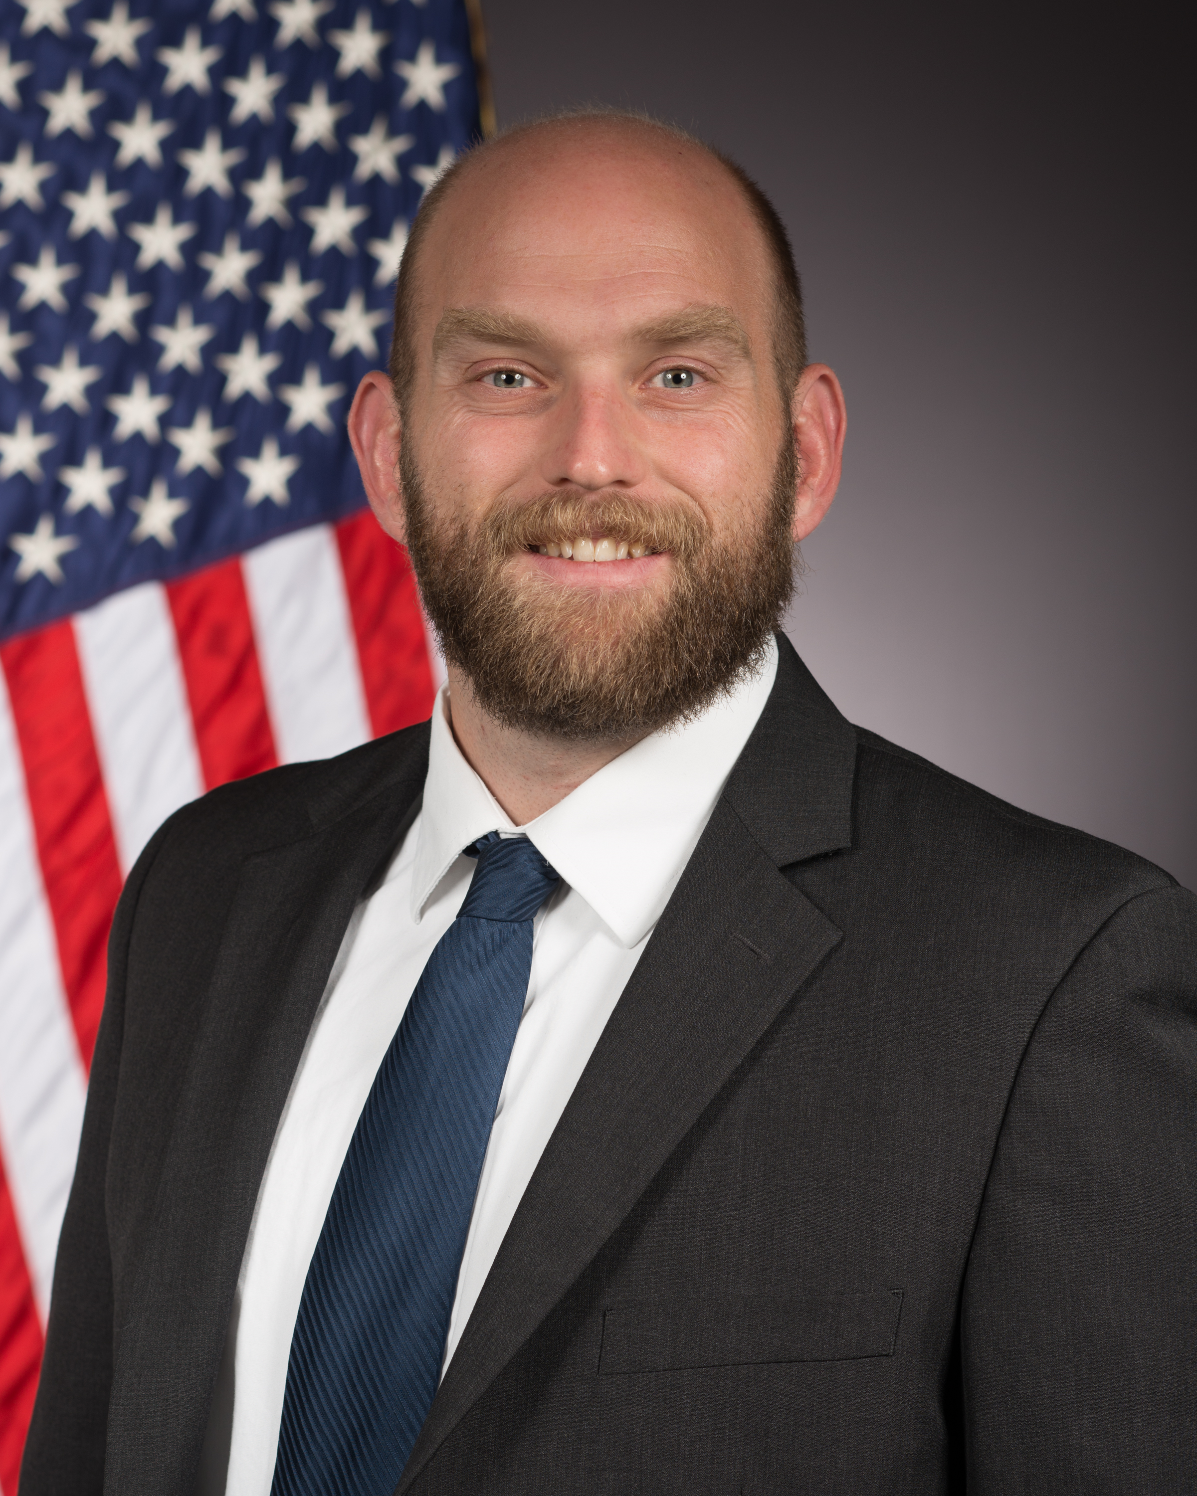
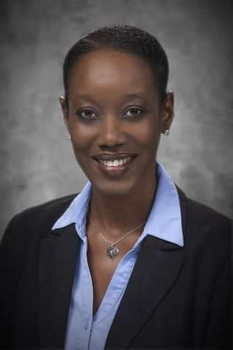

POLY Program Chairs Rotation Schedule
Date (Location) | Rob Mathers Penn State | Sara Orski NIST | Levi Moore AFRL | Danniebelle Haase Dow | New Program Chair (any sector, Q4 2022)
Spring 2022 (San Diego) | SUPPORT | SUPPORT, Chair | LEAD | SHADOW
Fall 2022(Chicago) | LEAD | SUPPORT, Chair | SUPPORT | SUPPORT
Spring 2023 (Indianapolis) | SUPPORT | SUPPORT | SUPPORT | LEAD | SHADOW
Fall 2023 (San Francisco) | SUPPORT | LEAD | SUPPORT | SUPPORT | SUPPORT
Spring 2024 (New Orleans) |  |  | SUPPORT | SUPPORT | LEAD

Slide 6
Team Composition
  POLY Program Committee Chair Rotation:
    2022 – Sara
    2023 – Rob
    2024 – Levi
    2025 – Danniebelle
  Recruiting 2 additional program chairs: Fall 2022 start (any sector) & Spring/Summer 2023 start (academic)
  4 Program Chairs – rotation/training model:
    Allows sector representation with flexibility
    Always industry, academia, & government + flex

Slide 7
2022 Spring Review and Report Summary
Spring National Attendance values for POLY → 551 total registrants
Spring Contributions from POLY
  POLY meeting presentation final presentation counts:
    121 Hybrid oral presentations
    39 Virtual oral presentations
    168 in-person oral presentations
    10 Virtual poster presentation
    125 in-person poster presentations
    463 POLY member presentations
The new allocation formula: meeting portion of the formula is based on division member registrations at the spring and fall meetings.
Important new factor for divisions: during this period is to attract division members to the meetings (virtual or in person registration) with programming and sign-up new division members attending the national meetings.
Notes:
(### % of total)
Presentation numbers will not affect the amount directly. The allocation formula for 2020 (sent in 2021) was calculated by using average data pre pandemic. The ACS Board also supplemented it by an extra amount but just for last year. The new allocation formula for 2021 (will be sent April),passed by Council, does not rely on presentation numbers or self reported oral session attendance.
The meeting portion of the formula is based on division member registrations at the spring and fall meetings. This is something that can be objectively and reliably counted even with the changing and mixed virtual and in person posters and presentations we have now at meetings. The important new factor for divisions during this period is to attract division members to the meetings (virtual or in person registration) with programming and sign up new division members attending the national meetings. This will exist until DAC proposes a new formula to Council. Kevin

Slide 8
Contributions

Slide 9

Recognizing Organizers
Organizer Pins and Care Packages well received and will continue in 2022.
  Come pick up at POLY desk if in San Diego
  Reach out to Kathy (kathyl@vt.edu) if you won’t be in Chicago and want yours mailed to you
Recognition of organizers with slide at POLY/ PMSE plenary and awards ceremony Wednesday evening.
Thank you to organizers and presiders for your time and efforts for POLY symposia!!!

Slide 10
Chicago – Fall 2022 (Aug 21-25)
Symposium Title | Symposium Organizers
General Topics: New Synthesis and Characterization of Polymers | Yongfu Li, Ferenc Horkay
Industrial Innovations in Polymer Science | Hayley Brown, Michael Petr, Daniel Abede
ACS Macro Letters/Biomacromolecule/Macromolecules Young Investigator | Paulomi Majumder, Jitesh Soares
Industrial Polymer Scientist Award in honor of Margaret (Peggy) Sheridan | Brett Krull, Cristina Thomas
2022 Mark Scholar Young Award in honor of Zachary Hudson | Hayley Brown
2022 Mark Scholar Award in honor of Kate Beers | Eric Lin, Chris Stafford, Chris Soles (NIST)
2022 Mark Scholar Senior Award in honor of Marc Hillmyer | Tim Lodge
2022 ACS Award in Applied Polymer Science in honor of Prof. Richard Kaner (PMSE session/POLY co-sponsored) | Prof. John Reynolds, Prof. Yue Wang
Next-generation synthesis and structure for pi-conjugated polymers | Nag Gavvalapalli
Green Polymer Chemistry and Sustainability | HN Cheng, Richard Gross
Dynamic Covalent and Supramolecular Polymer Networks | Svetlana Morozova
Characterization of Sustainable Polymers | Yujing Tan (ytan@dow.com)
Federally Funded Research for Polymer Circularity | Kate Peretti (DOE), Kate Beers (NIST), Christy Payne (NSF)
Circular Economy of Polymers | Dimitris Collias, (P&G) James Martin, Yujing Tan
Design of Polymers Toward Upcycling | Tomonori Saito, Brent Summerlin, Julia Kalow
Meeting Theme: Sustainability in a Changing World

Slide 11

Thank You – POLY Session Organizers
ACS Division of
Polymer Chemistry
Daniel Abebe
Kathryn Beers
Hayley Brown
H.N. Cheng
Dimitris Collias
Piril Ertem
Yanli Feng
Derek Gates
Nagarjuna Gavvalapalli
Richard Gross
Ferenc Horkay
Zachary Hudson
Martin James
Julia Kalow
Brett Krull
Yongfu Li
Eric Lin
Shiyong Liu
Timothy Lodge
Paulomi Majumder
David Meunier
Svetlana Morozova
Christina Payne
Kathryn Peretti
Michael Petr
Ralm Ricarte
Tomonori Saito
Jitesh Soares
Christopher Soles
Christopher Stafford
Brent Sumerlin
Yujing Tan
Jia Tang
J. Tovar
Cristina Urdaneta Thomas
Chunxiao Zheng
Programming Team
Lead: Robert Mathers
Danniebelle Haase
Sara Orski
Levi Moore

Slide 12
JOIN POLY TODAY
1st Year Membership
FREE
The Division of Polymer Chemistry, Inc., (POLY) is a diverse community of scientists and engineers from academia, industry, and government, as well as fans and supporters of polymers.
Mission: Advance the broader polymer enterprise and its practitioners to meet the global challenges of today and the future.
Vision: Be the premier professional organization promoting polymer science and its value to society.

Slide 13
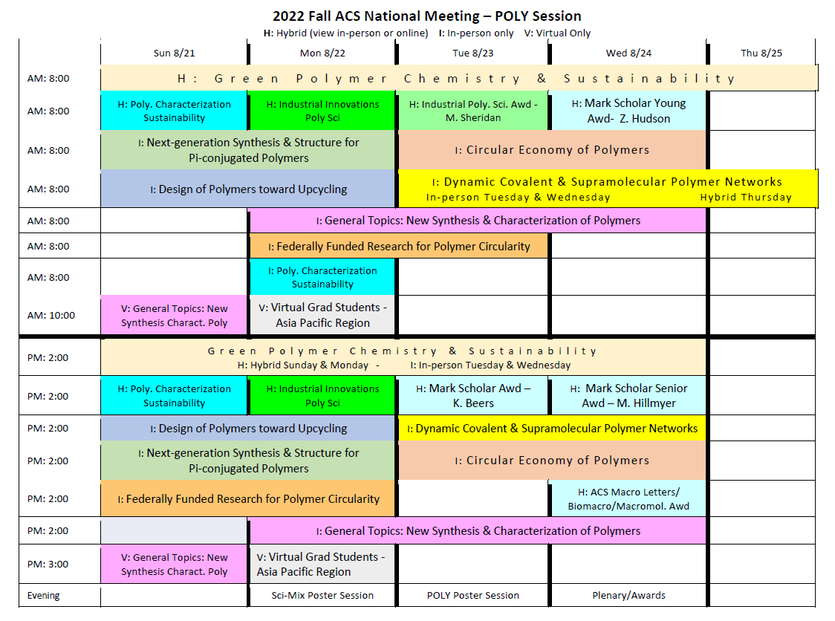
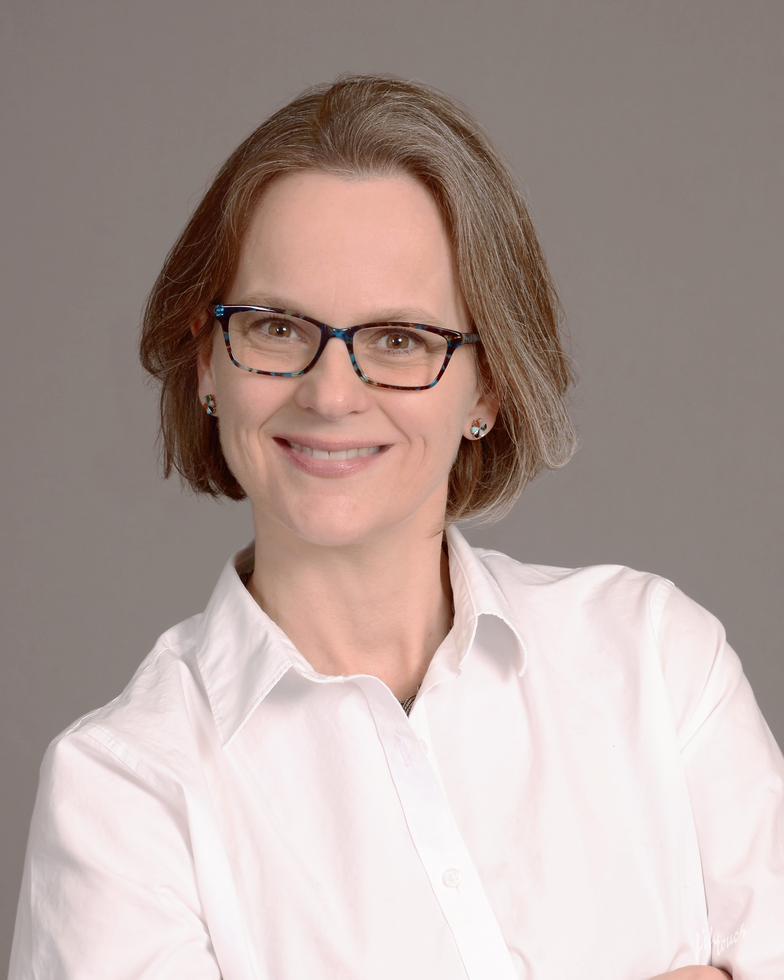
Chicago Grid
Posters:
Monday – Sci Mix
Tuesday – POLY/PMSE
Awards and Plenary: Wednesday
Speaker:
Dr. Kathryn Beers

Slide 14
Indianapolis – Spring 2023
Symposium Title | Symposium Organizer
ACS Award (will know Fall 2022 if any awardees from POLY)
Industrial Innovations in Polymer Science | Michael Minkler, Ashleigh Dahlstrom, Wenjun Wu
General Topics: The Intersection of Inorganic and Polymer Chemistry | Li, Horkay
General Topics: New Concepts in Polymer Chemistry | Li, Horkay
General Topics: Crosslinked and Linear Polymers | Li, Horkay
General Topics: New Synthesis and Characterization of Polymers | Li, Horkay
Undergraduate Research in Polymer Science | Sarah Morgan, Sergei Nazarenko, Heather Broadhead
Carl S Marvel Award for Creative Polymer Chemistry | Kathy Mitchem, Danniebelle Haase
Excellence in Graduate Polymer Research | Christine Coltrain, Jeffrey Self, Chris Ellison, Timothy Long (Others TBD)
Large Polymers the Size of Small Polymers | Julia Pribyl Ham, Matt Golder, Yutan Getzler, AJ Boydston
Crossroads of Polymer, Composite, and Sustainable Energy | Wei Gao, Jingbo Liu, Yunlong Zhang, Marinda Wu
Advances in Biomass-based Biodegradable Polymers | Hoyong Chung
Challenges and Opportunities in Semiconducting Polymers | Jianguo Mei
Polymers at the Interface of Biology | Tim Deming, Jessica R Kramer, Harm Anton Klok, Colin Bonduelle
Imaging Biopolymers and Biological Assemblies in Living Systems | Yan Yu, ‪Jiajie Diao
Polymers at the Crossroads: Molecular Circularity by Design | Eric Cochran, Dhananjay Dileep, Erik Hagberg
Polymer Dynamics across Multiple Length and Time Scales | Lisa Hall, Joshua Sangoro
Polymer Science of Everyday Things | Danniebelle Haase
Meeting Theme: Crossroads of Chemistry
Coordinating with PMSE and BIOT at this meeting:
co-locating request & co-sponsorship/advertising of related symposia
Notes:
Not too many repeats
What is the pipeline coming in for future meetings?
Plenary Speaker – Deadline by Fall 2022 to have in abstracts by the time MAPS closes
Our symposium titled “Large Polymers the Size of Small Polymers” is a comical description of polymer topologies that result in large macromolecules occupying small hydrodynamic volumes. We expect symposium participants will detail cutting edge synthetic strategies to achieve these unique topologies, as well as the characterization methods and physical properties. Discussion about the challenges of synthesis and characterization and the potential applications of these materials is expected.

Slide 15
San Francisco – Fall 2023
Meeting Theme: Harnessing the Power of Data
Symposium Title | Symposium Organizer
Industrial Innovations in Polymer Science | Brown, Lipscomb
General Topics: New Synthesis and Characterization of Polymers | Li, Horkay
Undergraduate Research in Polymer Science | TBD
Henkel Outstanding Graduate Research Award | TBD
Overberger International Prize | TBD
The Herman Mark Award | TBD
Biomacromolecules / Macromolecules | TBD
Young Industrial Polymer Scientists Award (YIPS) | TBD
Computational Strategies for Biological Materials Discovery | Lipscomb, Bishop
Polymer Mechanochemistry | Harm-Anton Klok, Robert Göstl, Jeff Moore, Andreas Herrmann
High-throughput and data-driven approaches to next generation macromolecular materials | Abigail Knight, Adam Gormley
Biorelated Polymers (honoring Dr. Ray Ottenbrite’s contributions to POLY and biopolymer research) | Carmen Scholz, Joerg Kressler, Kathryn Uhrich, Stefanie Sydlik
Polymers for Defense Applications | Alice Savage, Peter Zarras, Timothy Pruyn, Dawanne Poree, Alexander Lonnecker
We are currently soliciting additional ideas for SF symposia –
We’re looking for enthusiastic organizers (novice and veteran) to organize around the theme and other relevant topics in our community!
Notes:
The synthetic polymer community is beginning to harness the power of data with high-throughput experimentation to develop next generation materials. In this symposium, we aim to bring together computation and experimental experts to discuss how data science can be used to unlock unique material properties for a variety of applications.
What is the pipeline coming in for future meetings?
Plenary Speaker – Deadline by Fall 2022 to have in abstracts by the time MAPS closes
Our symposium titled “Large Polymers the Size of Small Polymers” is a comical description of polymer topologies that result in large macromolecules occupying small hydrodynamic volumes. We expect symposium participants will detail cutting edge synthetic strategies to achieve these unique topologies, as well as the characterization methods and physical properties. Discussion about the challenges of synthesis and characterization and the potential applications of these materials is expected.

Slide 16
Helpful Links and More Information
https://polyacs.org/symposium-proposal-online-form/
https://polyacs.org/wp-content/uploads/2018/07/Guidelines-for-symposia-organizers-and-chairs.pdf
https://www.acs.org/content/acs/en/membership-and-networks/td/manuals/future-meeting-deadlines.html
https://www.acs.org/content/acs/en/meetings/programming-resources/symposia-organizers.html

Slide 17
For POLY business meeting portion only

Slide 18
Indy Coordination with PMSE & BIOT
Letter drafted from POLY, PMSE, BIOT Chairs requesting shared hotel space for Indianapolis symposia – please review and send immediately after Chicago meeting to request with ACS
Discussion of overlapping program areas and nominal co-sponsorship of symposia (2 in each division)
cross-advertising = expand member attendees & remain consistent with division messaging
POLY
Polymer Colloids: Synthesis, Analysis, Modeling & Application
Polymers at the Interface of Biology
PMSE
Dynamically Bonded Materials: Advances in Synthesis, Characterization, and Application
Engineered Living Materials Through Synthetic Biology: Beyond the Crossroad of Biology and Chemistry
BIOT
Bomolecular and biophysical materials
BIOT spotlight: biopolymers & sustainability

Slide 19
Concepts to Support Diversity in Organizers/Presenters in POLY
  Programming Team Would like to Continue DEIR Efforts in 2022 by:
  Conducting a listening session Oct 2022– understand perspective and needs of our membership, build rapport with member stakeholders, summarize key learnings and concerns for POLY leadership
  Progress:
    Reached out to NIST acting DEIR director about feedback on plans – agreed to review survey, meeting discussion plans to look for any blind spots
    Research on putting together survey for seed questions and time to meet (virtually in October 2022) – Schusterman foundation guidelines for DEI data collection (https://tinyurl.com/2p8zedb6)
    summary of key learnings & recommendations to POLY ExComm at Winter Meeting
    GOALS:
        add and support successful diversity efforts in the division
        determine best course of action to expand POLY efforts that will foster scientific and member engagement
        foster additional membership within POLY
Notes:
honorees for initial with member stakeholders
and building rapport
to represent the perspective and needs of our membership

