Slide 1

POLY Workshops
Beth Elacqua: Workshop Chair
Committee: Gobet Advincula, Mike Hickner, Helen Tran, Jena McCollum, Rakesh Nambiar, and Yongping Zha

Slide 2
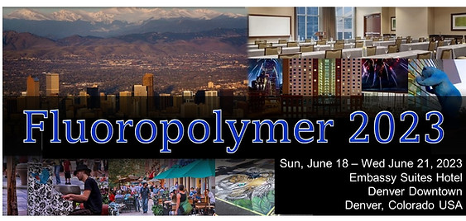
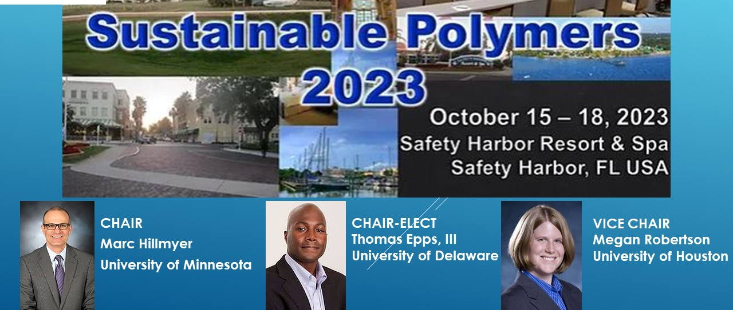
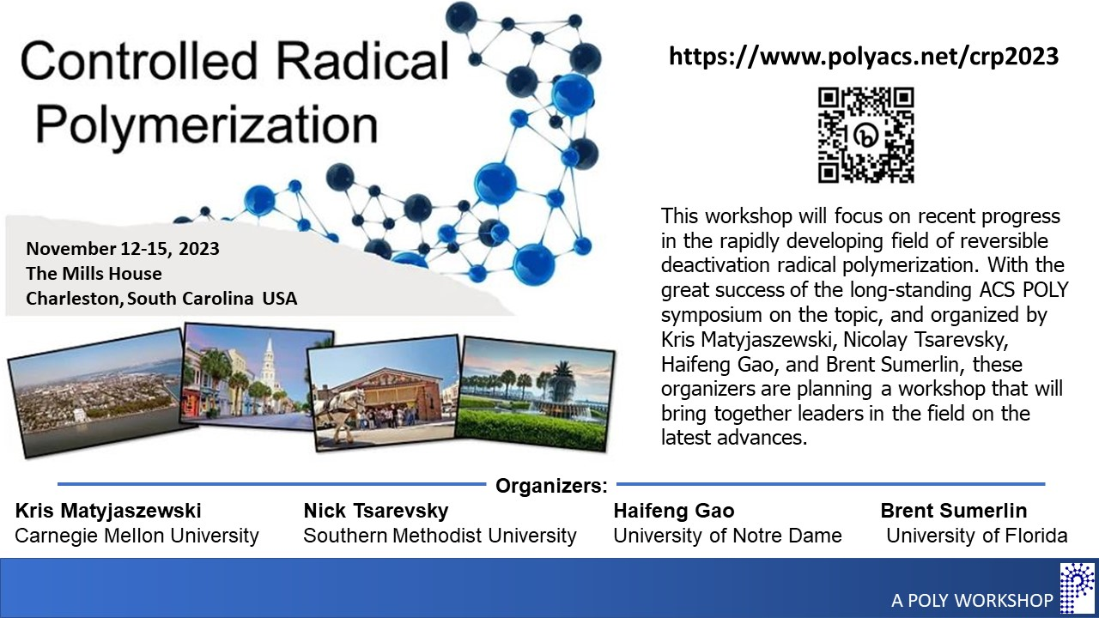
2023 POLY Workshops
87 Total Attendees 35 Speakers 18+ Posters 9 Sponsors | Budget Overview: $62,972 Income $62,637 Expenses (including 15k Admin Fee) $335 Meeting Gains Donated to POLY
Organizers:
Scott Iacono, US Air Force Academy
Bruno Ameduri, Charles Gerhardt Inst.
Jenna McCullum, University of Colorado
81 Total Attendees 32 Speakers 35 Posters 12 Sponsors | Budget Overview: $76,848 Income $67,145 Expenses (including15k Admin Fee) $9,703 Meeting Gains Donated to POLY
Kris Matyjaszewski
Carnegie Mellon Univ.
Nick Tsarevsky
Southern Methodist Univ.
Haifeng Gao
Corteva AgriScience
Brent Sumerlin
Univ. of Florida
76 Total Attendees 35 Speakers 26 Posters 4 Sponsors | Budget Overview: $60,150 Income $63,510 Expenses (including 15k Admin Fee) $-3,360 Meeting Gains donated to POLY
Notes:
Fluoropolymers
This fall a $1000 sponsor payment came in which we had given up on.
Hotel sent an unexpected refund $572

Slide 3
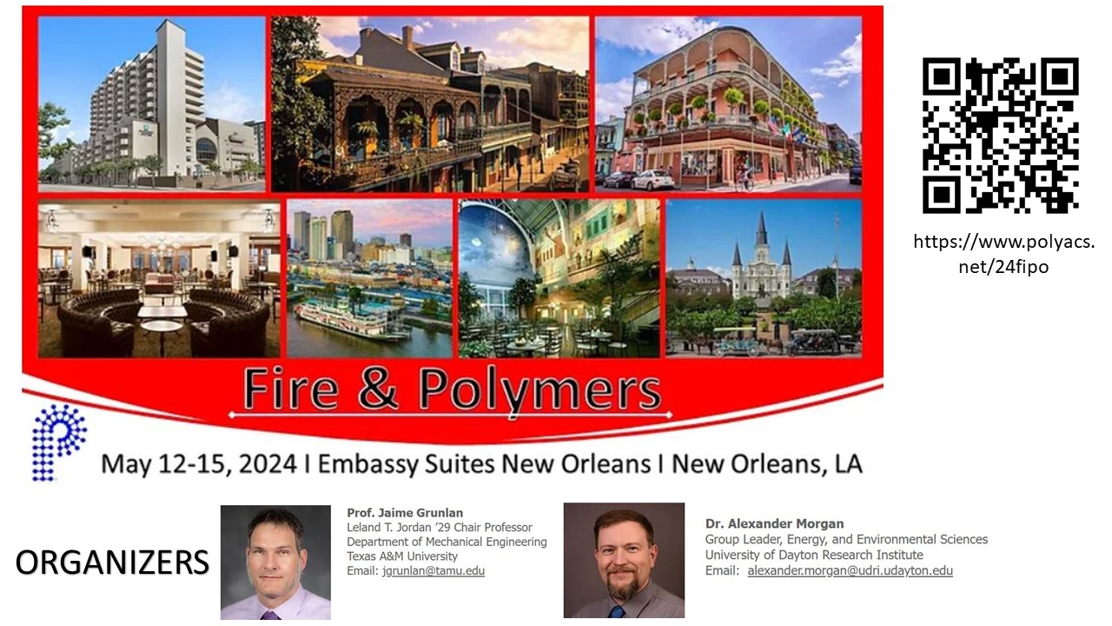
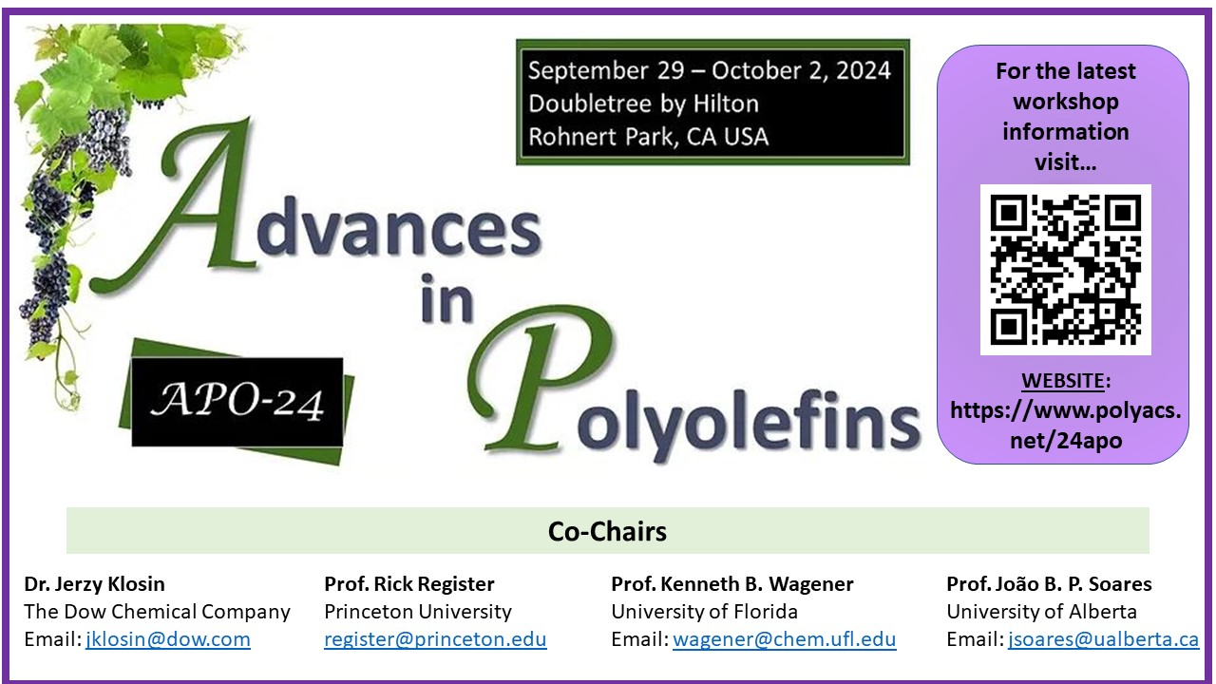

2024 POLY Workshops
Fire & Polymers
July 11-12, 2024 Northwestern University Evanston, IL, USA Organizers: J. Kalow, J. Alty, H. Tran, S. Alexander,
S. Orski, and K. Houston
(POLY Office provides acs grant funds, guidance, and promotes to membership
Notes:
Kathy: are there updates on this?

Slide 4
POLY NGRPC National Graduate Research Polymer Conference
Previous Graduate Conferences
Penn State, 1994
Virginia Tech, 1996
University of Akron, 1998
Southern Mississippi Univ., 2000
Lehigh, 2003
UMASS, 2005
UT Knoxville, 2007
Univ. of NC at Chapel Hill, 2010
Case Western Reserve Univ., 2012
Louisiana State Univ., 2014
University of Akron, 2016
University of Minnesota, 2018
Virginia Tech (virtual), 2021
University of Michigan 2023
Applications were collected Fall 2024:
CONGRATULATIONS:
POLY 2025 NGRPC Winner
Arizona State University
Target date: January 2025

Slide 5
2025 POLY Workshops
NGRPC: National Graduate Research Polymer Conference Arizona State University Target date: January 2025 (POLY Office provides seed funds, guidance, and promotes to membership) | ExComm Approved
Fluoropolymers (12th Biennial POLY Workshop) June 2025 Potential Location: Savannah Org: Jena McCollum, and Dr. Bruno Ameduri, Cameron Parrish, Frank Leibfarth | ExComm Approved
Fall 2025: Proposals Collected A recommendation has been submitted to Excomm for approval A decision will be announced shortly | Proposal Ready for ExComm Review
Moving forward, POLY will hold . . .
2 Workshops Annually (reduced from 4-6)
Workshops are scheduled SPRING (May/June) or FALL (Oct/Nov)

Slide 6
FOR EXCOMM MEETING
Derek to Present

Slide 7
2025 POLY Workshops
NGRPC: National Graduate Research Polymer Conference Arizona State University Target date: January 2025 (POLY Office provides seed funds, guidance, and promotes to membership) | ExComm Approved
Fluoropolymers (12th Biennial POLY Workshop) June 2025 Potential Location: Savannah Org: Jena McCollum, and Dr. Bruno Ameduri, Cameron Parrish, Frank Leibfarth | ExComm Approved
Fall 2025 Proposals Polymers for Fuel Cells, Energy Storage, and Conversion POLY Workshop Committee recommendation for Fall 2025 solicitation Org: Hickner, Zawodzinski, and Benicewicz Target location: Napa | Proposal Ready for ExComm Review/Approval
Other: Controlled Radical Polymerization Workshop: looking to repeat in International 2025 & US 2027
Organizers (lead: Sumerlin) would like to rotate International/US/International every 2 years (2025-Bert Klumperman: Stellenbosch)
ACTION ITEM: Organizers asked if POLY would support the international meeting by providing publicity & listing it on the website. ExComm approval?

Slide 8
Thank you for your support and advice moving forward!

Slide 9
FOR WORKSHOP COMMITTEE Workshops For Further Consideration
Silicon-Containing Polymers and Composites (December 1-4, 2021)
(Had a loss in 2021, but 2021 was rough Covid timing.)
Org: Furgal & Hartmann-Thompson, 2025 would be 3 Yr Rotation
They sent in a proposal last year, Workshop Comm. approved it, and Ex-Comm asked for a reduction due to staff shortage. Joe is waiting for a reply as to “when” there’s an opening.
Polymers for Fuel Cells, Energy Storage, and Conversion (May 15 – 18, 2022)
Brian Benicewicz (Univ. SC), Tom Zawodzinski (UTK), Mike Hickner (Penn St.)
I think Brian Retired. He was the key organizer.
Polymers in Medicine and Biology (November 28 – December 1,2022)
Theresa Reineke (UMN), Buddy Ratner (Univ. Washington) - NEED NEW ORGANIZER!!
Sustainable Polymer (October 15 – 18, 2023) PROJECTED REPEAT 2026
Merged with Polymer Upcycling and Circularity
M. Hillmyer, T. Epps, M. Robertson
May merge with Upcycling – I think 2026
Controlled Radical Polymerization (November 12–15, 2023) – PROJECTED REPEAT 2027
B. Sumerlin, K. Matyjaszewski, N. Tsarevsky, H. Gao

