Slide 1
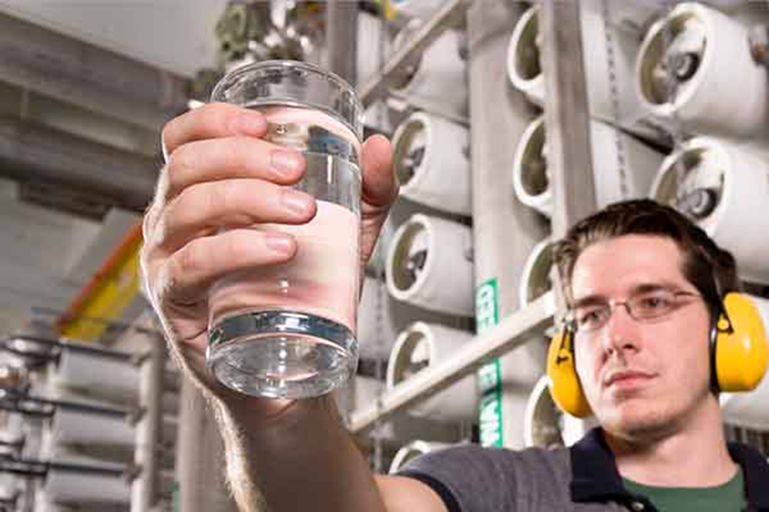

POLY Webinars: Two in 2022
Role of Polymer Science in Water Purification Membranes
Polymer Science in Defense Applications
Abhishek Roy
Senior Staff Scientist,
National Renewable Energy Laboratory
Geoffrey Geise
Associate Professor of Chemical Engineering, University of Virginia
Syed Islam
R&D Associate Staff,
Oak Ridge National Laboratory
Joseph L. Lenhart
Chief, Polymers Branch, Weapons and Materials Research Directorate,
DEVCOM Army Research Laboratory
Davide Simone
Senior Research Chemist,
Air Force Research Laboratory
Peter Zarras
Research Chemist, Naval Air Warfare Center Weapons Division
POLY / ACS webinars
529 Poly leads
> 2000 registered
93% satisfaction rate

Slide 2


POLY Webinars: Three Planned for 2023
Designing Polyelectrolyte Coatings: Coacervates, Assemblies, and Complex Materials, 1/26/2023
Polymers at the Interface of Biology, 4/13/2023
Future Webinar TBD
11/16/2023, 2-3:30pm ET
ACS webinars are
No charge to POLY Division
Jaime Grunlan
Leland T. Jordan ’29 Chair Professor
Department of Mechanical Engineering, Texas A&M University
Sarah Perry
Associate Professor
Department of Chemical Engineering, University of Massachusetts Amherst
Rong Yang (moderator)
Assistant Professor
Chemical and Biomolecular Engineering, Cornell University
Ke Zhang
Professor
Department of Chemistry and Chemical Biology Northeastern University
Matthew Becker
Hugo L. Blomquist Distinguished Professor
Department of Chemistry
Duke University
C. Adrian Figg (Moderator)
Assistant Professor
Department of Chemistry
Virginia Tech

Slide 3
First POLY/ACS Webinar in 2023 was successful!
Speakers
Jaime Grunlan
Leland T. Jordan ’29 Chair Professor
Department of Mechanical Engineering, Texas A&M University
Sarah Perry
Associate Professor
Department of Chemical Engineering, University of Massachusetts Amherst
Moderator
Rong Yang
Assistant Professor
Chemical and Biomolecular Engineering, Cornell University
POLY Leads
249

Slide 4
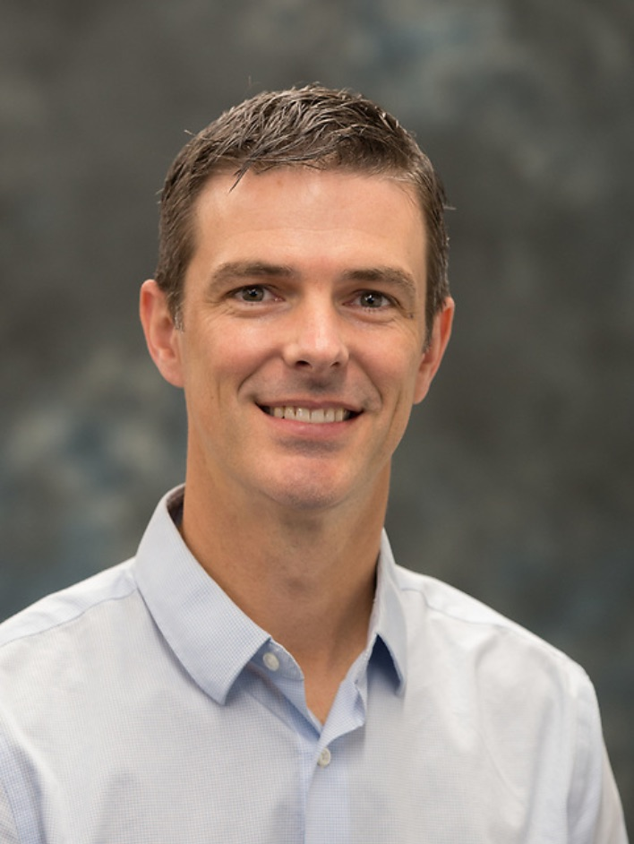
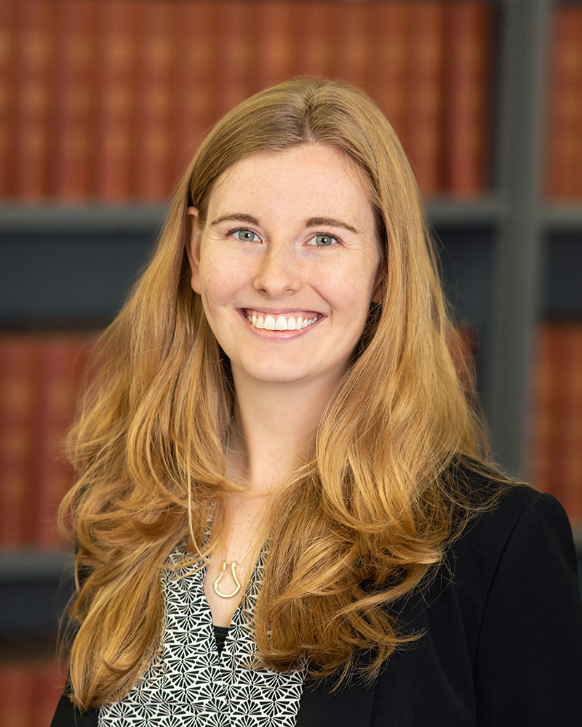
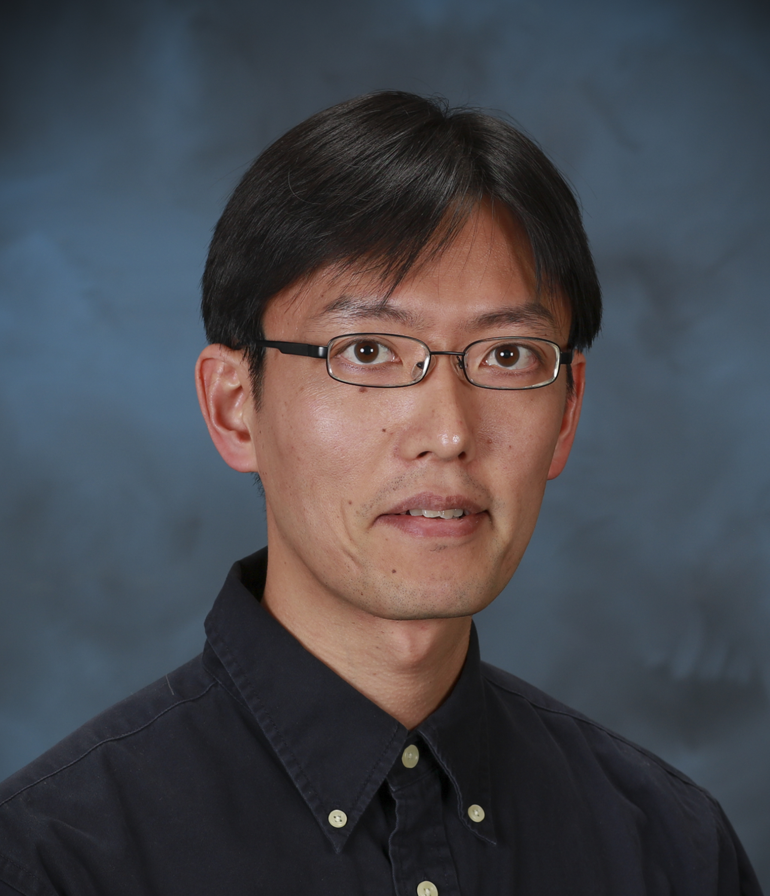

New POLY Webinar Committee
Tomonori Saito, Oak Ridge National Laboratory saitot@ornl.gov
Brent Sumerlin, University of Florida sumerlin@chem.ufl.edu
Rebecca Olson, Goodyear rebecca_olson@goodyear.com
Please send your ideas and feedback to any of us:

