Slide 1
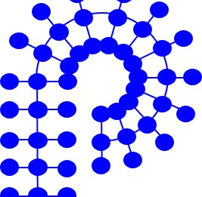
Welcome
Semra Colak Atan
2022 Chair

Slide 2
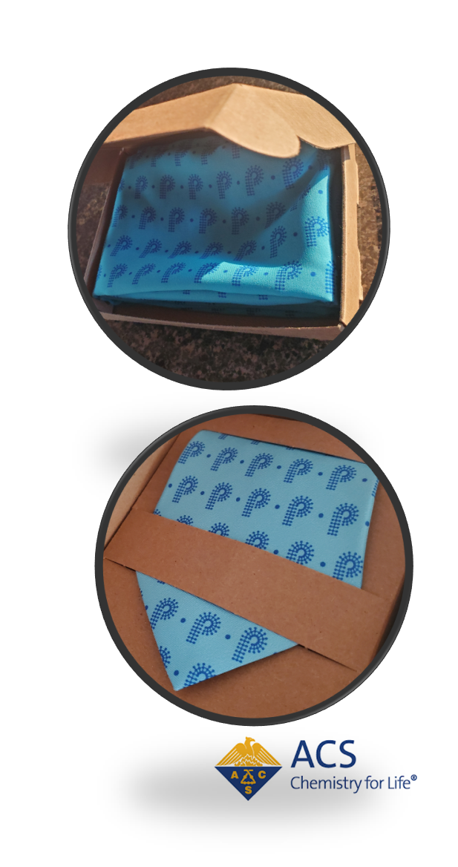


Thank You!!
Chairs Team: Andrea Kasko (Chair 2021), Allan Guymon, Dawanne Poree
Business Office: Kathy Mitchem, Lesia Pristas, Carlee Black
Programming Team: Sara Orski (Chair), Hayley Brown (Past Chair), Rob Mathers, Levi Moore, Danniebelle Haase
Treasurer: Christine Coltrain
Secretary: Erik Berda
Member-at-Large: Kat Knauer
Councilors: Kate Beers, Mary Ann, Meador, Greg Tew
Alternate Councilors: Emily Pentzer, Phil Costanzo, Wei Gao, Yoan Simon
IAB: Corinne Lipscomb (Chair), Peter Boul
Committee Chairs: Awards, Workshops, Webinars, Publicity, MACRO, Membership Committee, Student Chapters, International Relations, Regional Meetings, Nominations Committee
Dedicated Volunteers
American Chemical Society Division of Polymer Chemistry

Slide 3
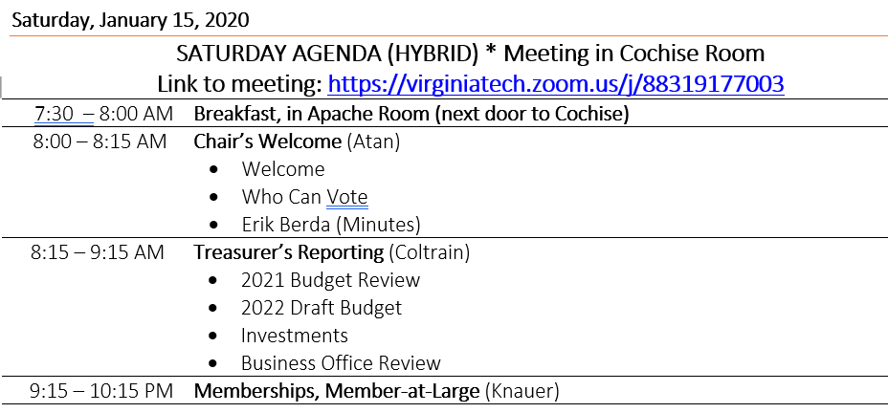
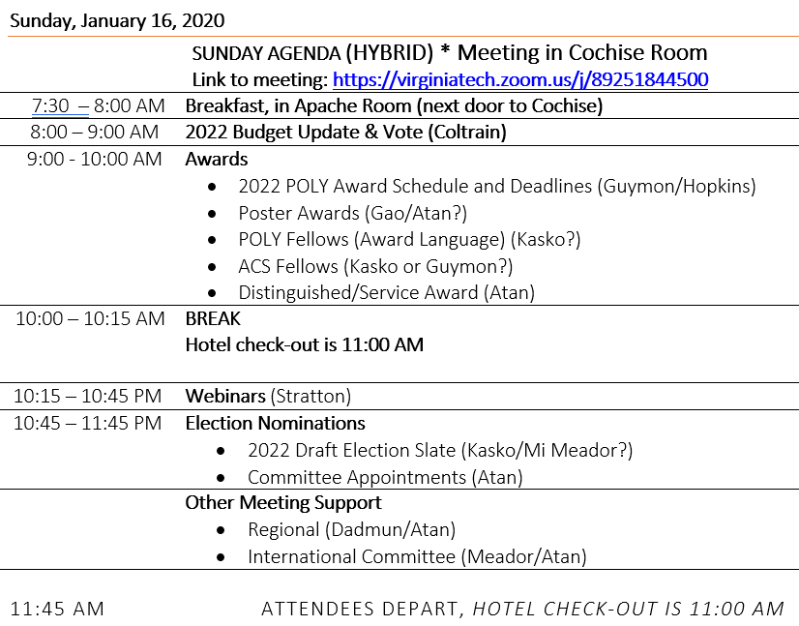
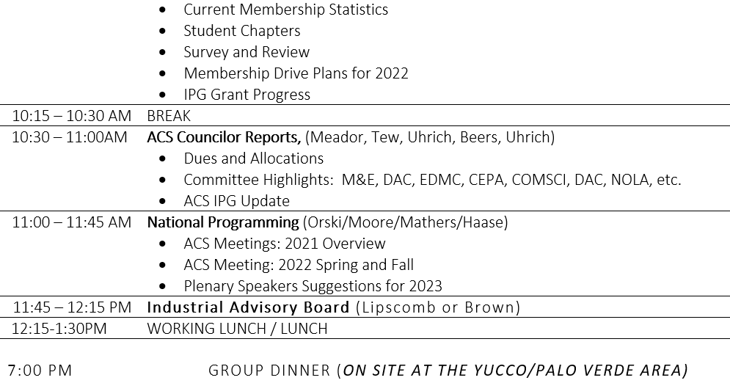
Agenda
American Chemical Society Division of Polymer Chemistry

Slide 4
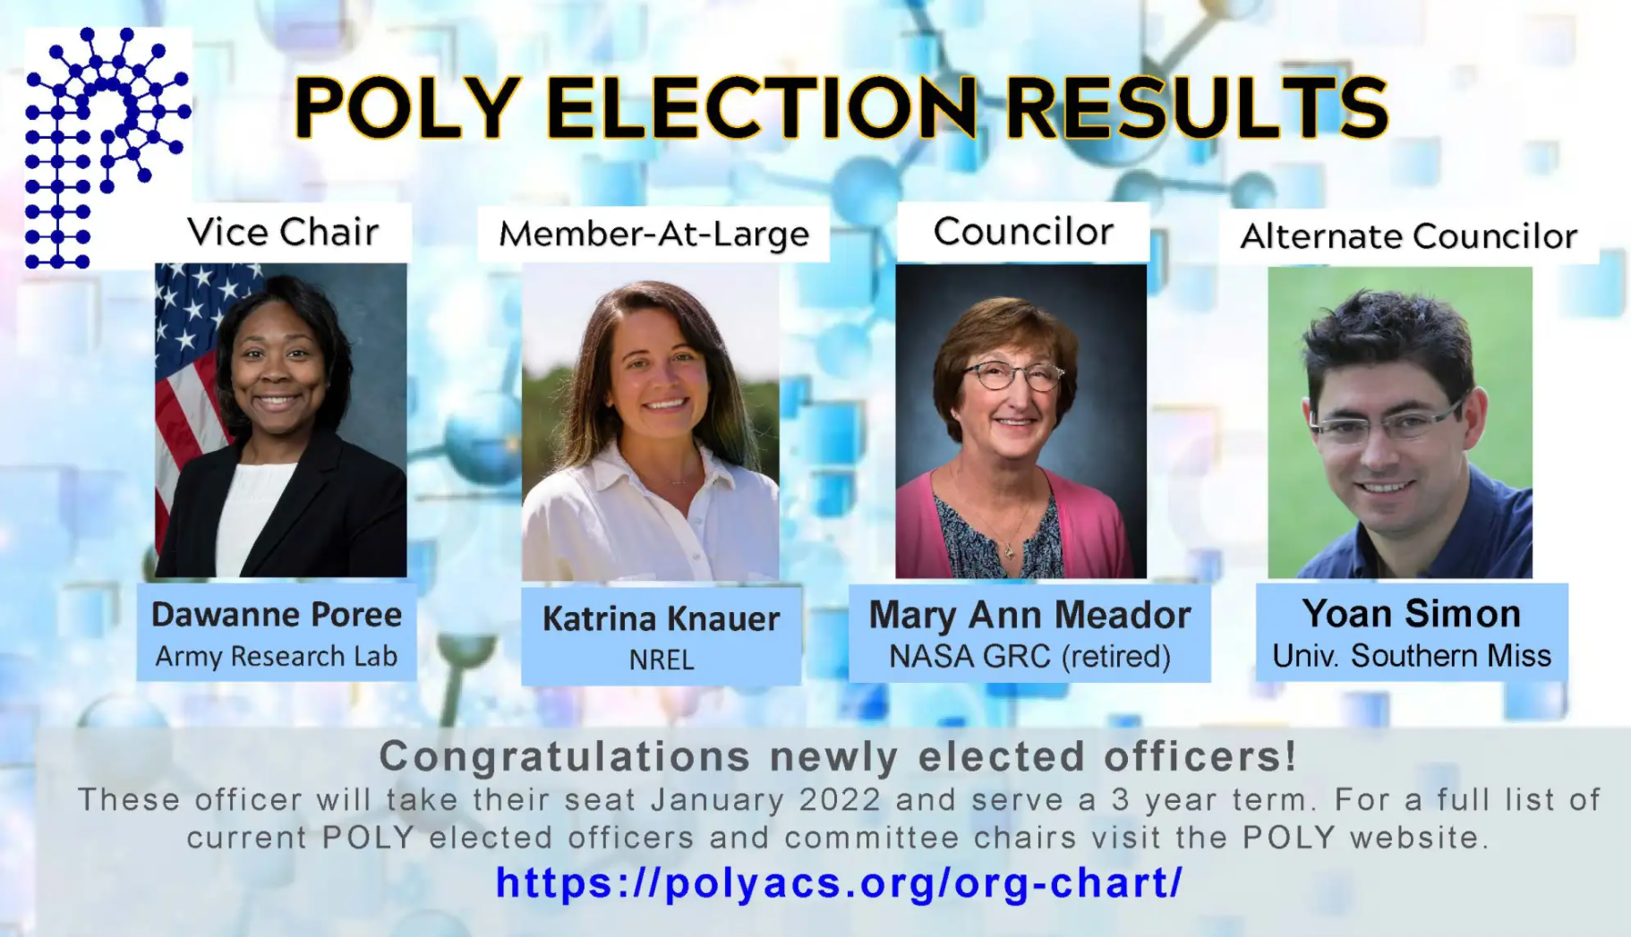
Congratulations to our newly elected officers!!
American Chemical Society Division of Polymer Chemistry

Slide 5
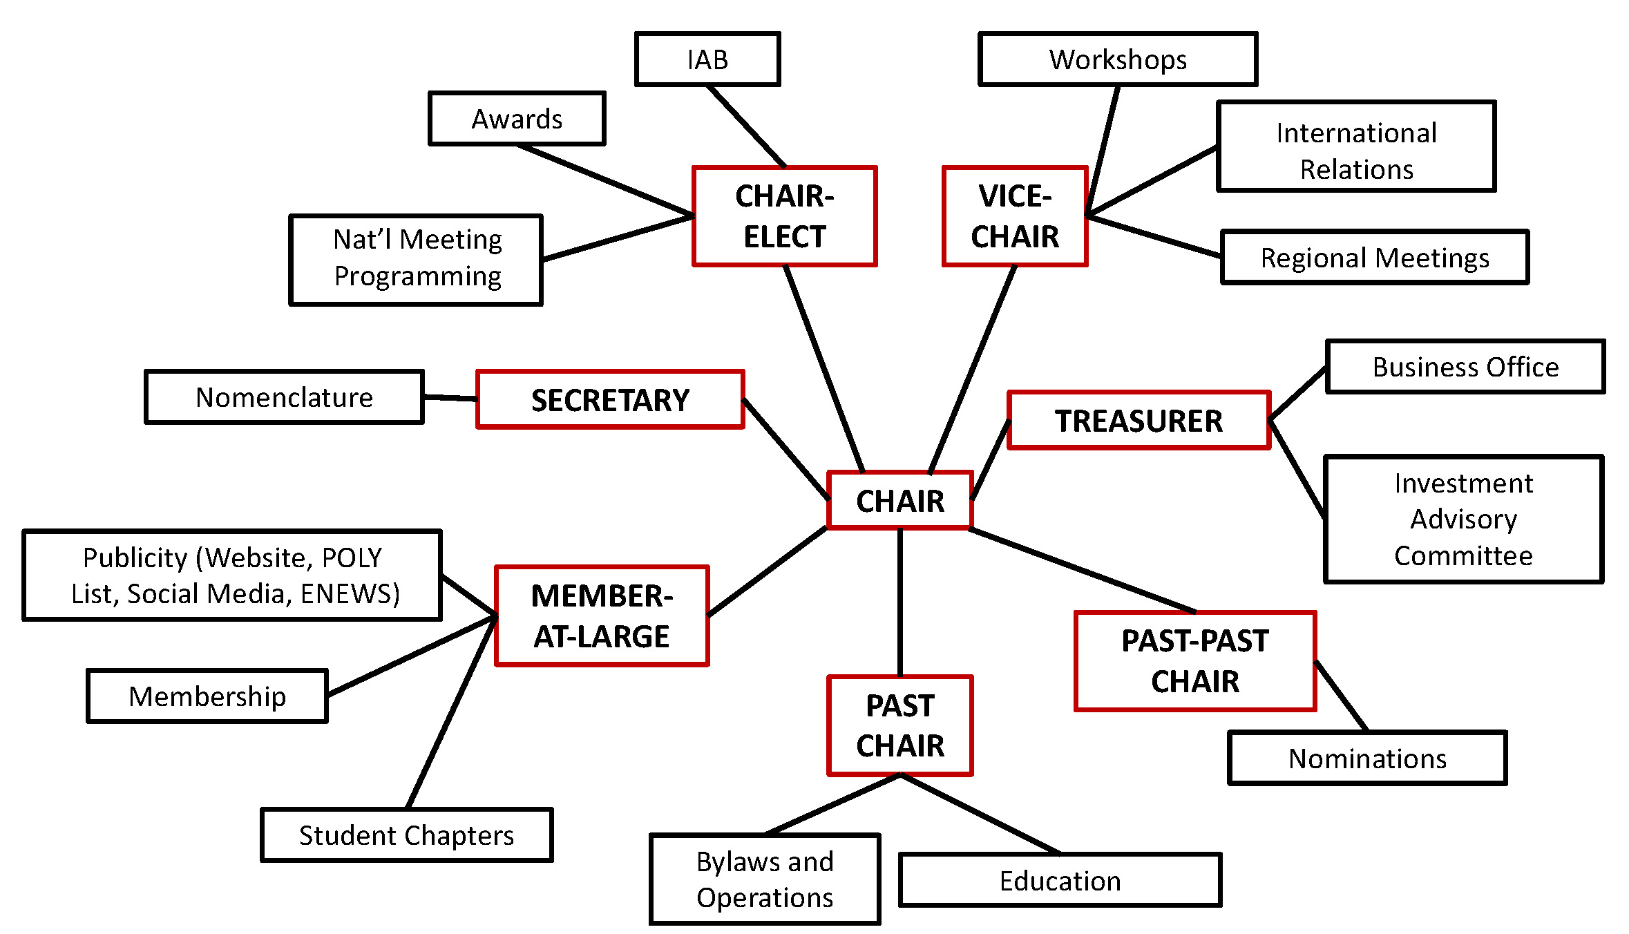
Organizational Chart Overview
American Chemical Society Division of Polymer Chemistry

Slide 6
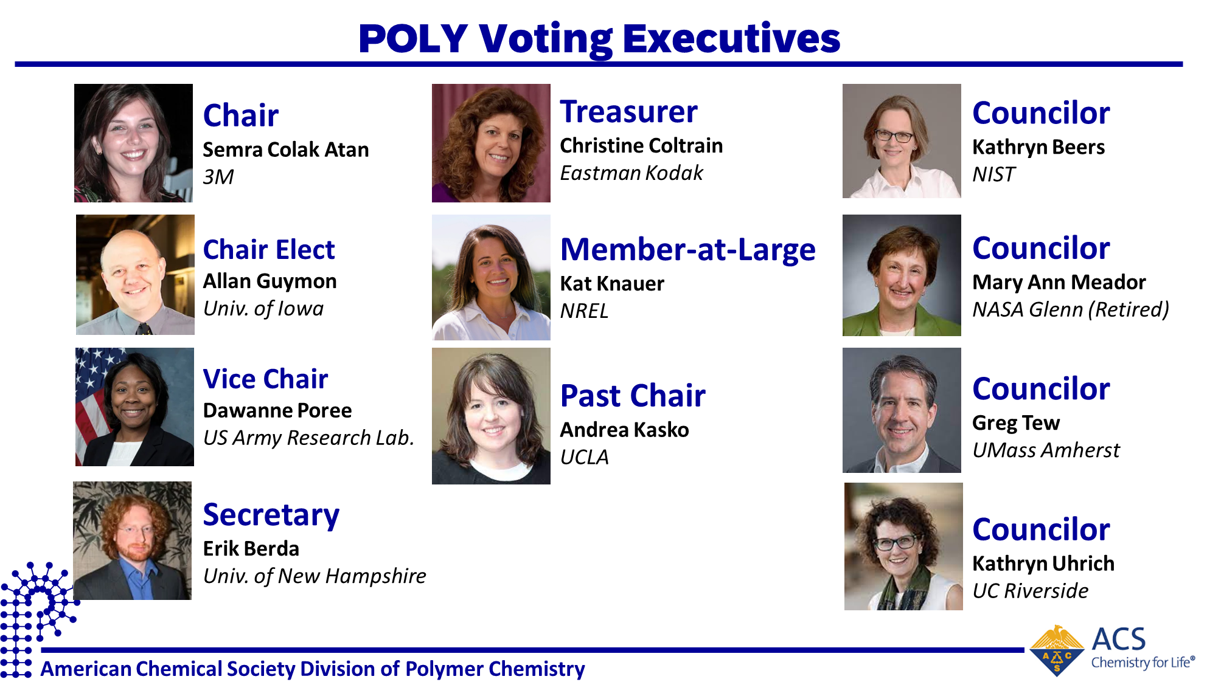

Slide 7
2022 Focus Areas
Broader Outreach to Membership
Communicate the value of being a POLY member, with content tailored to the members background (academia, industry, government)
Enhanced Communication & Publicity
Increase International and Regional Footprint
Continue providing strong Technical Programming
Focus on virtual, hybrid-broadcasting offerings
Continued commitment to Diversity, Inclusion and Respect

Slide 8
Agenda
American Chemical Society Division of Polymer Chemistry

Slide 10
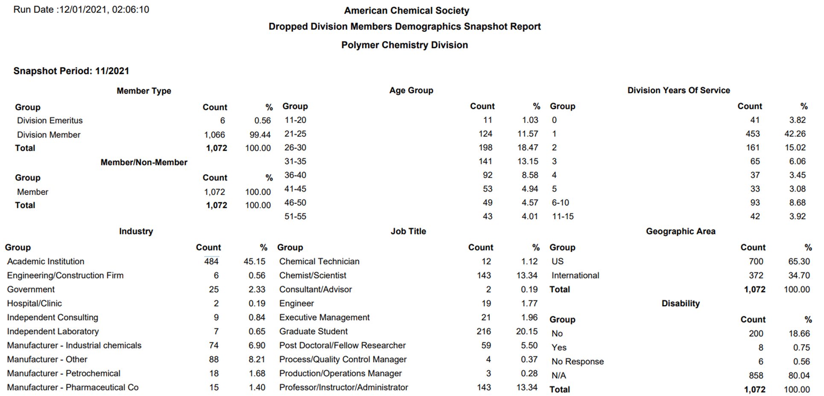
We are loosing members, mostly from academic institutions!
Membership

Slide 11
Membership, Publicity, and Communications
What can we do to address the issue? Ideas, suggestions?
Membership Committee:
Kat Knauer – Member-at-Large
* Chair: Colleen Scott (Miss State Univ.)
Will Gutekunst (Georgia Tech)
Brian Long (UT Knoxville)
* Co-Chair: Mark Grinstaff (BU) or Melanie Chiu (Stony Brook U)
* Co-Chair: Erin B. Murphy (Industry)
Liz Bright (3M) – POLY/PMSE Student Chapters
POLY Student Advisory Board
Proposed Actions:
Committee will work together on developing strategy to retain members
Can we have a 2nd Member-at-Large?
Revamp Membership site:
Move membership on the main tab
Highlight top 5 benefits
Should we have a members only access?
Job postings Discussion blogs
Recorded symposia links
Graphical abstracts, Other Ideas??
Publicity:
Chair: Emily Pentzer (TAMU)
POLY Website: Justin Kennemur (Florida State Univ.)
Prath Kharkar (Acelity)
Spencer Brucks (MIT)
Jeff Ting (Univ. of Chicago)
Proposed Actions:
Consistency in presentation format/template
Awards
Symposia
Member Recognition, etc..
Work closely with Communications
Publicize membership benefits
General
POLY affiliate only option
MACRO
Membership Drive
Communications:
*Chair: Helen Tran (Univ of Toronto
Other suggestions?
Proposed Actions:
Drive social media presence
POLY highlights
ACS content
Membership benefits
Volunteer opportunities
Volunteer sign-up sheet
American Chemical Society Division of Polymer Chemistry

Slide 12
POLY IPG Summary
ACS IPG Grants
New and unique opportunities to the applying Division
Projects designed to recruit new and retain existing Division members
Collaborative projects between Divisions and/or Local Sections (see Local Section IPG)
Strategic Planning Projects (1 every 5 years) - Maximum funding for Strategic Planning projects is $7,500.
Maximum funding for Innovative Project Grants is $25,000 for the calendar year.
Current POLY IPG Grants
Division IPGs:
Spring 2020: POLY Three Minute Pitch Competition
2021: Student Chapter Organized Symposium
New Ideas? (Application Deadline February 15, 2022)
Convergent Research Community IPG:
Sustainable Polymers: A Multidisciplinary Challenge ($30K)
Strategic Planning IPG:
POLY eligible for 2023 – Semra Colak Atan will apply in 2022, Allan Guymon will lead in 2023
American Chemical Society Division of Polymer Chemistry

Slide 13
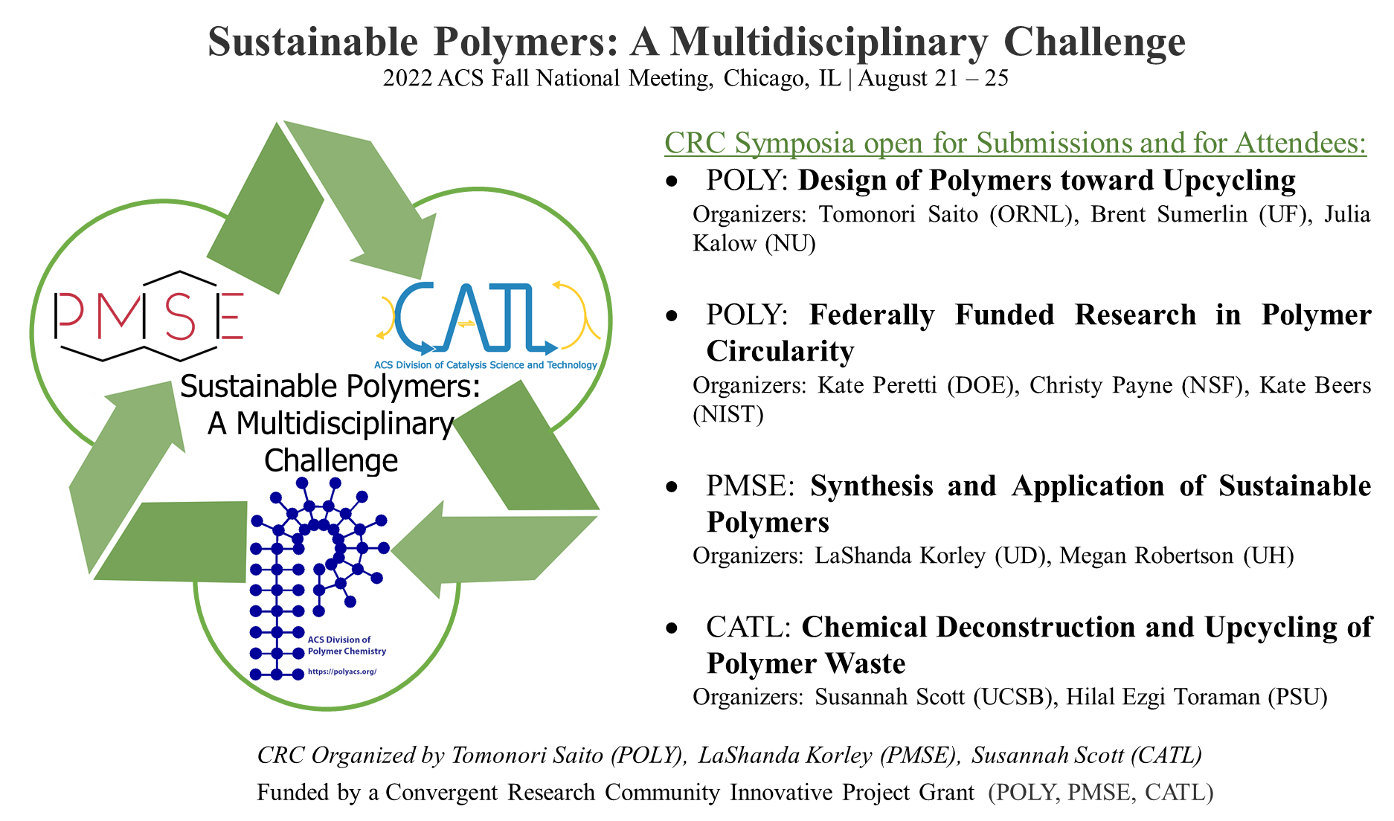
POLY IPG Summary
American Chemical Society Division of Polymer Chemistry

