Slide 1
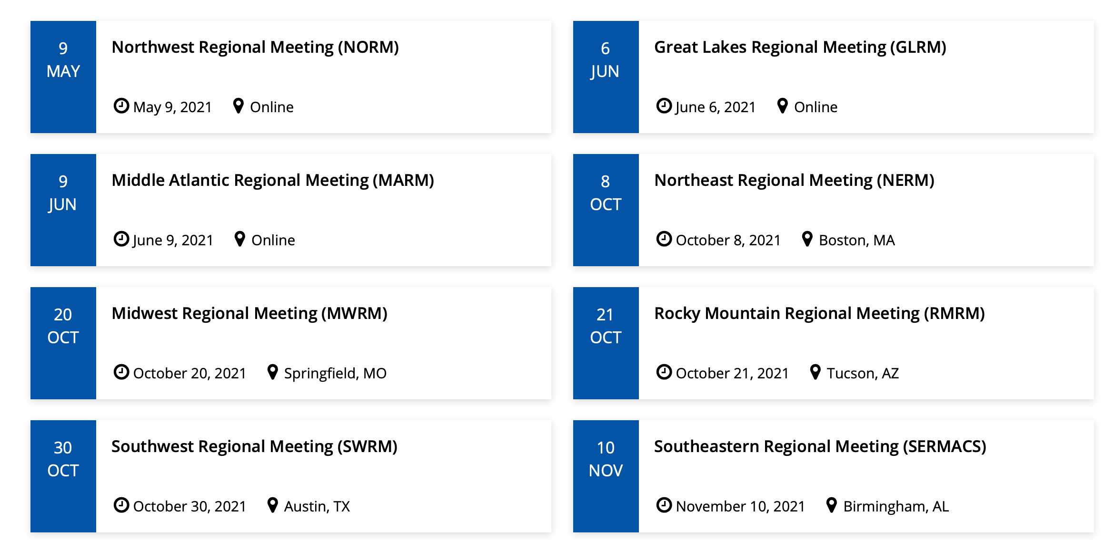


Regional Meetings 2021
Regional Meeting – Mark Dadmun
Other Meeting Support – Current Chair
2021
Regional Meetings
$500 Rocky Mountain Regional meeting
$1,000 POLY Graduate Meeting - VT (Virtual)
Annual Budget
Regional = $2,000 Other - $1,500
American Chemical Society Division of Polymer Chemistry

Slide 2
Regional Meetings Committee
In 2021, Regional Meetings Committee:
Chair: Mark Dadmun
Brittany deRonde (ProAmpac)
Kenny Mineart (Bucknell)
Dawanne Poree (ARO)
Piril Ertem (Surmodics)
Charge: For POLY to develop a more pro-active approach to interacting with the regional ACS meetings to expand benefits for our members and continue to improve our outreach beyond the national meetings.
American Chemical Society Division of Polymer Chemistry

Slide 3
Regional Meetings Committee
Areas identified for potential opportunity:
Who attends the Regional Meetings?
Industrial scientists at small to mid-size companies
Students and early career scientists
Faculty at primarily undergraduate institutions
Can we connect with 2022 Regional Meeting Chairs?
To alert them to POLY support of Regional meeting symposia with details and limitations
To request their perspective/input/feedback of how POLY may better serve these communities at Regional meetings
Can we engage POLY/PMSE Student chapters at Regional meetings?
Potential activities include lunch and learn, Science Café, or networking activities.
Other suggestions:
Utilize POLY IAB to discuss opportunities for industrial members to network with students/post-docs at Regional Meetings
POLY Meeting Chairs to discuss opportunities to steer proposed symposia to Regional meetings.
American Chemical Society Division of Polymer Chemistry

Slide 4
Regional Meetings 2022
In 2022, Proposal for the Regional Meetings Committee:
Build on the momentum from 2021
Appoint Laura Stratton as the Co-Chair to work with Mark Dadmun and the Committee
Laura had a great success at Rocky Mountain Regional Meeting in 2021
Proposed Strategy:
Have a representative of POLY at as many regional meetings as possible
Potentially focus on students in the area or pre-scope who is the major audience in those regions and organize target events.
Work on organizing local panel discussion on careers for students, networking hours etc..
Publicize the events on POLY social media channels
American Chemical Society Division of Polymer Chemistry

Slide 5
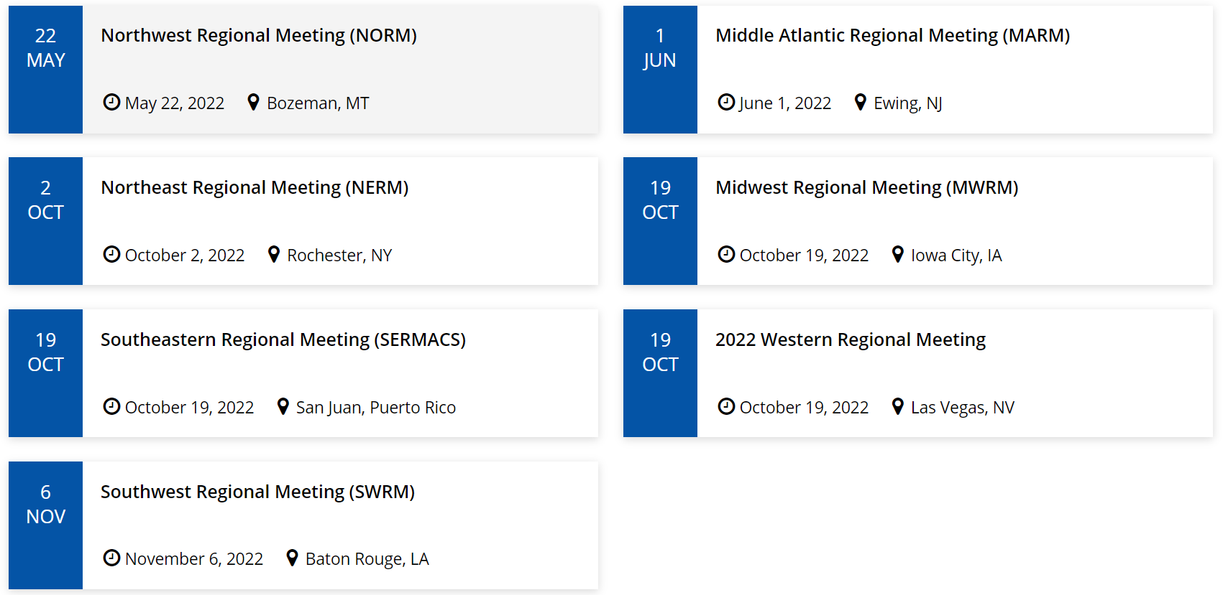
Regional Meetings 2022
WRM 2022
2022
Regional Meetings Request
$ ? Western Regional Meeting
American Chemical Society Division of Polymer Chemistry

