Slide 1
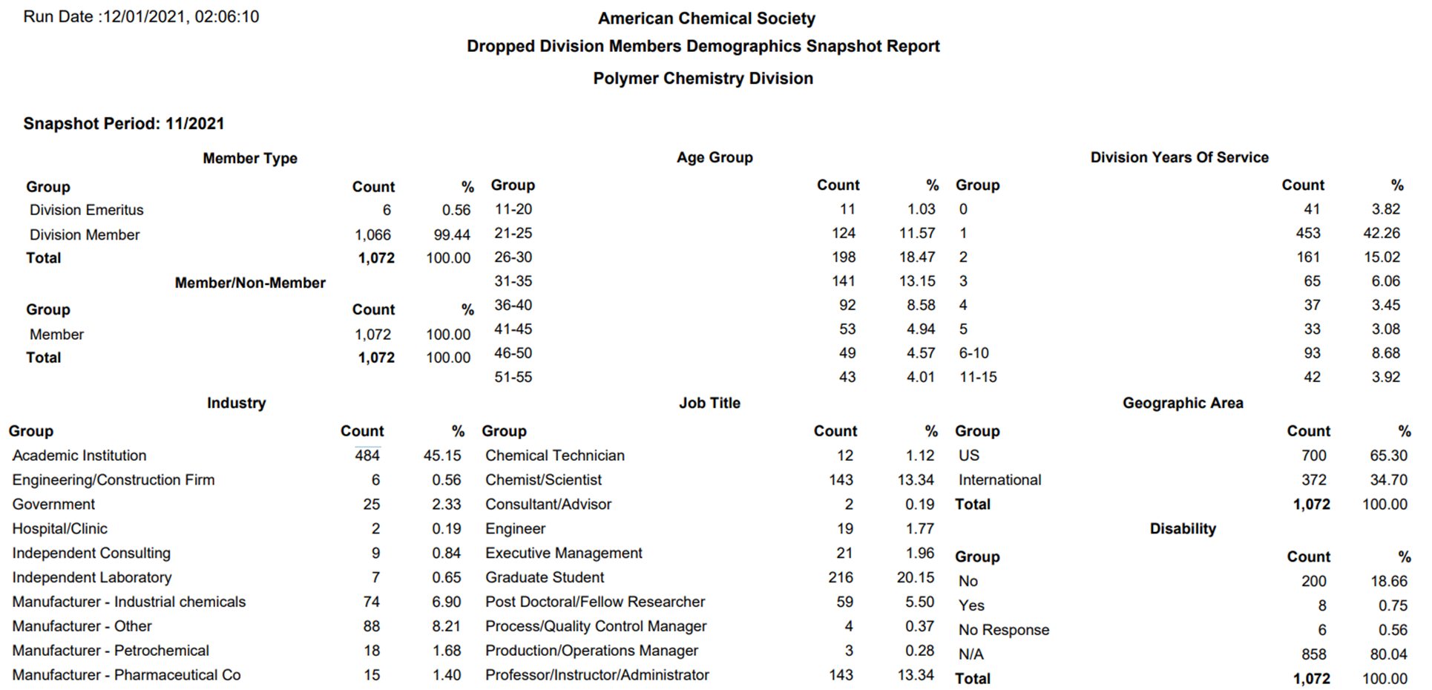


We are loosing members, mostly from academic institutions!
Membership

Slide 2
Membership, Publicity, and Communications
What can we do to address the issue? Ideas, suggestions?
Membership Committee:
Kat Knauer – Member-at-Large
* Chair: Colleen Scott (Miss State Univ.)
Will Gutekunst (Georgia Tech)
Brian Long (UT Knoxville)
* Co-Chair: Mark Grinstaff (BU) or Melanie Chiu (Stony Brook U)
* Co-Chair: Erin B. Murphy (Industry)
Liz Bright (3M) – POLY/PMSE Student Chapters
POLY Student Advisory Board
Proposed Actions:
Committee will work together on developing strategy to retain members
Can we have a 2nd Member-at-Large?
Revamp Membership site:
Move membership on the main tab
Highlight top 5 benefits
Should we have a members only access?
Job postings Discussion blogs
Recorded symposia links
Graphical abstracts, Other Ideas??
Publicity:
Chair: Emily Pentzer (TAMU)
POLY Website: Justin Kennemur (Florida State Univ.)
Prath Kharkar (Acelity)
Spencer Brucks (MIT)
Jeff Ting (Univ. of Chicago)
Proposed Actions:
Consistency in presentation format/template
Awards
Symposia
Member Recognition, etc..
Work closely with Communications
Publicize membership benefits
General
POLY affiliate only option
MACRO
Membership Drive
Communications:
*Chair: Helen Tran (Univ of Toronto
Other suggestions?
Proposed Actions:
Drive social media presence
POLY highlights
ACS content
Membership benefits
Volunteer opportunities
Volunteer sign-up sheet
American Chemical Society Division of Polymer Chemistry

Slide 3
POLY IPG Summary
ACS IPG Grants
New and unique opportunities to the applying Division
Projects designed to recruit new and retain existing Division members
Collaborative projects between Divisions and/or Local Sections (see Local Section IPG)
Strategic Planning Projects (1 every 5 years) - Maximum funding for Strategic Planning projects is $7,500.
Maximum funding for Innovative Project Grants is $25,000 for the calendar year.
Current POLY IPG Grants
Division IPGs:
Spring 2020: POLY Three Minute Pitch Competition
New Ideas? (Application Deadline February 15, 2022)
Convergent Research Community IPG:
Sustainable Polymers: A Multidisciplinary Challenge ($30K)
Strategic Planning IPG:
POLY eligible for 2023 – Semra Colak Atan will apply in 2022, Allan Guymon will lead in 2023
American Chemical Society Division of Polymer Chemistry

Slide 4
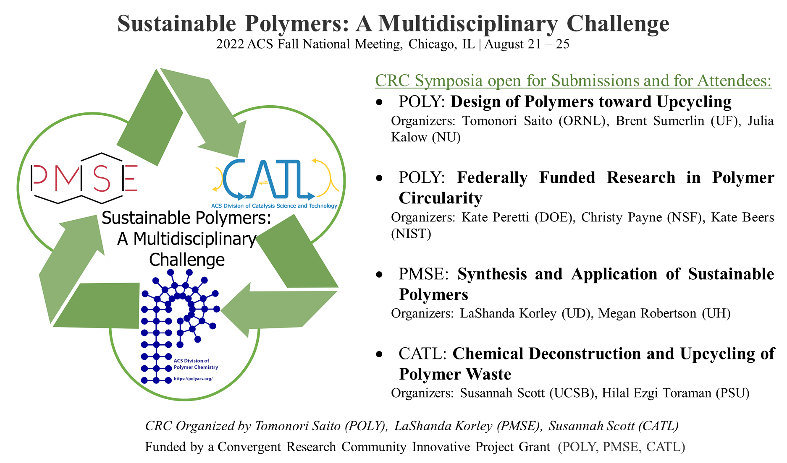
POLY IPG Summary
American Chemical Society Division of Polymer Chemistry

