Slide 1
POLY Webinar Update
Tomonori Saito, Brent Sumerlin, Rebecca Olson Short, Bob Lambeth

Slide 2


POLY Webinars: 2025
Flow Chemistry In Polymer Science 4/2/2025
Two-Dimensional Polymers
7/10/2025
TBD
10/29/2025
Frank Leibfarth
Royce Murray Distinguished Term Professor of Chemistry, The University of North Carolina, Chapel Hill
Damien Guironnet
James W Westwater Professorial Scholar, Department of Chemical and Biomolecular Engineering, University of Illinois Urbana-Champaign
Luke Baldwin (moderator)
Research Chemist, Polymers & Responsive Materials,
Air Force Research Laboratory
Dana D. Medina Habilitand, Department of Chemistry, Ludwig Maximilian University of Munich
Austin M. Evans Assistant Professor, Department of Chemistry, University of Florida
Ronald A. Smaldone (moderator) Associate Professor, Department of Chemistry and Biochemistry, University of Texas, Dallas

Slide 3
First POLY/ACS Webinar in 2025
Speakers
Frank Leibfarth
Royce Murray Distinguished Term Professor of Chemistry, The University of North Carolina, Chapel Hill
Damien Guironnet
James W Westwater Professorial Scholar, Department of Chemical and Biomolecular Engineering, University of Illinois Urbana-Champaign
Moderator
Luke Baldwin
Research Chemist, Polymers & Responsive Materials,
Air Force Research Laboratory
POLY Leads
171

Slide 4
Second POLY/ACS Webinar in 2025
Speakers
Dana D. Medina Habilitand, Department of Chemistry, Ludwig Maximilian University of Munich
Austin M. Evans Assistant Professor, Department of Chemistry, University of Florida
Moderator
Ronald A. Smaldone Associate Professor, Department of Chemistry and Biochemistry, University of Texas, Dallas
POLY Leads
137

Slide 5
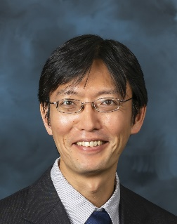
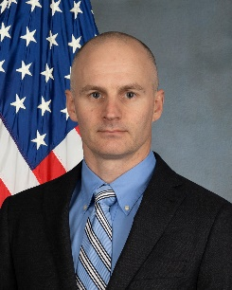

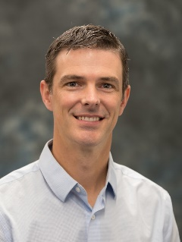
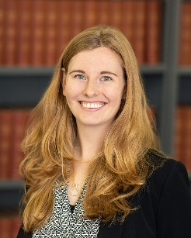
POLY Webinar Committee
Future Webinar
Please send your ideas and feedback to any of us.
Tomonori Saito (chair), Oak Ridge National Laboratory saitot@ornl.gov
Bob Lambeth (vice-chair), Army Research Laboratory robert.h.lambeth2.civ@army.mil
Brent Sumerlin, University of Florida sumerlin@chem.ufl.edu
Rebecca Olson Short, PPG RAShort@PPG.com

