Slide 1

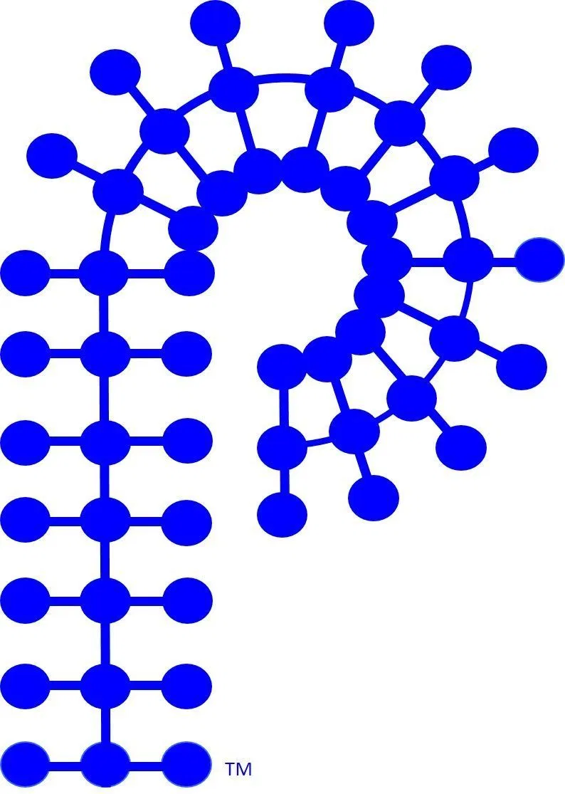
POLY Webinars

Slide 2
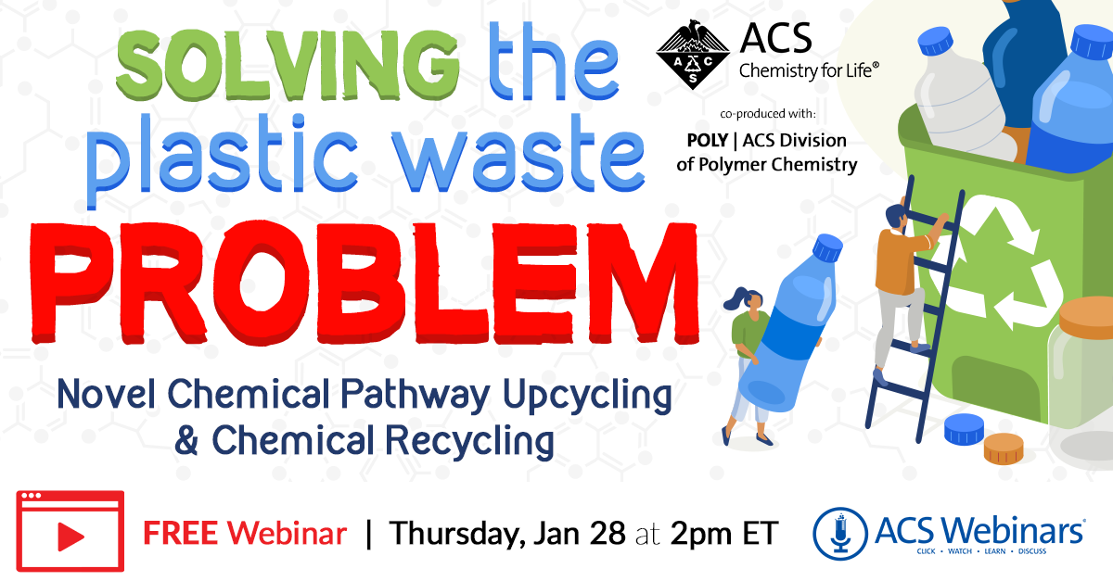
1/28/2021 Kat Knauer, Biocellection Philippe Rentenauer, Leá Nature Moderator Peter Boul, Aramco 1461 Views in 24 hours

Slide 3

6/16/2021 Michael Shulz, Virginia Tech Emilie Rexeisen, 3M Moderator, Tomonori Saito, ORNL 823 Views in 24 hours

Slide 4
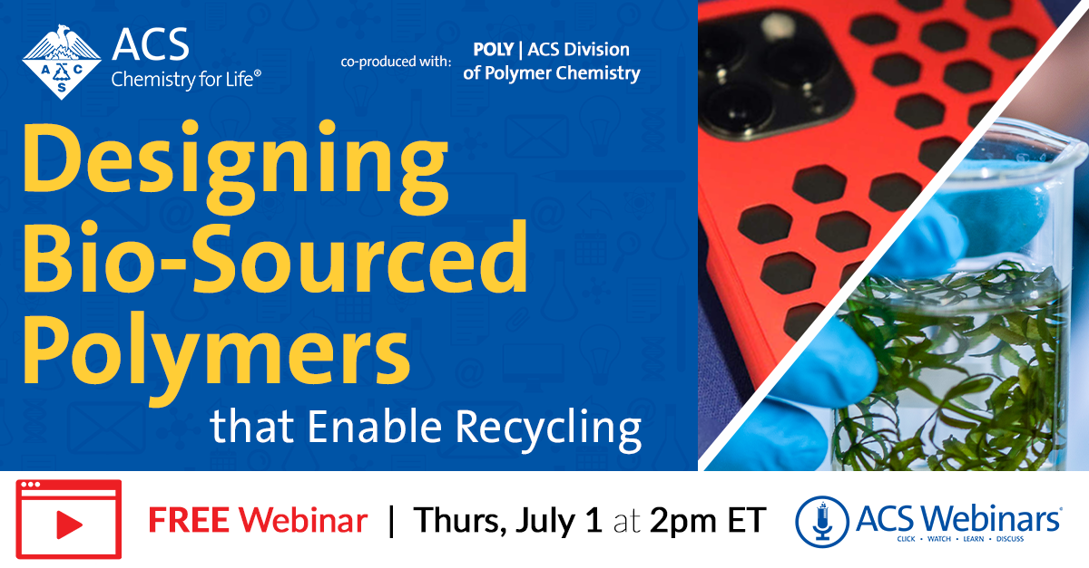
7/1/2021 Stephan Mecking, University of Konstanz Moderator: Mark Jones, Dow Chemical (retired) 887 Views in 24 hours

Slide 5
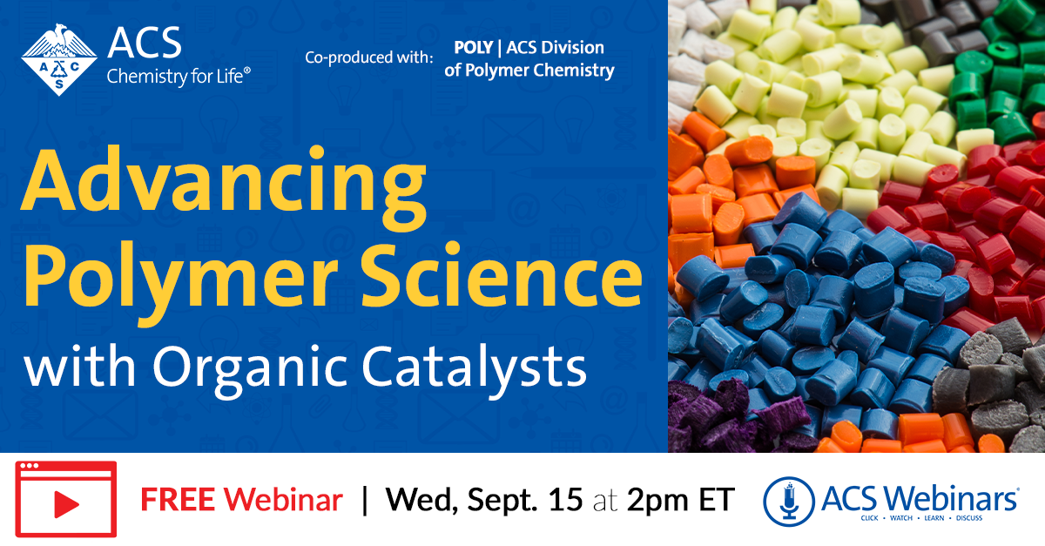
9/15/2021 Robert M Waymouth, Stanford University Andrew Dove, University of Birmingham Moderator: Rachel A Letteri, University of Virginia 511 Views in 24 hours

Slide 6

10/21/2021 Emily B. Pentzer, Texas A&M Johann Plank, Technical University of Munich Moderator: Laura Stratton, PCI

Slide 7

Stephanie Vivod, NASA, John H Glenn Research Ctr. Christopher Wohl, NASA, Langley Research Ctr. Moderator: Sadeq Malakooti, NASA, John H Glenn Research Ctr.
11/17/2021
682 Views in 24 hours

Slide 8
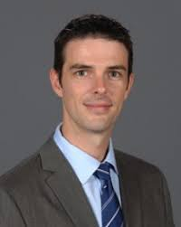
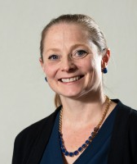
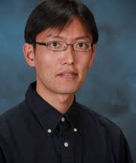

Webinar Committee
Laura Stratton, Polymer Chemistry Innovations, Inc. (PCI) laura@polychemistry.com
Brent Sumerlin, University of Florida sumerlin@chem.ufl.edu
Tomonori Saito, Oak Ridge National Laboratory saitot@ornl.gov

Slide 9
Five Poly webinars 2021
IAB co-organized
POLY co-organized
2020 Summary
1/28/2021
Upcycling Plastic Waste via Novel Chemical Pathways
Kat Knauer, Biocellection
Philippe Reutenauer, Léa Nature
Moderator Peter Boul, Aramco
10/21/2021
Achieving Climate Goals by Capturing Atmospheric Carbon & Storing it Safely
Emily B Pentzer, Texas A&M
Johann Plank, Technical University of Munich
Moderators: Peter Boul, Aramco
Laura Stratton, PCI
7/1/2021 Bonus ACS organized
Designing Bio-Sourced Polymers that Enable Recycling
Stefan Mecking, University of Konstanz Moderator: Mark Jones, Dow Chemical (retired)
Wed 6/16/2021
Polymers of the Pandemic: Antivirals and Decontaminating PPE
Michael Shulz, Virginia Tech
Emilie Rexeisen, 3M
Moderator: Tomonori Saito, Oak Ridge National Laboratory (ORNL) and University of Tennessee, Knoxville
Wed 9/15/2021
Advancing Polymer Science with Organic Catalysts
Robert M Waymouth, Stanford University
Andrew Dove, University of Birmingham
Moderator: Rachel A Letteri, University of Virginia
Wed 11/17/2021
New Polymers in Space: Long-Term Exploration Beyond Our Planet
Stephanie Vivod, NASA John H Glenn Research Ctr.
Christopher Wohl, NASA, Langley Research Ctr.
Moderator: Sadeq Malakooti, NASA, John H Glenn Research Ctr.
3,757 Total attendees
2,149 Poly leads
7,649 registered
49% attended
No charge to POLY Division
Please send your ideas and feedback to any of us:
laura@polychemistry.com
sumerlin@chem.ufl.edu
saitot@ornl.gov

Slide 10
2021 Snapshot

Slide 11
Highlights
94 % Satisfaction rate on average.
510 live attendees on average.
Attendees from 50 – 77 countries.
7841 registrants, attendance rate average 49%.
130 questions per event on average.
210 registrants, on average, ask for more information about POLY.

Slide 12
Question?
1821 people requested more information from POLY in 2021.
2,149 people requested more information from POLY in 2020.
How many joined POLY after that contact?
What information and promotion do we send?
Along with the first year free, what about a 10-day offer, 1st year free, 2 and 3rd year for the price of one, so three years for the price of one. This keeps them on the roster longer and gives POLY time to get them in involved and invested in POLY.

Slide 13

Three POLY/ACS co-produced webinars allotted for 2022
Thurs, May 5 2:00 – 3:30 ET
Wed, June 15 2:00 – 3:30 ET
Thurs, Aug 11 2:00 – 3:30 ET

Slide 14
IDEAS for these three co-produced dates?
POLY/ACS co-produced must appeal to a broad range of chemists
Within that guideline, how can POLY / ACS Webinars be leveraged to better promote and support POLY’s goals?

Slide 15
New or Innovative ideas
POLY Member benefits Self-produced webinar or zoom
Use a webinar with a similar topic to build interest for an upcoming workshop

Slide 16
Question for POLY EXCOMM
From ACS Webinars: In regard to marketing, we would like permission to email your Poly membership list directly for your 3 polymer events in 2022, a total of 3 emails to your members.
I believe this would involve POLY sharing the email list with ACS Webinars.

Slide 17

Extra webinar that highlights POLY

